Slide 1
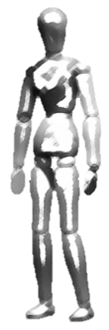
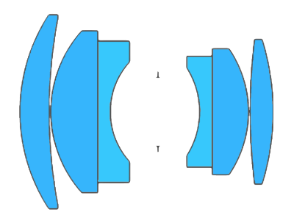






$$F$$
$$\acute{H}$$
$$H$$
Optical axis
Sensor
Plane of Sharp Focus (PoSF)
Depth of Field (DOF)
(a)
Depth of Field (DOF)
$$F$$
$$\acute{H}$$
$$H$$
Sensor
Optical axis
Plane of sharp focus (PoSF)
(b)

Slide 2
Depth of Field (DOF)
$$F$$
$$\acute{H}$$
$$H$$
Sensor
Optical axis
Plane of sharp focus (PoSF)

