Slide 1
Notes:
[Blank??] Bought a Sinar camera … did experiments …. Saw problems

Slide 2
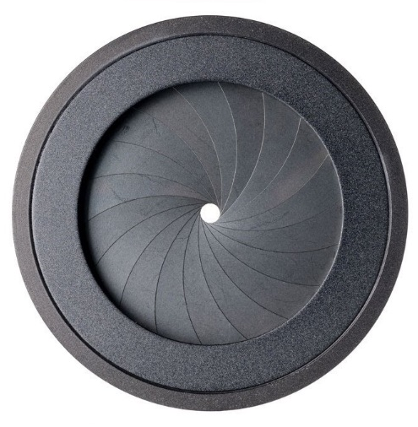


Chief rays from the object space to the image space defines the image shape
Aperture
Image plane
$$\text{x}$$
Chief ray
Object
Optical axis
Image
$$\acute{\text{x}}$$

Slide 3
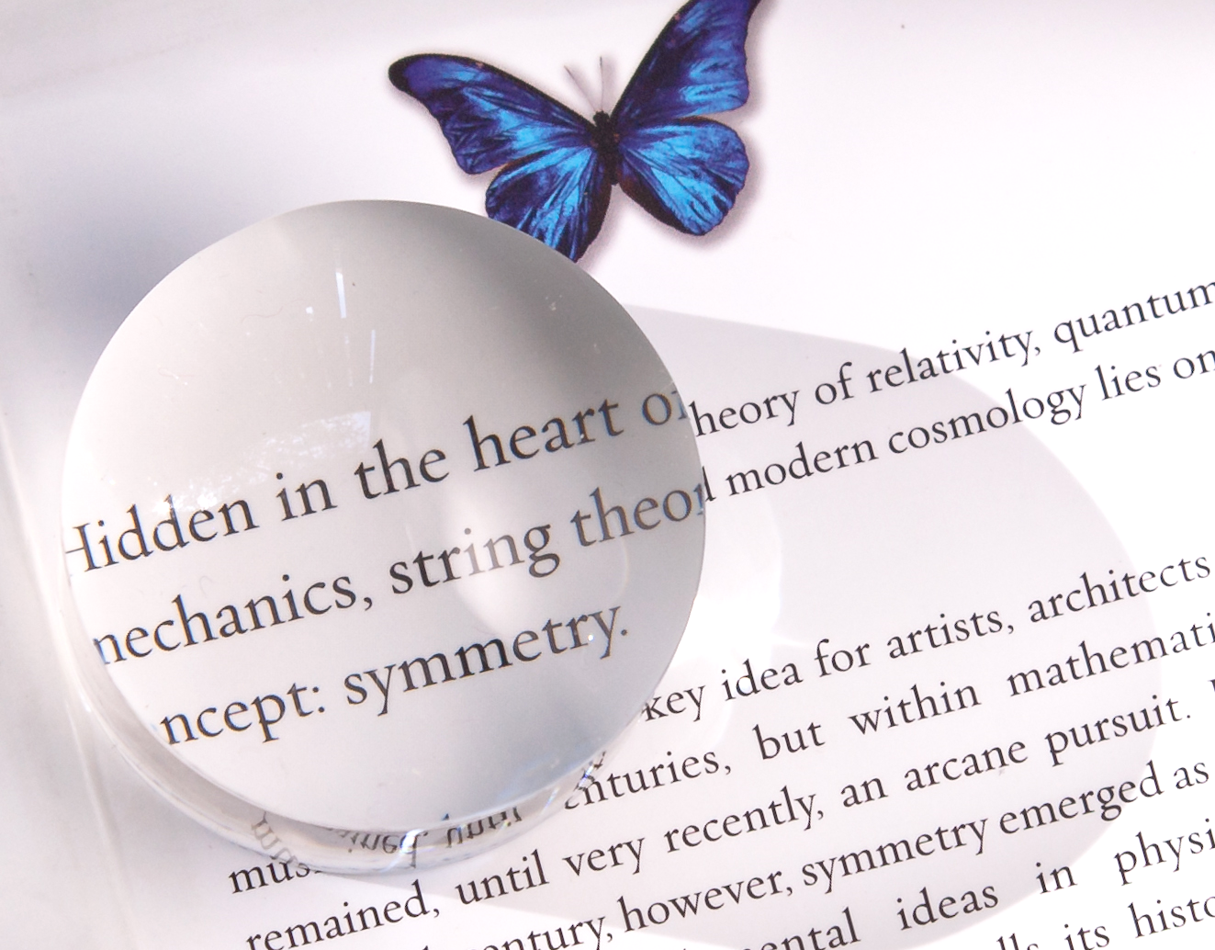
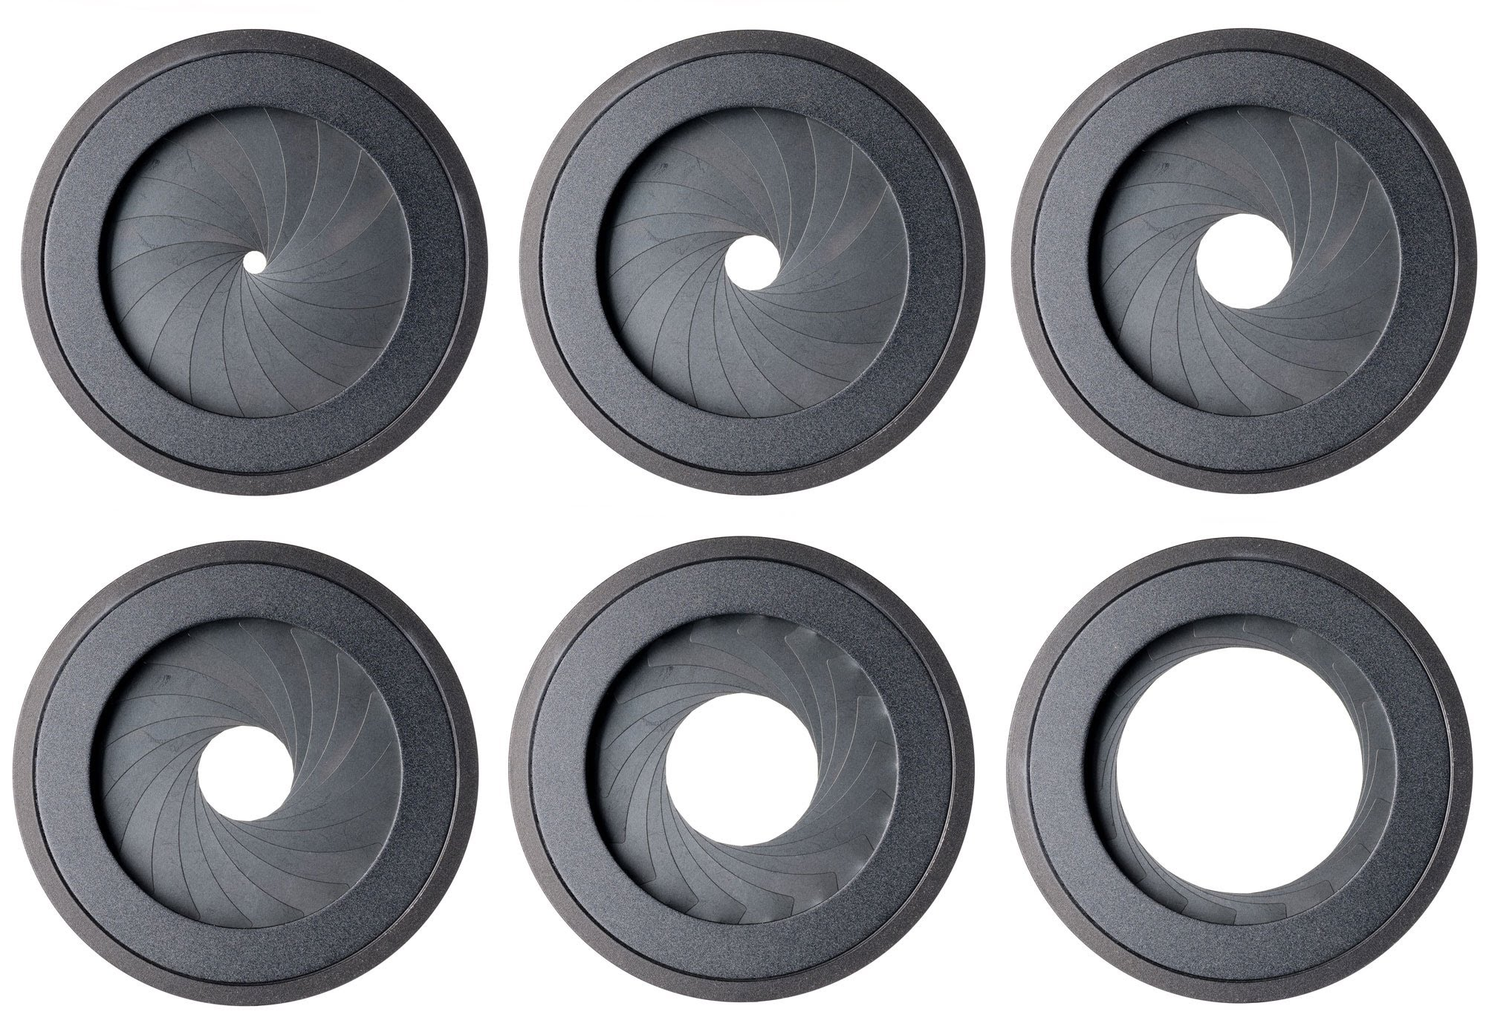
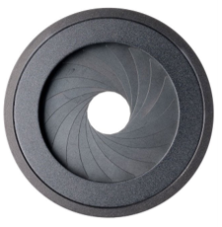
The “entrance pupil” is the image of the stop formed by the front lens elements
and the “exit pupil” is the image of the stop formed by the rear lens elements

Slide 5
Everything in optics makes sense in light of the pupils

Slide 6
Notes:
Explain pupil magnification

Slide 7




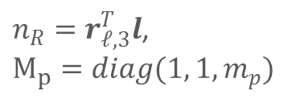





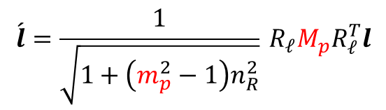


The pupil magnification $m_{p}$ changes the chief ray’s direction cosine
in the image space
Exit pupil
Chief ray
Entrance pupil
$$\text{x}$$
$${\hat{c}}_{y}$$
$$l$$
$$\left\{C\right\}$$
$$\acute{E}$$
$$\acute{ω}$$
$$α_{ }$$
$$ω$$
$${\hat{c}}_{z}$$
$$E$$
OPTICAL AXIS (OA)
$$\acute{l}$$
Lens pivot & origin of camera coordinate frame
$$\acute{l}=\frac{1}{\sqrt{1+\left(m_{p}^{2}−1\right)n_{R}^{2}}}{}_{ }^{ }{R_{𝓁}}M_{p}R_{𝓁}^{T}l$$
Chief ray’s direction cosine at the input (object space)
$n_{R}=r_{𝓁,3}^{T}l$,
$M_{p}=diag(1, 1, m_{p})$
Chief ray’s direction cosine at the output (image space)
Notes:
The first step in bu
.. The pivot of the lens is the center of the camera coordinate system

Slide 8





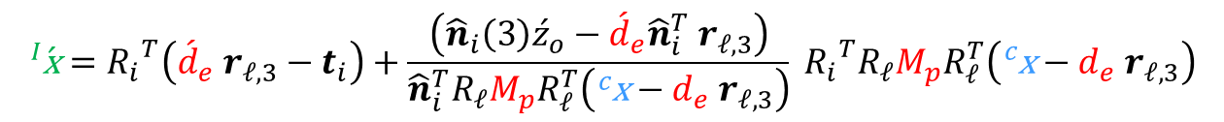














xxxxxxxxxxxxxxxxxxxxxxxxxxxxxxxxxxxxxxxxxxxxxxxxx
Chief ray
Exit pupil
$${\hat{n}}_{i}$$
Pivots
Entrance pupil
$$\text{x}$$
$${\hat{c}}_{y}$$
$${\hat{i}}_{y}$$
$$l$$
$$\acute{E}$$
$${\hat{i}}_{x}$$
$$\left\{C\right\}$$
$$\acute{ω}$$
$$α_{ }$$
$$ω$$
$${\hat{c}}_{z}$$
$$\left\{I\right\}$$
$$E$$
$$\acute{l}$$
OPTICAL AXIS (OA)
$$\acute{\text{x}}$$
$${\acute{d}}_{e}^{ }$$
$$d_{e}$$
$${\acute{z}}_{o}^{ }$$
Image plane
$$\begin{aligned}{}_{ }^{I}{\acute{\text{x}}}=&{R_{i}}^{T}\left({\acute{d}}_{e} r_{𝓁,3}−t_{i}\right)+\frac{\left({\hat{n}}_{i}\left(3\right){\acute{z}}_{o}−{\acute{d}}_{e}{\hat{n}}_{i}^{T} r_{𝓁,3}\right)}{{\hat{n}}_{i}^{T}R_{𝓁}M_{p}R_{𝓁}^{T}\left({}_{ }^{c}{\text{x}}−d_{e} r_{𝓁,3}\right)}{}_{ }^{ }{{R_{i}}^{T}R_{𝓁}}M_{p}R_{𝓁}^{T}\left({}_{ }^{c}{\text{x}}−d_{e} r_{𝓁,3}\right)\end{aligned}$$
Coordinates of image point in image reference frame
Coordinates of object point in camera frame
Notes:
… then we introduce an sensor plane, that can rotate about its independent pivot (at a distance z_o dash) from the pivot of the lens.
The pupil coordinates are highlighted in red

