Slide 1
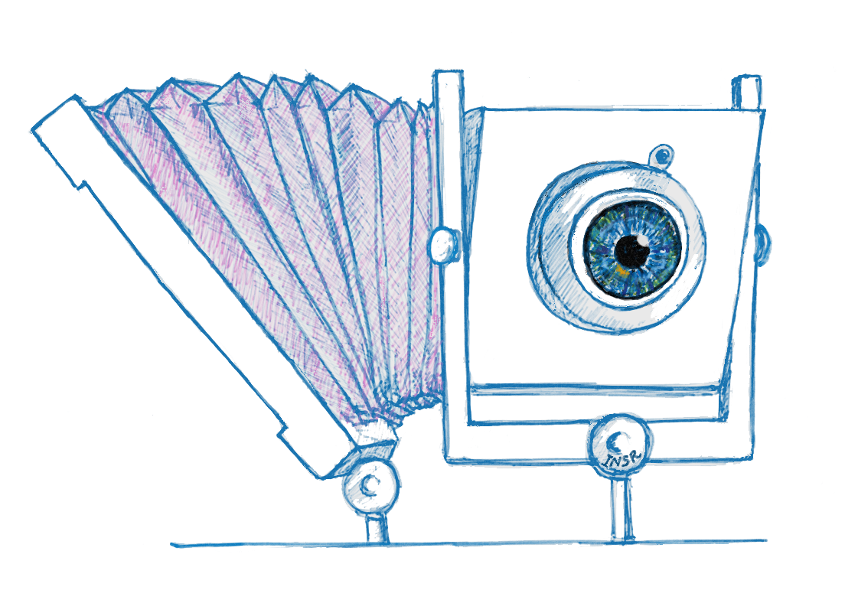
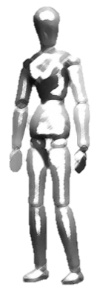
Scheimpflug with Computational Imaging to Extend
the Depth of Field of Iris Recognition Systems
Indranil Sinharoy
Committee:
Dr. Marc P. Christensen
Dr. Delores M. Etter
Dr. Dinesh Rajan
Dr. Panos Papamichalis
Dr. Yunkai Zhou

Slide 2
0.000000000000000000000000000000000000000000000000000000000000000000000001
Notes:
71 zeros following the decimal point followed by 1

Slide 3
Iris recognition is an

Slide 4
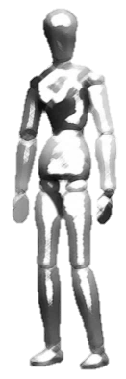
Demonstration of capture volume improvement using AFS in the laboratory
L
W
H
Standoff distance
Notes:
Explain the capture volume … how our approach suits our goals …. We are interested in increasing the axial capture volume …

Slide 5
The depth of field (DOF) is the limited range of distances in the scene that appear sharp in the image

Slide 6
