Slide 1
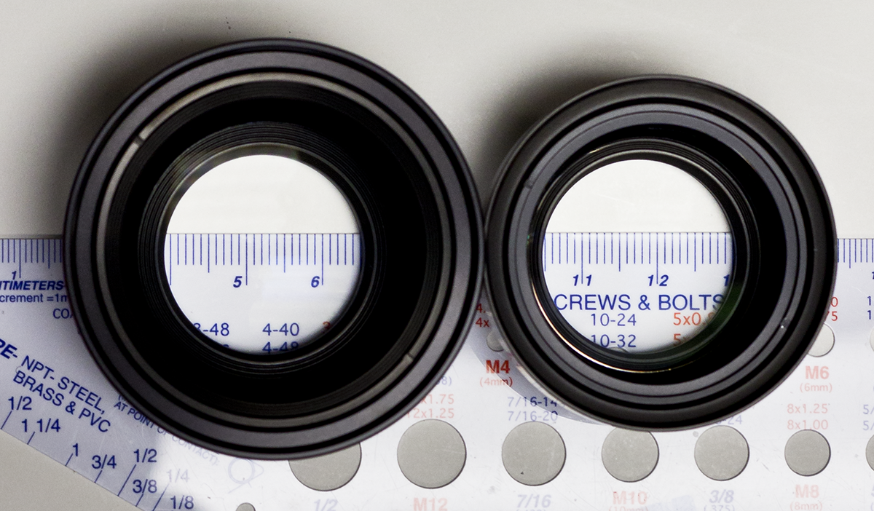
182 pixels
181 pixels
Elements in front of the aperture (towards object)
Elements in behind of the aperture (towards sensor)

