Slide 1
































Chief ray
Exit pupil
$${\hat{n}}_{i}$$
$\left\{C\right\}$, $\left\{I\right\}$, $\{O\}$: Camera, image, and object coordinate frames. Origin of $\left\{C\right\}$ is coincident with the lens’s pivot.
Marginal ray
Pivots
Entrance pupil
SENSOR PLANE
${\hat{c}}_{x}$, ${\hat{c}}_{y}$, ${\hat{c}}_{z}$: Standard basis of $\left\{C\right\}$. ${\hat{c}}_{z}$ = ${\left[0, 0, 1\right]}^{T}$
$${\hat{n}}_{o}$$
OBJECT PLANE
$E$, $\acute{E}$: Center of entrance & exit pupils respectively.
$$\text{x}={\left[x, y, z\right]}^{T}$$
$${\acute{h}}_{e}^{ }$$
Meridional Plane
$d_{e}$, ${\acute{d}}_{e}$: Location of entrance & exit pupils in $\{C\}$ along OA.
$$h_{e}$$
$${\hat{c}}_{y}$$
$$\acute{Ω}$$
$d$: Directed distance of $\acute{E}$ from $E$ along OA.
$$\left\{O\right\}$$
$$l$$
$$\acute{E}$$
$$\acute{ω}$$
$$\left\{I\right\}$$
$R_{ℓ}$: Rotation matrix; orientation of lens plane.
$$ω$$
$$E$$
$$\left\{C\right\}$$
$${\hat{c}}_{z}$$
$$\acute{l}$$
$r_{𝓁,3}$: 3rd column of $R_{ℓ}$(also represents the OA).
$$α_{ }$$
$$Ω$$
OPTICAL AXIS (OA)
$${\acute{d}}_{e}^{ }$$
$${\acute{z}}_{e}^{ }$$
$R_{i}$: Rotation matrix; orientation of sensor plane.
$$d_{e}$$
${\hat{n}}_{i}$: Normal to sensor plane.
SAGITTAL Plane
$$d_{ }$$
$R_{o}$: Rotation matrix; orientation of object plane.
y
$$z_{e}$$
y
x
$$z_{o}^{ }$$
$${\acute{z}}_{o}^{ }$$
${\hat{n}}_{o}$: Normal to object plane.
x
z
$$z$$
$$\acute{z}$$
$z_{o}$, ${\acute{z}}_{o}$: Directed distance of object & image plane $\left\{C\right\}$.
z
$$\acute{\text{x}}={\left[\acute{x}, \acute{y},\acute{z}\right]}^{T}$$
$t_{i}$ : Vector to ${\acute{z}}_{o}$ $t_{i}≔{\left[0, 0,{\acute{z}}_{o}\right]}^{T}$

Slide 2
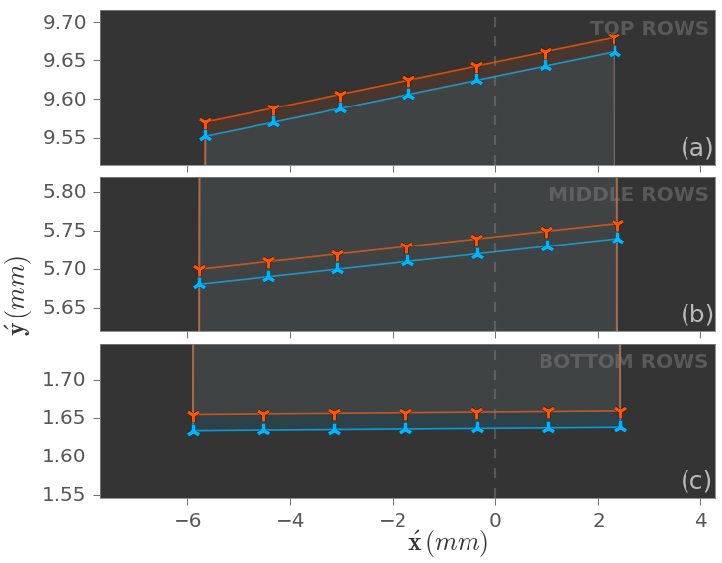
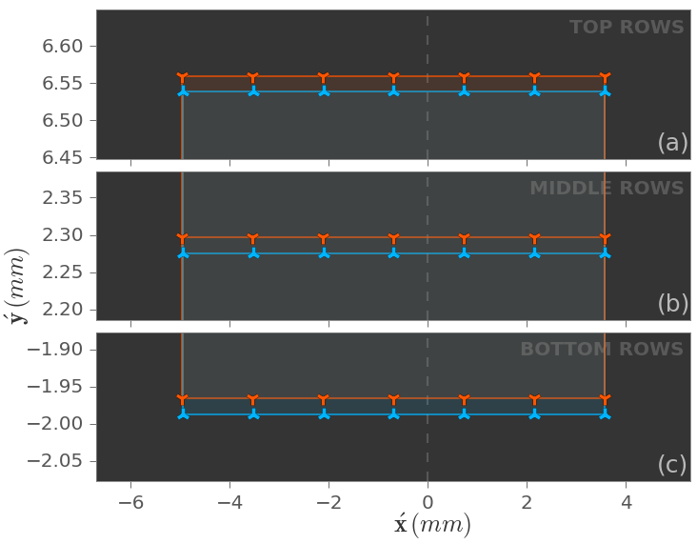
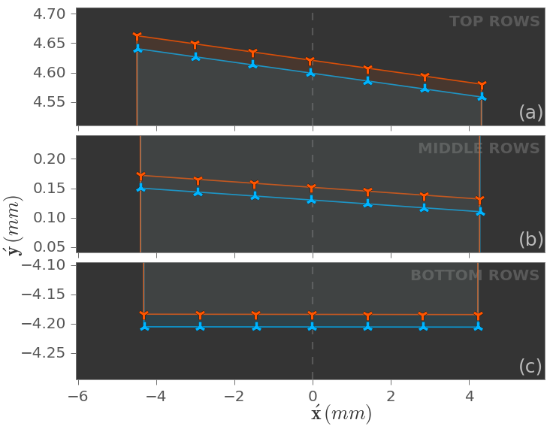
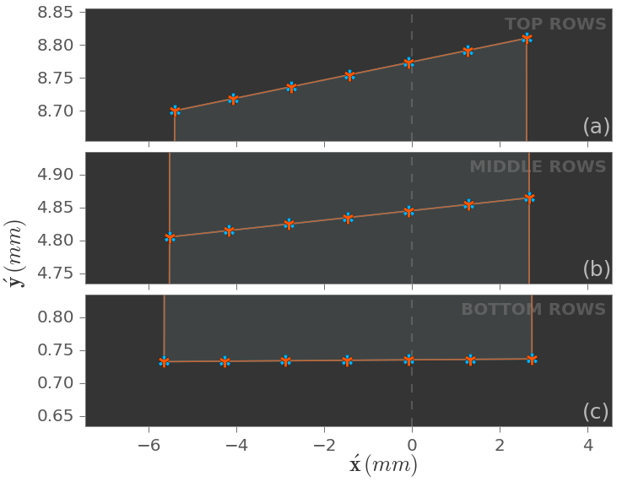
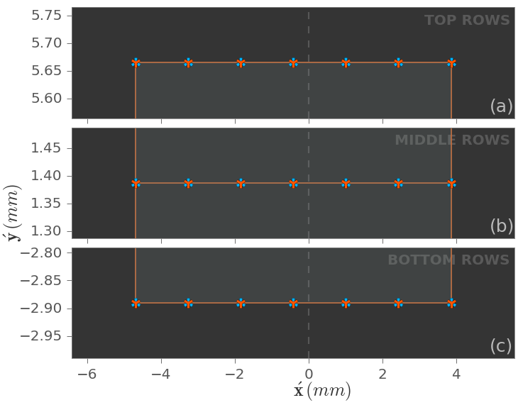
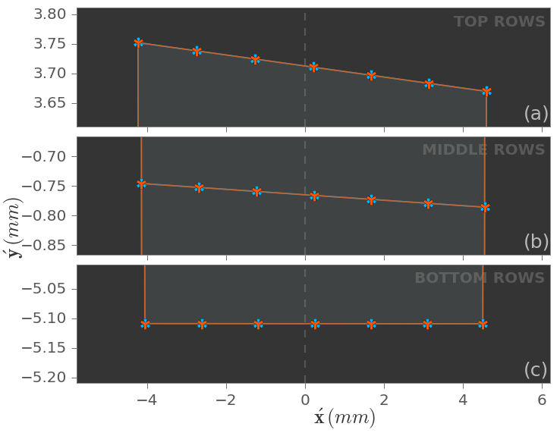





$$m_{p}=0.55$$
$$m_{p}=1.0$$
$$m_{p}=2.0$$
$$d_{e}=−5 mm$$
(a)
(b)
(c)
$$d_{e}=0$$
(d)
(e)
(f)

Slide 3
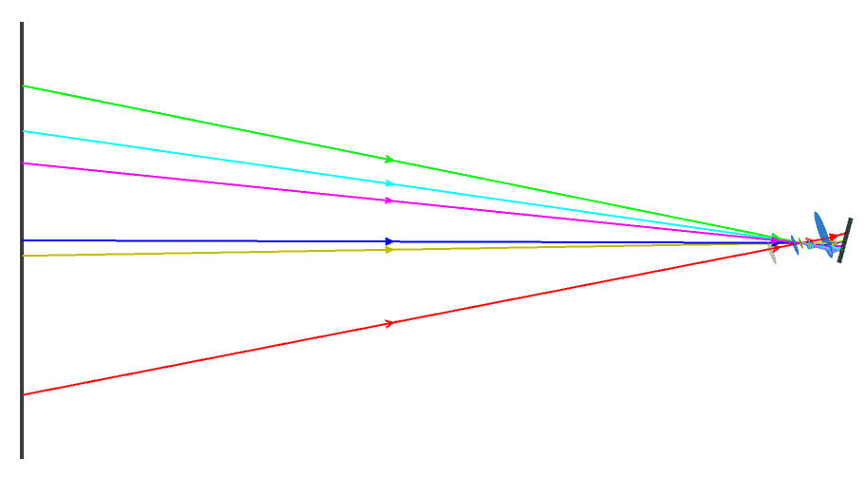
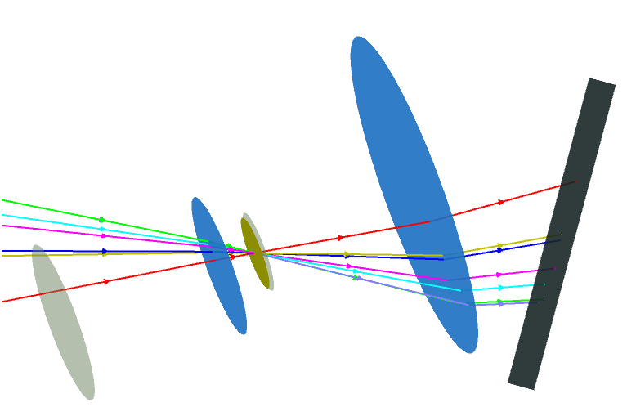
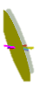










Object plane
$z_{o}$= -509 mm
Chief rays
y
x
z
$f_{eff}$ = 24 mm, $m_{p}$= 2.
Lens 2, $f$ = 30 mm
$d_{e}$ = -5 mm, $\acute{d_{e}}$= -25 mm.
$α_{x}$ = -20°, $α_{y}$ = 10°,
$β_{x}$ = 15°, $β_{y}$ = -5°.
Image plane
Lens 1, $f$ = 40 mm
$${\hat{c}}_{y}$$
Optical axis
Stop
$$\left\{C\right\}$$
$${\hat{c}}_{z}$$
Entrance pupil
Exit pupil
$\acute{z_{o}}$ = 24.17 mm

Slide 4
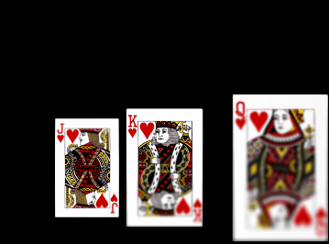
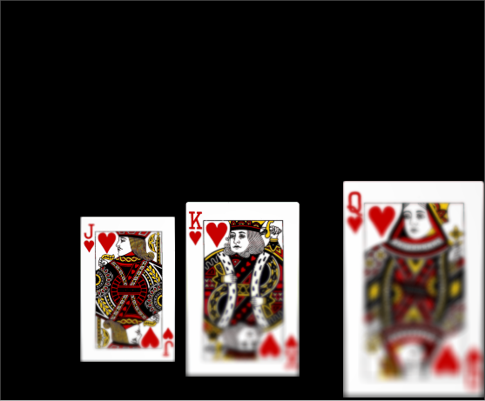



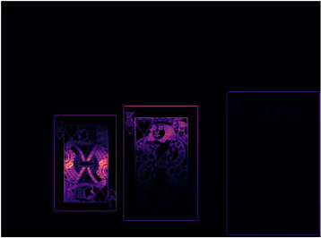
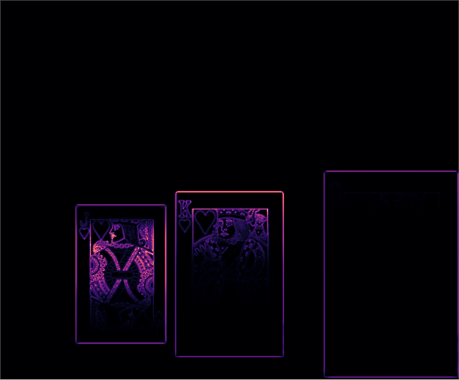
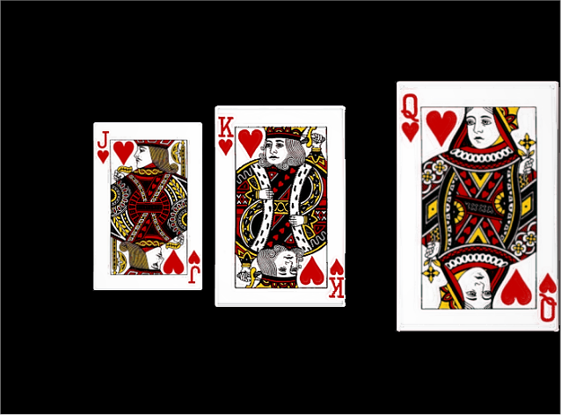
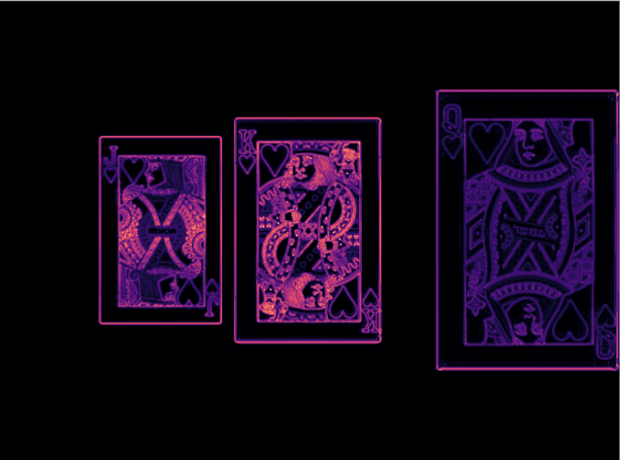
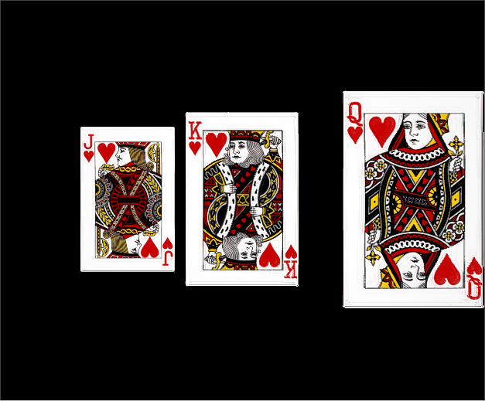
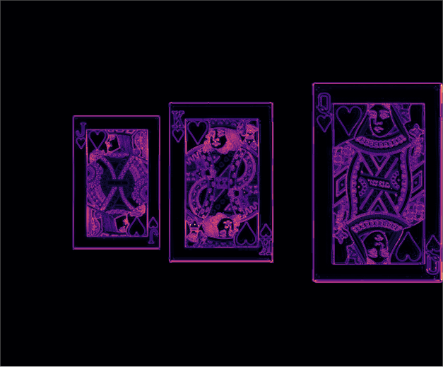





Setup of simulation in Zemax
Paraxial thick-lens model with spherical aberration;
$f$ = 24 mm, F/2.5, $d$*= 8 mm
Lens ($m_{p}=1$)
Sensor image 1/13
Lens tilt, $α=−8^{o}$
1/2
64 mm
$z$-axis
Sensor plane
(b)
6 x 5 sq. mm, 1.78 $μm$
Focus measure (LoG)
89 mm
13 tilts
between -8° & +8°
y
x
1/2
200 mm
200 mm
800 mm
z
(a)
* $d$ is the separation between the pupils.
(c)
Composite image
Focus measure (LoG) of the composite image
1/2
1/2
(d)
(e)

Slide 5
y
x
z

