Slide 1
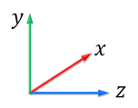
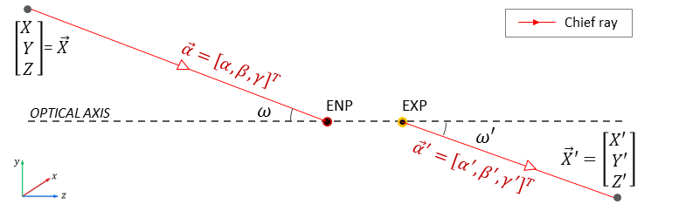



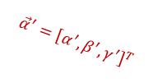


$\left[\begin{aligned}X \\ Y \\ Z\end{aligned}\right]$ = $\vec{X}$
Chief ray
$$\vec{α}={\left[α, β,γ\right]}^{T}$$
OPTICAL AXIS
$$ω$$
ENP
EXP
$$ω′$$
$$\vec{X}′=\left[\begin{aligned}X′ \\ Y′ \\ Z′\end{aligned}\right]$$
$${\vec{α}}^{′}={\left[α^{′}, β^{′},γ^{′}\right]}^{T}$$

Slide 2
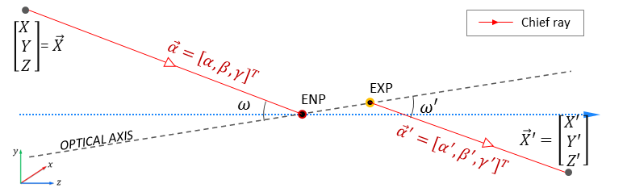

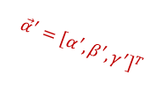

$\left[\begin{aligned}X \\ Y \\ Z\end{aligned}\right]$ = $\vec{X}$
Chief ray
$$\vec{α}={\left[α, β,γ\right]}^{T}$$
$$ω$$
ENP
EXP
$$ω′$$
$$\vec{X}′=\left[\begin{aligned}X′ \\ Y′ \\ Z′\end{aligned}\right]$$
OPTICAL AXIS
$${\vec{α}}^{′}={\left[α^{′}, β^{′},γ^{′}\right]}^{T}$$

Slide 3
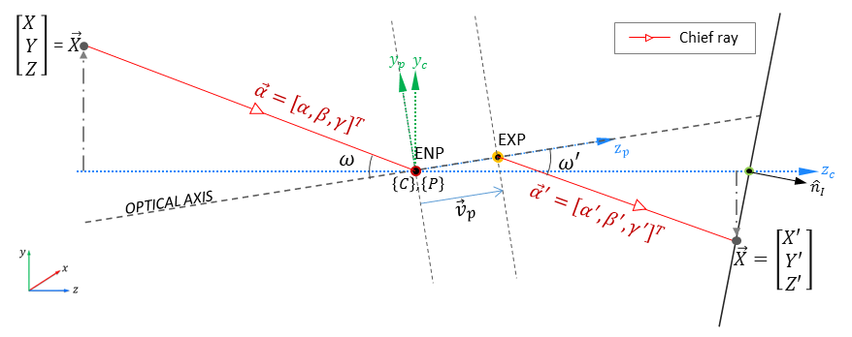












$\left[\begin{aligned}X \\ Y \\ Z\end{aligned}\right]$ = $\vec{X}$
Chief ray
$$y_{p}$$
$$y_{c}$$
$$\vec{α}={\left[α, β,γ\right]}^{T}$$
$$ω$$
ENP
EXP
$$z_{p}$$
$$ω′$$
$$z_{c}$$
OPTICAL AXIS
$$\left\{C\right\},\left\{P\right\}$$
$${\vec{v}}_{p}$$
$${\hat{n}}_{I}$$
$${\vec{α}}^{′}={\left[α^{′}, β^{′},γ^{′}\right]}^{T}$$
$$\vec{X}=\left[\begin{aligned}X′ \\ Y′ \\ Z′\end{aligned}\right]$$
TO DO: indicate $z_{ENP}^{′}$

