Slide 1
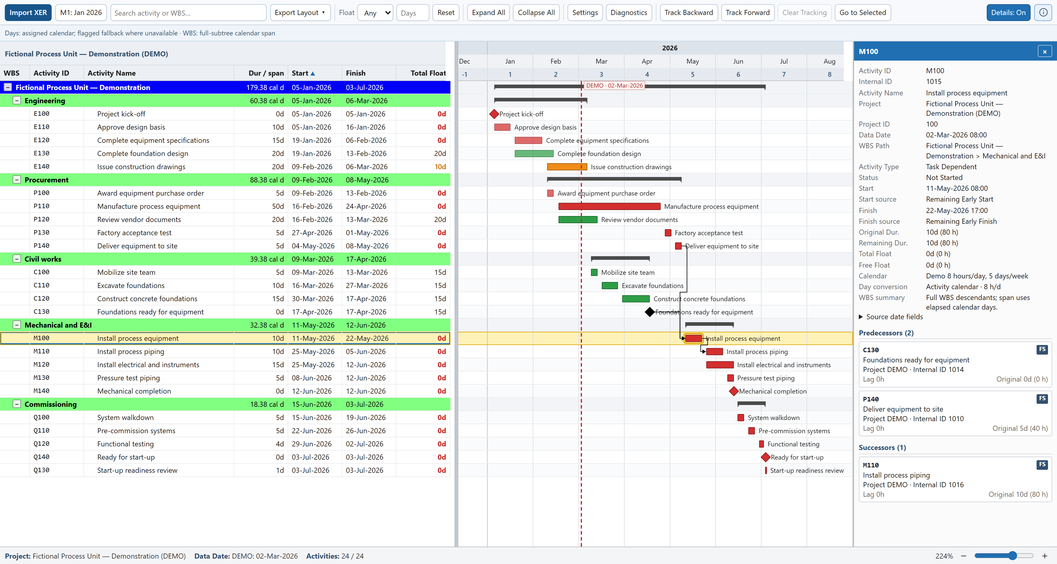
P6 XER VIEWER
Make your schedule
easier to share.
Explore P6 schedules in your browser.
Indra Pandu Prasetyo
github.com/indrapandu/project-toolkit
Notes:
P6 XER Viewer LinkedIn cover. Viewer screenshot source: https://github.com/indrapandu/project-toolkit/blob/2e37a7a61da4c9ff446a7782ef287ce4cb65887c/tools/p6-xer-viewer/preview.png . The screenshot shows the fictional demonstration schedule.

