Slide 1
Demo Scoping Deck
Generated on 2026-02-12

Slide 2
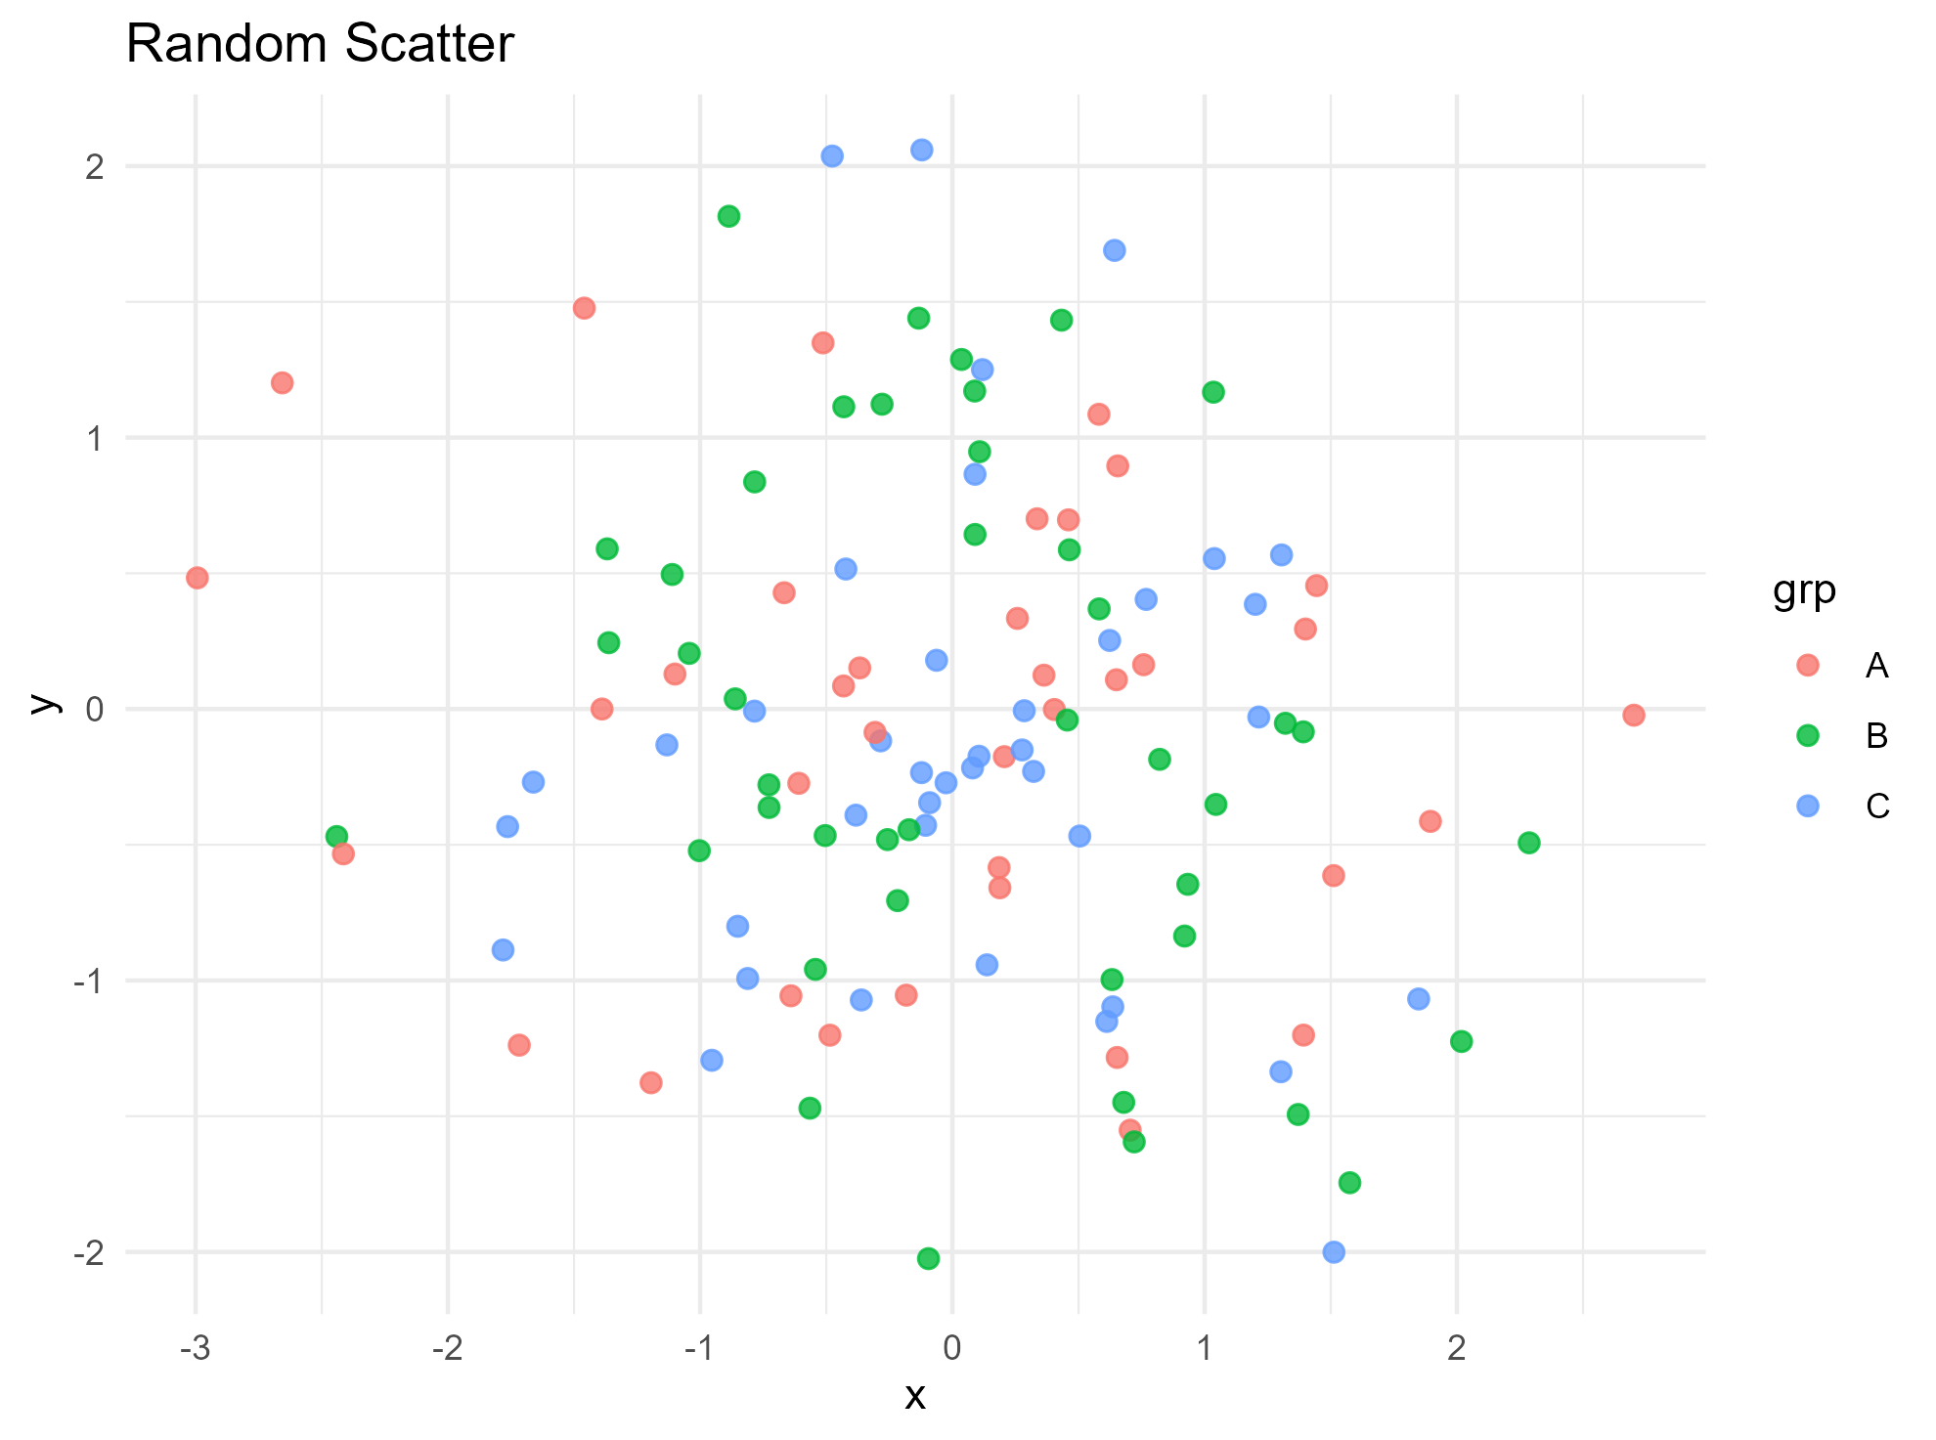
Random Data Snapshot
Data is randomly generated for demonstration.
Points are grouped into 3 categories.
Template placeholders control chart/text placement.

