Slide 1
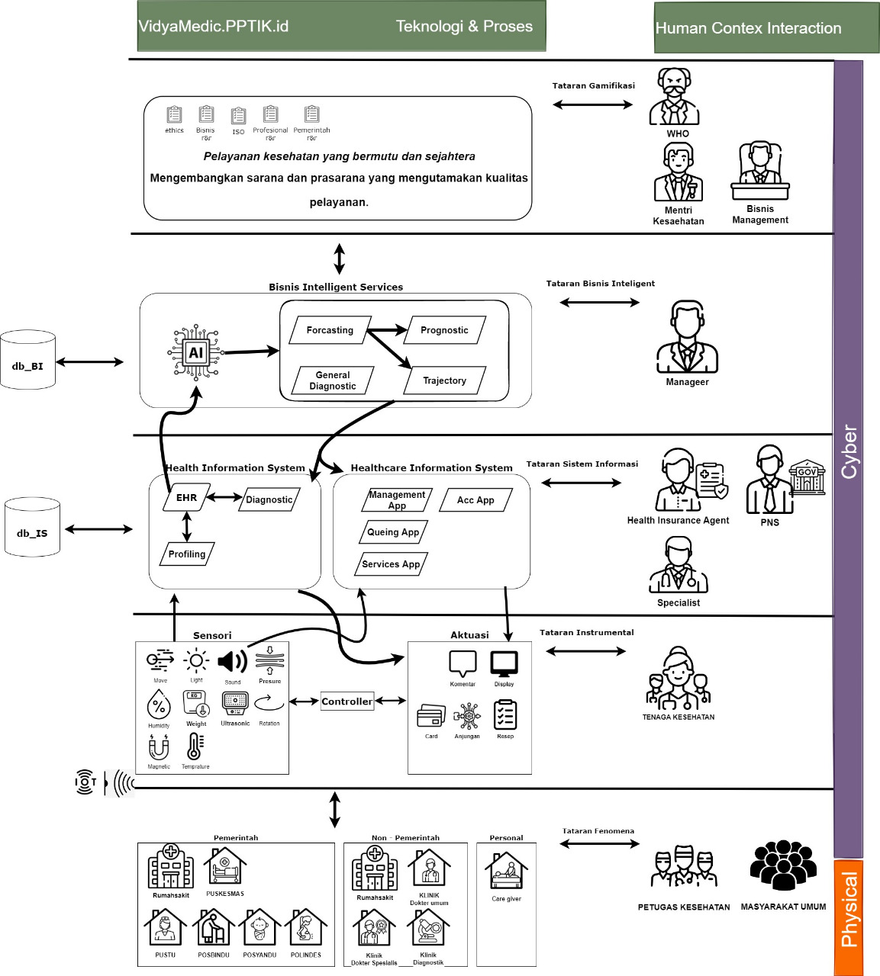
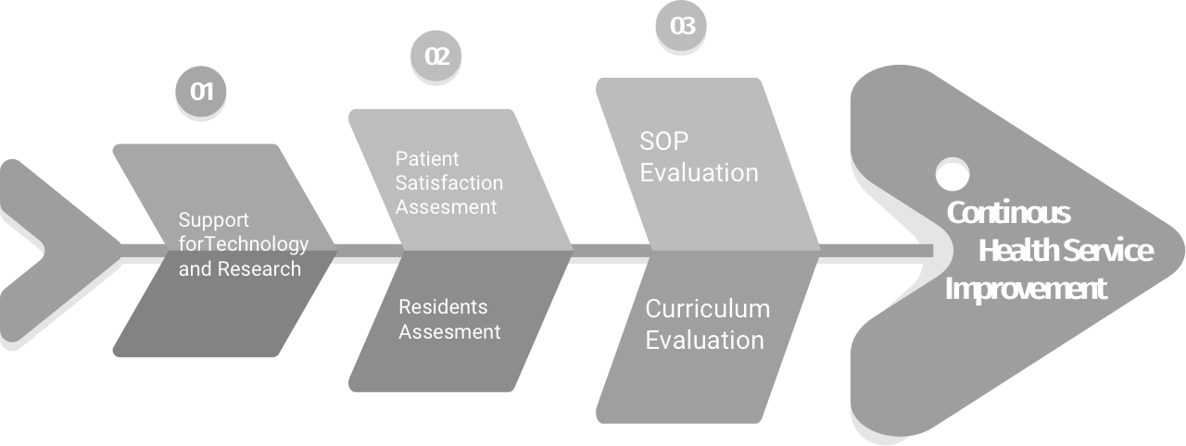


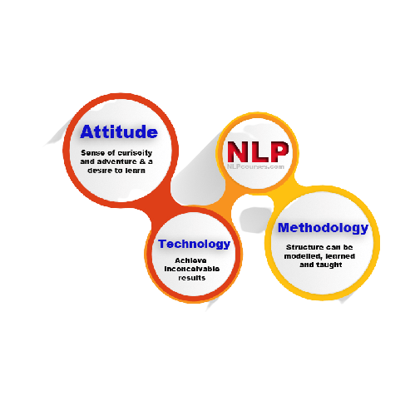

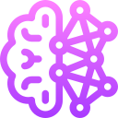







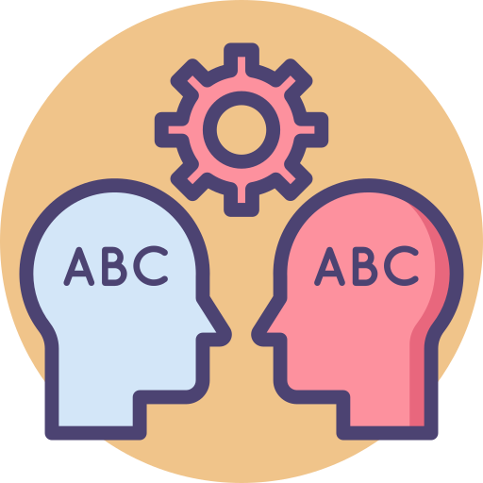


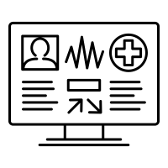



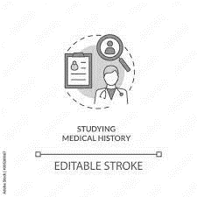

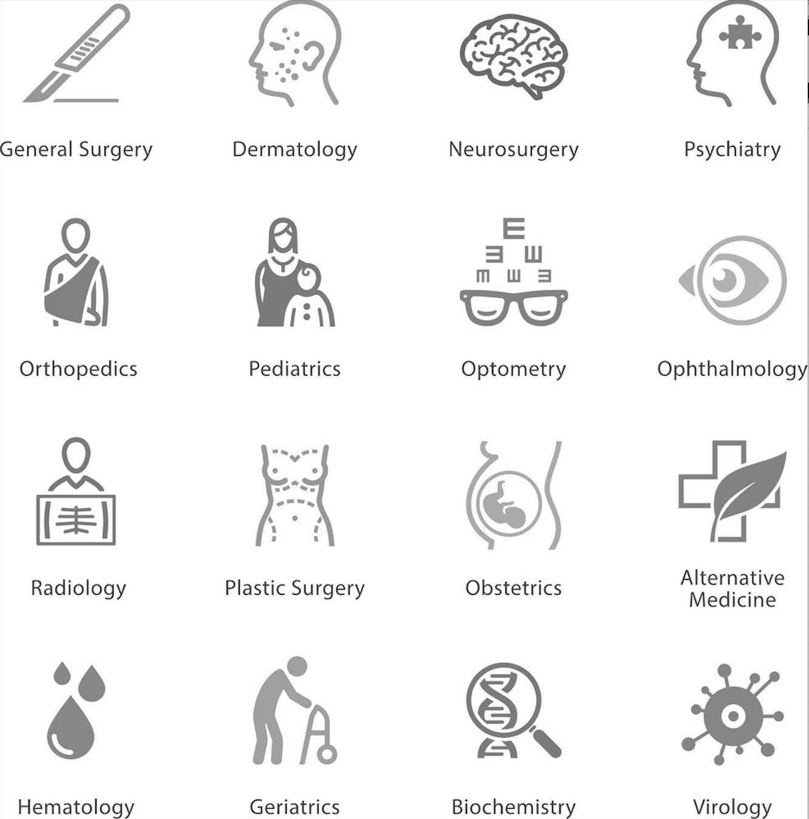

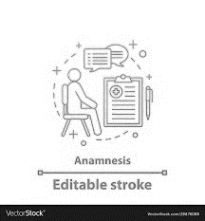

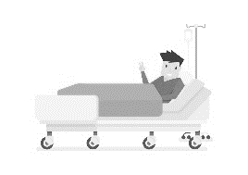



Tataran Gamifikasi
VidyaMedic SmartAnamnesis
Providing IOT based tools to record the anamnesis done by the resident doctors of medical faculty in teaching hospital and processed it with NLP-based model. Combined with some physical examination, the result will then enter further processing phaase done by some other machine learning models which result in some information that could minimize unecessary redundancy.
So that every anamnesa held by multi-medical specialties background resident doctors will leads to convaaaergent examination process that results in accurate conclusion about the source of the patient’s desease.
Manajemen
RS Pendidikan
Dekan
& Staf Pengajar
Fakultas
Kedokteran
Machine Learning
Tataran Bussiness Intelligence
Text Inferencing/
Classifying
Physical
examination
resume
Language Translation
Web crawling
Emphaty Analysis
Radiology expertise
AI Engineer
Dokter Konsulen
Laboratory Test Result
(blood, urine, faeces)
Tataran Sistem Informasi
Sistem Informasi Kesehatan
Anamnesis Transcription Text File (.txt)
Anamnesis Audio File (.wav)
Residents
EHR
Admin Rekam Medis
Sensori
Aktuasi
Physical
Tataran Instrumentasi
Suggestion of Proper Desease Management Procedure
Dokter Konsulen
DIAGNOSTIC INTERVIEW
MEDICAL HISTORY TAKING
ANAMNESA
AUDIO RECORDING
Suggestion of List of Medical Specialty Domain
Residents
Pasien
Suggestion to improve communication in anamnesa
Medical Faculty
Teaching Hospital

