Slide 1
NETSENTINEL
Network Intrusion & Log Anomaly Detector
End-to-End Data Engineering & Machine Learning Pipeline
Class Presentation | Dataset: CICIDS2017

Slide 2
OVERVIEW
Executive Summary
Project Objectives
Core Accomplishments
• Build a fully automated data pipeline capable of digesting, cleaning, and preprocessing high-volume network security log datasets.
• Implement a dual ML engine combining supervised learning (for known attack categorization) and unsupervised learning (for zero-day anomaly scores).
• Export metrics and live predictions into an interactive, high-fidelity web dashboard with real-time threat maps.
• ETL Pipeline: Successfully merges and processes ~2.8 million network flow logs from the Canadian Institute for Cybersecurity (CICIDS2017).
• ML Modeling: Deployed Random Forest with 99.4% weighted classification accuracy, alongside a robust Isolation Forest outlier detector.
• Data Export: Engineered automated JSON outputs detailing protocol breakdowns, port mappings, and threat vectors for immediate visualization.

Slide 3
ARCHITECTURE
End-to-End Pipeline Workflow
1. Ingestion
Loads and merges multiple raw CSV datasets into one master dataframe (~2.8M rows).
2. Cleaning
Removes Inf/NaN noise, handles duplicate logs, and cleans column header syntax.
3. Feature Eng.
Performs feature selection (40 key columns), handles scale normalization.
4. ML Modeling
Splits train/test splits. Trains Isolation Forest (unsupervised) + Random Forest.
5. Statistics
Runs numeric analysis to compile protocol distributions and threat counts.
6. Visualization
Generates 8 high-quality analytical charts (PNG) saved in output/charts/.
7. Dashboard
Compiles metrics & logs into dashboard_data.json to feed the front-end app.

Slide 4
DATA PROCESSING
ETL Phase: Ingestion, Cleaning & Features
Dataset Name | CICIDS2017 (UNB)
Original Records | ~2.8 Million network flows
Feature Columns | 78 numeric + 1 label column
Selected ML Features | 40 high-relevance columns
Attack Ratio In Data | ~20.0% of total flows
Attacks Covered | DoS, DDoS, PortScan, Botnet, Web, etc.
Data Preprocessing Pipeline
• Data Ingestion: Efficient chunk-wise loading to prevent RAM overflows when merging massive Monday-Friday CSVs.
• Data Cleansing: Identifies and replaces Infinite/NaN values in high-variance columns. Sanitizes duplicate flow instances.
• Scaling & Standardization: Fits a standard scaler to normalise high-value variables (e.g. Flow Duration, Init Win Bytes) for proper mathematical weighting.
• Subsampling: Smart balanced selection up to 500,000 samples for swift model training iteration without data loss.

Slide 5
MODELING
Dual Machine Learning Engines
Engine A: Random Forest (Supervised)
Engine B: Isolation Forest (Unsupervised)
• Goal: Multi-class attack categorisation (identifies if a threat is Botnet, DDoS, Web Attack, PortScan, etc.).
• Handling Imbalance: Uses 'class_weight="balanced"' to handle highly imbalanced attacks (e.g., Infiltration has very few samples compared to normal traffic).
• Robustness: High depth limit of 20 with 100 estimators prevents overfitting while locking in structural patterns.
• Feature Importance: Computes Gini impurity scores per feature, helping security analysts understand what metrics expose intrusions.
• Goal: Outlier detection. Flags anomalies and potential Zero-Day exploits without relying on class labels.
• Logic: Isolate observations by randomly selecting a feature and split value. Anomalies require fewer splits to isolate.
• Hyperparameters: Set contamination threshold to 20% (approximate historical ratio of attack traffic in the environment).
• Complementary Analysis: Feeds anomaly scores into system logs to alert on unusual volumes before classification occurs.

Slide 6
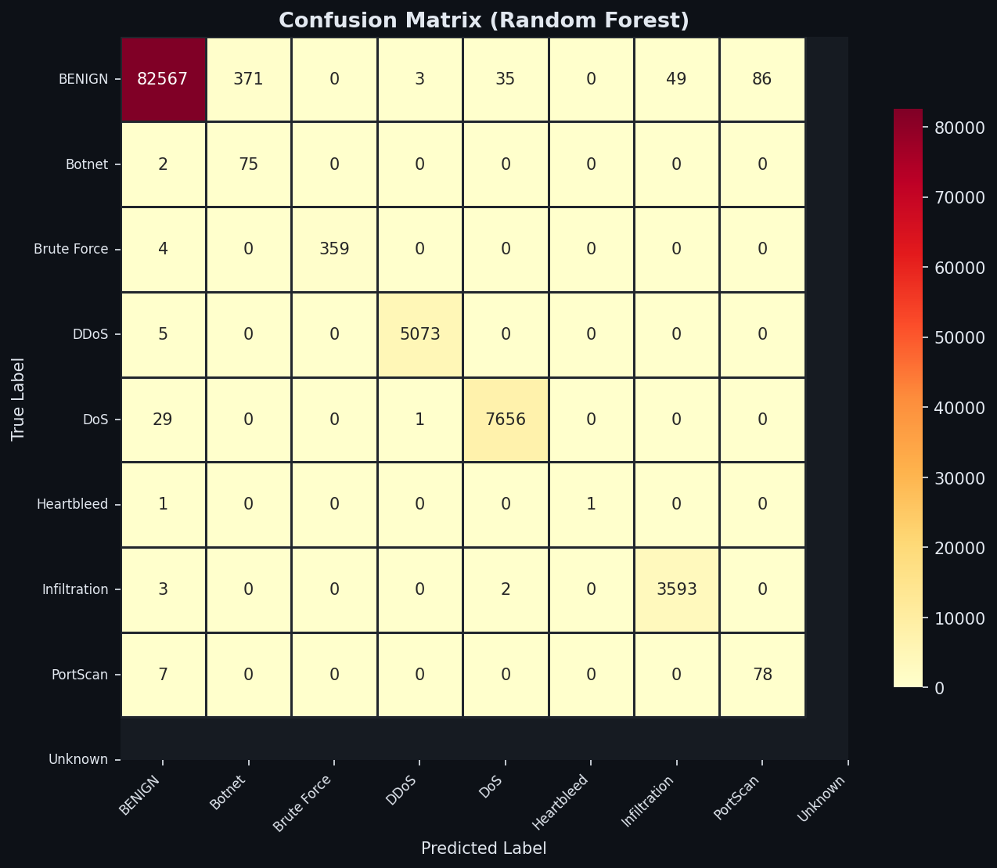
EVALUATION
Model Training Results & Metrics
Metric | Isolation Forest | Random Forest
Accuracy | 82.2% | 99.4%
F1-Score (Weighted) | 51.9% | 99.6%
Training Time | 10.2s | 62.0s
Learning Type | Unsupervised | Supervised (Multi)

Slide 7
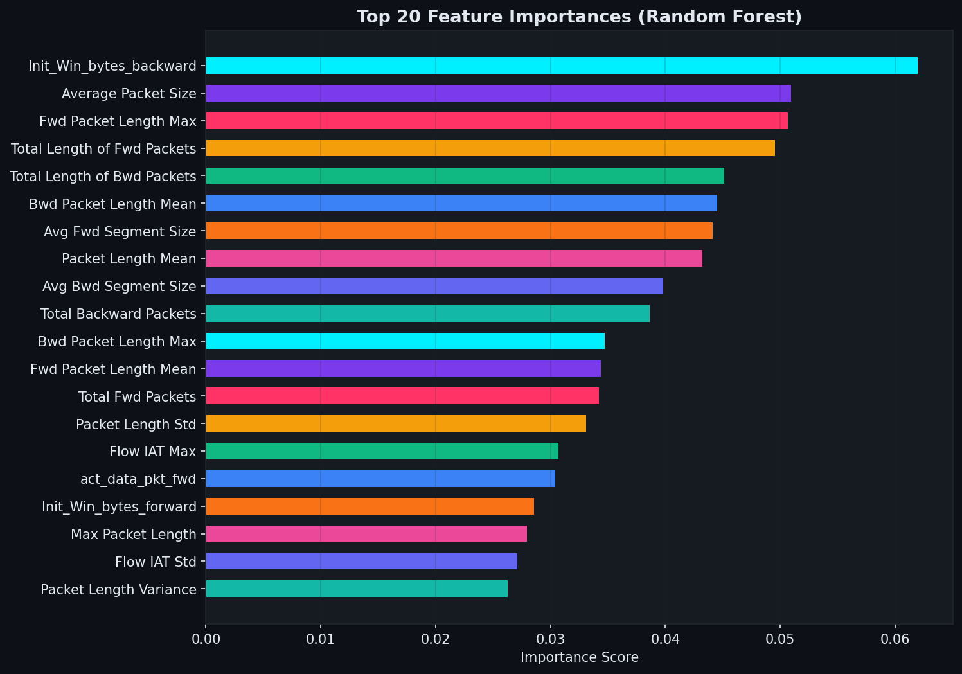
INSIGHTS
Key Security Features & Importances
Top Diagnostic Features
• Init_Win_bytes_backward: Handshake characteristics are extremely crucial for flagging SSH/FTP brute force and web exploits.
• Bwd Packet Length Mean / Max: High volumes of outgoing response payloads indicate possible data exfiltration.
• Flow Duration & Flow IAT: Small, rapid duration indicators show automated flooding attacks (e.g. SYN Flood, DDoS).
• PSH/ACK Flag Counts: Set flags expose session scanner sweeps (PortScan) and packet structural anomalies.

Slide 8
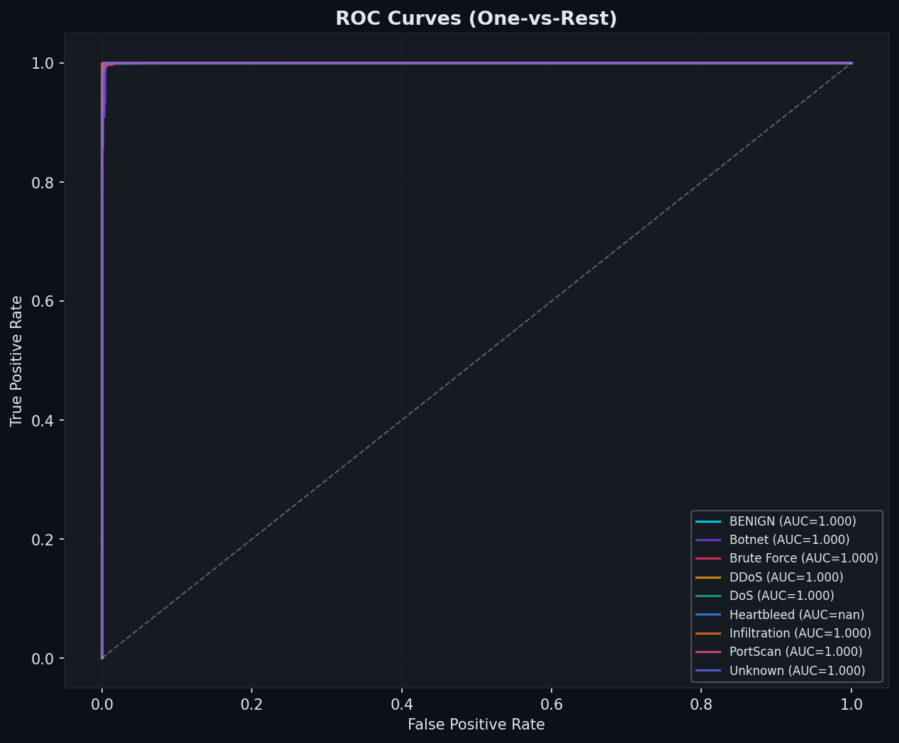
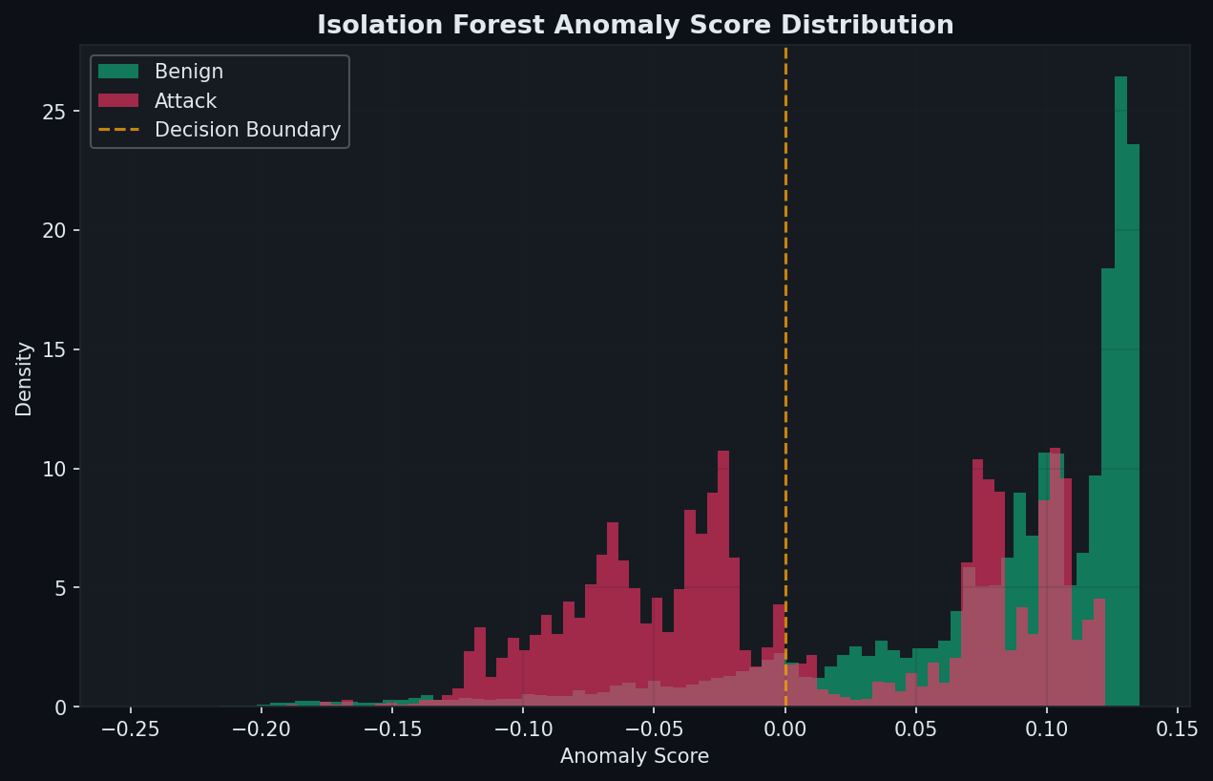
PERFORMANCE
Validation Curve Analysis

Slide 9
MONITORING
Interactive Cybersecurity Dashboard
Front-End Capabilities
System Technologies
• Visual Map Layer: Renders an active map representing global threat sources pointing to the central network node.
• Interactive Log Feed: Displays system warnings, notifications, and alerts categorized by severity (Critical, Warning, Info).
• Active Threat Logs: Lists offending IP addresses, their protocol types, target services, and blocking statuses.
• Dynamic Statistics: Connects automatically to pipeline output (dashboard_data.json) or runs in simulation mode.
• Pipeline Engine: Written in Python utilizing Pandas, Scikit-learn, and Joblib for stateful model serialization.
• Web Dashboard: Implemented in vanilla HTML5, modern CSS3 transitions, and raw client-side Javascript.
• Data Visualizations: Custom built dashboard widgets rendering using Chart.js alongside standard matplotlib plots.
• Production Readiness: Packaged layout suitable for local hosting or containerized deployment.

