Slide 1


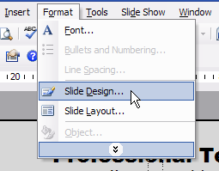
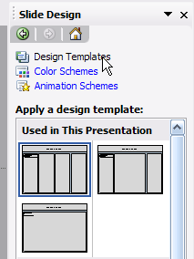
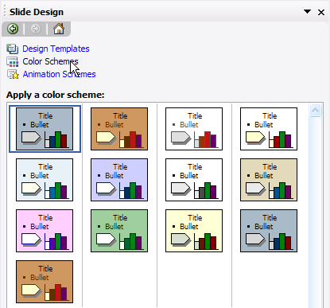
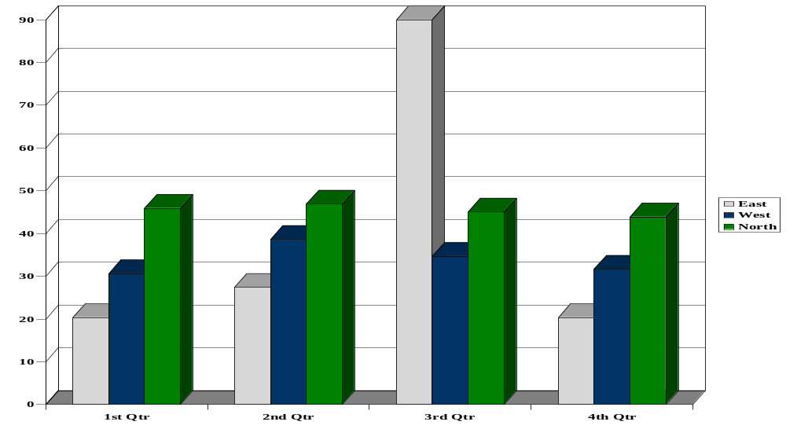

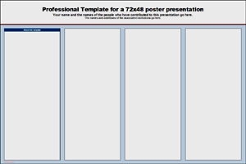
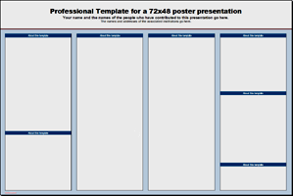






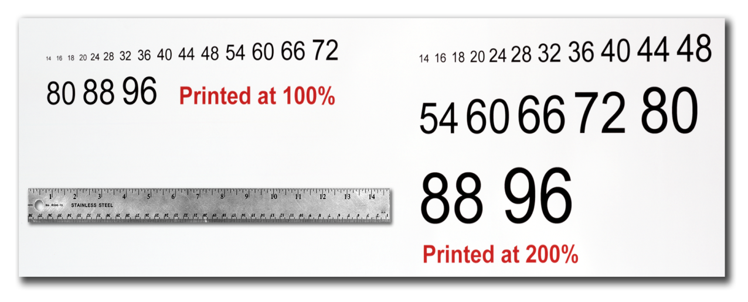
Research Conclave 2016 Template for a 4 ft x 3ft poster presentation
Your name and the names of the people who have contributed to this presentation go here.
The names and addresses of the associated institutions go here.
Email Id: XXX@iitg.ernet.in
About this template
Changing the poster’s column layout
Importing Tables & Graphs
This template was designed to produce a 4ft x 3ft poster.
You can modify it as needed for your presentation before you send it back to http://www.iitg.ernet.in
for premium quality, same day (rush-free) affordable printing.
By using this template poster will look professional, easy to read and save you valuable time from figuring out proper placement of titles, subtitles and text body.
For poster design beginners we have included many helpful tips you can find on the poster template itself.
For better understanding of the poster-making process, we have also added a series of helpful online tutorials that will guide you through the poster design process and answer most of your poster production questions.
For further assistance and to order your printed poster call http://www.iitg.ernet.in/rc2016/contact.html
at +91 9085756257.
Depending on how you layout your poster, you may want to change the column layout configuration.
For your convenience, we have included alternate master layouts. To select a different layout go to FORMAT>SLIDE DESIGN (Fig. 5). The slide design pane will open. From there you can select an alternate layout (Fig. 6).
Importing tables, charts and graphs is easier than importing photos. To import charts and graphs from Excel, Word or other applications, go to EDIT>COPY, copy your chart and come back to PowerPoint. Go to EDIT>PASTE and paste the chart on the poster. You can scale your charts and tables proportionally by holding down the Shift key and dragging in or out one of the corners.
TABLE ONE
1998 | 1999 | 2000
2001 | 2002 | 2003
2004 | 2005 | 2006
Fig. 5
Fig. 6
Customizing the template color schemes
For those who wish to further personalize their poster presentation, we have included a number of printer-tested alternative color schemes for this poster template.
If you want to change the default colors and use your own color scheme, go to FORMAT>SLIDE DESIGN (Fig. 7). The SLIDE DESIGN pane will open. Select COLOR SCHEMES (Fig. 8). There, you can try different color schemes until you find the one you like.
Poster Basics – Poster Layout
To start using this template you first need to delete most of the contents of this page. Keep the poster title and one of the blue section headers.
The cleared template should now look like in Fig. 1.
After you decide how many sections you need for your poster (Introduction, Methods, Results, References, etc.), use the “copy” and “paste” commands to create as many copies of the blue section headers as needed.
Move the header copies approximately to where you think they need to be on the poster, so you can get a better sense of the overall poster layout. It will help you organize your content. See Fig. 2.
You can now start adding your text.
To add text use the text tool to draw a text box starting from the left edge of a column to the right edge and start typing in your text. You can also paste the text you may have already copied from another source. See Fig. 3.
Repeat the process throughout the poster as needed.
Fig. 7
Fig. 8
Importing Photographs
It is highly recommended to use the largest images you have access to for your poster. Avoid images downloaded from the web and avoid copying and pasting images instead of using the “Insert” command. To insert an image to your poster go to INSERT>PICTURE>FROM FILE (Fig. 9).
(Fig 9)
A
B
When the only source of a needed photo or graphic is the Web, scaling has to be applied with caution. Scaling an image more than three times its original size may introduce pixelization artifacts. Refer to fig. 10 as an example. A simple way to preview the printing quality of an image is to zoom in at 100% or 200%, depending on the final size of the poster. What you’ll see is likely what you’ll get at printing time.
Fig. 1: Research Conclave 2016.
Fig. 2:
Fig. 3:
Text Sizes
For this template we use the Arial font family at several recommended text sizes. You can use any typeface you like and at any size but try to stay close to the suggested limits.
Fig. 4 gives a visual reference of what different font sizes look like when printed at 100% and at 200%.
Due to a page size limitation in PowerPoint and unless your poster is going to be less than 56” in length, all the work done on this template is at half the size of the final poster.
Fig. 10: Original image at 100%, enlarged 200% and 400%.
Contact information
Research Conclave 2016 An amalgamation of Academia, Industry & StartUps
Mr. Arupjyoti Borah Doctoral Representative Coordinator Email: rciitg2016 @gmail.com Mob no: +91 9085756257
Labeling your headers
The blue headers are used to identify and separate the main topics of your presentation. The most commonly used headers in poster presentations are:
Introduction, Summary or Abstract | Conclusion
Materials and Methods | Literature Cited
Results | Acknowledgements
Fig. 4: Justice polo

