Slide 1
Database Management Systems
INDRESH SONI
ISIT COLLEGE
SIPRI BAZA JHANSI

Slide 2
Introduction
Data – Any fact that can be recorded
e.g., - texts, numbers, alphanumeric, audio, video, image.
Database – Collection of interrelated data
Types of database –
Traditional database
Multimedia database
Geographic Information System (GIS) Database
Real-time database
Data Warehouse (huge volume of historical data)
DBMS – Collection of interrelated data and a set of programs to access those data. It helps us to store and retrieve database information in a convenient and efficient manner.
Database (DB) + Database Management System (DBMS) = Database System (DBS)

Slide 3
Introduction (contd..)
DBMS Softwares – MS Access, Oracle, SQL Server, MySQL DB2, SYBASE, etc.
MS Excel – Does possess data management capabilities, but not a pure DBMS.
Languages used by DBMS Softwares – SQL, PL/SQL
Applications – Banking, Airline, Retail, Manufacturing, Telecommunication, Universities, etc.
Users of Database –
Naive Users – Who knows nothing about the database but interacts with the system by invoking one of the application programs that have been written earlier.
Sophisticated Users – performs the same task of data entry not by using any application program, but by means of query language like SQL.

Slide 4
Introduction (contd..)
Application Programmers – Developers who interact with the database by means of DML queries or Rapid Action Development (RAD) tools. These DML queries are written in the application programs like C, C++, JAVA, Pascal etc. These queries are converted into object code to communicate with the database. For example, writing a C program to generate the report of employees who are working in particular department will involve a query to fetch the data from database. It will include a embedded SQL query in the C Program.
Sophisticated Users – They are sophisticated users who write specialized database applications like computer-aided designs, knowledge and expert systems that store data with complex data types (e.g., audio/video data, graphics data).
Database Administrators (DBA) – A person or a group of persons who monitors the database management system handling.
Creates the original database
Makes physical changes (modifications) to the schema
Grants authorization for data access
Does routine maintenance and periodic back up.

Slide 5
DBMS Vs. File-processing Systems
Data redundancy and inconsistency
Difficulty in accessing data
Data isolation – multiple files and formats
Integrity problems (enforcing consistency constraints)
Atomicity of updates
Concurrent access by multiple users
Security problems

Slide 6
DBMS Architectures
User
User
Application Programs
Application Programs
Server
Database
Database
Two-tier Architecture
Three-tier Architecture

Slide 7
Views
Part of the database that is visible to a particular user, for e.g., in a banking system, the person who checks the account debits and credits of a customer is not granted access to the payroll system. The account, depositor and borrower tables are his view.
Differ from person to person.
The authorization of access is granted by the DBA.

Slide 8
Levels of Abstraction
Users
User View level describes how users see the data.
Conceptual or Logical level defines logical structure
Physical level describes the files and indexes used.
View 1
View 2
View 3
Conceptual Schema
also known as the
ANSI/SPARC model
Physical Schema
DB
Notes:
6

Slide 9
Example: University Database
Conceptual schema:
Students (sid: string, name: string, age: integer, gpa:real)
Courses (cid: string, cname:string, credits:integer)
Enrolled (sid:string, cid:string, grade:string)
External Schema (View Level):
Course info (cid:string, enrollment:integer)
Physical schema:
Relations stored as unordered files.
Index on first column of Students.
View 1
View 2
View 3
Conceptual Schema
Physical Schema
DB
Notes:
7

Slide 10
Data Independence
Ability to modify a schema definition in one level without affecting a schema definition in the other levels.
Logical data independence: Protection from changes in logical structure of data.
Physical data independence: Protection from changes in physical structure of data.
View 1
View 2
View 3
Conceptual Schema
Physical Schema
DB

Slide 11
Metadata & Data dictionary
Metadata – Data about data
It is the overall description of the database specified by a set of definitions and constraints, for e.g. –
Means of creation of the data
Purpose of the data
Time and date of creation
Creator or author of the data
Location on a computer network where the data was created
Standards used
File size
Data dictionary – Metadata repository
It stores information about each data element in the database such as its name, data type, range of value, source, access authorization and indicates which application programs use this data item.

Slide 12
Database Models

Slide 13
Database Models
Object based
data model
Record based
data model
Physical
data model
Entity-Relationship (E-R)
Hiearchical
Unifying
Semantic
Network
Frame-memory
Functional
Relational
Object based

Slide 14
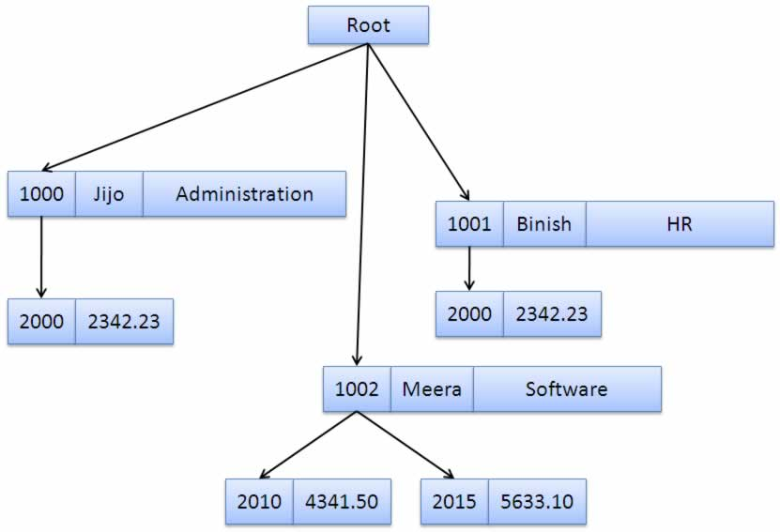
Hierarchical Data Model

Slide 15
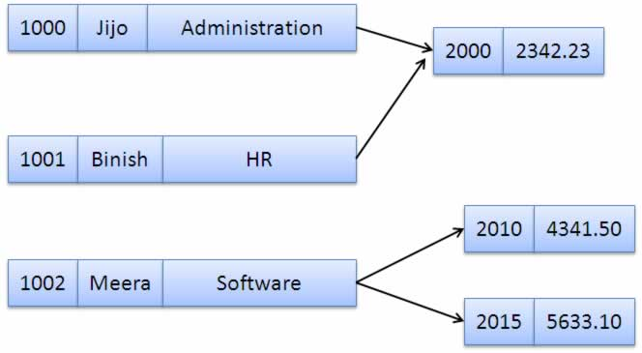
Network Data Model

Slide 16
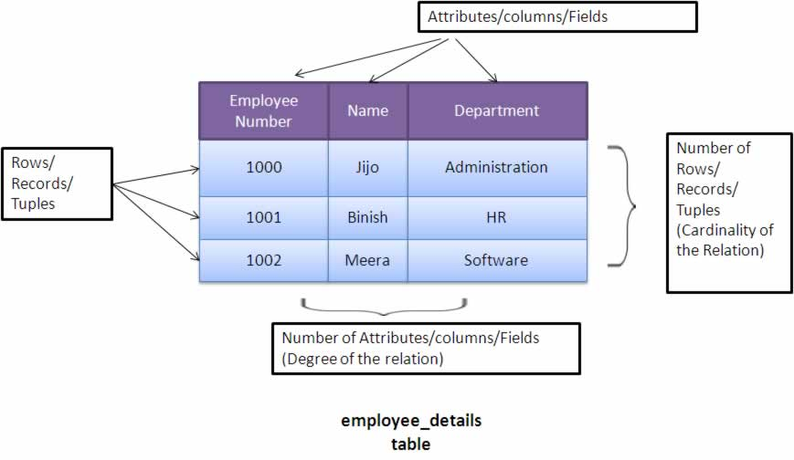
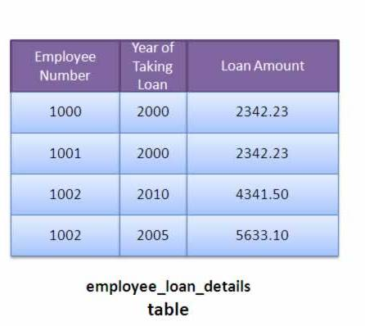
Relational Data Model

Slide 17
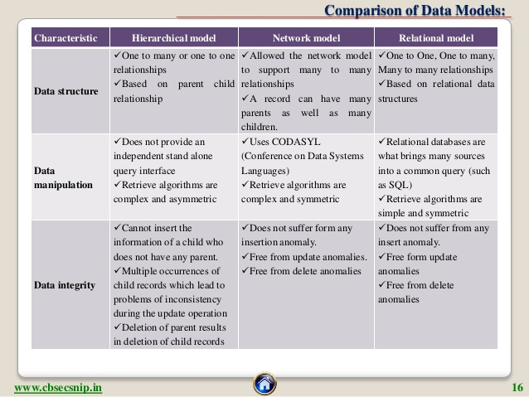
Comparison

Slide 18
Entity-Relationship (E-R) Model
social-security
customer-street
account-number
customer-name
customer-city
balance
depositor
customer
account

Slide 19
E-R Model (Contd..)
name
dob
cid
age
roll
cname
enroll
student
course
Attributes
Relationship
Entity Set

Slide 20
RDBMS

Slide 21
RDBMS
A relational database management system (RDBMS) is a database management system (DBMS) that is based on the relational model as invented by E. F. Codd
He proposed thirteen golden rules to define what is required from a database management system in order for it to be considered relational, i.e., RDBMS
See Codd’s 13 Golden Rules
Basic Idea –
to present the data to the user as relations (i.e. as a collection of tables with each table consisting of a set of rows and columns)
to provide relational operators to manipulate the data in tabular form.

Slide 22
Relational Schema
Fields / Attributes
C
a
r
d
i
n
a
l
i
t
y
Student
Roll | Name | DOB | Age
1 | Aamir Khan | 14-03-1965 | 50
2 | Shahrukh Khan | 02-11-1965 | 50
3 | Salman Khan | 28-12-1965 | 50
Tuple /
Record /
Entity
Degree
Student
Entity Set
Values
Schema

Slide 23
Few Terminologies
Schema – the logical structure of the database (e.g., set of customers and accounts and the relationship between them).
Instance – the actual content of the database at a particular point in time.
Degree – the number of columns associated with a relation or table.
Cardinality – the number of rows in a table.
Domain – the range of possible values for an attribute.
e.g. – the domain for the attribute gender may be {‘M’, ‘F’}
the domain for the attribute title may be { ‘Mr.’, “Ms.’, ‘Mrs.’, ‘Dr.’}

Slide 24
Few Terminologies (Contd..)
Extension - The extension of a given relation is the set of tuples appearing in that relation at any given instance. The extension thus varies with time. It changes as tuples are created, destroyed, and updated.
EmpNo | EmpName | Dept
1001 | Ramesh | Marketing
1002 | Suresh | Finance
at time t1
EmpNo | EmpName | Dept
1001 | Ramesh | Marketing
1002 | Suresh | Finance
1003 | Amar | Sales
1004 | Akbar | HR
1005 | Antony | Finance
at time t2

Slide 25
Few Terminologies (Contd..)
Intension - The intension of a given relation is independent of time. It is the permanent part of the relation. It corresponds to what is specified in the relational schema.
It is a combination of two things : a structure and a set of integrity constraints.
Example -
Employee (EmpNo Number(4) Not NULL, EmpName Char(20), Dept Char(10) )
This is the intension of Employee relation.
Control Redundancy – Read only data is repeated sometimes to increase availability.

Slide 26
Types of Atrributes
Simple attribute – attribute that consist of a single atomic value.
e.g. – Roll, Marks, Salary, etc.
Composite Attribute – attributes which can be decomposed further
e.g. – Name (First Name, Middle Name, Last Name)
Address (House No., Street, City, State)
Single-valued atribute – attribute that hold a single value
e.g. – City, EmpId, Salary, etc.
Multi-valued attribute – attribute that hold multiple values
e.g. – Phone no., EmailID
Derived attribute – an attribute that can be calculated or derived from another attribute
e.g. – Age (derived from DOB)
Null attribute – an attribute whose value is missing for a record.
e.g. - if a record does not contain an assignment for the Price attribute

Slide 27
Concept Of Keys

Slide 28
Keys
Super Key – An attribute or a group of attribute that can uniquely identify a tuple from a relational schema.
Candidate Key – Minimal Super key.
Prime attribute – Member of some candidate key
Primary Key – One of the Candidate keys (usually the most powerful one, depends on the choice of the user) that can uniquely fetch a tuple from a relational schema.
A primary key cannot accept NULL values.
A composite primary key is a primary key comprising of more than one attributes.
Alternate / Secondary Key – Rest all candidate keys.
Unique Key – same as primary key, but can accept NULL values.

Slide 29
Keys (Contd..)
Foreign Key – An attribute of an entity set E, which is dependant on the primary key of another entity set E1.
The former table is called the referencing table and the latter is called the referenced or derived table.
In such a case, E has to be constructed first and then E1. While deletion, E1 has to be deleted first and then E.
e.g. – Consider the below relations:
student = (roll, name, marks)
course = (cid, cname)
enroll = (roll, cid)
roll, cid in the enroll relation are foreign keys and together form the composite primary key for the relation.

Slide 30
Strong and Weak Entity Set
Strong entity set – An entity set that has a fixed entity set.
Weak entity set – An entity set that does not have sufficient attributes to form a primary key.
e.g. –
loan = (loan_id, loan_name, borrower, amount)
payment = (payment_id, payment_date, amount)
The payment relation does not have a primary key (payment_id cannot uniquely identify tuples) and hence is a weak entity set.
Discriminator/Partial Key – An attribute of a weak entity set which normally
does not show uniqueness, but shows uniqueness when combined with a strong
Entity set.
e.g. – payment_id when combined with loan_id, can uniquely identify tuples.

Slide 31
Integrity Constraints
Entity Integrity – If an attribute is a prime attribute, it cannot accept NULL values. In other words, no component of a primary key can be NULL.
Extension to the above rule - No non-key attribute can be referenced.
Referential Integrity – Ensures that a value that appears in one relation for a given set of attributes also appears for a certain set of attributes in another relation.
In other words, it states that any foreign key value must match a primary key value (or the foreign key value can be NULL).
e.g. –
Restrict – do not allow deletion of ‘parent’ side if related rows exist in ‘dependant’ side.
Cascade – automatically delete ‘dependant’ side rows that correspond to the ‘parent’ side row to be deleted.

Slide 32
Entity-Relationship Diagram

Slide 33
E-R Model
Proposed by Peter Chen in 1976
ER diagram is widely used in database design
Represent conceptual level of a database system
Describe things and their relationships in high level
Entity set – an abstraction of similar things, e.g. cars, students
An entity set contains many entities
Attributes – common properties of the entities in a entity sets
Relationship – specify the relations among entities from two or more entity sets

Slide 34
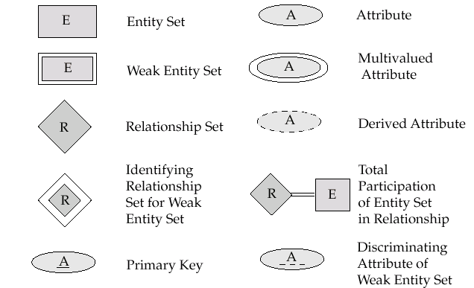
E-R Diagram Notations

Slide 35

E-R Diagram Notations (contd..)

Slide 36
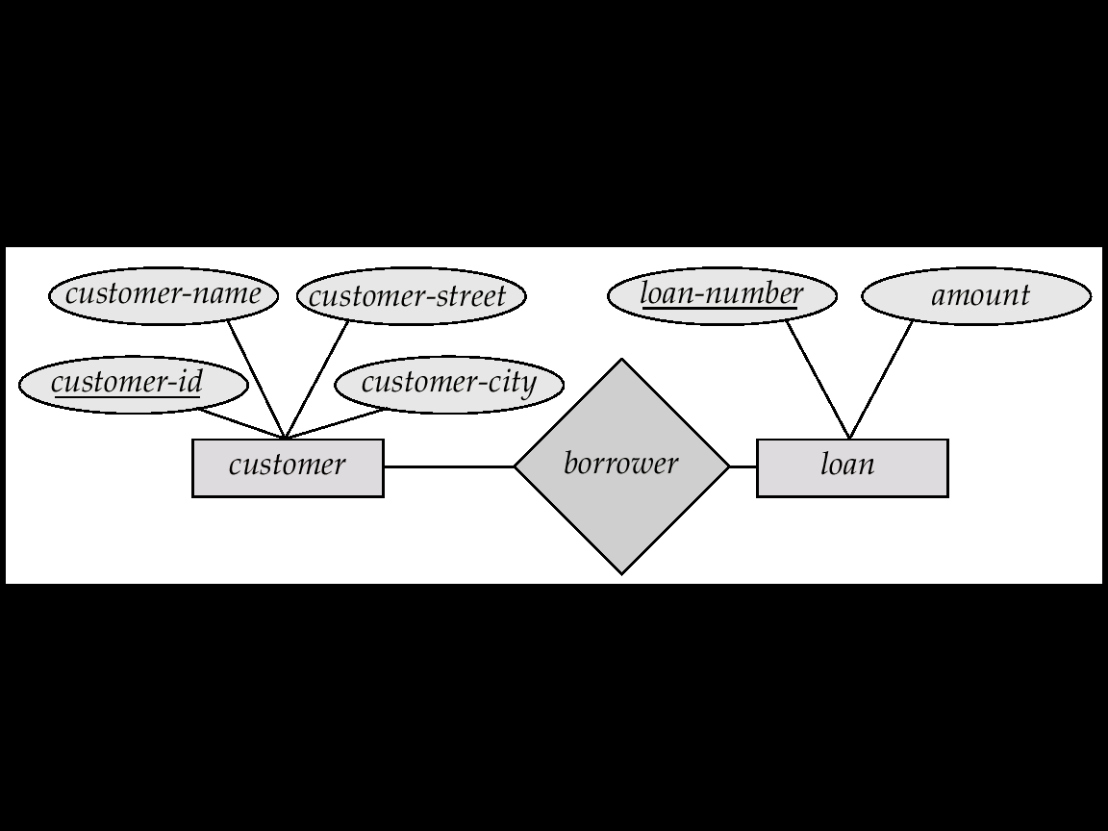
An Example

Slide 37
Attributes
Both entity sets and relationships can have attributes
Attributes may be
Composite
Multi-valued (double ellipse)
Derived (dashed ellipse)

Slide 38
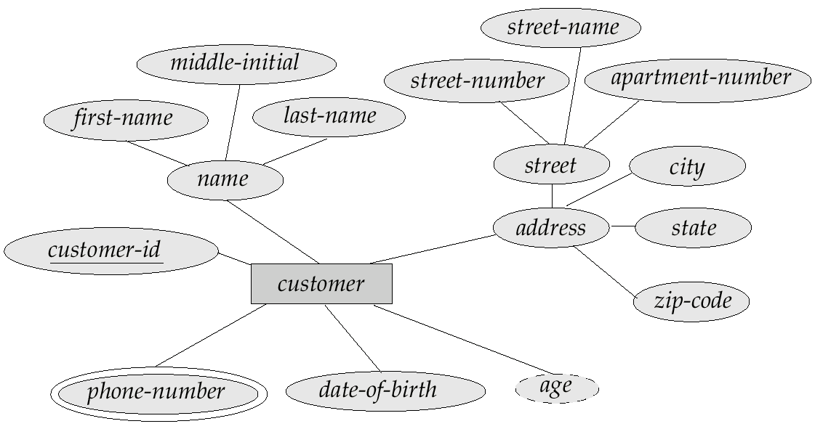
An Example

Slide 39
Relationship
The degree of a relationship = the number of entity sets that participate in the relationship
Mostly binary relationships
Sometimes more
Mapping cardinality of a relationship
1 –1
1 – many
many – 1
Many-many

Slide 40
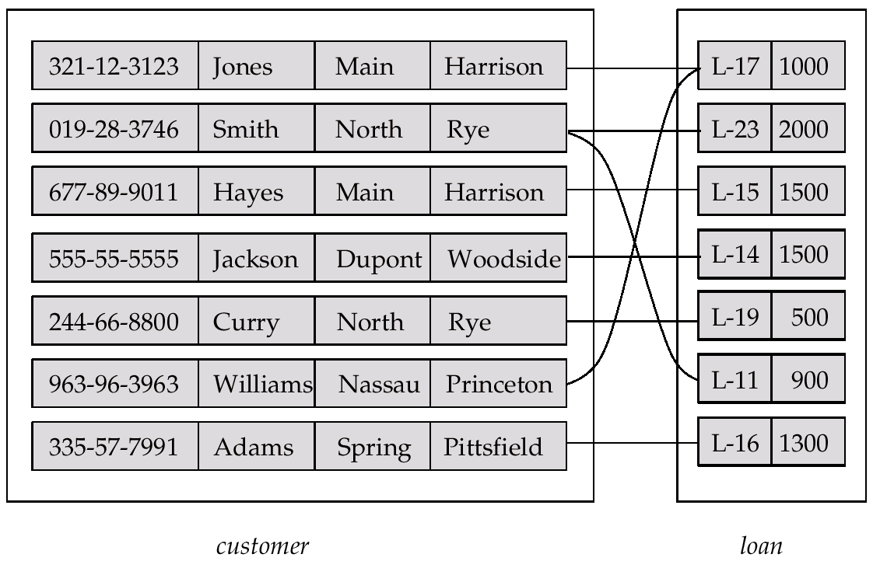
Relationship Example

Slide 41
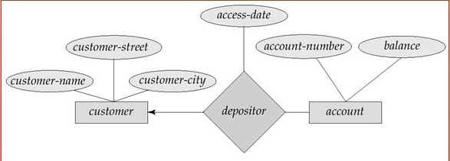
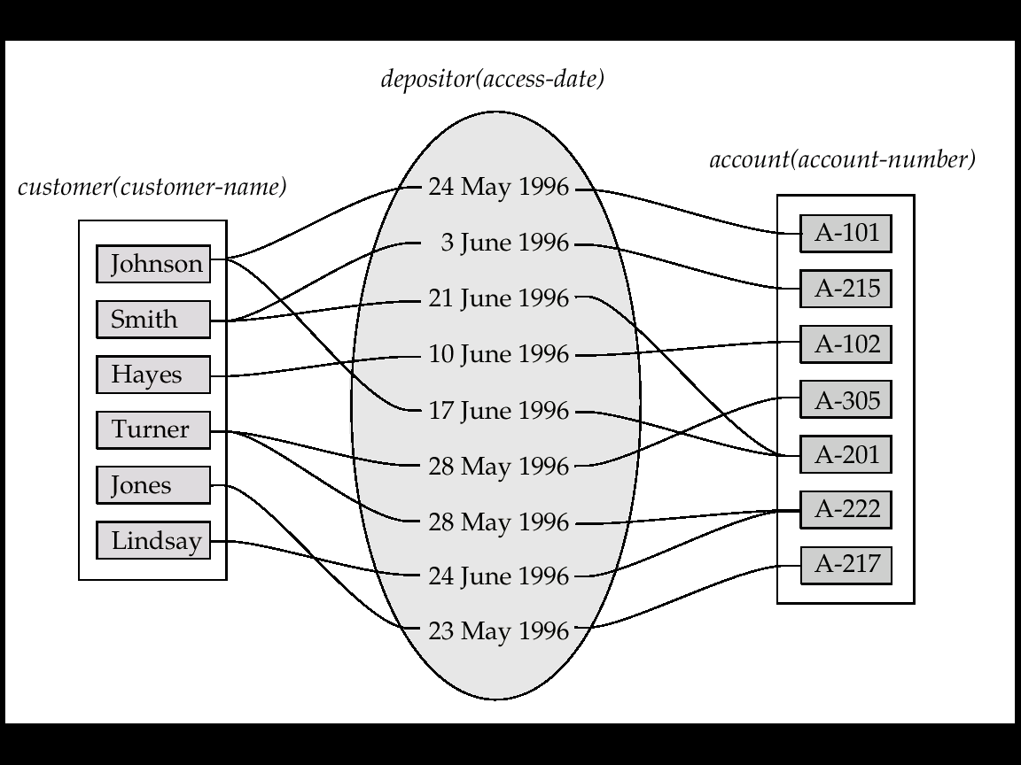
Attribute of A Relationship Set

Slide 42
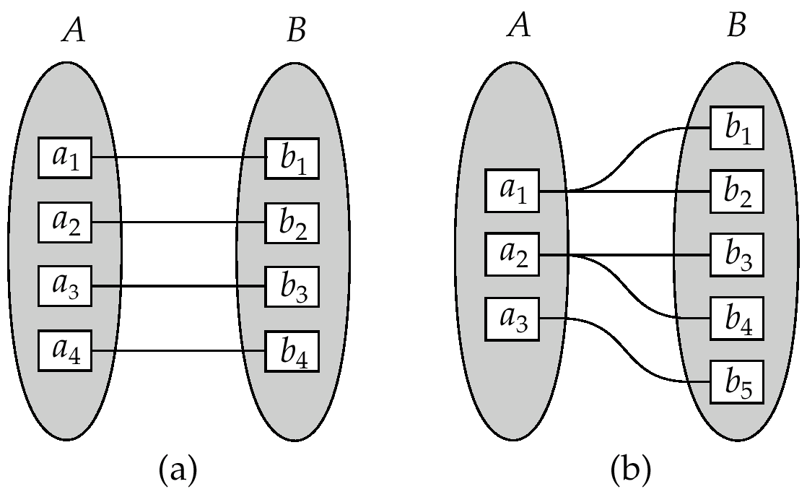
One-One and One-Many

Slide 43
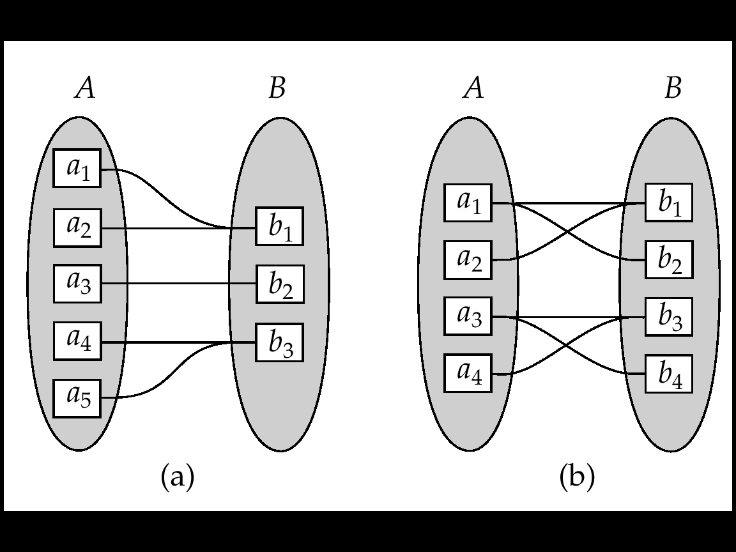
Many-one and many-many

Slide 44
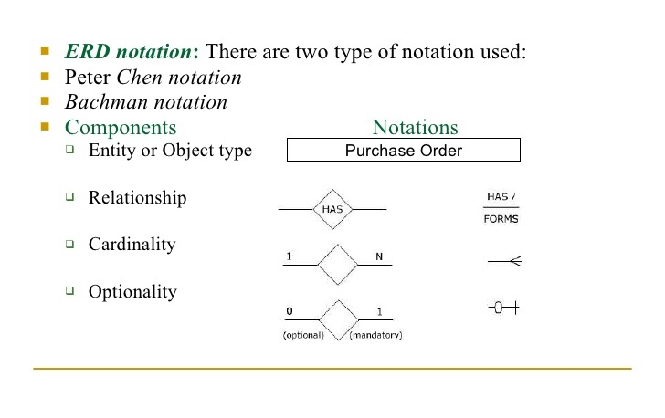
Peter Chen & Bachman Notations

Slide 45
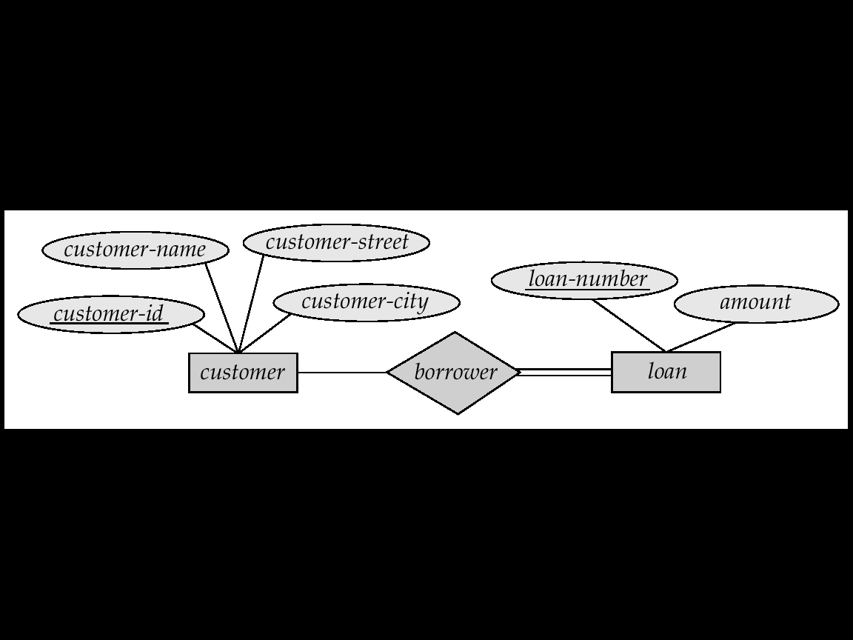
Total Participation
When we require all entities to participate in the relationship (total participation), we use double lines to specify
Every loan has to have at least one customer

Slide 46
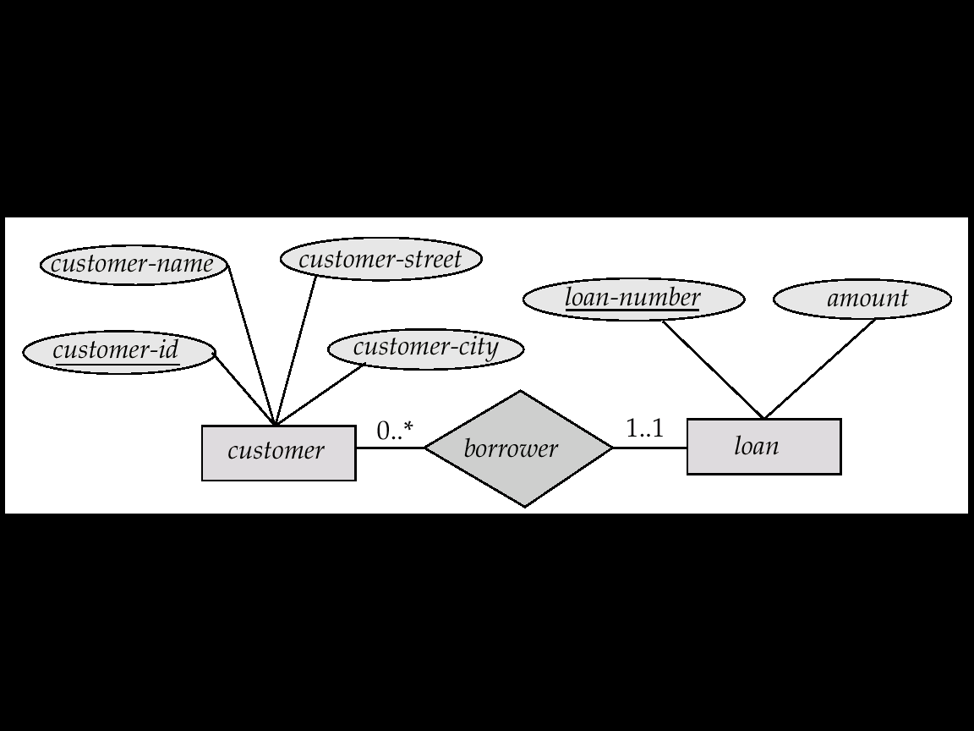
Alternative Cardinality Specification
l..h - Minimum cardinality..maximum cardinality
A minimum value of 1 indicates total participation of the entity set in the relationship
A maximum value of 1 indicates that the entity participates in at most one relationship, while a maximum value of * indicates no limit.
A label 1..* indicates total participation.

Slide 47
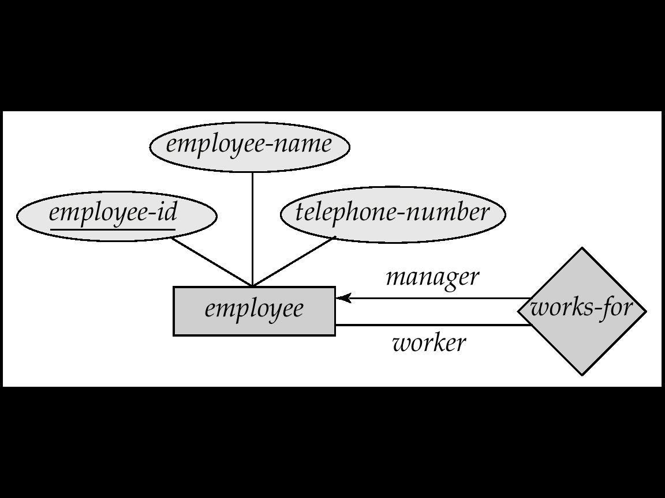
Self Relationship
Sometimes entities in a entity set may relate to other entities in the same set. Thus self relationship
Here employees mange some other employees
The labels “manager” and “worker” are called roles the self relationship

Slide 48
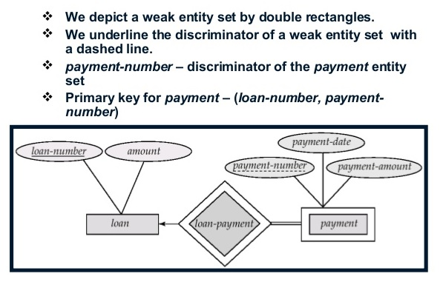
Weak Entity Set
Some entity sets in real world naturally depend on some other entity set.
They can be uniquely identified only if combined with another entity set
Double rectangles for weak entity set
Double diamond for weak entity relationship
Dashed underscore for discriminator

Slide 49
Extended E-R Features

Slide 50
Generalization & Specialization
Shows inheritance of attributes.
A lower-level entity set inherits all the attributes and relationship participation of the higher-level entity set to which it is linked.
A lower-level entity set may have additional attributes and participate in additional relationships.
Also knows as Superclass-Subclass relationship.

Slide 51
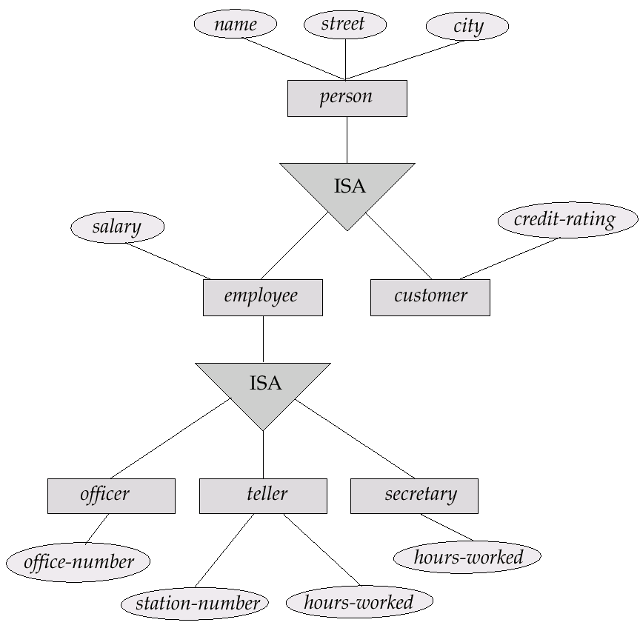
Specialization
Generalization

Slide 52
Constraints
Domain Constraint –
Declaring an attribute to be of a particular domain acts as a constraint on the values that it can take.
Participation Constraint –
The participation of an entity set in a relationship can be total or partial, thus acting as a constraint on the values.
Cardinality Constraint –
The type of mapping – one-one, one-many, many-one and many-many acts as a constraint on the values.

Slide 53
Constraints (contd..)
Constraints on Generalization –
Disjoint – A disjointness constraint requires that en enity belong to no more than one lower-level entity set within a single generalization.
e.g. – An account entity can be either a savings account or a checking account, but not both.
Overlapping – In overlapping generalization, the same entity may belong to more than one lower-level entity set within a single generalization.
e.g. – An employee may appear in more than one of the team entity sets that are lower-level entity sets of employee. The same person can be both an officer and a secretary.

Slide 54
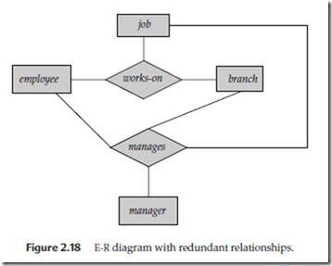
Limitation of E-R Model
Cannot represent relationship among relationships.
Some employee, branch, job combination may not have a manager.
Since every employee, branch, job combination in manages is also in works_on, there is redundant information.

Slide 55
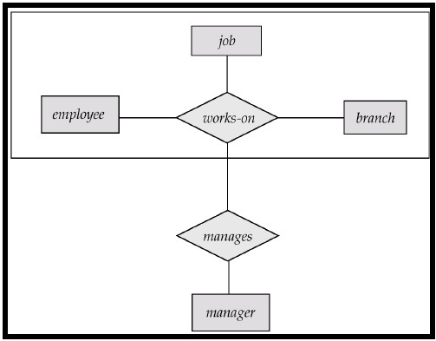
Aggregation
Treats relationships as higher level entities.

Slide 56
More E-R Diagram Examples

Slide 57
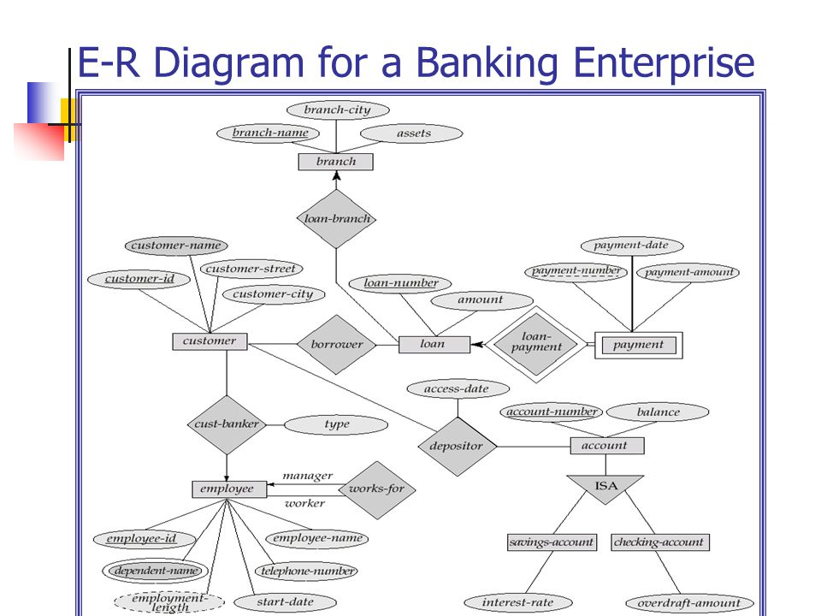

Slide 58
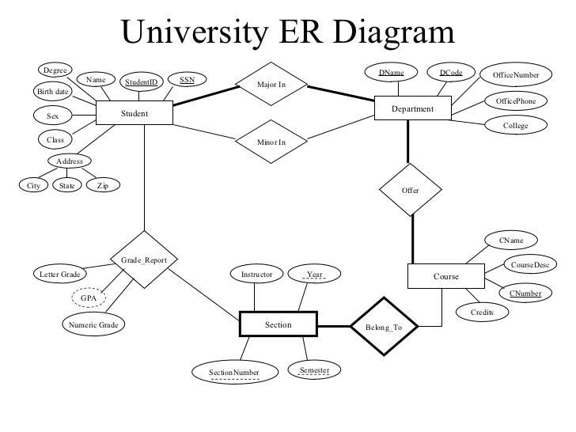

Slide 59
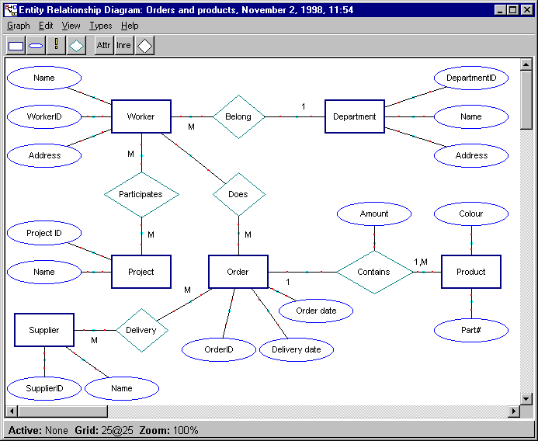

Slide 60
Database Languages

Slide 61
Database Languages
Procedural | Non-procedural
Determines WHAT & HOW a process should be done. e.g. – Relational Algebra | Is concerned with the WHAT not the HOW e.g. – Relational Calculus, SQL

Slide 62
Types of SQL Statements
Data Definition Language (DDL) – specifies the database schema (CREATE, ALTER, DROP)
Data Manipulation Language (DML) – enables the user to access or manipulate data such as insertion, deletion and modification or records (INSERT, DELETE, UPDATE)
Data Query Language (DQL) – enables the user to query* on one or more tables to get the required information they want (SELECT)
Data Control Language (DCL) – using this, the access of users is controlled by the DBA (GRANT, REVOKE)
Transaction Control Language (TCL) – enables the user for transaction processing (COMMIT, ROLLBACK, ROLLBACK TO)
* A query is a statement requesting the retrieval of information (e.g., select * from student where age > =18;)

Slide 63
Appendix

Slide 64
Codd’s 13 Golden Rules
Rule 0: The Foundation rule:
For any system that is advertised as, or claimed to be, a relational data base management system, that system must be able to manage data bases entirely through its relational capabilities.
Rule 1: The information rule:
All information in a relational data base is represented explicitly at the logical level and in exactly one way — by values in tables.
Rule 2: The guaranteed access rule:
Each and every datum (atomic value) in a relational data base is guaranteed to be logically accessible by resorting to a combination of table name, primary key value and column name.
Rule 3: Systematic treatment of null values:
Null values (distinct from the empty character string or a string of blank characters and distinct from zero or any other number) are supported in fully relational DBMS for representing missing information and inapplicable information in a systematic way, independent of data type.
Rule 4: Dynamic online catalog based on the relational model:
The data base description is represented at the logical level in the same way as ordinary data, so that authorized users can apply the same relational language to its interrogation as they apply to the regular data.

Slide 65
Codd’s 13 Golden Rules (Contd..)
Rule 5: The comprehensive data sublanguage rule:
A relational system may support several languages and various modes of terminal use (for example, the fill-in-the-blanks mode). However, there must be at least one language whose statements are expressible, per some well-defined syntax, as character strings and that is comprehensive in supporting all of the following items: Data definition.
View definition.
Data manipulation (interactive and by program).
Integrity constraints.
Authorization.
Transaction boundaries (begin, commit and rollback).
Rule 6: The view updating rule:
All views that are theoretically updatable are also updatable by the system.
Rule 7: High-level insert, update, and delete:
The capability of handling a base relation or a derived relation as a single operand applies not only to the retrieval of data but also to the insertion, update and deletion of data.
Rule 8: Physical data independence:
Application programs and terminal activities remain logically unimpaired whenever any changes are made in either storage representations or access methods.

Slide 66
Codd’s 13 Golden Rules (Contd..)
Rule 9: Logical data independence:
Application programs and terminal activities remain logically unimpaired when information-preserving changes of any kind that theoretically permit unimpairment are made to the base tables.
Rule 10: Integrity independence:
Integrity constraints specific to a particular relational data base must be definable in the relational data sublanguage and storable in the catalog, not in the application programs.
Rule 11: Distribution independence:
A relational DBMS has distribution independence.
Rule 12: The nonsubversion rule:
If a relational system has a low-level (single-record-at-a-time) language, that low level cannot be used to subvert or bypass the integrity rules and constraints expressed in the higher level relational language (multiple-records-at-a-time).
<< Back

Slide 67
......The End.....

