Slide 1
Drugmonizome-ML
Notes:
https://academic.oup.com/database/article/doi/10.1093/database/baab017/6206636
https://currentprotocols.onlinelibrary.wiley.com/doi/full/10.1002/cpz1.355

Slide 2
Drugmonizome
Processed data extracted from drug & small molecule databases available from a variety of online repositories and data portals
Enables users to submit lists of drugs & small molecules as the input query
Compared against various drug set libraries that contain known associations between drugs and their attributes, for e.g. side effects, indications, targets, pathways, induced gene expression signatures, and other attributes
Provides options for querying metadata associated w/ drug sets to find relevant drugs, small molecules and drug sets for a given free-text query

Slide 3
Drugmonizome-ML
Flexible options for creating customized ML models to predict novel attributes for small molecules and drugs, for e.g., side effects or indications, that are poorly annotated
Make predictions for indications and other attributes such as drug targets or side effects for poorly annotated pre-clinical bioactive small molecules

Slide 4
Parameters
Input
Phenotypic: LINCS gene exp, GO transformed sign, MLPCN Cell morph
Structural: MACCS Chemical Fingerprint, Morgan Chemical Fingerprint
Attribute: L1000FWD, DrugCentral, DrugBank, Geneshot, PharmGKB, SIDER
Target Label
Positive label for a binary classification problem
Drugmonizome drug set libraries
Upload own list of compounds
ML Pipeline
Input feature space w/ UMAP
ROC and PRC across cross-validation splits after hyperparameter optimization
Notes:
https://github.com/MaayanLab/Drugmonizome/blob/master/drugsetlibraries/README.md

Slide 5
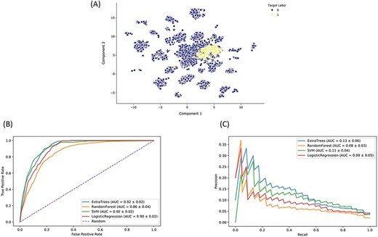
Output
Top drugs predicted by the model that are known to be associated w/ target labels
Top drugs predicted by the model that are unknown to be associated w/ target labels

Slide 6
More Parameters
If applicable, ‘Dimensionality Reduction Algo’
Feature-selection
Algos: GradientBoosting, RF, AdaBoost, ExtraTrees, DecisionTree, KNeighbors, RadiusNeighbors, MLP, SVC
Calibrate algo predictions: calibrate the predictions output by the chosen model, eliminating model-imparted bias
Cross-validation: recommend Repeated Stratified Group K-fold because this method will maintain class ratios across train & validation splits
# cross-validated folds
# cross-validated repetitions
Primary evaluation metric
Additional evaluation metric

Slide 7
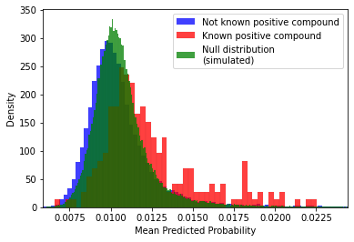
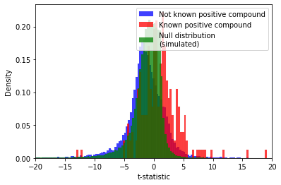
More outputs
Examine predictions
Compare distributions of predictions for +ve & -ve labels
Distribution of t-statistics
Notes:
By examining the validation-set predictions, we can rank the +ve compounds and identify additional compounds that were not known to be in the +ve class, but nevertheless had high predictions. These may share similar properties w/ the known compounds

Slide 8
UMAP dimensionality reduction of the input feature space overlaid w/ predictions
Top-predicted compounds
Feature importance tables
Notes:
The relative contribution of each input feature to the final model predictions can be estimated for recursive feature selection and for a variety of tree-based models.

