Slide 1
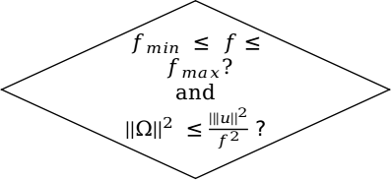
Point from the ensemble
Generate T based on desired speed
Generate Trajectory
T = T - ∂T
T = T + ∂T
set Bool limits_crossed to True
No
$f_{min} ≤ f≤ f_{max}$?
and
${||Ω||}^{2} ≤\frac{|{||u||}^{2}}{f^{2}}$ ?
limits_crossed = True?
Yes
No
Yes
Got Final Trajectory
End

Slide 2
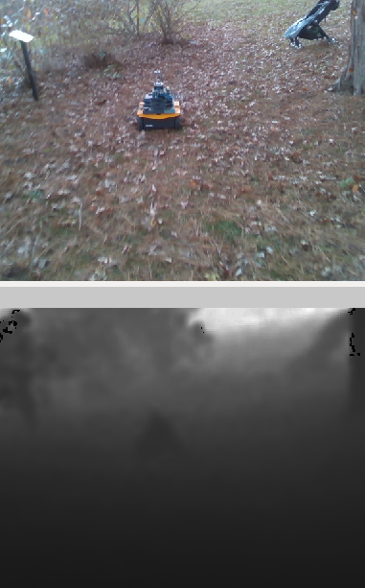
FLANN based Feature Matching RANSAC and Outlier Rejection
Detection Box
SSD MobileNet V2
Image
Inliers
Disparity
3D Relative Position of the Box
Position Measurements
Kalman Filter
Final Relative Positions to the Trajectory Planner

Slide 3
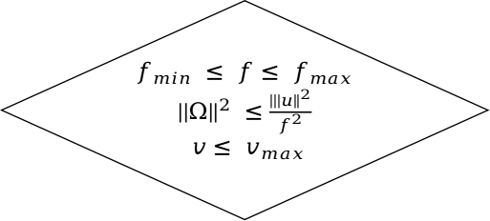
Point from the ensemble
Select k based on max speed
Generate the desired trajectory
End
T = T + ∂T
Final Trajectory
$f_{min} ≤ f≤ f_{max}$
${||Ω||}^{2} ≤\frac{|{||u||}^{2}}{f^{2}}$
$$v≤ v_{max}$$
No
Yes

