Slide 1


K.RAMAKRISHNAN COLLEGE OF TECHNOLOGY
(AUTONOMOUS), TRICHY
A Novel Adaptive Ensemble Machine Learning Approach for Personalized Cardiovascular Risk Prediction Using SHAP and LIME
BATCH N0 - 9
PRESENTED BY GUIDED BY
HEMNATH A -2403811724321033 Mr.A.JOSHUA ISSAC.M.E.,(PhD).,
HINDUJA P -2403811724322034 AP/AIDS
INDUMATHI R -2403811724322035
JANANI M - 2403811724322036

Slide 2
PRESENTATION OVERVIEW
Abstract
Objective
Architecture diagram
Existing system
Proposed system
Conclusion
Future enhancement

Slide 3
ABSTRACT
Predict cardiovascular disease risk using ML.
Use ensemble models for better prediction.
Use adaptive oversampling to handle imbalanced data.
Use SHAP/LIME to explain predictions.
Provide personalized risk results.

Slide 4
OBJECTIVE
Improve cardiovascular risk prediction.
Handle imbalanced data.
Explain model predictions using SHAP/LIME.
Provide personalized risk prediction.
Improve early risk detection.

Slide 5
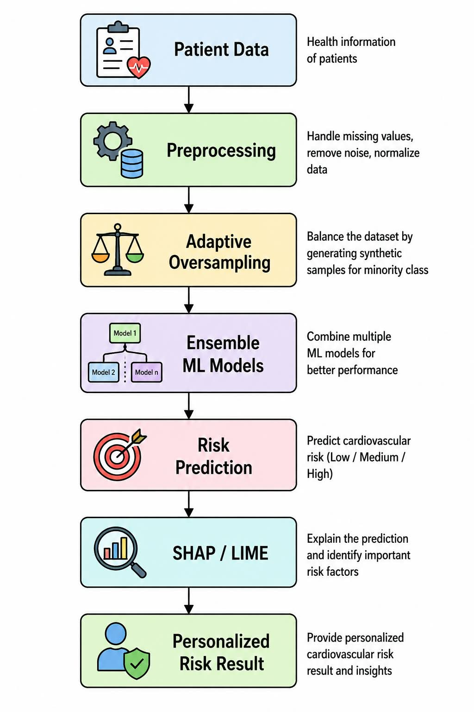
ARCHITECTURE DIAGRAM

Slide 6
Literature survey
https://docs.google.com/spreadsheets/d/1sscuP_CIYtd65b0EnD2QQV7Qjy5QIMhJ/edit?usp=drivesdk&ouid=102035905087210704808&rtpof=true&sd=true

Slide 7
Modules
1. Adaptive Oversampling
Use the ADASYN technique to handle imbalanced risk classes.
Generate additional synthetic samples for minority classes.
Balance the training dataset.
Prepare the balanced data for machine learning model training.
2.Ensemble Machine Learning Modules
Train two machine learning algorithms: Random Forest and Gradient Boosting.
Obtain prediction probabilities from both models.
Combine the probabilities by averaging them.
Predict one of four risk levels: Low Risk, Moderate Risk, High Risk, or Very High Risk.
3.Explainable AI Using SHAP and LIME
Use SHAP to identify important features affecting the predicted cardiovascular risk.
Use LIME to explain the individual prediction.
Display the top four influencing features in the application.

Slide 8
4.Personalized Result
Develop a graphical user interface using Python Tkinter.
Accept patient details through input fields and dropdown menus.
Display the predicted cardiovascular risk.
Show SHAP and LIME explanations.
5.Risk Prediction
Collect patient health details.
Apply Random Forest and Gradient Boosting.
Predict four cardiovascular risk levels.
Explain risk factors using SHAP and LIME.

Slide 9
EXISTING SYSTEM
Uses ML and ensemble methods.
Oversampling handles data imbalance.
Good prediction performance.
Limitation: Less focus on explanation and personalization.

Slide 10
PROPOSED SYSTEM
Ensemble ML for prediction.
Adaptive oversampling for imbalance.
SHAP/LIME for explanation.
Personalized cardiovascular risk prediction.

Slide 11
CONCLUSION
The proposed system combines ensemble ML, adaptive oversampling, and Explainable AI for cardiovascular risk prediction. It improves prediction by handling imbalanced data. SHAP/LIME helps explain the reasons behind each prediction. The system identifies important cardiovascular risk factors. It provides personalized risk results for patients. It can help in early risk detection. Overall, the system supports better preventive healthcare.
Notes:
11

Slide 12
FUTURE ENHANCEMENT
Use more diverse patient data.
Improve SHAP/LIME explanations.
Test with real clinical data.
Develop real-time prediction.
Improve personalized prevention.

Slide 13
THANK YOU

