Slide 1

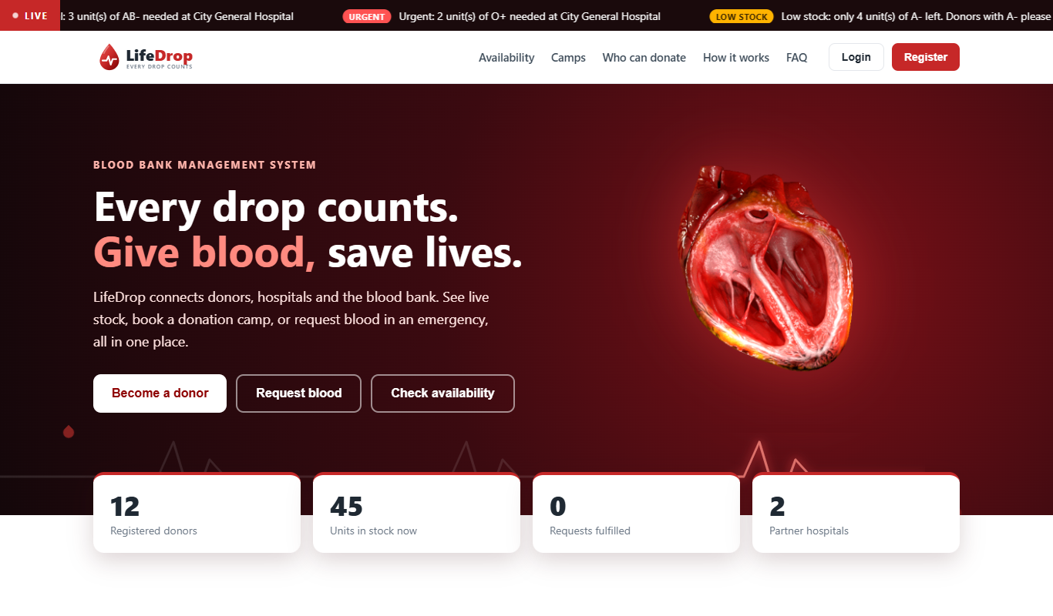
COLLEGE PROJECT
Blood Bank
Management System
Live stock, donors, hospital requests and donation camps in one web application
Public home page: live ticker, availability and counters
HTML | CSS | JavaScript | Python FastAPI | SQLite
Team of 5 | Guide: ____________ | College: ____________
Notes:
Member 1: Introduce the team and the project. One sentence: LifeDrop connects donors, hospitals and the blood bank so blood is found quickly and not wasted.

Slide 2
THE PROBLEM
Paper records make blood hard to find and easy to waste
1
2
3
4
Stock is invisible
Blood expires unnoticed
Donors are unmanaged
Requests are slow
Hospitals phone several blood banks to learn whether a group is available.
A unit lasts only 42 days. Without tracking, units are thrown away.
Nobody tracks who may donate again, so donors are called too early or forgotten.
Emergencies run on phone calls and paper forms, with no priority and no record.
Our answer: one web system that keeps live stock, manages donors and camps, and lets hospitals request blood online.
LifeDrop | Blood Bank Management System
2
Notes:
Member 1: Explain the four problems in your own words. Finish with the problem statement in the red line at the bottom.

Slide 3
USERS AND OBJECTIVES
Three roles share one system, each with its own screens
Admin
Donor
Hospital
Blood bank staff
Public volunteers
Hospital blood desk
Dashboard with charts and alerts
Manage blood stock and expiry
Approve or reject requests
Create camps, record donations
Registers and sees eligibility
Books donation camps
Tracks donation history
Finds the next donation date
Sees live blood availability
Raises requests with urgency
Tracks or cancels requests
Searches donors by group and city
LifeDrop | Blood Bank Management System
3
Notes:
Member 1: Each role logs in with the same login page but sees a different menu. The server also checks the role on every request, so a donor cannot open admin pages.

Slide 4
EXISTING SYSTEMS
We studied national and hospital portals and kept their best ideas
Feature | eRaktKosh (national portal) | Max Healthcare pages | LifeDrop
Availability without login | Yes, search by state, district, group | Information pages only | Yes, live tiles on home page
Donation camps | Yes, camp schedule | Donation guidance | Yes, list and online booking
Donor registration | Yes | Not found | Yes, with eligibility check
Eligibility guidance | About blood donation page | Age, Hb 12.5, 3 / 4 month gap | Applied automatically
Hospital requests | Thalassemia request and services | Not applicable | Yes, urgency and approval
Based on the public pages and search results we reviewed. The real systems offer more than we list; this shows which ideas we adopted.
LifeDrop | Blood Bank Management System
4
Notes:
Member 1: We read about eRaktKosh and Max Healthcare. The biggest idea we took is that useful information, such as blood availability and camps, should be visible before login. We also adopted Max's donor criteria, including the haemoglobin rule and the different gap for men and women.

Slide 5
FUNCTIONALITIES
Twenty functions cover the full blood bank cycle
Eligibility check
Live stock and alerts
Blood requests
Oldest first issue
Age, weight, haemoglobin and months since last donation
Unit level records, 42 day expiry, low stock warnings
Normal, urgent or critical, tracked end to end
FIFO, plus optional compatible groups when stock is short
Donation camps
Public home page
Rolling live ticker
Demo mode
Online booking, capacity limit, stock rises on donation
Live availability, camps and counters without login
Urgent requests, low stock and camps from the database
Step guide, one click role switch, reset sample data
Plus compatibility checker, donor search by group and city, profile and history, admin unit management and dashboard charts.
LifeDrop | Blood Bank Management System
5
Notes:
Member 2 or 3: Do not read the cards. Pick three that matter most: eligibility, FIFO issue and the public home page, and say why each one helps.

Slide 6
SCREENS | HOME PAGE
The public home page helps people before they log in
Rolling ticker: urgent requests, low stock and camps, read live from the database
Live availability: 8 blood group tiles refresh every 30 seconds
Camps and rules: who can donate, FAQ and a compatibility checker
Privacy: patient names are never shown
LifeDrop | Blood Bank Management System
6
Notes:
Member 3 or 5: Inspired by eRaktKosh, where blood availability is visible without login. Our ticker and tiles update from the database.

Slide 7
TECHNOLOGY STACK
A simple stack that runs on any laptop with no setup headaches
Frontend
HTML + CSS + JavaScript
No framework or build step. Every line can be explained. Charts are drawn on canvas, so no internet is needed.
Backend
Python + FastAPI
Short readable code, automatic input validation, and API documentation generated at /docs.
Database
SQLite
Single file, real SQL with foreign keys and constraints. Can move to MySQL or PostgreSQL later.
Why FastAPI over Flask or Django? Automatic validation and documentation, high speed, and a clean fit for a JavaScript frontend that calls a REST API.
LifeDrop | Blood Bank Management System
7
Notes:
Member 1: If asked why not Django: Django is excellent for large full stack apps, but we wanted a clean REST API with a separate frontend, and FastAPI gives validation and documentation for free. If asked why SQLite: no installation, one file, same SQL as MySQL.

Slide 8
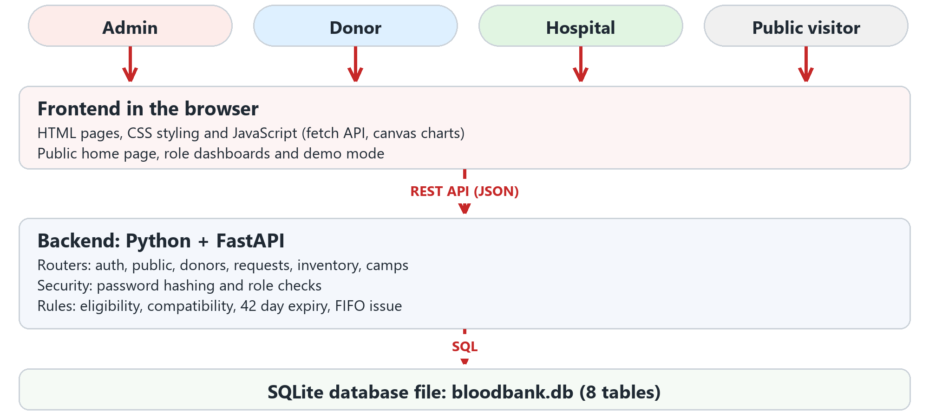
ARCHITECTURE
The browser talks only to the API, never to the database
LifeDrop | Blood Bank Management System
8
Notes:
Member 1: Walk top to bottom. Four kinds of visitors use the browser. JavaScript calls the REST API with JSON. FastAPI applies the rules and talks to SQLite. Mention that passwords are hashed and every endpoint checks the role.

Slide 9
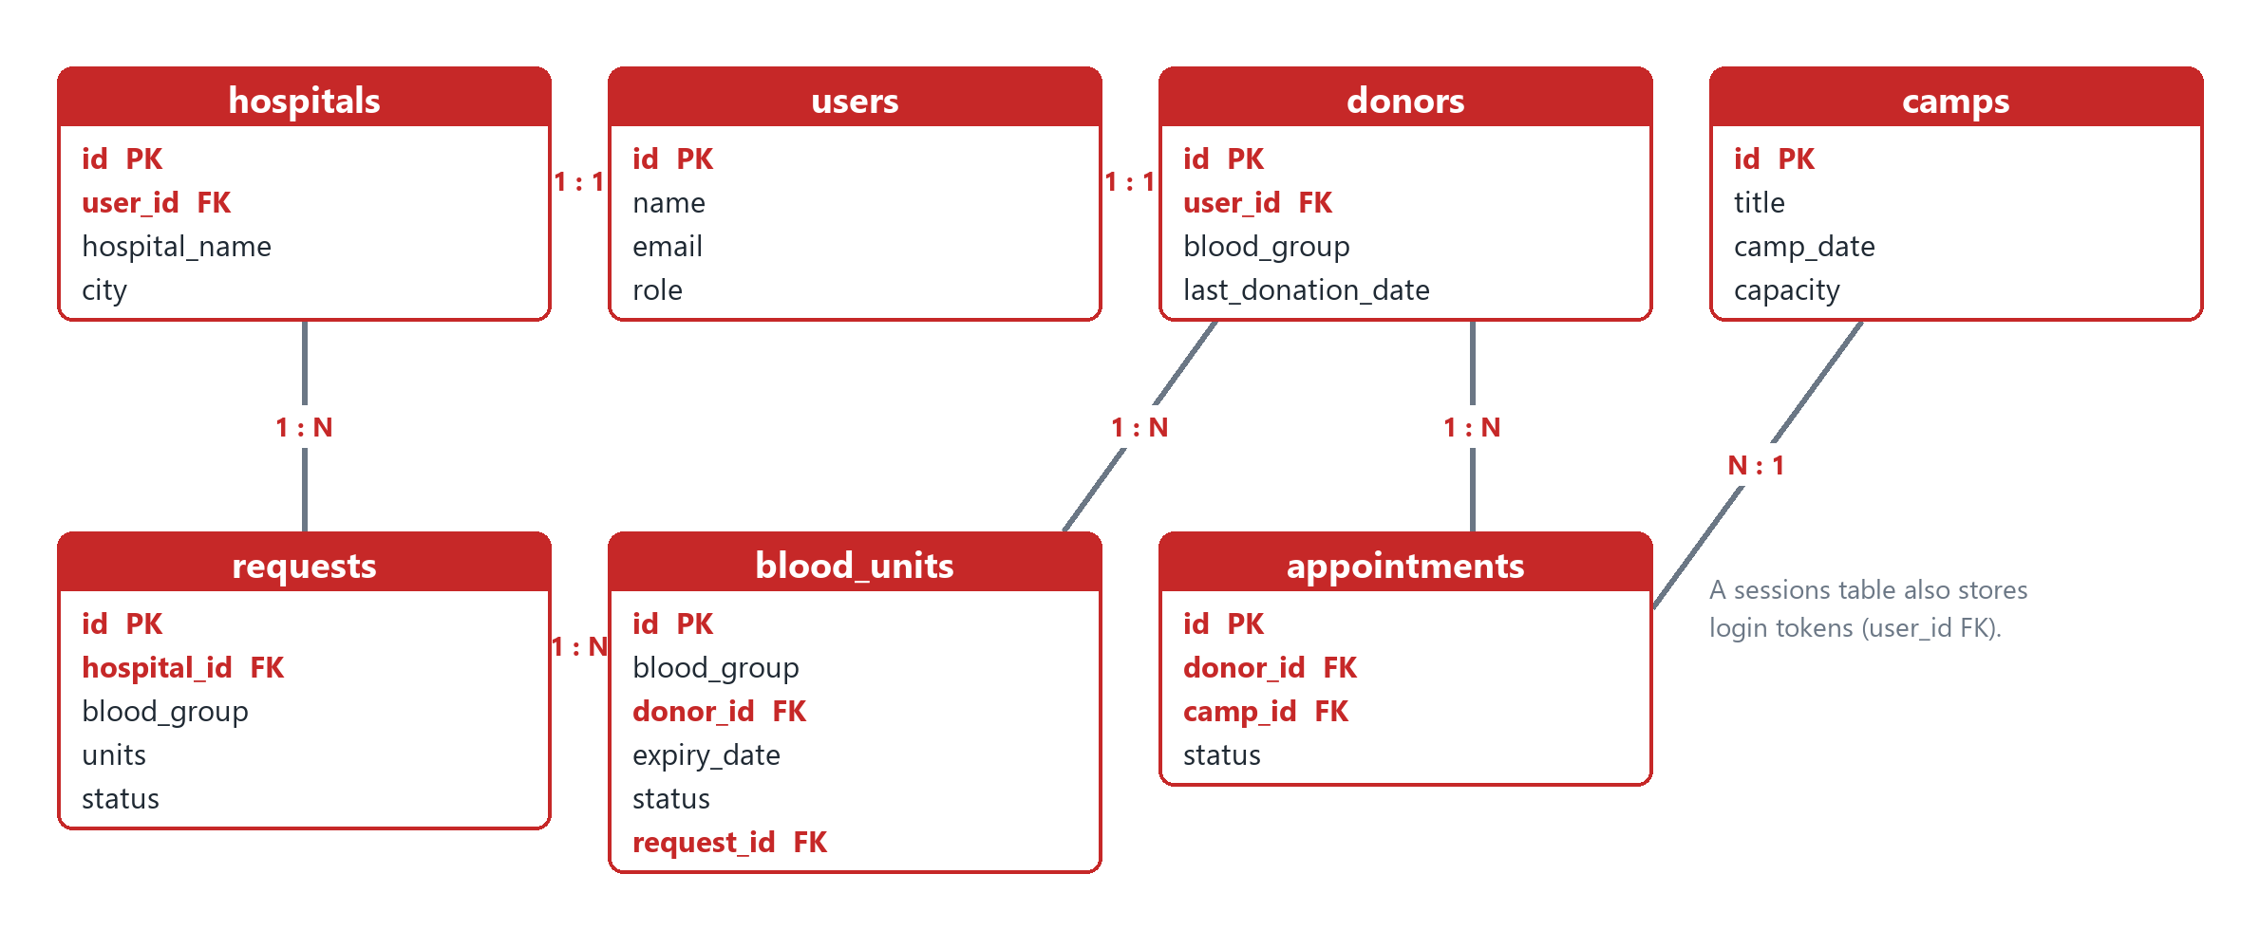
DATABASE DESIGN
Eight related tables keep donors, stock and requests consistent
blood_units is the most important table: one row per bag with collection date, expiry date and status. Foreign keys and CHECK rules stop invalid data.
LifeDrop | Blood Bank Management System
9
Notes:
Member 5: Start from users, which links one to one with donors and hospitals. Then explain blood_units as the most important table. Mention foreign keys are enabled and CHECK constraints restrict status values. The full diagram with all columns is in the project document.

Slide 10
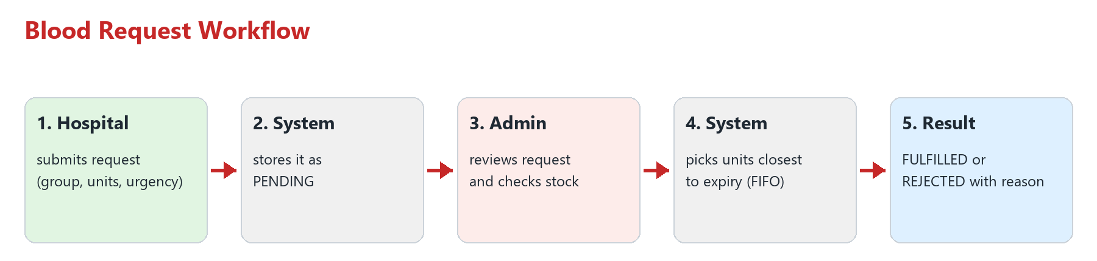
CORE WORKFLOW
A blood request moves from hospital to issued units in five steps
Priority: critical and urgent requests appear first for the admin
Fairness: the oldest units are issued first, so fewer units expire
Safety net: if exact stock is short, the admin may allow compatible groups
LifeDrop | Blood Bank Management System
10
Notes:
Member 4: This is the heart of the project. Say the three bullets, then promise the live demo of this exact flow.

Slide 11
BUSINESS RULES
Medical rules are enforced by the server, not left to the user
18 - 65
50 kg
12.5 g/dL
3 / 4 mo
42 days
years: donor age
minimum donor weight
minimum haemoglobin
gap for men / women
shelf life of a unit
Rules live in one file (rules.py), so they are easy to change and to explain
Booking a camp is blocked for an ineligible donor, and the next possible date is shown
Expired units are marked automatically; fewer than 5 units of a group raises a low stock alert
LifeDrop | Blood Bank Management System
11
Notes:
Member 2: These criteria match the donor guidance published by Max Healthcare and common national guidelines. Explain that the check happens on the server so it cannot be bypassed from the browser.

Slide 12
BACKEND CODE | RULES.PY
Code sample 1: donor eligibility is one small, testable function
def check_eligibility(age, weight, last_donation_date,
gender=None, haemoglobin=None):
reasons = []
if age < MIN_AGE or age > MAX_AGE:
reasons.append("Age must be between 18 and 65")
if weight < MIN_WEIGHT:
reasons.append("Weight must be at least 50 kg")
if haemoglobin is not None and haemoglobin < 12.5:
reasons.append("Haemoglobin must be at least 12.5")
if last_donation_date:
next_date = date.fromisoformat(last_donation_date) \
+ timedelta(days=gap_days(gender))
if next_date > date.today():
reasons.append(f"Next possible date is {next_date}")
return {"eligible": not reasons, "reasons": reasons}
Returns a clear yes or no, plus the reasons
Used for the donor dashboard, camp booking and donor search
gap_days() gives 90 days for men and 120 days for women
LifeDrop | Blood Bank Management System
12
Notes:
Member 2: Read the function top to bottom: four checks, one result. The same function is reused in three places, which is why we kept it separate.

Slide 13
BACKEND CODE | ROUTERS/REQUESTS.PY
Code sample 2: issuing blood picks the oldest units first
for group in groups: # exact group first
need = req["units"] - len(picked)
if need <= 0:
break
rows = db.execute(
"SELECT id FROM blood_units "
"WHERE blood_group = ? AND status = 'available' "
"AND expiry_date >= ? "
"ORDER BY expiry_date LIMIT ?", # oldest first
(group, today, need)).fetchall()
picked += [r["id"] for r in rows]
if len(picked) < req["units"]:
raise HTTPException(400, "Not enough suitable units")
ORDER BY expiry_date gives FIFO
Values go in as ? parameters, which prevents SQL injection
The request is only fulfilled if all needed units are found
LifeDrop | Blood Bank Management System
13
Notes:
Member 4: Point to ORDER BY expiry_date and explain FIFO. Then point to the question marks and explain parameterised queries protect against SQL injection.

Slide 14
SECURITY AND FRONTEND | SECURITY.PY AND API.JS
Code sample 3: the server checks the role, the browser only asks
Backend: protect an endpoint
Frontend: one place for every call
def require_role(*roles):
def checker(user=Depends(current_user)):
if user["role"] not in roles:
raise HTTPException(403, "Not allowed")
return user
return checker
@router.get("/stats")
def stats(user=Depends(require_role("admin"))):
...
async call(method, url, body) {
const opts = { method, headers: {
"Content-Type": "application/json" } };
if (API.token())
opts.headers.Authorization =
"Bearer " + API.token();
if (body !== undefined)
opts.body = JSON.stringify(body);
const res = await fetch("/api" + url, opts);
...
}
Passwords are stored with PBKDF2 (SHA-256, 100,000 rounds, random salt per user). A hidden menu is not security, so every endpoint verifies the role.
LifeDrop | Blood Bank Management System
14
Notes:
Member 1: Left side is how a route is locked to a role. Right side is how the browser sends the login token with each request. Mention hashing and that wrong role returns 403.

Slide 15
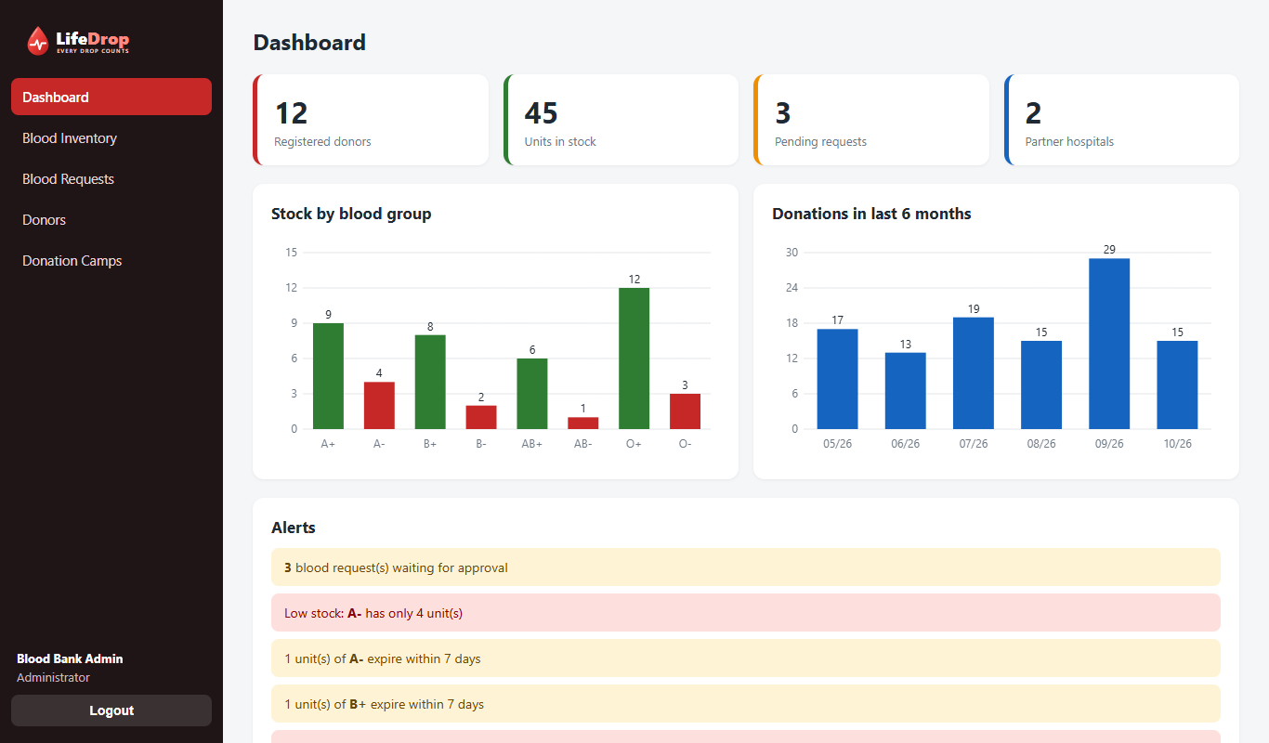
SCREENS | ADMIN
The admin sees stock, trends and alerts on a single screen
Red bars mark groups below 5 units
Alerts list pending requests, low stock and units expiring within 7 days
Charts are drawn on canvas, so they work offline
LifeDrop | Blood Bank Management System
15
Notes:
Member 3: Show this live if possible. Point at the red bars and the alerts list.

Slide 16
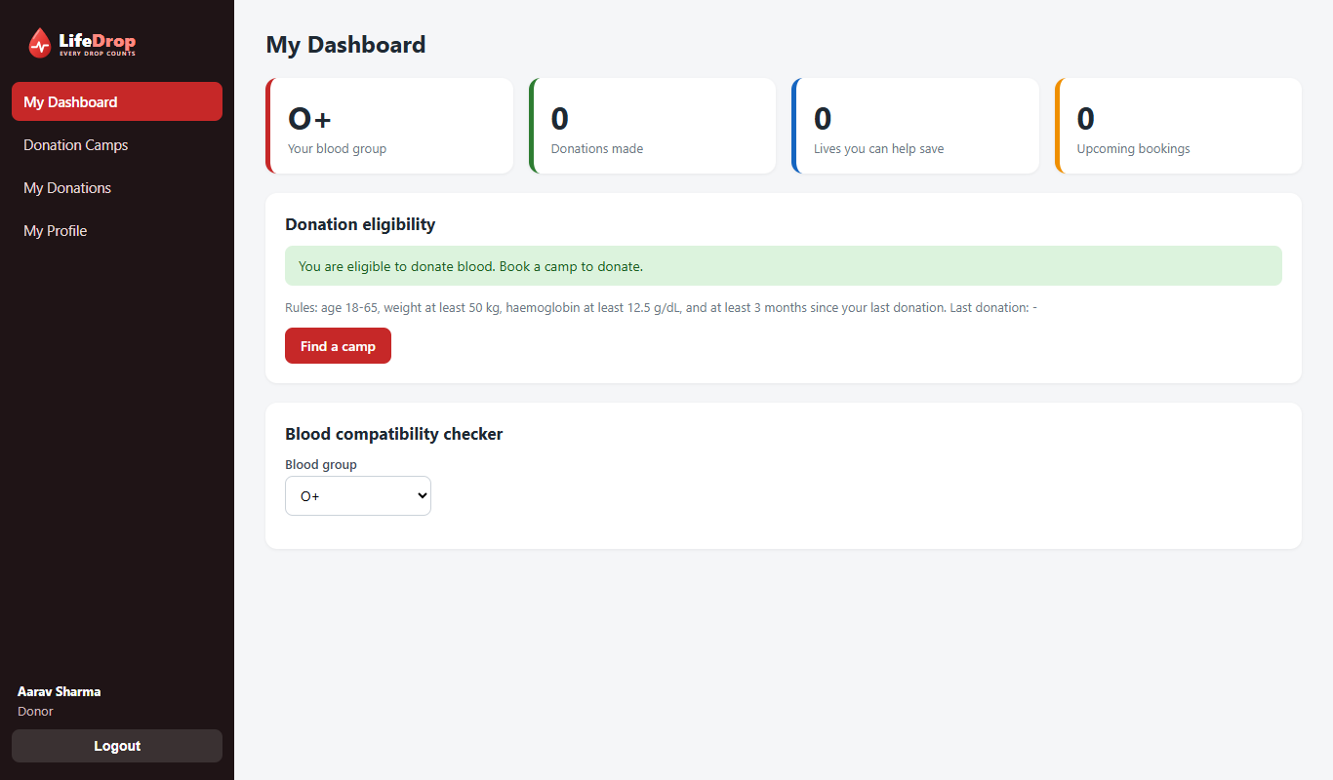
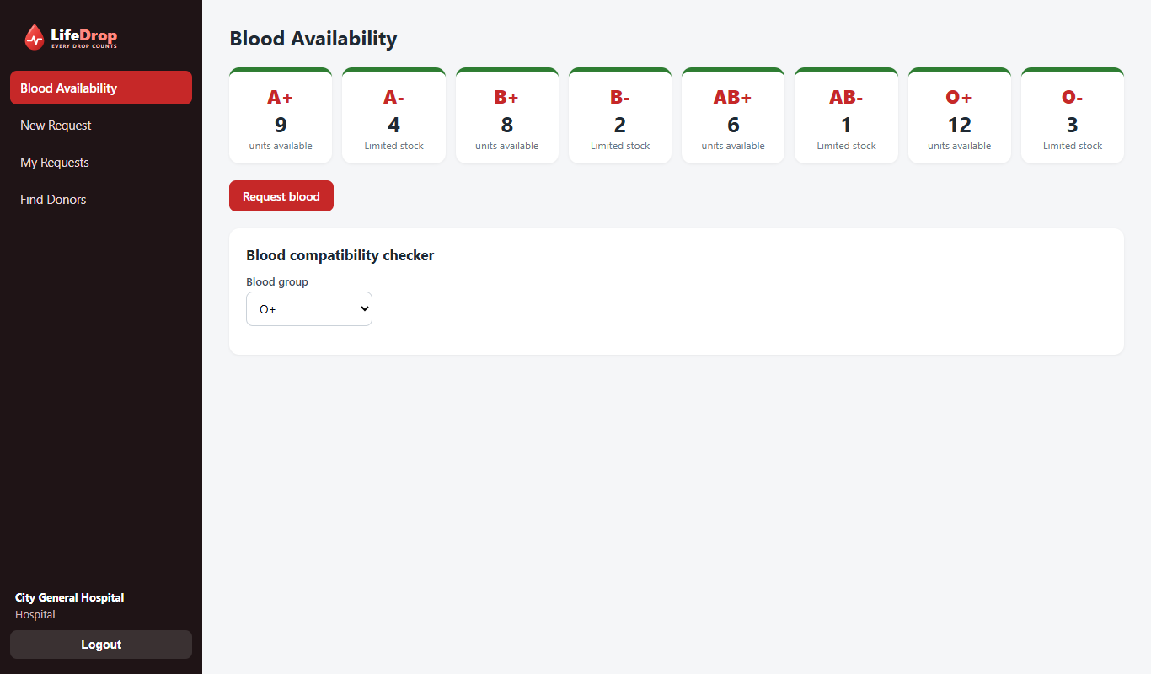
SCREENS | DONOR AND HOSPITAL
Donors see eligibility, hospitals see stock instantly
Donor dashboard: eligibility result, next possible date, compatibility checker
Hospital dashboard: units per group, limited stock warning, one click to request blood
LifeDrop | Blood Bank Management System
16
Notes:
Member 2 and Member 4: Donor side first, then hospital side.

Slide 17
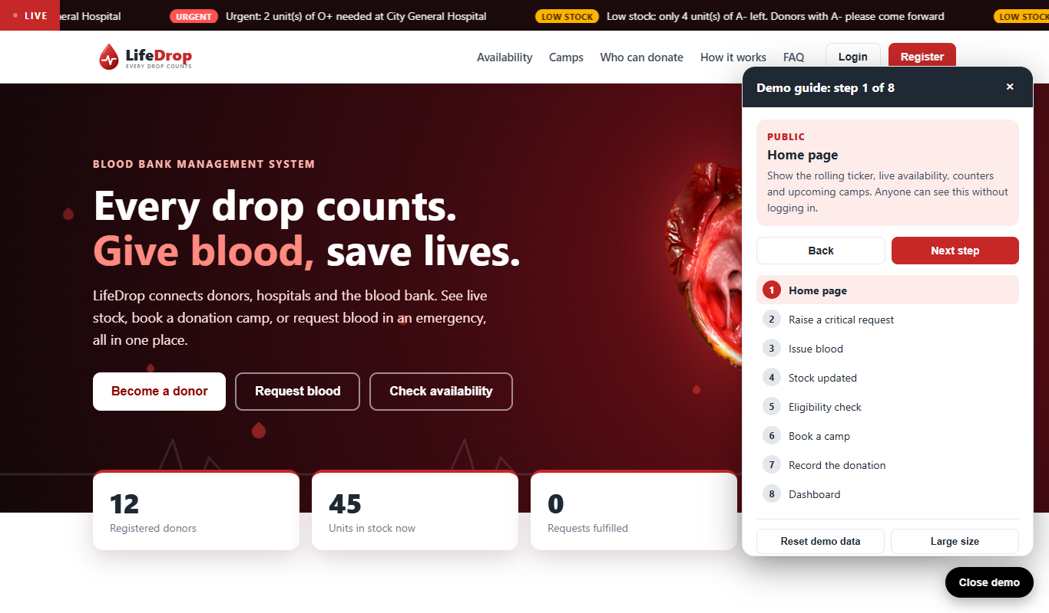
PRESENTATION TOOL
Demo mode keeps the live presentation on track
Eight guided steps from home page to dashboard
One click login as Admin, Donor or Hospital
Reset demo data between rehearsals
Large size mode for the back row; arrow keys move between steps
LifeDrop | Blood Bank Management System
17
Notes:
Member 5: Click Demo mode at the bottom right. Use Next step or the arrow keys. It logs in for you, so nobody types passwords on stage.

Slide 18
DEMO
Live demo: one blood request from start to finish
1
Hospital
Raises a critical request for 3 units of AB-
2
Admin
Sees it first in the list and tries to issue blood: stock is short
3
Admin
Allows compatible groups and issues the units
4
Inventory
Stock for the used groups drops, request shows Fulfilled
5
New donor
Registers, books a camp, admin marks donation: stock rises, donor must now wait
LifeDrop | Blood Bank Management System
18
Notes:
All members: Follow the demo script in the project document, section 15.3, or use the Demo mode guide. Backup: the screenshots in the docs folder.

Slide 19
TESTING
All eighteen test cases passed, rules and security included
Security: wrong password, missing token and wrong role are all rejected
Validation: invalid blood group, bad haemoglobin value and bad input return clear errors
Stock logic: short stock fails, compatible issue works, double issue is blocked
Camps and rules: double booking blocked; donation adds a unit; low haemoglobin is not eligible
18 / 18
test cases passed
plus the home page, all 13 role
screens and the 8 demo steps
opened without errors
LifeDrop | Blood Bank Management System
19
Notes:
Member 5: The full list of test cases is in section 13 of the project document. Mention that tests were run against the API and in the browser.

Slide 20
TEAM WORK
Each member owns one module from database to screen
Member | Module | What they present
Member 1 | Authentication, security, home page design | Login, register, hashing, roles, look and feel
Member 2 | Donor module | Eligibility rules, profile, donor search
Member 3 | Inventory and dashboard | Stock, expiry, alerts, charts
Member 4 | Hospital and requests | Request workflow, FIFO issue, compatibility
Member 5 | Camps, database, public API, demo mode, testing | ER design, camps, home page data, demo mode, test cases
LifeDrop | Blood Bank Management System
20
Notes:
Replace Member 1 to 5 with real names. Each person says one sentence about what they built.

Slide 21
FUTURE SCOPE
Next steps: alerts, maps and stronger security
SMS and email alerts
Map of blood banks
Reports and certificates
Notify matching donors when a critical request arrives
Nearby banks and camps on an OpenStreetMap view
PDF and Excel export, donor certificate after donation
Stronger security
Multiple branches
Demand forecasting
Token expiry, HTTPS, login attempt limits, audit log
Stock transfer between blood banks
Predict requests from history with machine learning
LifeDrop | Blood Bank Management System
21
Notes:
Member 5: Mention that we kept the built version simple on purpose so everything shown works reliably.

Slide 22
Thank you
Fewer wasted units, faster requests, and donors who are managed and valued.
Questions?
Code, database and documentation: BloodBankMS folder
Notes:
Keep the app running in the background in case examiners ask to see a screen.

