Slide 1
Linear Discriminant Analysis
Indukala (15CO230), Aparna(15CO236)

Slide 2
What is LDA?
Generalization of Fisher's linear discriminant, a method used in statistics, pattern recognition and machine learning to find a linear combination of features that characterizes or separates two or more classes of objects.
Commonly used as a dimensionality reduction technique in the pre-processing step for pattern-classification and machine learning applications.
Projects dataset onto lower-dimensional space with good class separability
in order avoid overfitting and also reduce computational costs.

Slide 3
PCA vs LDA
Both are linear transformation techniques that are commonly used for dimensionality reduction.
PCA is “unsupervised” algorithm, since it “ignores” class labels and its goal is to find the directions (the principal components) that maximize the variance in a dataset.
LDA is “supervised” and computes the directions (“linear discriminants”) that will represent the axes that that maximize the separation between multiple classes.

Slide 4
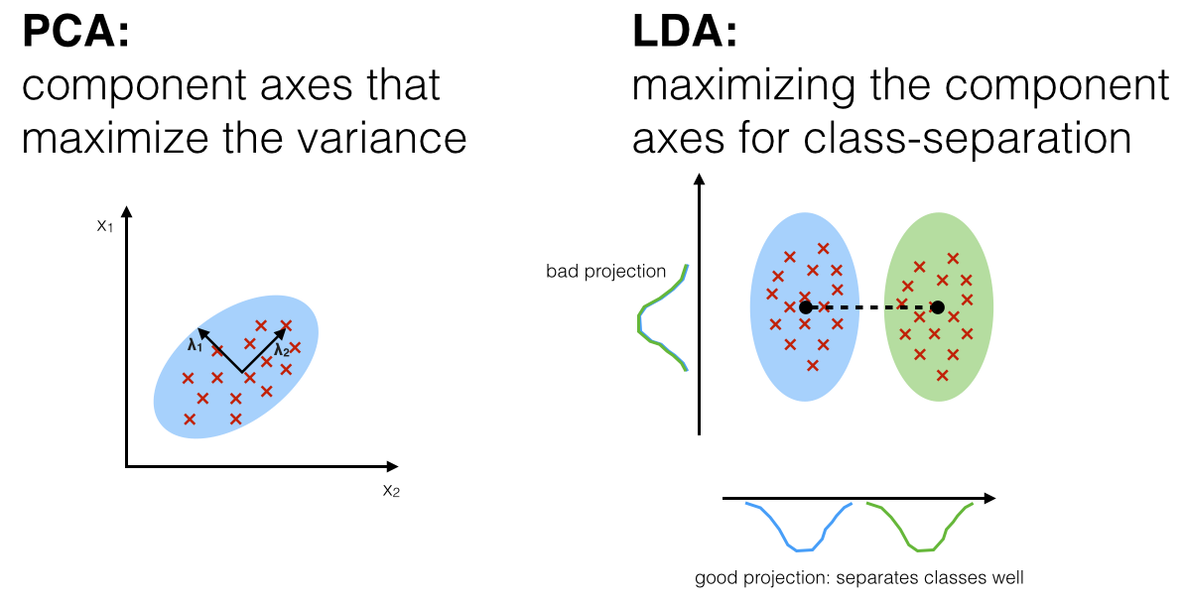
PCA tends to outperform LDA if the number of samples per class is relatively small

Slide 5
Algorithm
Compute the d-dimensional mean vectors for the different classes from the dataset.
Compute the scatter matrices (in-between-class and within-class scatter matrix).
Compute the eigenvectors (e₁,e₂,...e_{d}) and corresponding eigenvalues (λ₁,λ₂,...λ_{d}) for the scatter matrices.
Sort the eigenvectors by decreasing eigenvalues and choose k eigenvectors with the largest eigenvalues to form a d × k dimensional matrix W (where every column represents an eigenvector).

Slide 6
Use this d × k eigenvector matrix to transform the samples onto the new subspace. This can be summarized by the matrix multiplication: Y = X × W (where X is a n × d-dimensional matrix representing the n samples, and Y are the transformed n × k-dimensional samples in the new subspace).

Slide 7
Algorithm Explanation
Goal : Reduce the dimensions of a d-dimensional dataset by projecting it onto a k-dimensional subspace (where k<d)
Compute eigenvectors from data set and collect them in a scatter-matrices.
Each eigenvector is associated with an eigenvalue, which indicates the “magnitude” of the eigenvectors.
If all eigenvalues have a similar magnitude, then our data is already projected on a “good” feature space.
If some eigenvalues are much larger than others, keep only the eigenvectors with the highest eigenvalues, as they contain more info about data distribution

Slide 8
Example of LDA : Iris Dataset
The three classes in the Iris dataset: Iris-setosa (n=50), Iris-versicolor (n=50), Iris-virginica (n=50)
The four features of the Iris dataset: sepal length in cm, sepal width in cm, petal length in cm, petal width in cm
Compute d-dimensional mean vector of the three different flower classes. Here, d=4.
Mean Vector class 1: [ 5.006 3.418 1.464 0.244]
Mean Vector class 2: [ 5.936 2.77 4.26 1.326]
Mean Vector class 3: [ 6.588 2.974 5.552 2.026]

Slide 9
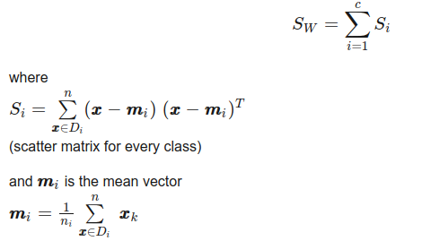

Slide 10
Within Class Matrix:
38.9562 | 13.683 | 24.614 | 5.6556
13.683 | 17.035 | 8.12 | 4.9132
24.614 | 8.12 | 27.22 | 6.2536
5.6556 | 4.9132 | 6.2536 | 6.1756

Slide 11
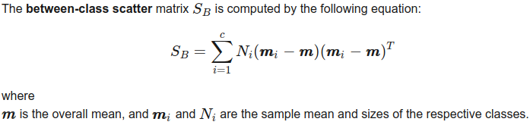
63.2121 | -19.534 | 165.1647 | 71.363
-19.534 | 10.9776 | -56.0552 | -22.4924
165.1647 | -56.0552 | 436.6437 | 186.9081
71.363 | -22.4924 | 186.9081 | 80.6041

Slide 12
Solving the generalized eigenvalue problem for the matrix S⁻¹_{W}S_{B} to obtain linear discriminants and sorting eigenvectors in decreasing order of eigenvalues.
32.2719577997, 0.27756686384, 5.71450476e-15, 5.71450476e-15
Calculating “explained variance” as percentage: 99.15, 0.85, 0, 0

Slide 13
The first eigenpair is by far the most informative one, and we won’t lose much information if we would form a 1D-feature spaced based on this eigenpair.
Choose 2 most informative eigenpairs to get 2-dimensional feature subspace.
Compute matrix W and use it to transform samples onto new subspace via equation Y = X * W

Slide 14
Matrix W:
-0.2049 | -0.009
-0.3871 | -0.589
0.5465 | 0.2543
0.7138 | -0.767

Slide 15
LDA + SVM vs PCA +SVM
For Face Recognition, feature representation (dimensionality reduction) and classification are the two steps involved.
It is observed that recognition rate of the method LDA+SVM is 93.9% on ATT face database and 70% on IFD face database. It is higher as compared to PCA+SVM for both IFD and ATT databases. (PCA +SVM has accuracy of 90.24 and 66.8 percent for ATT and IFD databases respectively.)
,

Slide 16
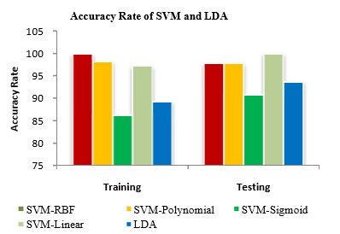
LDA vs SVM
In classifying Indian industries, SVM (other than sigmoid kernel) outperformed LDA.

