Slide 1
IMAGE STEGANOGRAPHY

Slide 2
STUDENT DETAILS :
Name : Indupriya Are
Roll Number : 22X41A0423
E-Mail : indupriya.are@gmail.com
Branch : Ece
College : SRK Institute Of Technology
Internship Domain : Cyber Security with Kali Linux

Slide 3
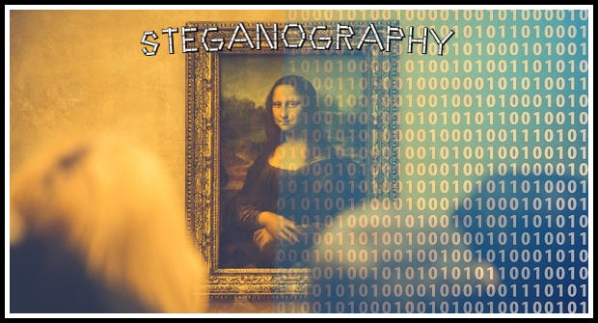
IMAGE STEGANOGRAPHY
Steganography is the practice of concealing information within another message or physical object to avoid detection.
Image steganography is the practice of concealing information within the data of digital images without altering their visual appearance.
The hidden data can include text, images, audio, or any other form of binary information.

Slide 4

AGENDA
Introduction to Image Steganography.
Project Overview.
Who are the end user’s of this project?
Solution and it’s Proposition.
How did you customize the project and make it your own?
Modelling.
Conclusion.
Results.
Link.

Slide 5
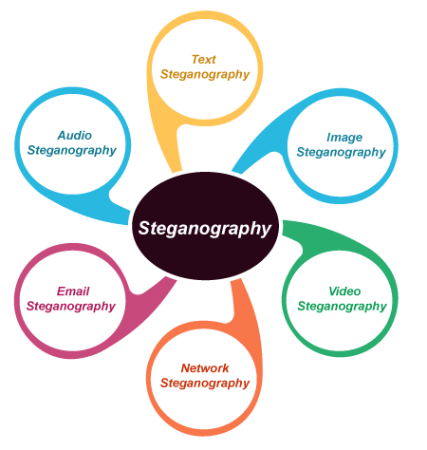
PROJECT OVERVIEW
Steganography can be used to hide virtually any type of digital content,including text,image,video, or audio content.That hidden data is then extracted at its destination.
It has scope in various fields such as :
Secure communication.
Digital forensics.
Privacy and Confidentiality.
Online applications,etc.
The objectives of image steganography are:
1. To hide sensitive information(confidentially) within a digital image.
2. To ensure the hidden information remains robust and resistant to detection(security).

Slide 6
WHO ARE THE END USERS OF THIS PROJECT ?
The end users of image steganography can vary depending on the application and purpose, but some potential end users include :
Military and defense personnel: For secure communication and transmission of classified information.
Government agencies: For secure communication and data transfer.
Law enforcement agencies: For covert surveillance and evidence gathering.
Healthcare professionals: For secure sharing of medical images and patient data.
Researchers and scientists: For secure sharing of research data and results.
Individuals: For privacy and security concerns, such as hiding personal information or sensitive data.

Slide 7
SOLUTION AND ITS PROPOSITION
Embed secret message into digital images using advanced algorithms(LSB substitution, DCT coefficient modification, etc.).
Ensure robustness and security of the hidden message.
Provides a secure and covert communication channel.
Proposition:
Image steganography offers a reliable and secure solution for confidential communication, data protection, and privacy preservation.
For security purpose that is to avoid unauthorized users getting access to the message, a secret key used to hide and unhide the data.
By this project we can hide the data inside an image using secret key.

Slide 8
HOW DID YOU CUSTOMIZE THE PROJECT AND MAKE IT YOUR OWN?
Implementing a user-friendly interface that allows users to easily embed and extract hidden messages, making the tool more accessible and practical for real-world applications.
Developing a steganalysis tool to detect and evaluate the security of the steganographed images.
Developing a novel algorithm that utilizes a combination of LSB substitution and DCT coefficient modification, enhancing the security and capacity of the steganography technique.
Extending the project to support multiple image formats(JPEG, PNG) .

Slide 9
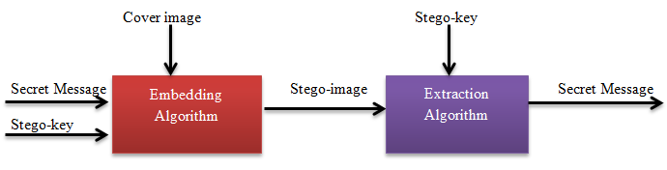
MODELLING
Here’s a simple implementation of image steganography in python using the PIL(Pillow) library for image processing.This code will embed a hidden message within an image by altering the least significant bits of the image’s pixel.

Slide 10
Stego-Key: A secret password or code used to embed and extract hidden messages in image steganography.
Stego-Image: A digital image that contains a hidden message or data, embedded using image steganography techniques, making it difficult to detect the presence of concealed information.
Embedding the Message: The embed message function takes an input image, the message to embed, and the path for the output image. It converts the message to binary.
Extracting the Message: The extract message function reads the image and extracts the least significant bit of each pixel color value to reconstruct the binary message. It converts binary message back to text.

Slide 11
CONCLUSION
In conclusion, the image steganography project successfully achieved its objectives, contributing to the advancement of secure and covert communication techniques.
Though steganography is not implemented in wider ways but it can be the best security tool nowadays.
The main problem in today’s world is to secure their data confidentially, this steganography technique may replace those techniques which are currently being used.

Slide 12
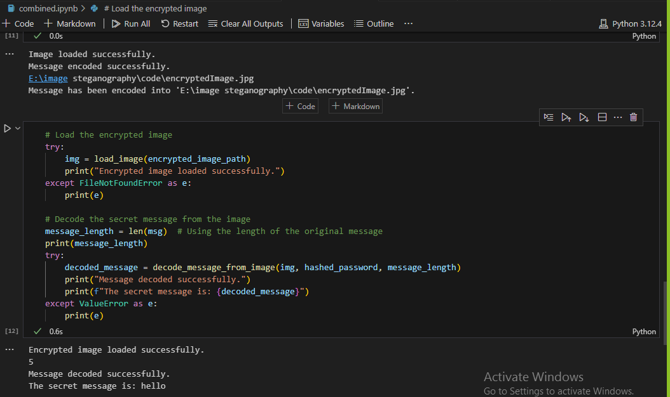
RESULT

Slide 13


RESULT
Cover Image: Encrypted Image:

Slide 14
LINKS
https://github.com/induare27/image_steganography

