Slide 1
Campus Placement Cell
TS- WEB
Presented By:
1. Miss Indu Chennupati
Guided By:Poova Ragavan Veumani

Slide 2
OUTLINE
Abstract
Problem Statement (Should not include solution)
Aims , Objective & Proposed System/Solution
System Design
System Development Approach(Technology Used)
Algorithm & Deployment
Conclusion
References
Future Scope

Slide 3
Abstract
Campus Placement Cell (CPC) is web-based tool to reduce communication gap between Job providers and Job seekers or students. The Main objective of this project is to make easy the recruitment process of any organization.
This CPC is designed by keeping in mind both parties Job providers and Job seekers. CPC allows students to register their details like skills and experience with the system, and then on the other hand even it allows job providers to post their requirements with the system.
This portal's main aim is to provide the vacancies available for the students in IT technologies. CPC will automatically send mails to all students whose skills are matched with the requirement.

Slide 4
Problem Statement
Introduction 1 Introduction to Web Technologies
1.1 Internet The Internet is a global wide area network that connects computer system across the world. The internet Provides different online services.
1.2 WWW(World Wide Web) The World Wide Web -- also known as the web, WWW or W3 -- refers to all the public websites or pages that users can access on their local computers and other devices through the internet.
1.3 Why web applications ? Web applications have become an essential component of in today’s world. By using the web applications, business can now develop and become simpler, and achieve their objectives much faster. Some common benefits of Web apps include: Allowing multiple users access to the same version of an application. Web apps don't need to be installed. Web apps can be accessed through various platforms such as a desktop, laptop, or mobile.

Slide 5
Proposed Solution
Tools And Technologies Used : Front-End : HTML5,CSS3 AND JAVASCRIPT Back-End : NODEJS Database : MySQL Tool : VS Code Editor
2.1 HTML : HTML stands for the Hyper Text Markup Language. HTML is the standard markup language for Web pages. HTML elements are the blocks of the HTML Markup. HTML elements consist of start tag,end tag and content in between them
2.2 CSS3 : CSS3 stands for Cascading Style Sheet level 3, which is the advanced version of CSS. It is used for structuring, styling, and formatting web pages. Several new features have been added to CSS3 and It is supported by all modern web browsers.
2.3 JAVASCRIPT : JavaScript is a scripting language that enables you to create,dynamically updatingcontent, control multimedia, animate images, and pretty much everything else.

Slide 6
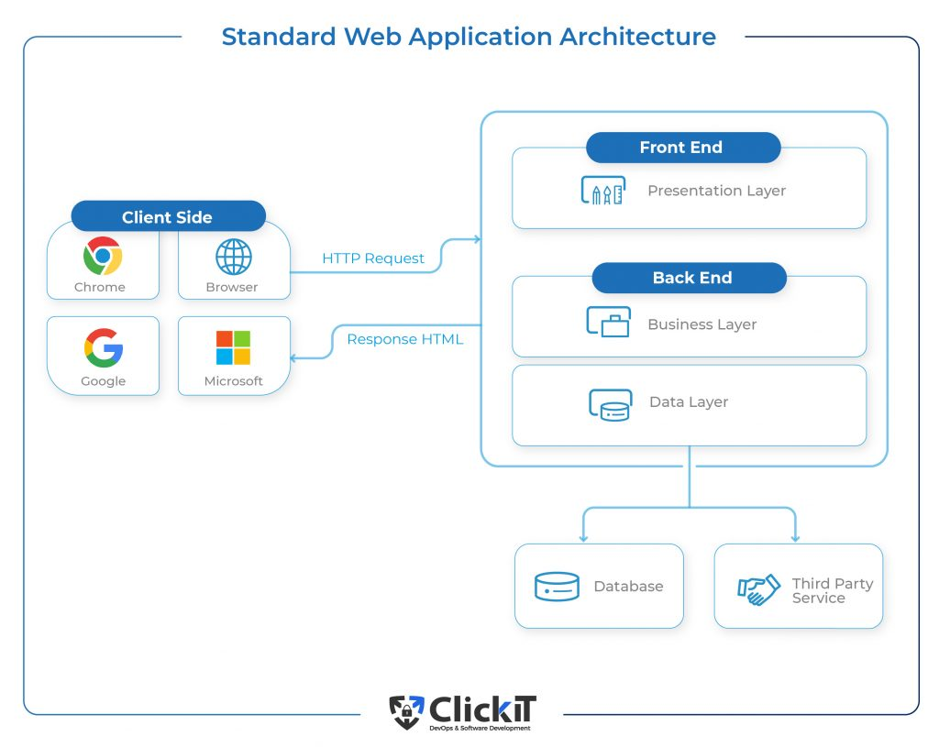
System Architecture

Slide 7
System Deployment Approach
Learning During The Project :
3.1 JAVASCRIPT : JavaScript, often abbreviated to JS, is a programming language that is one of the core technologies of the World Wide Web, alongside HTML and CSS. As of 2022, 98% of websites use JavaScript on the client side for webpage behavior, often incorporating third-party libraries.
3.2 DBMS : A database management system (DBMS) is system software for creating and managing databases. A DBMS makes it possible for end users to create, read, update and delete data in a database.

Slide 8
Algorithm & Deployment
Responsive web Design (RWD) is a web development approach that creates dynamic changes to the appearance of a website, depending on the screen size and orientation of the device being used to view it. RWD is one approach to the problem of designing for the multitude of devices available to customers, ranging form tiny phones to huge desktop monitors.

Slide 9
THANK YOU

