Slide 1
Enterprise Portals
Empowering Business
via Technology
Rajesh Moparthi

Slide 2

Why Portals
Render and aggregate content to provide information to users in a compact and simple view.
Enable interaction with common applications such as e-mail, calendar, banking and so on.
Leverage existing applications without reinventing the wheel.

Slide 3

Types of Portals
Internal
  HR Portal
  Employee Portal
Customer Facing
  Customer Support Portal
  Community Portal (Ex: MyYahoo)

Slide 4

The Mechanics
Portlets
  Serve content that is embedded into portal pages
  Live in portlet containers such as J2EE container

Slide 5
The Mechanics …
Portal Page
  Collection of Portlets along with branding (header, footer), navigation
  Can be either Pre-configured or Personal pages
  Can be either Guest Pages or Authenticated Pages

Slide 6
The Mechanics …
Communities
  Collection of pre-configured pages
  Can have specific header, footer, style-sheet scheme
  Content and security is controlled by Community Administrator

Slide 7
The Mechanics …
My Pages
  Collection of Personal pages
  Administrator can configure default content to start with
  Users can add portlets based on their security

Slide 8
Portal Vendors
Integrated Solution
  BEA Weblogic Portal
  IBM Websphere Portal
Stand alone Solution
  TIBCO Portal Builder
  Plumtree Corporate Portal
Open Source Solution
  Apache JetSpeed

Slide 9
Plumtree Portal Solution
Plumtree portal offers following features
  Distributed and Scalable Architecture
  Supports standard features like Branding, Navigation schemes.
  Authentication& Profile based on Active Directory, LDAP, Custom J2EE Authenticators.
  Custom Portlet Templates for MS-Excel, MS-Exchange.
  Document, Database, WWW Crawlers

Slide 10
Plumtree Portal Solution …
  Knowledge Directory and Search.
  Delegated Administration.
  Robust Collaboration Suite.
  Supports J2EE and .NET portlets.
  Simple to use pre-build portlet suite for Polls, Surveys, Calendar, Links.
  Compatible with BEA Weblogic, IBM Websphere and Tomcat application servers.
  Efficient Caching of Portlets.

Slide 11
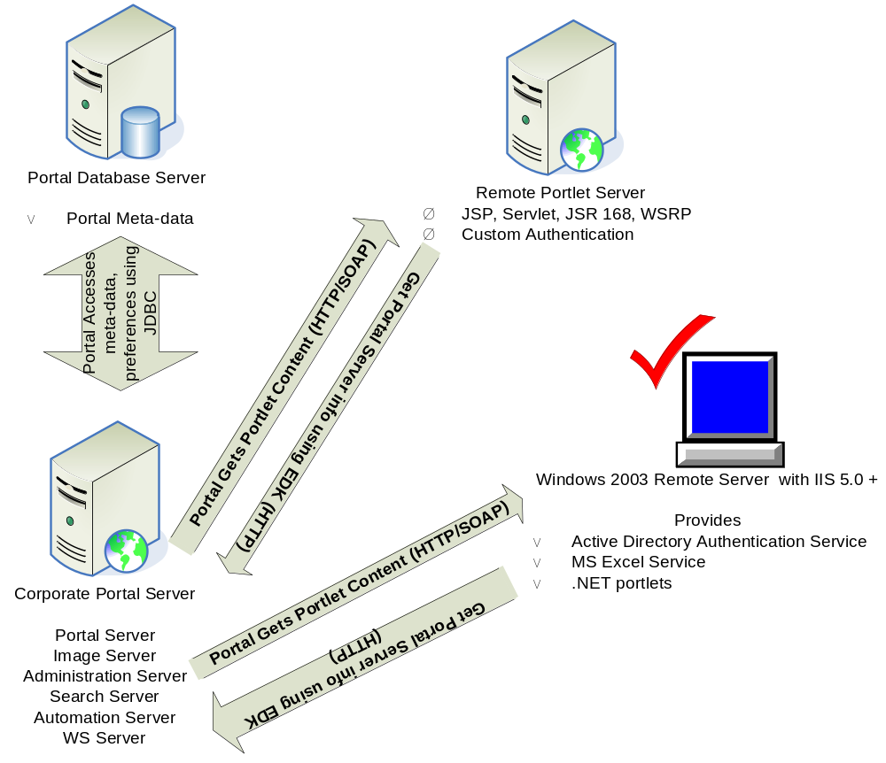
Plumtree Portal Architecture

Slide 12
Security
Governed by ACL (Access Control list) on portal object.
Access Levels
  Read : User can view the object
  Select : User can select object into his MyPage.
  Edit : User can edit the object.
  Admin: Administrative privileges.

Slide 13
Security …
Activity Rights
  Global privileges that can be assigned to users/groups. Ex: Create a Portlet, Create Administrative Folder etc.
  Activity Rights along with ACL determine the actions that can be performed by the user.

Slide 14
Personalization
Portlet developers have access to following information through Plumtree EDK
Standard Settings (Read only)
  System Information
  User Information

Slide 15
Personalization …
Preferences
  Administrative Settings
  User Settings
  Portlet Settings
  Community Settings
  Community Portlet Settings
Portlet developers can personalize content based on combination of Standard settings and Preferences

Slide 16
Portlet Standards
JSR-168
Provides standard API for creating portlets to work in any portal environment http://developers.sun.com/prodtech/portalserver/reference/techart/jsr168/index.html
WSRP
Defines a web service interface for accessing and interacting with interactive presentation oriented web-services
http://www.oasis-open.org/committees/download.php/3343/oasis-200304-wsrp-specification-1.0.pdf

