Slide 1
The Autonomous Compliance Workforce
Every User gets an AI agent that does their compliance work for them
Agents talk to each other. The system gets smarter daily.
Deploys anywhere — including air-gapped.

Slide 2
The Problem
Compliance is a $45B+ market built on human Powered Work
• $3-5M/year per mid-size company — still 80% manual labor
• Control owners lose 5-10 hrs/month on tasks they don't understand
• Compliance managers spend days chasing people, not managing compliance
• Most regulated industries (defense, finance, healthcare) are locked out of modern tooling
— data can't leave their network

Slide 3
Our Solution
An autonomous AI workforce that runs your compliance program
We don't give companies a better dashboard.
We give every person an AI agent that does their compliance work
for them — sends messages, collects evidence, evaluates controls,
escalates issues, and coordinates with other agents.
The Users never needs to understand how our platform works

Slide 4
What Makes This Possible
Three innovations, integrated from day one
# | Innovation | What It Means
1 | Shadow AI | Every user gets a personal agent that acts on their behalf
2 | Multi-Agent Coordination | Agents talk to each other to get work done collaboratively
3 | Self-Improving Engine | 3-layer deterministic + LLM pipeline that gets smarter daily

Slide 5
Shadow AI — The Core Innovation
Every user gets a personal compliance agent. Zero knowledge required.
Agent → Sarah (Slack): "Hey Sarah — I need a Q1 access review
export from Okta. Want me to ask Mike in IT, or do you have access?"
Sarah: "Ask Mike"
Agent → Mike's Agent: [coordinates automatically]
Mike's Agent → Mike (Teams): "Sarah needs an Okta export.
Takes 2 min — here's how."
Mike: pulls the export → Agent uploads → evaluates → done.
Sarah never opened the compliance platform. Mike never heard 'SOC 2.'
Total human effort: 2 messages + 2 minutes.

Slide 6
What the Agent Does Behind the Scenes
• Translates compliance requirements into plain language actions
• Knows who has the data and how to get it
• Sends messages, emails, notifications on the user's behalf
• Tracks deadlines and follows up automatically
• Learns each user's communication style and preferences
• Escalates with graduated urgency when things are stuck
• Gets better over time — learns what works for each person
The agent IS the interface. The platform disappears.

Slide 7
Multi-Agent Network
Agents don't just assist — they form an autonomous workforce
[CISO Agent] ◄──► [CompMgr Agent] ◄──► [Owner Agents (Sarah, John)]
│ │
[Auditor Agent] [IT/HR/Dev Agents]
Every arrow = agent-to-agent communication
Humans just approve and answer the occasional question.
• 5 agents: basic coordination, some automated evidence flow
• 20 agents: compliance program runs semi-autonomously
• 50+ agents: full autonomous workforce, humans manage by exception

Slide 8
The Evaluation Engine
3-Layer Pipeline: Rules → LLM Judgment → Deterministic Score
Layer | What | Cost | Reproducibility
1 | Deterministic rules (8 types) | $0 | 100%
2 | Bounded LLM judgment (ambiguous items only) | Low | High
3 | Deterministic scoring formula | $0 | 100%
60-70% of criteria resolve in Layer 1 — zero LLM cost
Layer 2 asks specific questions with rubrics, not 'evaluate this entire control'
Layer 3 always produces the same score given same inputs. Always.

Slide 9
Why This Matters
Metric | Pure LLM (competitors) | Our 3-Layer Pipeline
Reproducibility | ~70-80% | 97-99%
Cost per evaluation | $$$ (every criteria hits LLM) | $ (60-70% free)
Explainability | "AI said compliant" | Rule X passed because Y
Speed | Seconds per criterion | Milliseconds (rules)
Audit trail | Black box | Every step traceable
Auditors can trust it. CFOs can afford it. Regulators can inspect it.

Slide 10
Self-Improving System — The Observer
Gets smarter every day. No code deploy needed.
Signal | Meaning | Auto-Fix
55% escalation rate | Model struggling | Route to stronger tier
Confidence trending ↓ | Prompt degrading | Rewrite via canary test
Parse failures >15% | Output format drift | Adjust constraints
Score variance >15% | Potential bias | Alert + investigation
After 6 months: measurably better than day 1.
Competitors: identical to day 1.

Slide 11
Graduated Autonomy — Not a Loose Cannon
Tier | What | Safety
1 — Auto-apply | Routing changes, thresholds | Confidence ≥ 0.80, 20+ samples
2 — Canary first | Prompt rewrites, model swaps | 20% traffic, 30+ samples, 4+ hrs
3 — Human approval | Model removal, policy changes | Notify and wait
Circuit breaker: 3+ rollbacks in 6 hours → all auto-applies stop
The system improves aggressively but fails safely.

Slide 12
AI Governance Built In
The system audits itself. For SR 11-7, EU AI Act, and customer trust.
Automated model governance (no human maintenance):
• Model inventory — auto-tracked from routing config
• Drift detection — KS test on weekly confidence distributions
• Bias monitoring — cross-tenant score variance flagging
• Performance trending — per model, per task, over time
• Decision audit trail — every observer action: what, why, outcome
• Weekly/monthly governance reports — structured for auditors
Auditor: "Show me your AI governance." Us: GET /observer/governance-report — generated automatically since deployment.

Slide 13
Deploy Anywhere — First-Class Air-Gapped
Cloud-Only | Hybrid | Air-Gapped
All LLMs deployed on AWS | Local eval, cloud for complex | Everything on-prem
Fastest to start | Best of both | Total data control
Same code. Same Docker images. Different routing.yaml.
Air-gapped deployment:
tar xzf compliance-v1.5.0-offline.tar.gz && ./install.sh
Zero data leaves the building.

Slide 14
On-Premises Infrastructure Requirements
Application Tier (CPU-only VMs)
VM | Spec | Role | Est. Cost/mo
App VM 1 | 8 vCPU, 32 GB RAM, 200 GB SSD | All 8 services (Docker Compose) | ~$300
App VM 2 | 8 vCPU, 32 GB RAM, 200 GB SSD | HA replica / horizontal scale | ~$300
DB VM | 8 vCPU, 64 GB RAM, 1 TB NVMe | PostgreSQL + pgvector, Redis, MinIO | ~$500
LLM Tier (GPU VMs) — separate from app tier
VM | Spec | Models Hosted | Est. Cost/mo
LLM Strong | 4x A100 80GB (or 2x H100) | DeepSeek-V3 / Qwen-72B (1M context) | ~$8,000-12,000
LLM Mid | 1x A100 80GB (or 2x A6000) | Mistral-22B / Qwen-32B | ~$2,500-4,000
LLM Fast | 1x A10 24GB (or RTX 4090) | Phi-3 / Qwen-7B / Llama-8B | ~$500-1,000
Why multiple LLMs?
Strong (1M context): Complex policy analysis, long document reasoning
Mid: Standard evaluations, evidence review, agent coordination
Fast: Classification, routing, simple checks (60-70% of all calls)
Total on-prem: 5-6 VMs, ~$12K-18K/mo (vs. $50K-100K/yr SaaS + data sovereignty risk)

Slide 15
Architecture: AWS Deployment
IDENTITY & AUTH
Azure AD / Okta (SAML/OIDC)
AWS Cognito (federated)
IAM Roles (S2S)
Secrets Manager
ECS FARGATE (private subnets)
llm-gateway → Bedrock (LLMs)
agent-eval | compliance-assistant
memory-svc | observer
preprocessor | sandbox-svc
COMMS & CHANNELS
Slack API
Microsoft Teams
Email (SES)
Webhooks
CUSTOMER APPS
Jira / ServiceNow
Splunk / Datadog
Workday HCM
Salesforce
MANAGED SERVICES
RDS PostgreSQL + pgvector
S3 (evidence artifacts)
ElastiCache Redis
Cloud Map (discovery)
VPC + ALB + PrivateLink + VPN
Bedrock LLM and Agents
FILE STORAGE
SharePoint Online
Google Drive
Box / Dropbox
Confluence

Slide 16
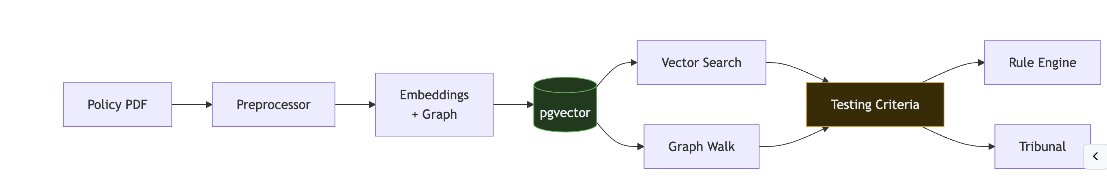
Policy RAG

Slide 17
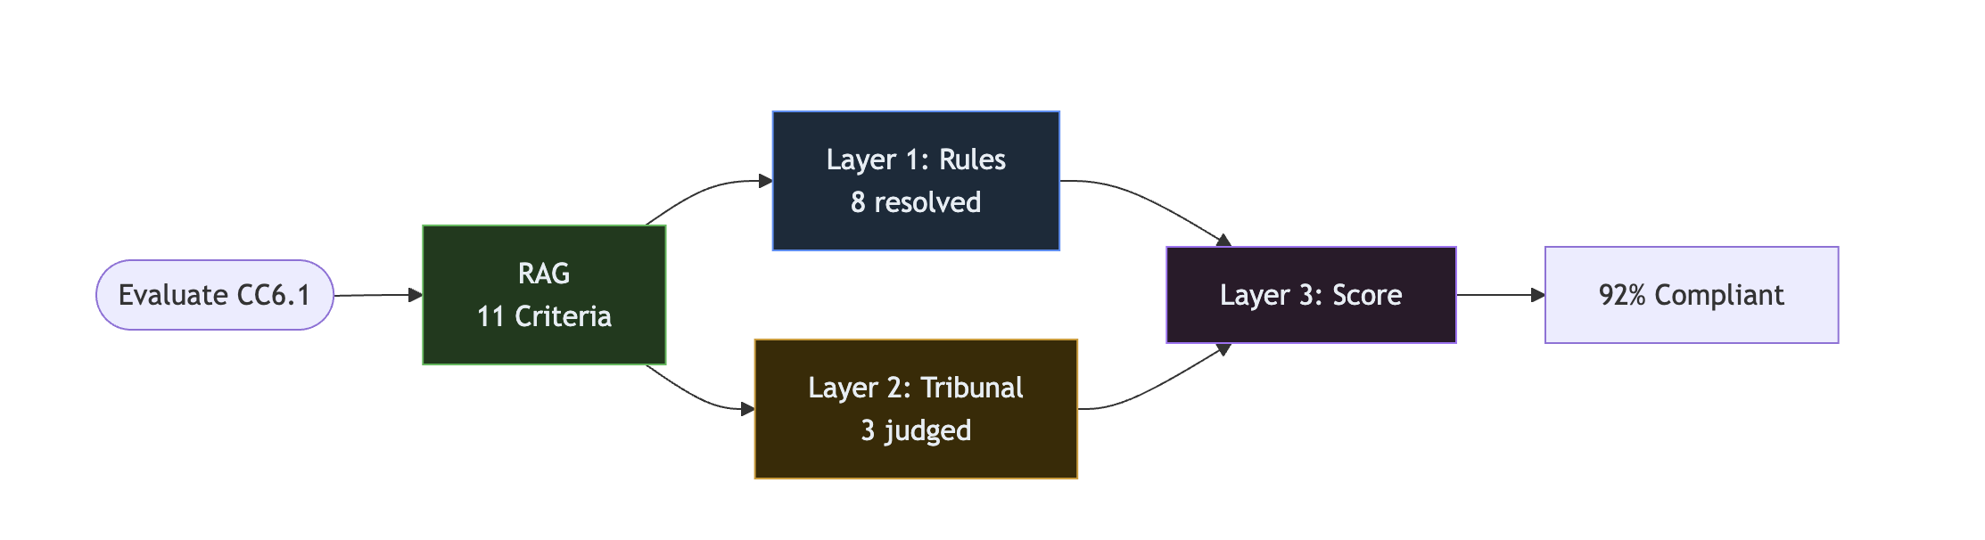
Policy Evaluation

Slide 18
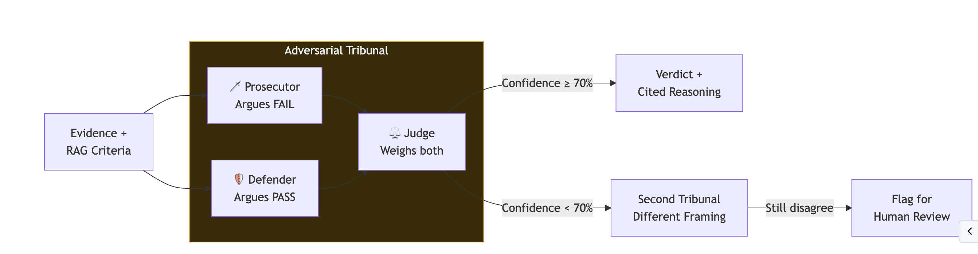
Evidence Evaluation

Slide 19
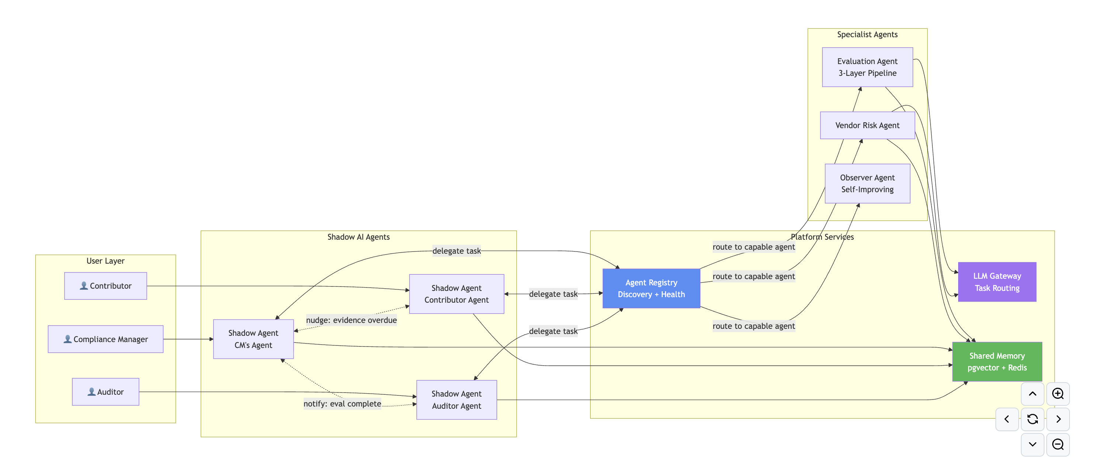
Agent to Agent Communication

