Slide 1
CAR MARKET TRENDS ANALYSIS USING CARDEKHO DATA
SUBMITTED BY:
Indulekha Sagampalli
COLLEGE NAME: Jawaharlal Nehru New College
Of Engineering
USN: 4JN24CD014
AICTE ID: STU6a68cd1bc7bd01785253147

Slide 2
TABLE OF CONTENTS
1.Problem Statement
2.Project Description
3.Who are the End Users?
4.Technology Used
5.Data Cleaning
6.Exploratory Data Analysis
7.Data Visualization & Analysis
8.Results & Key Insights
9.Conclusion

Slide 3

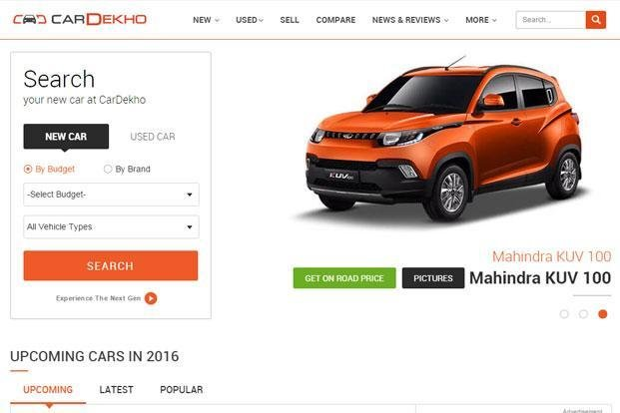
PROBLEM STATEMENT
The used-car market is influenced by several factors such as the car's age, current price, kilometers driven, fuel type, seller type, transmission, and previous ownership. However, it can be difficult to understand how these factors affect the resale value of a car.
This project aims to analyze CarDekho car data to identify market trends and understand the factors that influence the selling price of used cars. The analysis will use data visualization and statistical techniques to discover useful patterns that can help buyers, sellers, and car dealers make better decisions.
By studying the relationships between these different attributes, the project can provide insights into car pricing patterns, helping users better understand the factors that contribute to the value of a used vehicle.

Slide 4
PROJECT DESCRIPTION
This project focuses on analyzing used-car market data obtained from CarDekho. The dataset contains information about different cars, including car name, manufacturing year, selling price, present price, kilometers driven, fuel type, seller type, transmission type, and number of previous owners. This data helps us understand the characteristics and pricing patterns of used cars.
The project involves examining and preparing the dataset and then analyzing different factors that may affect the selling price. Factors such as car age, kilometers driven, fuel type, transmission, seller type, and ownership history are studied to find relationships and patterns in the data.
Graphs and charts are used to present the findings in a simple and understandable way. The main goal of the project is to identify important trends in the used-car market and generate useful insights that can help buyers, sellers, and car dealers make better decisions.

Slide 5
WHO ARE THE END
USERS?
The analysis provides useful insights that can support different stakeholders involved in the used-car market in making informed decisions.
​
3. Car Dealers & Companies:​
Can use market insights to make better decisions about vehicle pricing, inventory, sales, and purchasing strategies.​
​
4. Market Analysts:​
Can study trends, customer preferences, and relationships between different car attributes and selling prices.​
1. Used Car Buyers:
Can compare prices and car characteristics to make informed purchasing decisions
2. Car Sellers:
Can understand pricing trends and estimate a suitable resale price for their vehicles.
5. Business & Marketing Teams:​
Can use the analysis to understand market demand, identify popular vehicle categories, and support future business and marketing decisions.​

Slide 6
TECHNOLOGY USED
1.Python: Used as the main programming language for data analysis and processing.
2.Pandas: Used to load, clean, organize, and analyze the CarDekho dataset.
3.Matplotlib: Used to create graphs and visualizations to represent the analyzed data.
4.Seaborn: Used to create clear and attractive statistical visualizations and identify relationships between different variables.
5.Google Colab / Jupyter Notebook: Used as the development environment to write and execute the Python code.
6.CSV Dataset: The CarDekho dataset is used as the primary source of data for the project.

Slide 7
DATA CLEANING
Data Cleaning is the process of preparing the CarDekho dataset for accurate analysis. The dataset was checked for missing values, duplicate records, incorrect data types, and inconsistencies.
Initial Dataset
301
Rows and 9 columns (No Missing Values Found)
|
|
V
After Cleaning
299
Unique records retained (Duplicate Records Deleted)
Checked dataset size, column names, and data types.
Verified that no missing values were present in any column.
Identified and removed 2 duplicate records.
Confirmed that all columns had appropriate data types for analysis.

Slide 8
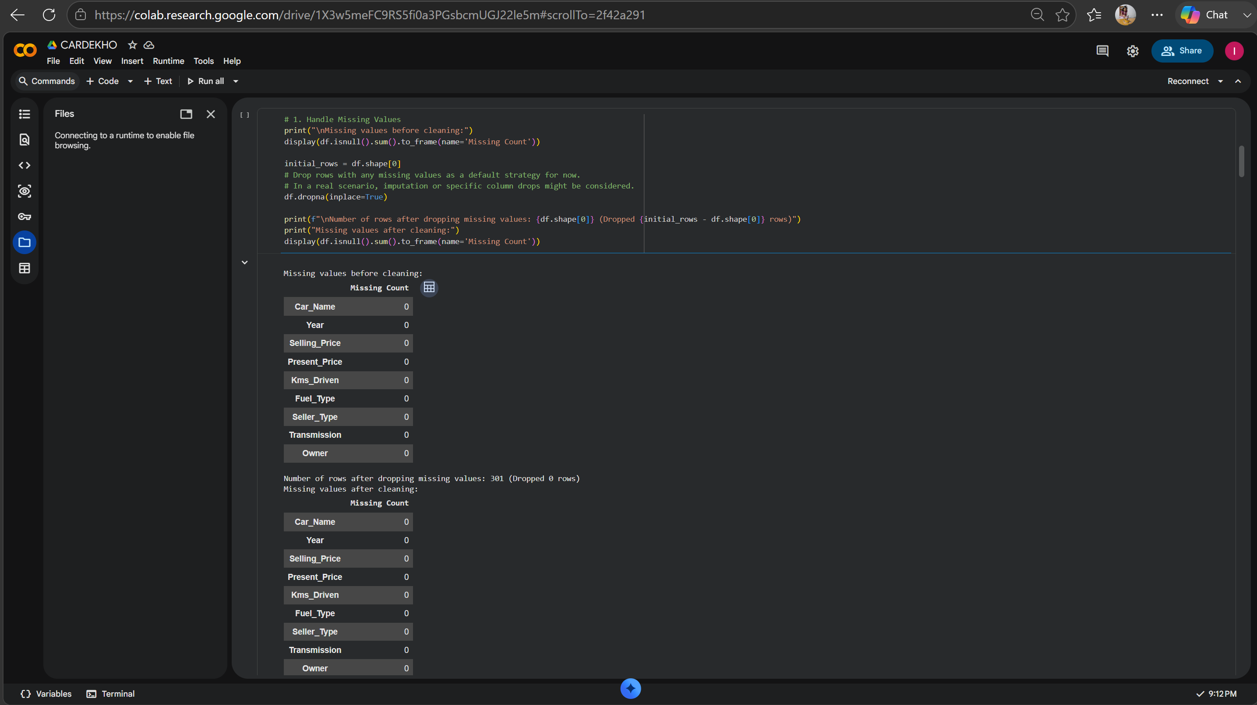
DATA CLEANING
The dataset was checked for missing values, and all 9 columns contained zero missing values.

Slide 9
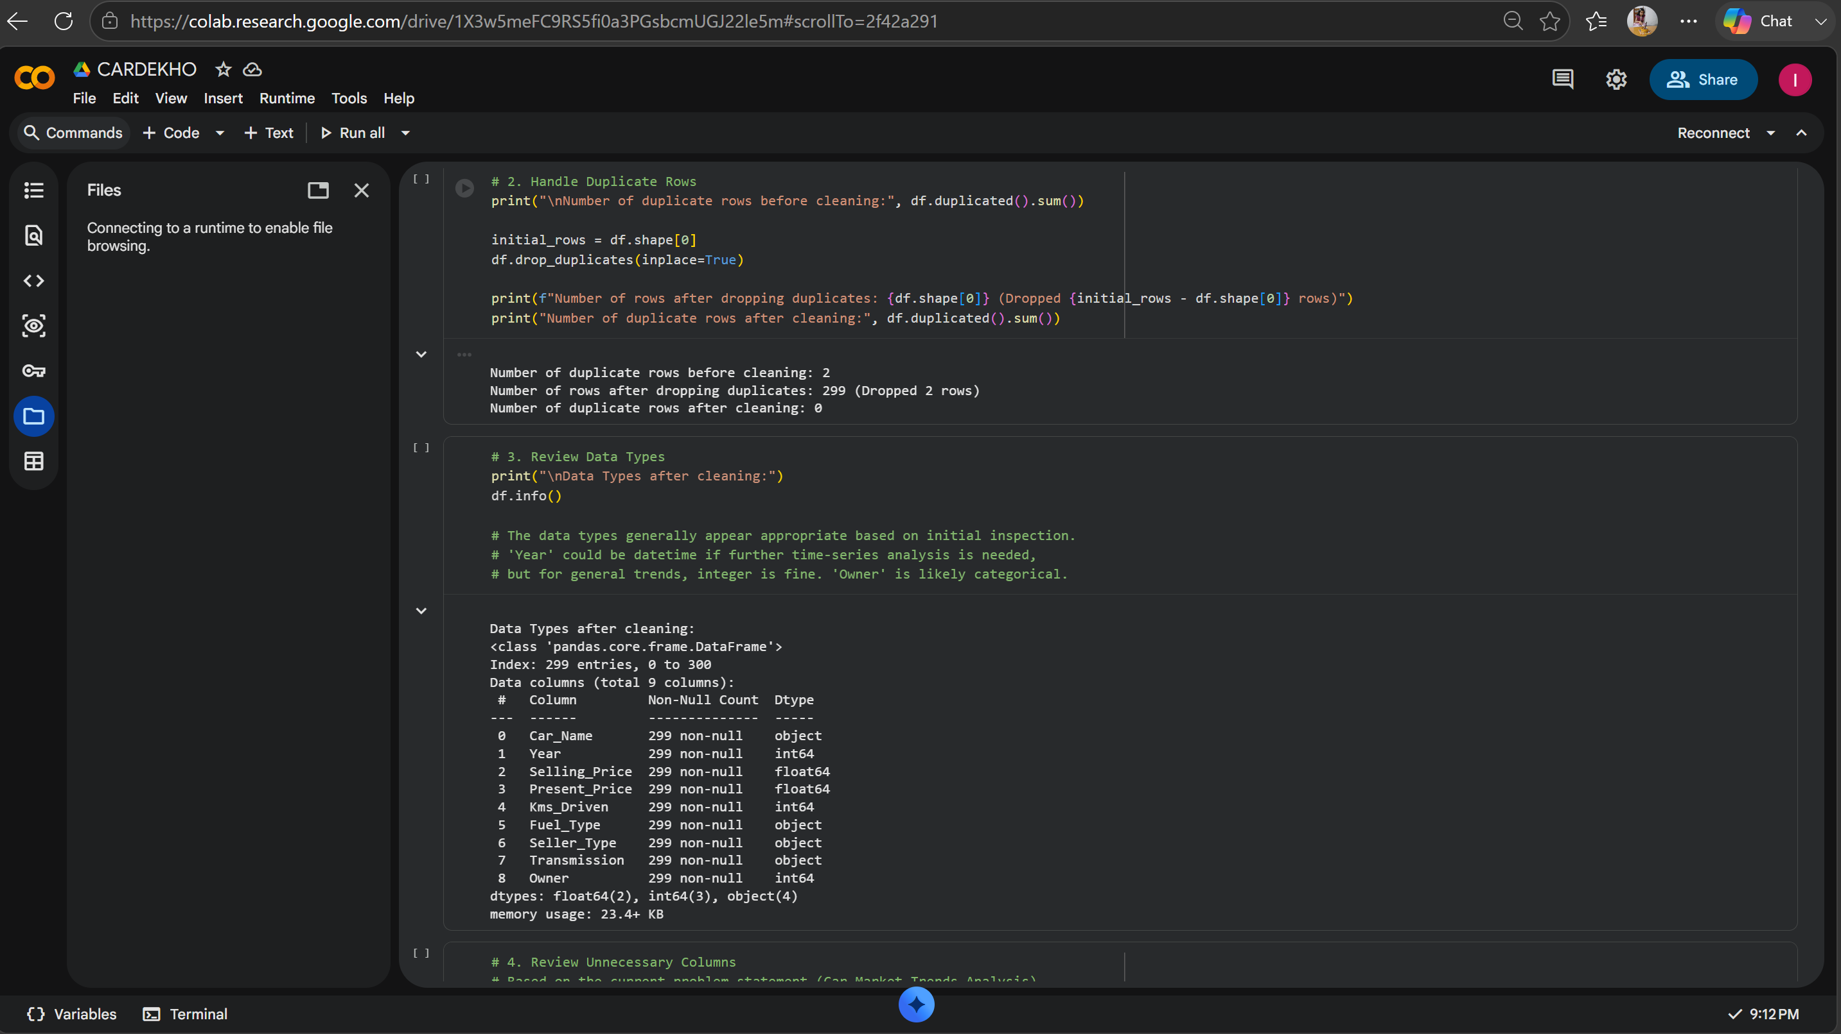
DATA CLEANING
The data types of all 9 columns were verified and found to be appropriate for further analysis.

Slide 10
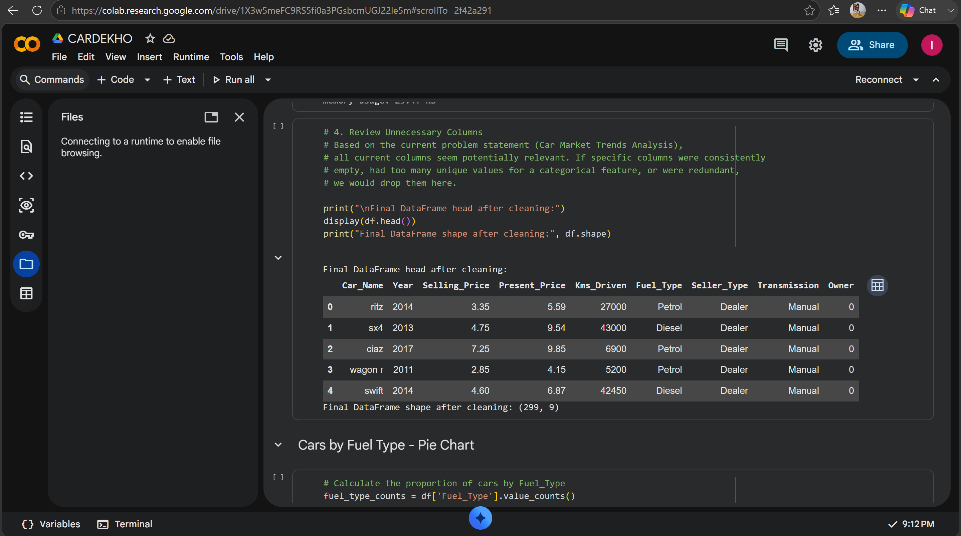
DATA CLEANING
After removing 2 duplicate records, the dataset was reduced from 301 to 299 unique records across 9 columns.

Slide 11
EXPLORATORY DATA ANALYSIS
After cleaning the dataset, Exploratory Data Analysis (EDA) was performed to understand the main characteristics and patterns in the used-car market.
The analysis focused on:
Fuel Type – Distribution of Petrol, Diesel and CNG cars
Selling Price – Price distribution and average prices
Manufacturing Year & Car Age – Effect of vehicle age on the market
Kilometers Driven – Relationship between vehicle usage and price
Transmission – Comparison of Manual and Automatic cars
Seller Type – Distribution of Dealer and Individual sellers
Car Models – Identification of high-value car models
Cleaned Dataset → EDA → Visualization → Insights

Slide 12
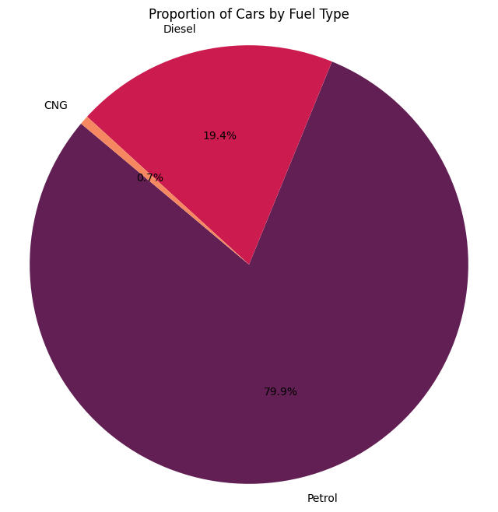
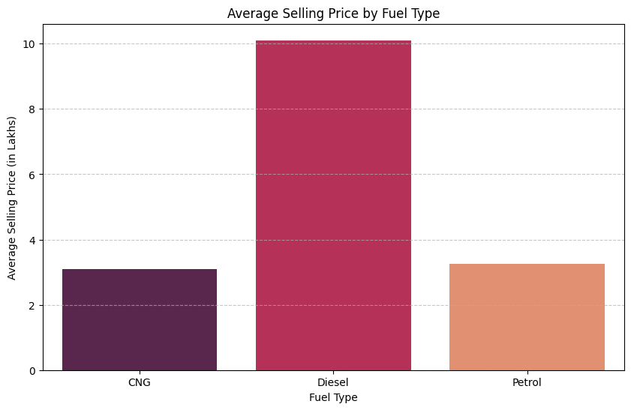
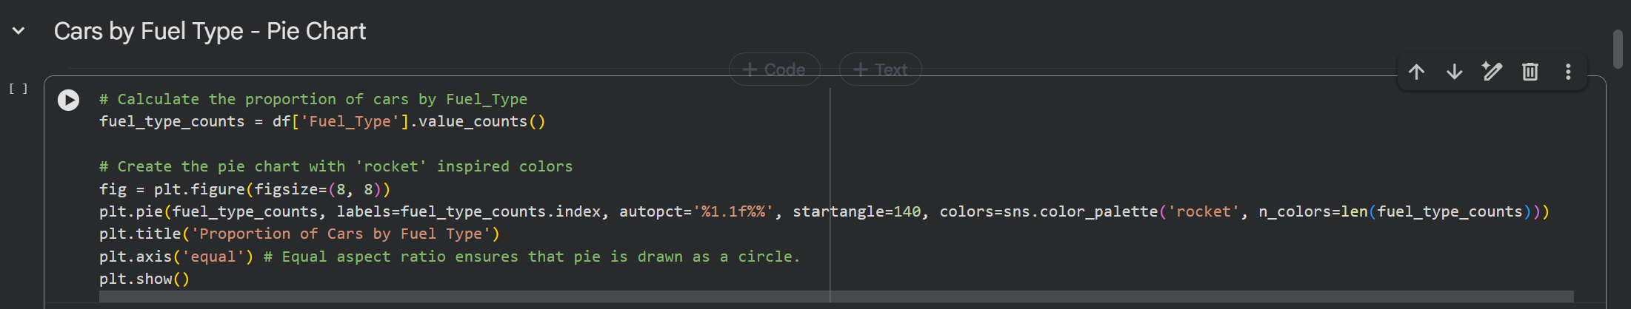
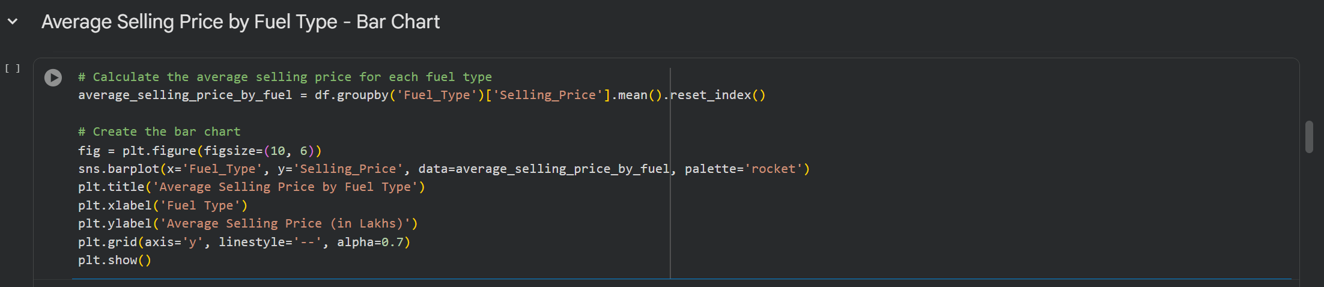
DATA VISUALIZATION & ANALYSIS
1. Cars by Fuel Type — Pie Chart:
Petrol cars make up the largest share of the dataset, followed by Diesel and CNG cars.
2. Average Selling Price by Fuel Type — Bar Chart
Diesel cars have the highest average selling price, while CNG cars have the lowest.

Slide 13
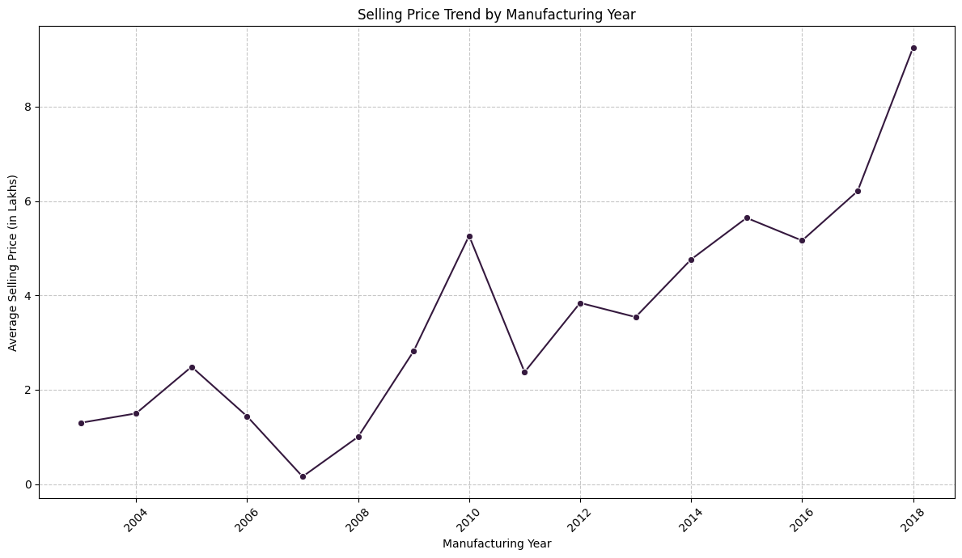
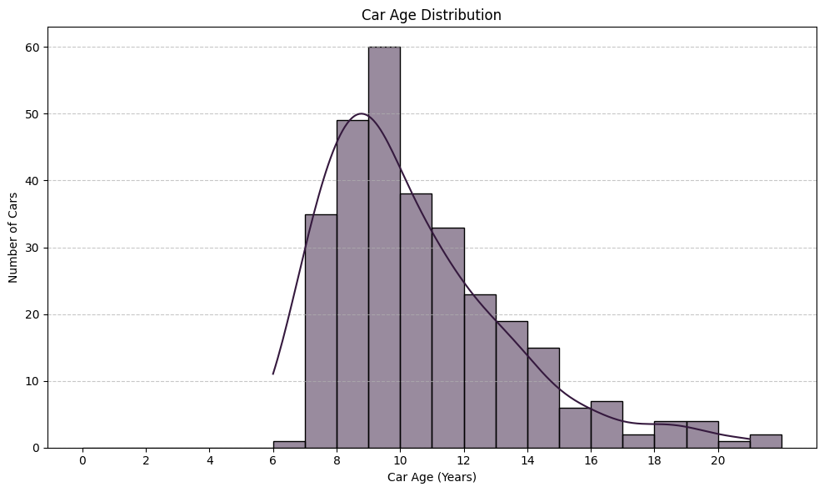
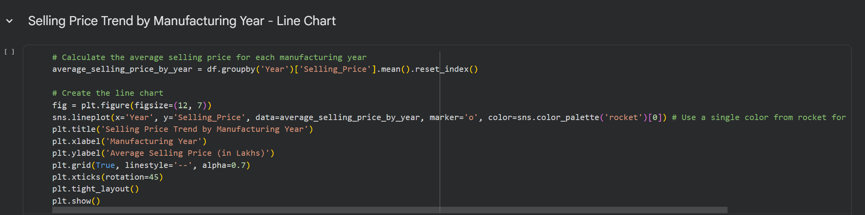
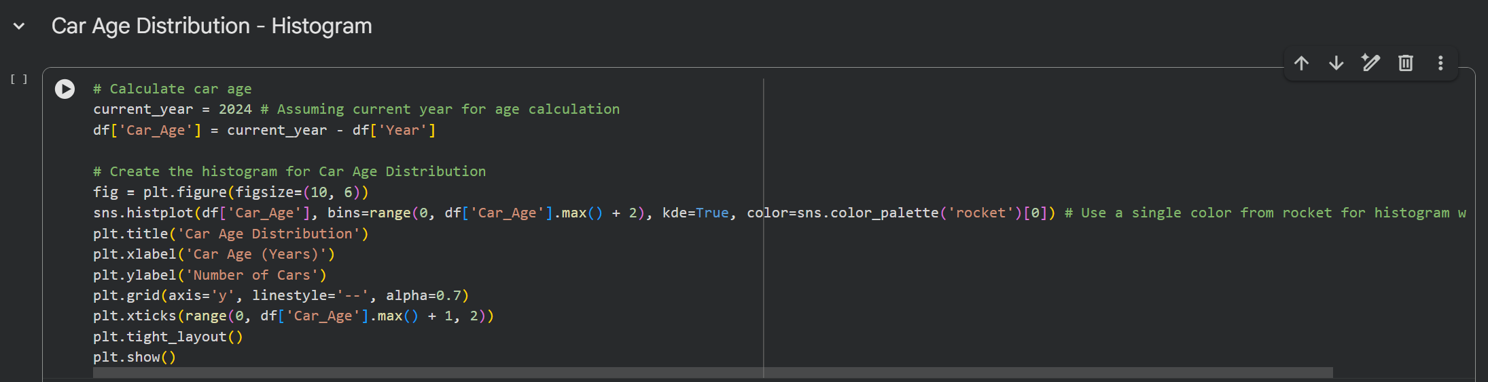
DATA VISUALIZATION & ANALYSIS
3. Average Selling Price by Manufacturing Year — Line Chart
The average selling price generally increases for newer cars, showing that vehicle age has an effect on resale value.
4. Car Age Distribution — Histogram
The dataset contains mostly moderately aged cars, with fewer very new or very old vehicles.

Slide 14
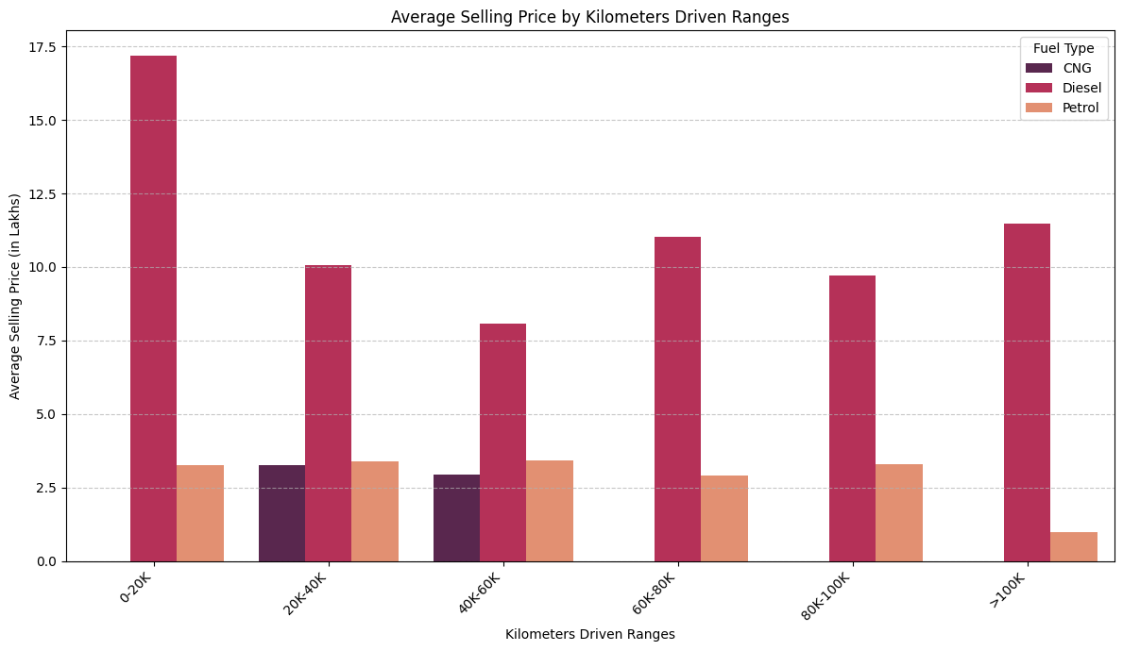
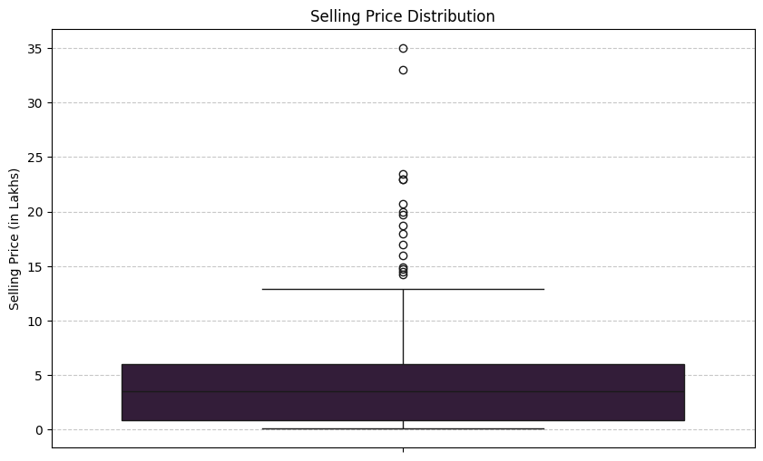
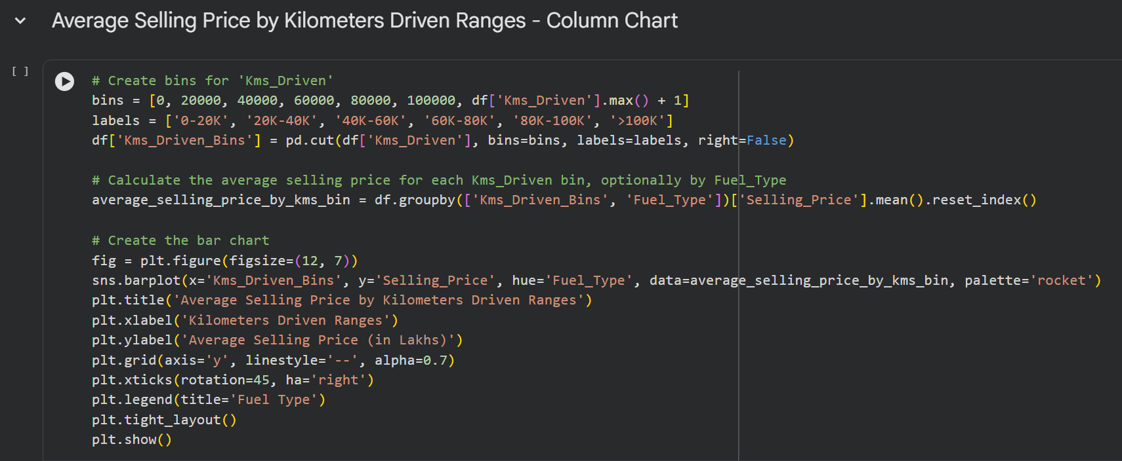
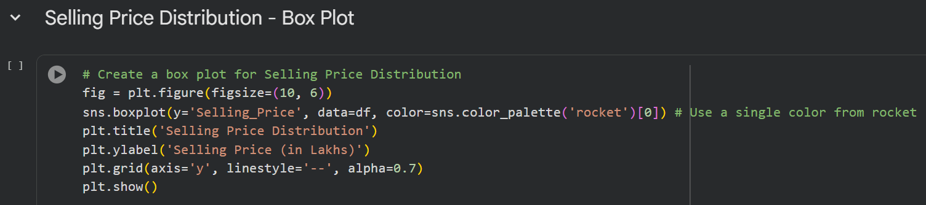
DATA VISUALIZATION & ANALYSIS
5. Average Selling Price by Kms Driven Range — Bar Chart
Cars with lower to moderate kilometers driven generally have higher selling prices than highly driven cars.
6. Selling Price Distribution — Box Plot
Most cars have relatively lower selling prices, while a small number of high-priced cars appear as outliers.

Slide 15
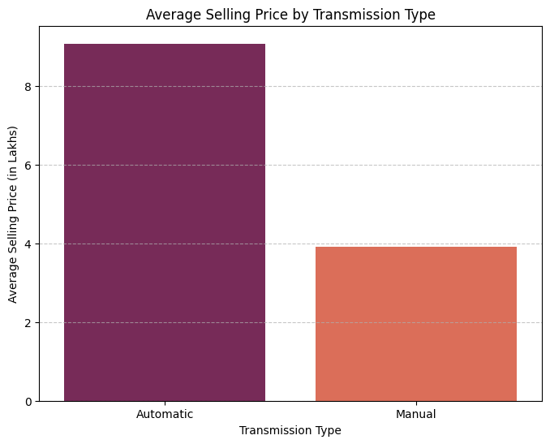
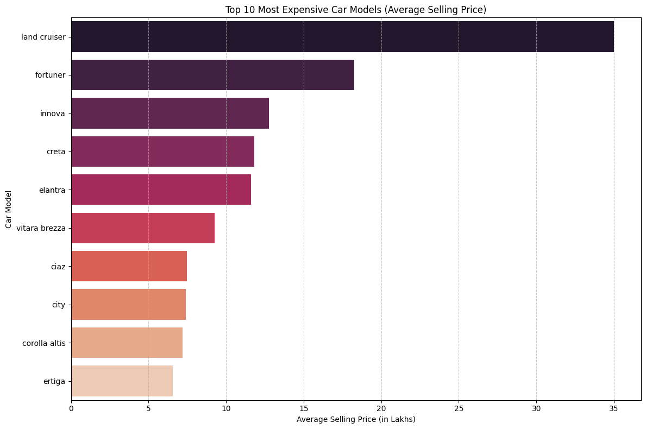
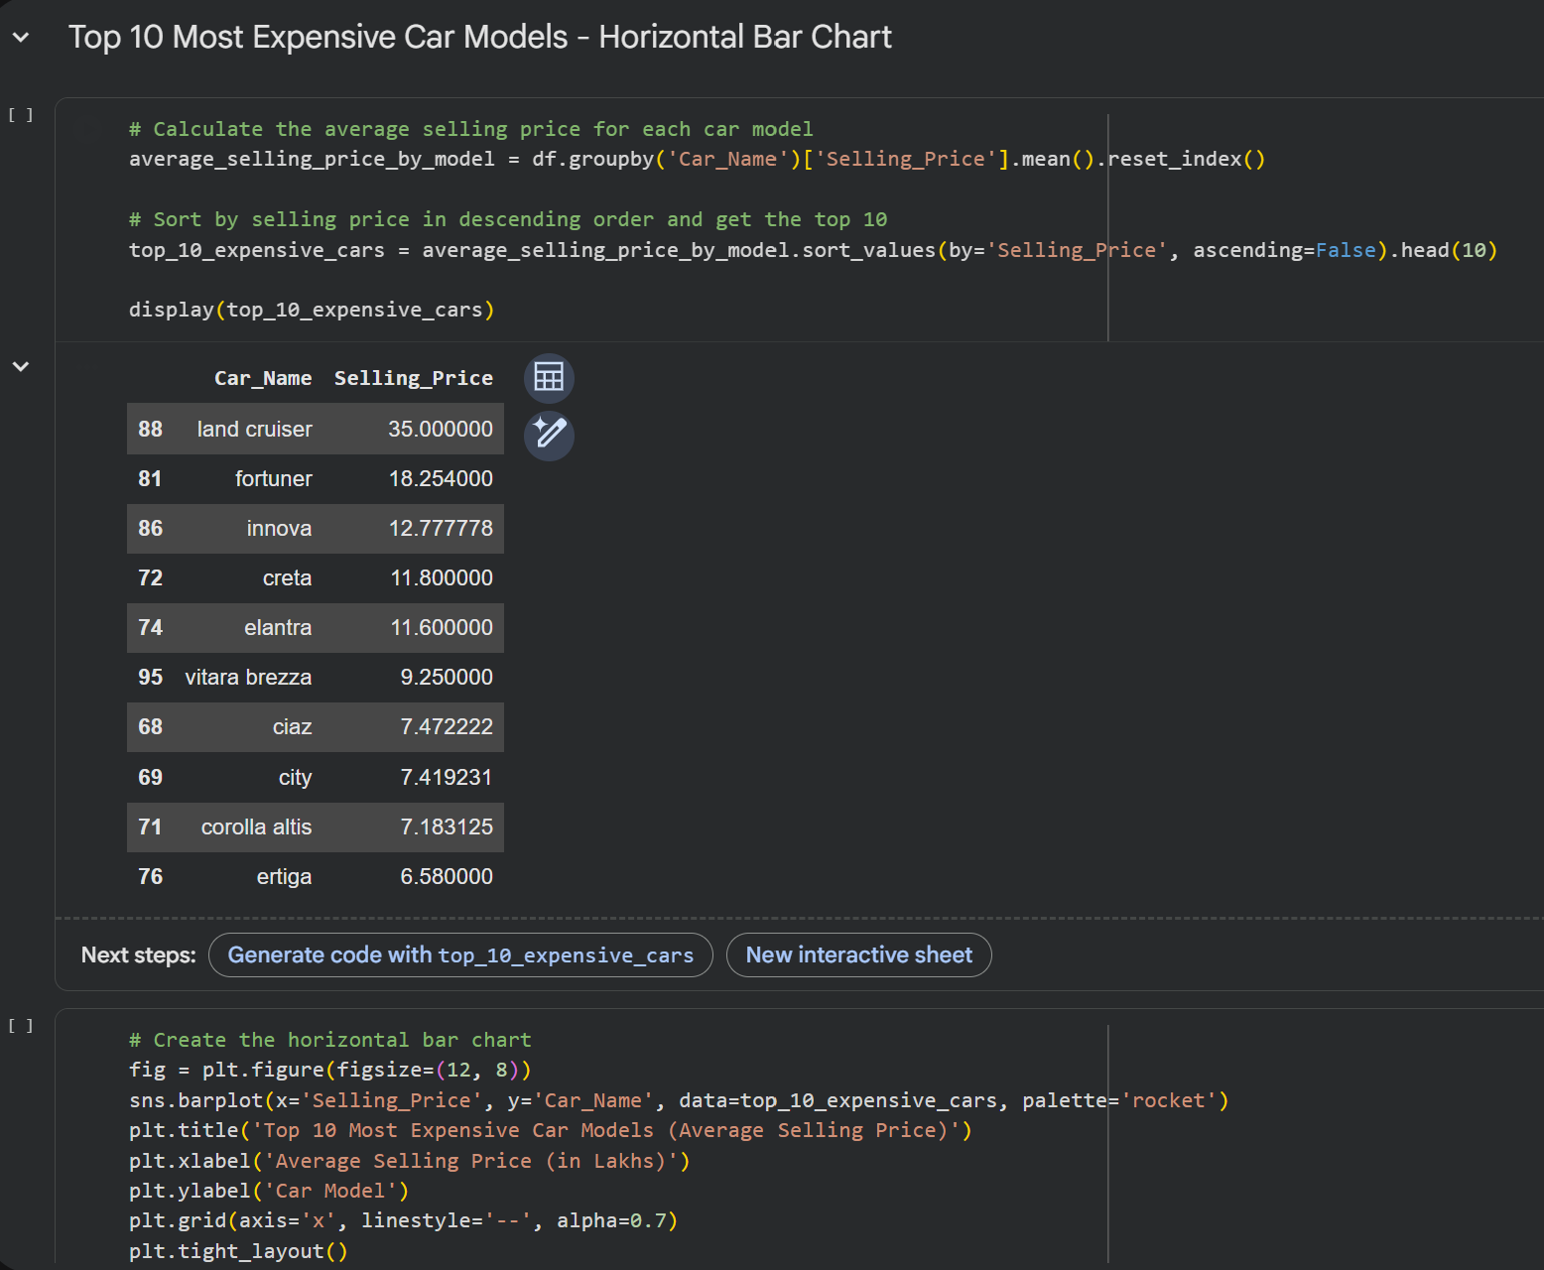
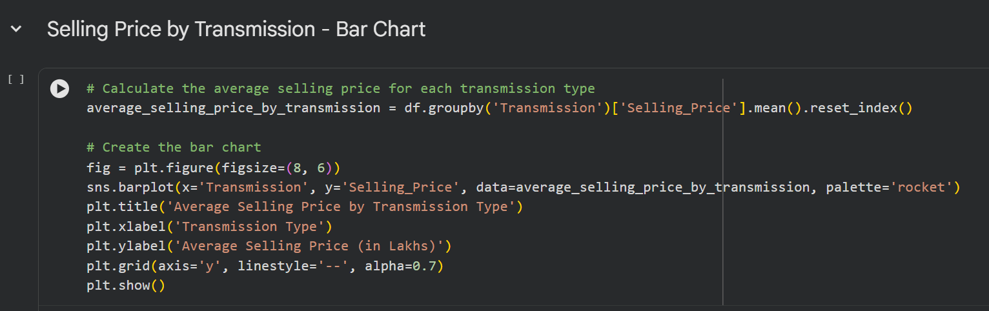
DATA VISUALIZATION & ANALYSIS
7. Average Selling Price by Transmission — Bar Chart
Automatic cars have a higher average selling price than manual cars in the dataset.
8. Top 10 Most Expensive Car Models — Horizontal Bar Chart
The car models with the highest average selling prices, with premium models occupying the top positions.

Slide 16
RESULTS & KEY INSIGHTS
The analysis of the cleaned CarDekho dataset revealed several patterns related to vehicle pricing, age, usage, and market characteristics.
1.Pricing:
Selling prices vary considerably across different car categories and characteristics.
2.Fuel Type:
Petrol cars form the largest portion of the dataset, while Diesel cars show a higher average selling price.
3.Vehicle Age:
Newer vehicles generally have higher resale values than older vehicles.
4.Usage:
Cars with higher kilometers driven generally tend to have lower resale values.
5.Transmission:
Automatic cars have a higher average selling price than manual cars in the dataset.

Slide 17
CONCLUSION
This project analyzed the CarDekho used-car dataset to understand the major factors that influence the selling price of vehicles. The dataset was first cleaned by checking for missing values, duplicate records, and data types, ensuring that the data was suitable for further analysis.
Exploratory Data Analysis and different visualization techniques were then used to study fuel type, manufacturing year, car age, kilometers driven, transmission, seller type, and car models. The visualizations helped identify pricing patterns and differences between various categories of used cars.
The analysis provides a better understanding of how different vehicle characteristics are associated with resale prices. These insights can be useful for buyers when comparing vehicles, sellers when deciding a suitable price, dealers when managing their inventory, and businesses when studying market trends.
Overall, the project demonstrates how data cleaning, exploratory analysis, and visualization can transform raw used-car data into meaningful and easy-to-understand insights, supporting better decision-making in the used-car market.

Slide 18
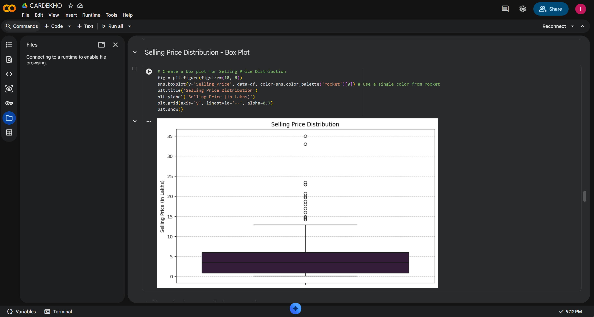
PROJECT DEMO
Google Colab Demo:
Use the link to view the complete project.
https://colab.research.google.com/drive/1X3w5meFC9RS5fi0a3PGsbcmUGJ22le5m?usp=sharing

Slide 19
THANK YOU!

