Slide 1
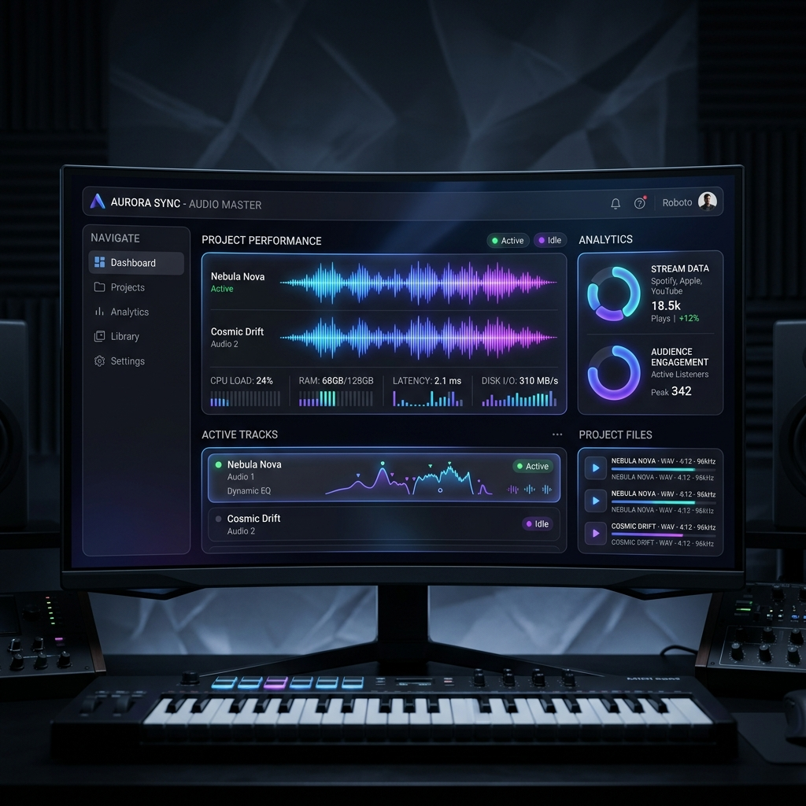
FUGA – Music Product Management
Engineering for High-Performance Discovery & Secure Asset Lifecycles.

Slide 2
Engineering Philosophy & Challenges
Focus: Moving beyond 'functional' to 'production-grade.'
Key Challenges Tackled:
• High-Bandwidth Asset Management: Efficiently handling large binaries.
• Search Latency: Delivering a 'Google-like' instantaneous experience.
• Data Integrity: Managing relational mapping between Artists, Products, and Assets.

Slide 3
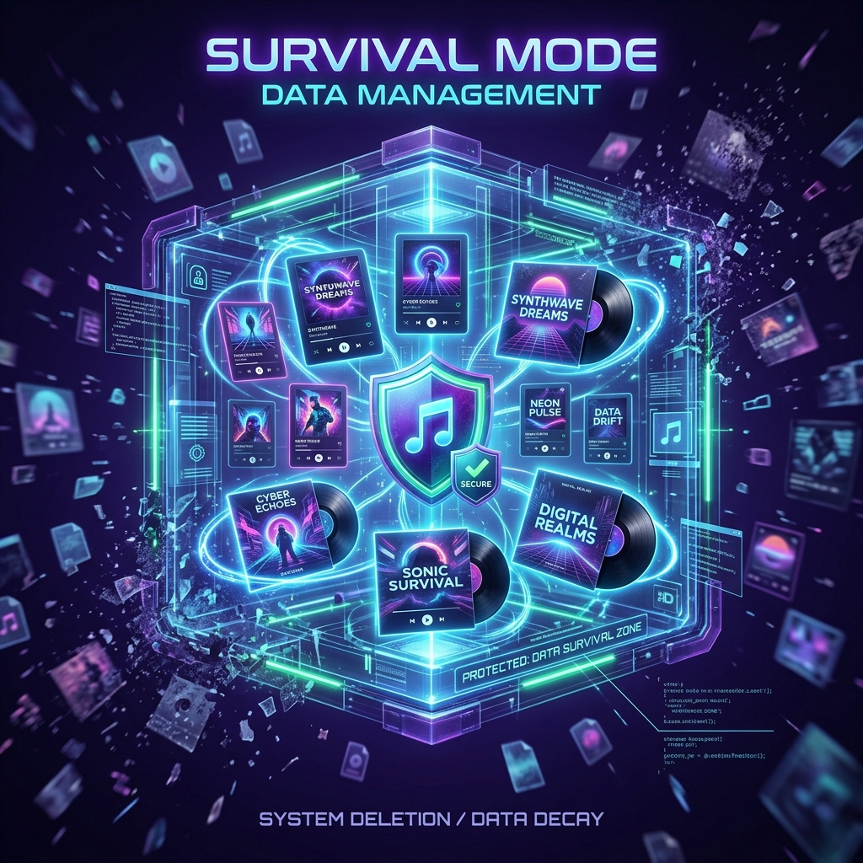
The Standout Feature – 'Survival Mode'
Concept: Decoupling Image entities from the Product life-cycle.
Logic: Images are Permanent Artist Assets, not temporary metadata.
• Zero Storage Fragmentation: Deleting a product doesn't orphan assets.
• Smart Reuse: High-res art reused across Singles, Albums, and Remixes.

Slide 4
Deep Dive – High-Efficiency Search
Hybrid Strategy: Two-phase approach (Local + Global).
Stack: Redux + React Query + useDebounce (400ms).
• Phase 1 (Instant): UI filters React Query cache (0ms response).
• Phase 2 (Background): Debounced request hits PostgreSQL GIN Trigram index.

Slide 5
Deep Dive – Secure & Scalable Creation
Protocol: Protecting backend from heavy binary processing.
• Client-Side Compression: Resizing in browser before transfer.
• Direct-to-S3 Upload: Node.js server never handles raw binary data.
• Atomic Transactions: Prisma Upsert Pattern for safe DB operations.
• Optimistic UI: Instant feedback for a seamless experience.

Slide 6
Backend Foundation & Security
Identity: Auth0 PKCE Flow with strict JWT verification.
Safety:
• Rate Limiting: express-rate-limit protection.
• DB Optimization: GIN Trigram Indexes (pg_trgm) for fuzzy search.
Performance: 'Sub-millisecond fuzzy search as catalog scales.'

Slide 7
Technical Stack Summary
Layer: Frontend (React 19 + Vite) - Auto-memoization.
State: Redux + React Query - Intelligent caching.
Database: PostgreSQL + Prisma - Relational integrity.
Storage: AWS S3 - Direct-to-cloud offloading.
Identity: Auth0 - Enterprise-grade PKCE.

Slide 8
The Dual-User Journey
Guest: The Discovery Layer (Public & Fast)
• Instant Catalog Access (No-auth required).
• Fuzzy Search (Sub-millisecond typo handling).
• Browsing with ZLS (Zero Layout Shift).
• Optimized Asset Streaming (Direct from S3).
Admin: The Secure Lifecycle (Authorized & Smart)
• Auth0 Identity Protection (PKCE flow).
• Direct-to-Cloud Upload Pipeline (S3 Presigned).
• Smart Artist Mapping (Prisma Upsert pattern).
• Survival Mode Management (Asset persistence).

