Slide 1

InGARSS 2026 Young Professionals Hackathon
Dynamic and Seasonal Surface-Water Mapping
& Change Detection Using NISAR Dual-Frequency Radar
Indupriya Potru
Honeywell Aerospace

Slide 2
Data Ingestion, Study Area & Geometric Calibration
Study Area & Spatial Footprint
• Full Scene Footprint: Spans 57,557.48 km² over northern Bihar, centered at (25.5°N, 86.5°E).
• Acquisition Dates: July 14, 2026 vs. October 18, 2026
• Sensor Configurations: Track 98 Ascending Dual-Pol (HH/HV) in both L-band and S-band .
Key Preprocessing Pipeline
• Bilinear Co-Registration: Warped S-band arrays onto master 80 m L-band UTM Zone 45N grid in the linear power domain with explicit NaN / NoData, eliminating log-domain resampling bias.
• Dynamic Adaptive Otsu: Maximizes between-class variance independently per date and sensor within physical water transition windows (-11.64 dB in July; -12.11 dB in October).

Slide 3
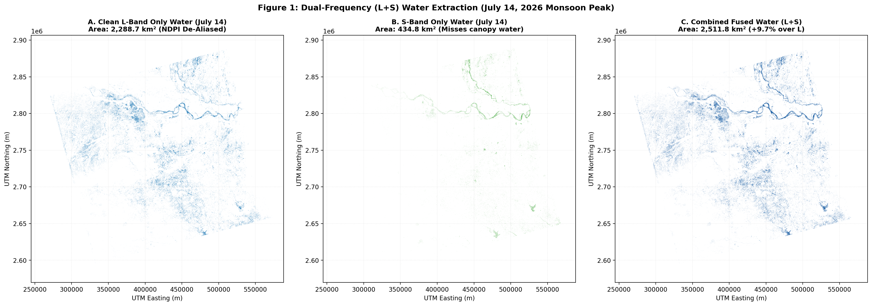
Dual-Frequency (L+S) Water Extraction (July 14, 2026 Monsoon Peak)
A. Clean L-Band Only (2,288.7 km²)
NDPI de-aliased water penetrates canopy via 24 cm wavelength, detecting extensive waterlogged fields across southern Bihar.
B. S-Band Only (435.2 km²)
9 cm S-band experiences strong diffuse volume scattering from paddy/sugarcane canopies, missing canopy water.
C. Combined Fused Water (2,511.8 km²)
Asymmetric linear NDFI fusion recovers sub-canopy water while preserving fine river boundaries (+9.75% / +223.1 km² over L-band alone; +477.8% over S-band alone).

Slide 4
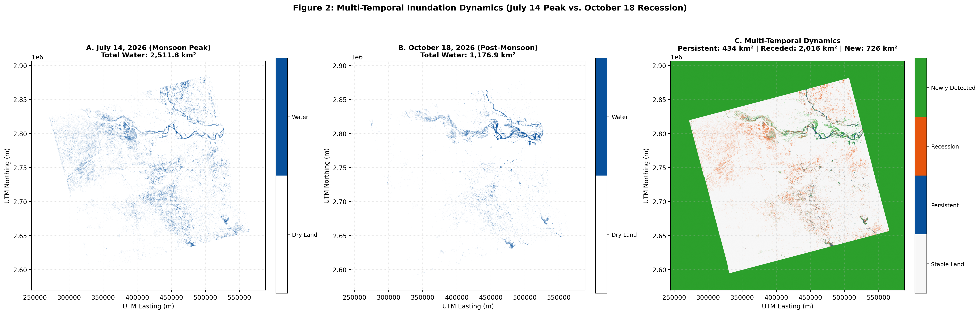
Seasonal Flood Dynamics (July 14 Peak vs. October 18 Recession)
A. July Peak Flood (2,511.8 km²)
Widespread inundation: Southern depressions and river floodplains completely submerged under peak monsoon flow.
B. October Post-Monsoon (1,176.9 km²)
Net -53.15% contraction: Shallow floodplains dried up, river discharge decreased, and water retreated to primary braided channels.
C. Multi-Temporal Transition Matrix
• Persistent Water: 433.7 km² (perennial river stem) • Water Recession: 2,016.2 km² (monsoon floodplains drying) • Newly Detected: 726.0 km² (post-flood braids & chaur pools) • Stable Land: 53,180.4 km²

Slide 5
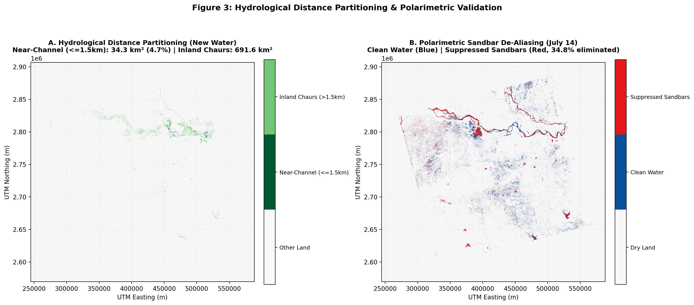
Hydrological Distance Partitioning & Polarimetric Sandbar Validation
A. Hydrological Distance Partitioning (1.5 km Buffer)
Buffered from continuous primary river channels (>3.2 km²), partitioning newly detected October water into:
• Near-Channel Expansion (<=1.5 km): 34.3 km² (4.7%) — lateral river braiding and meander cutoffs.
• Inland Floodplain Chaurs (>1.5 km): 691.6 km² (95.3%) — rainwater retention in low-lying agricultural depressions.
B. Polarimetric Sandbar De-Aliasing (34.8% Elimination)
Flat quartz river sandbars reflect radar specularly, causing naive single-pol Otsu to falsely flag 3,508.6 km² as candidate water.
• Physical mechanism: Water produces zero depolarization (NDPI ≈ 1.0), whereas sand grains depolarize radar via multiple subsurface bounces.
• Result: Linear NDPI > 0.65 eliminated 1,219.9 km² (34.8%) of false alarms, retaining 2,288.7 km² of verified, clean surface water.

Slide 6
Summary Scorecard & Key Technical Takeaways
Quantitative Results Scorecard
• Valid Scene Area: 57,557.48 km² (8,993,357 pixels)
• Raw L-Water (July): 3,508.60 km² (Otsu = -11.64 dB)
• Suppressed Sandbars: 1,219.87 km² (34.8% eliminated by NDPI)
• Clean L-Water (July): 2,288.74 km² (Verified specular water)
• Clean S-Water (July): 435.24 km² (Missed canopy water)
• Combined L+S Fused Water: 2,511.81 km² (+9.75% gain over L-only)
• Post-Monsoon Water (Oct): 1,176.90 km² (-53.15% seasonal contraction)
• Persistent River Channels: 433.74 km² (Perennial core Ganga/Kosi)
• Floodwater Recession: 2,016.17 km² (Dried floodplain chaurs)
• Newly Detected Water: 725.95 km² (Near: 4.7% | Inland Chaurs: 95.3%)
• Stable Non-Water: 53,180.36 km² (Unflooded terrain)
Key Scientific Takeaways
1. Complementary Physics of L and S Bands
L-band (24 cm) penetrates monsoon canopy and dense vegetation, while S-band (9 cm) sharpens narrow riverbanks and water boundaries.
2. Polarimetry Eliminates Sandbar False Alarms
Without cross-polarization (NDPI), flat river sandbars mimic calm water. Linear NDPI filtering successfully eliminated 34.8% of sandbar errors.
3. Dynamic Seasonal Thresholding
Independent per-date thresholding prevents post-monsoon classification error caused by changing soil dielectric states.

