Slide 1
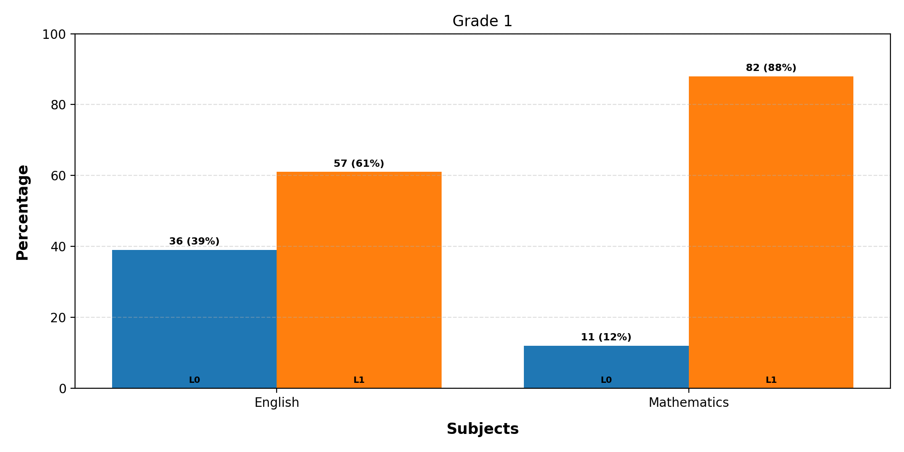
Mastery Levels Analysis - Grade 1
Note: L is Mastery Level

Slide 2
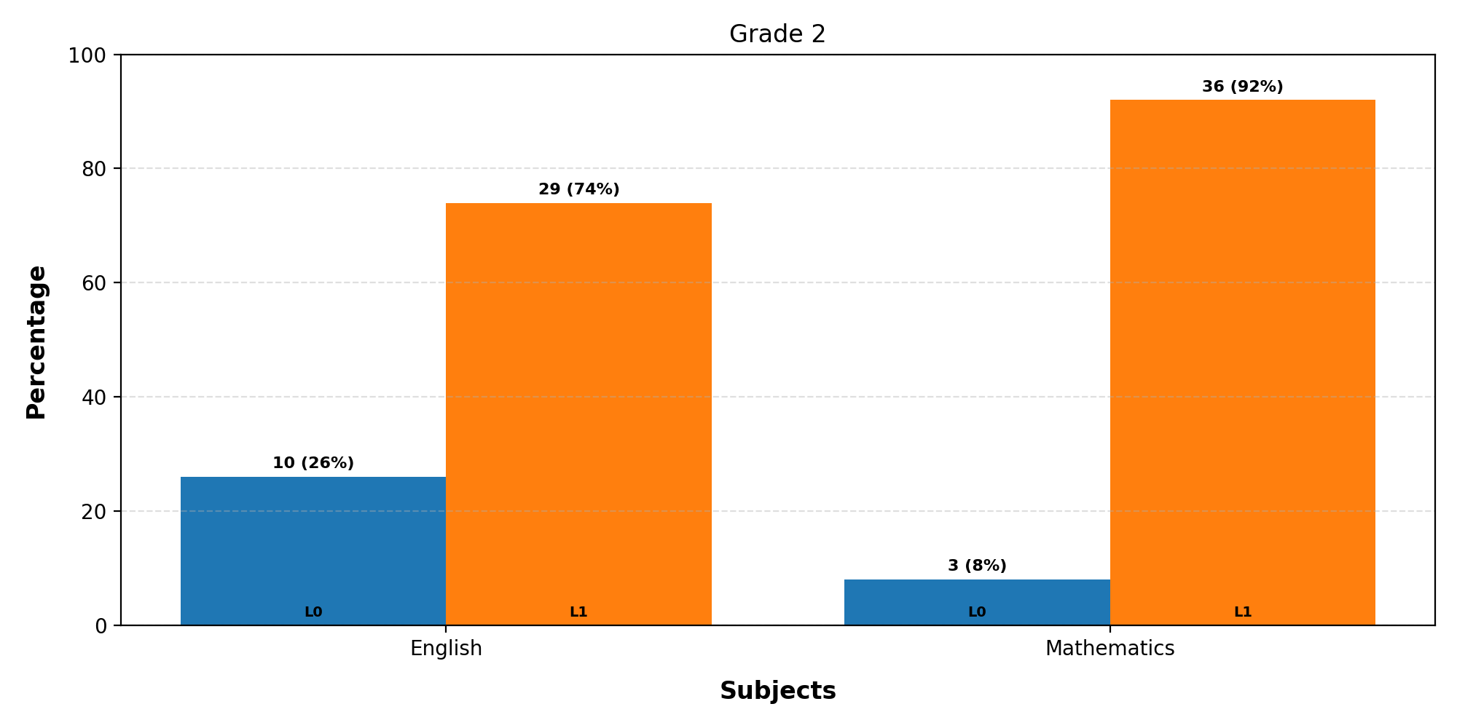
Mastery Levels Analysis - Grade 2
Note: L is Mastery Level

Slide 3
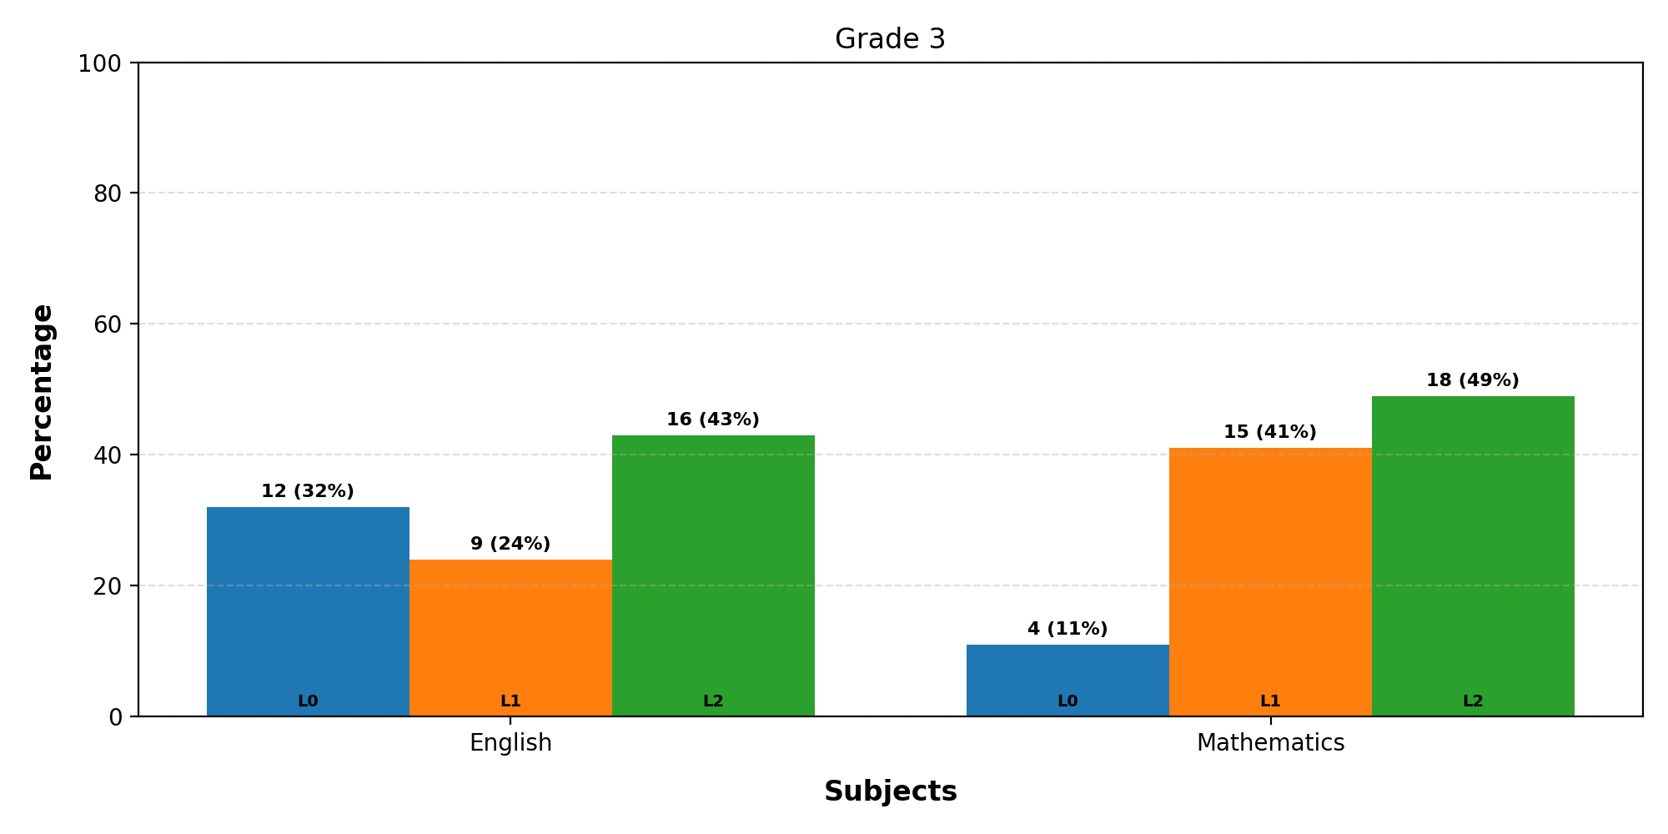
Mastery Levels Analysis - Grade 3
Note: L is Mastery Level

Slide 4
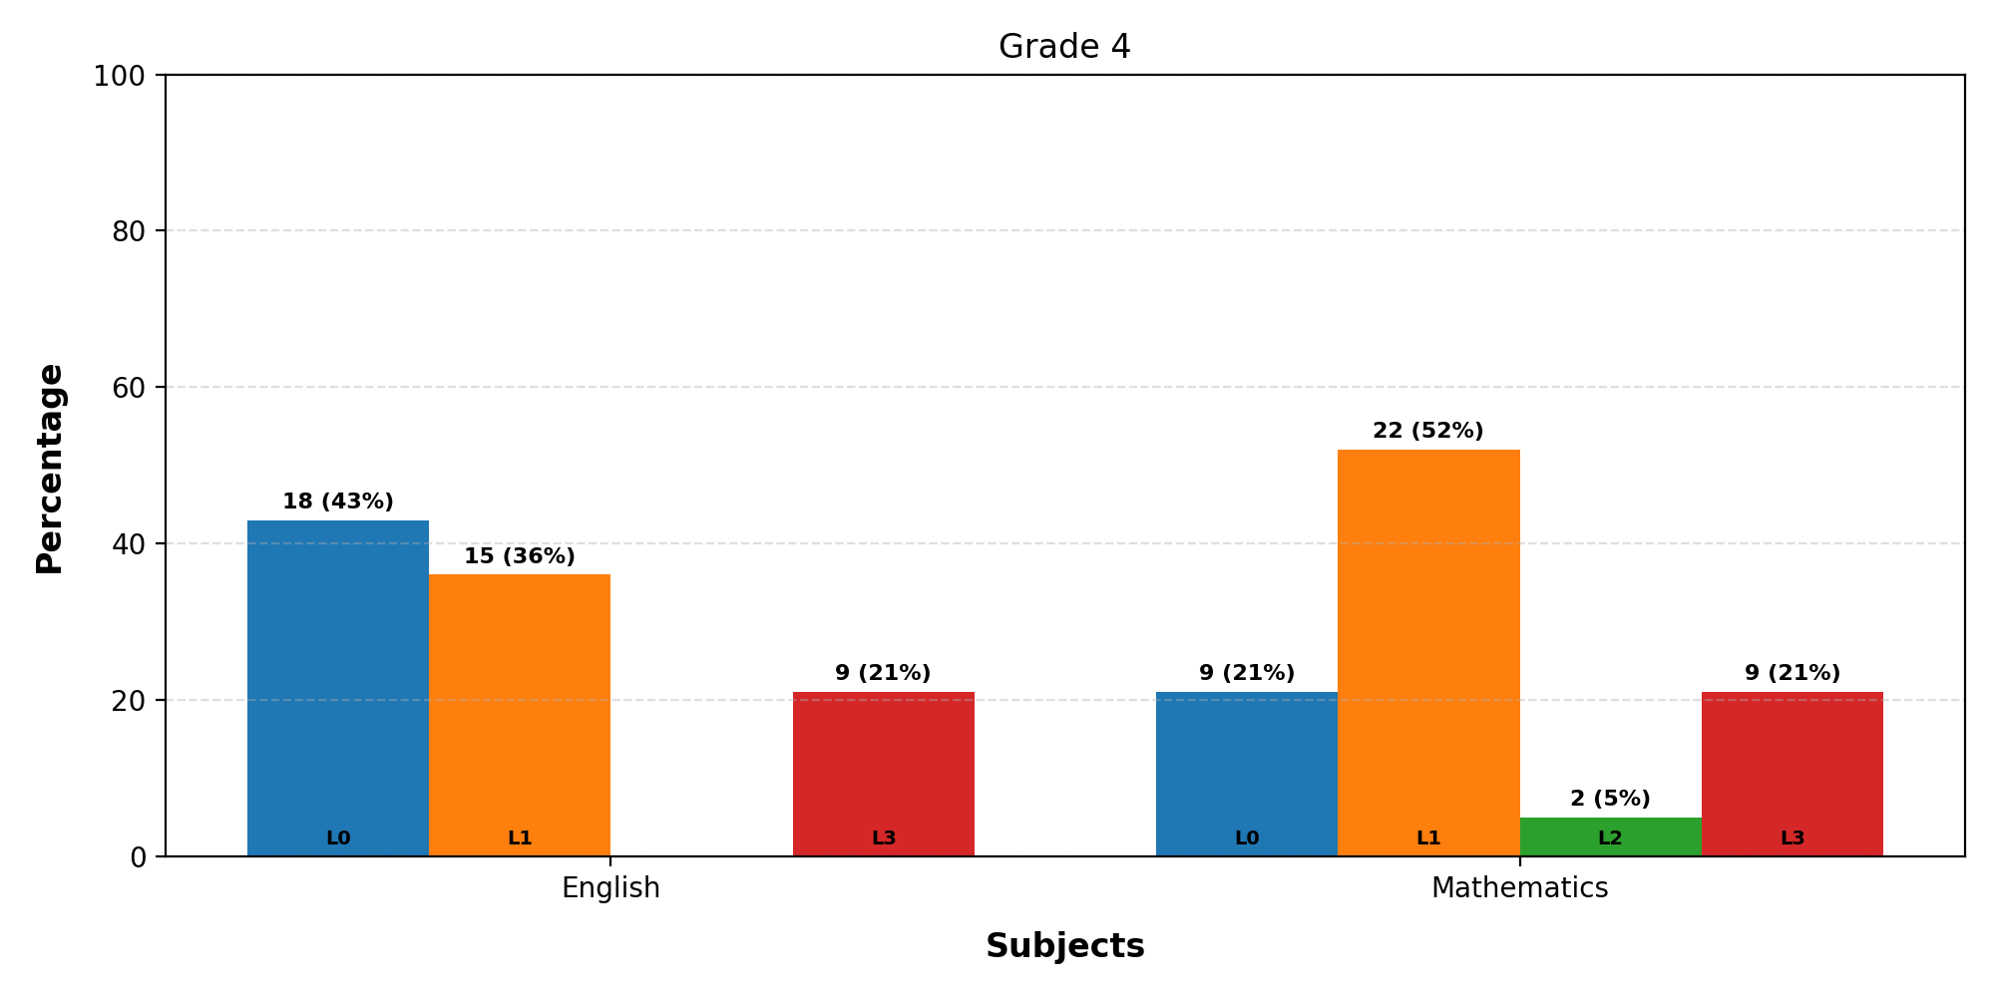
Mastery Levels Analysis - Grade 4
Note: L is Mastery Level

Slide 5
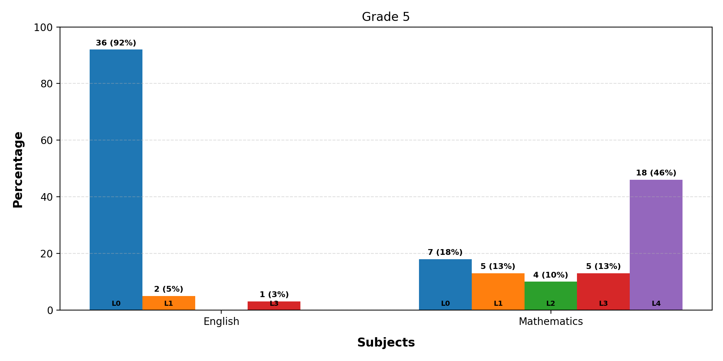
Mastery Levels Analysis - Grade 5
Note: L is Mastery Level

Slide 6
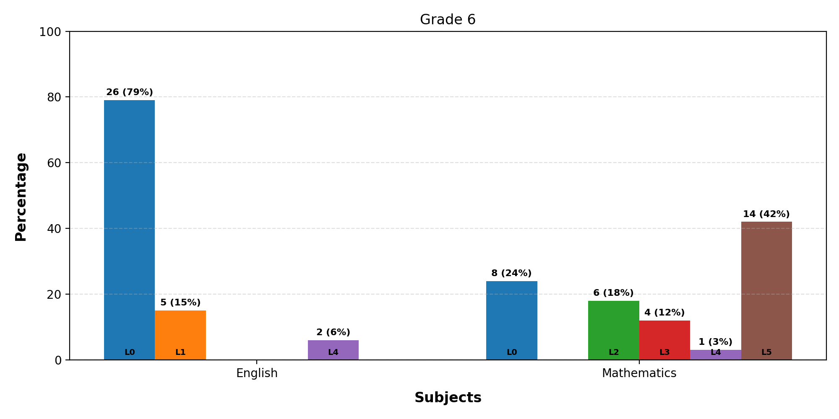
Mastery Levels Analysis - Grade 6
Note: L is Mastery Level

Slide 7
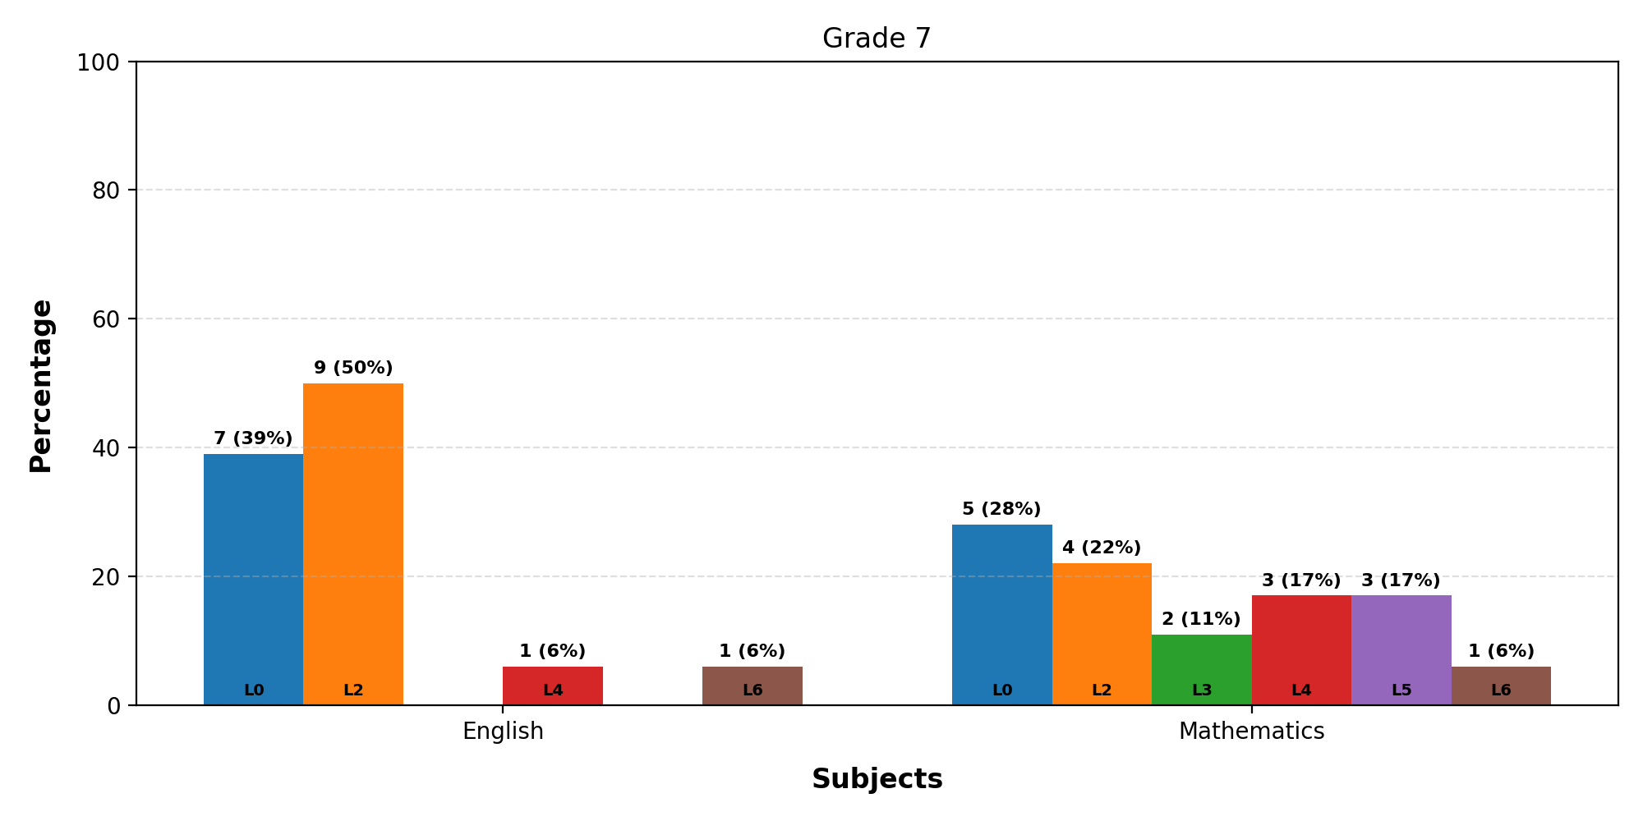
Mastery Levels Analysis - Grade 7
Note: L is Mastery Level

Slide 8
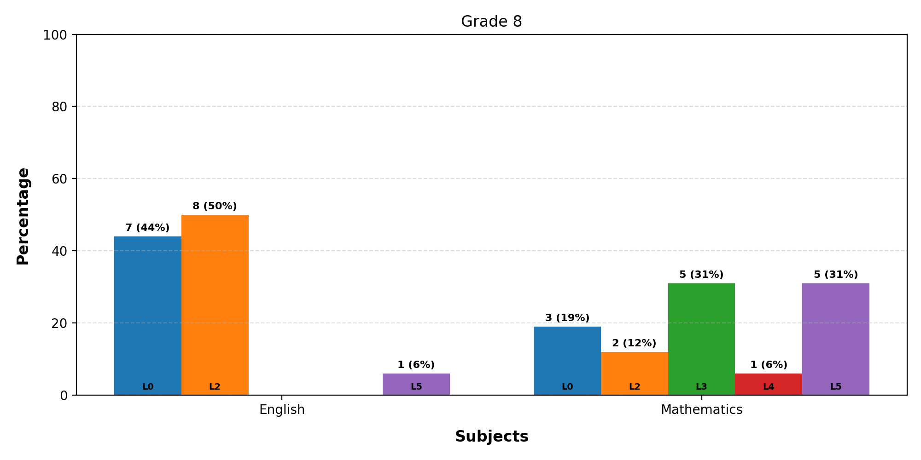
Mastery Levels Analysis - Grade 8
Note: L is Mastery Level

Slide 9
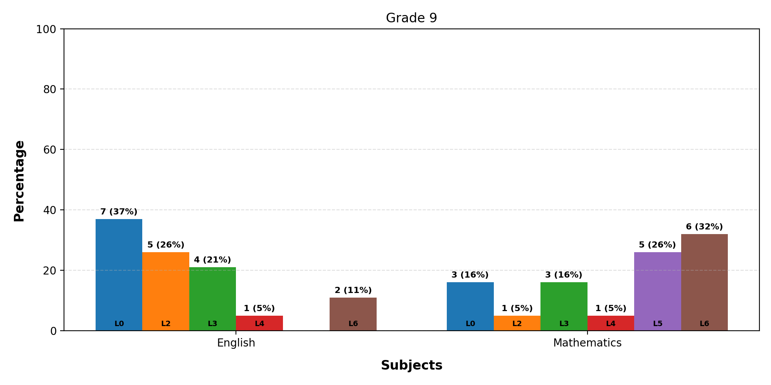
Mastery Levels Analysis - Grade 9
Note: L is Mastery Level

Slide 10
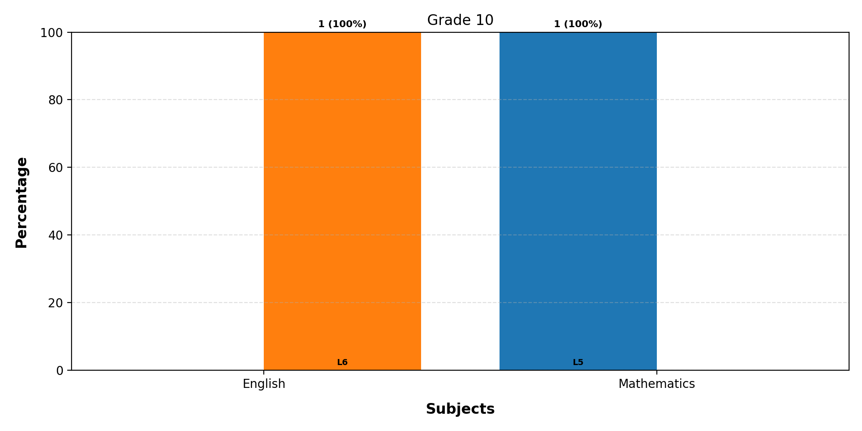
Mastery Levels Analysis - Grade 10
Note: L is Mastery Level

Slide 11
Learning Outcome Performance - Grade 1 - English
LO | Questions | Avg Performance (%)
The student will be able to give/explain the meaning of words in context. | Q3, Q4, Q5, Q7, Q8, Q9, Q10, Q11, Q12, Q13, Q15 | 51
The student will be able to identify/explain how information/narrative content is related and contributes to meanings as a whole. | Q2 | 65
The student will be able to make comparisons within the text. | Q1 | 70
The student will be able to retrieve and record information/identify key details from fiction and non-fiction. | Q6, Q14 | 78

Slide 12
Learning Outcome Performance - Grade 1 - Mathematics
LO | Questions | Avg Performance (%)
Compare 2-3 objects using terms like tall/short, heavy/light | Q7, Q15 | 87
Compares numbers using more, less, and equal | Q11 | 74
Match and name basic shapes; use positional words like “on”, “under” | Q8, Q9 | 71
Recognize coins and notes through play/poems/stories | Q10, Q14 | 84
Repeat simple AB/ABC patterns using objects, sounds, movements | Q2 | 85
Sort objects by color, size, shape (2-3 categories) | Q1 | 66
Understands and applies the concept of zero | Q12 | 77
Use terms like more/less/same up to 5 objects | Q3, Q4 | 86
Use vocabulary: today, tomorrow, yesterday; identify day/night | Q5, Q6 | 71
Uses symbols ‘+’ and ‘=’ in addition sentences | Q13 | 83

Slide 13
Learning Outcome Performance - Grade 2 - English
LO | Questions | Avg Performance (%)
The student will be able to comprehend literal information. | Q13 | 77
The student will be able to give/explain the meaning of words in context. | Q3, Q4, Q5, Q7, Q8, Q9, Q10, Q12, Q14, Q15 | 58
The student will be able to identify/explain how information/narrative content is related and contributes to meanings as a whole. | Q2 | 64
The student will be able to make comparisons within the text. | Q1 | 92
The student will be able to retrieve and record information/identify key details from fiction and non-fiction. | Q6, Q11 | 82

Slide 14
Learning Outcome Performance - Grade 2 - Mathematics
LO | Questions | Avg Performance (%)
Compare 2-3 objects using terms like tall/short, heavy/light | Q6, Q15 | 90
Compares numbers using more, less, and equal | Q10 | 77
Match and name basic shapes; use positional words like “on”, “under” | Q7, Q8 | 70
Recognize coins and notes through play/poems/stories | Q9, Q14 | 94
Repeat simple AB/ABC patterns using objects, sounds, movements | Q2 | 85
Sort objects by color, size, shape (2-3 categories) | Q1 | 69
Understands and applies the concept of zero | Q11 | 95
Understands and performs subtraction using real contexts | Q13 | 87
Use terms like more/less/same up to 5 objects | Q3 | 85
Use vocabulary: today, tomorrow, yesterday; identify day/night | Q4, Q5 | 70
Uses symbols ‘+’ and ‘=’ in addition sentences | Q12 | 87

Slide 15
Learning Outcome Performance - Grade 3 - English
LO | Questions | Avg Performance (%)
Antonym | Q13, Q14, Q15, Q16 | 70
The student will be able to give/explain the meaning of words in context. | Q1, Q2, Q3, Q4, Q5, Q6, Q7, Q8, Q9, Q10, Q11, Q12, Q17, Q18, Q19, Q20 | 70

Slide 16
Learning Outcome Performance - Grade 3 - Mathematics
LO | Questions | Avg Performance (%)
Adds numbers using real objects and illustrations | Q12 | 43
Adds two-digit numbers using place value and real objects | Q18, Q20 | 76
Compare 2-3 objects using terms like tall/short, heavy/light | Q6 | 92
Compares two-digit numbers using place value concepts | Q15, Q16, Q17, Q19 | 69
Match and name basic shapes; use positional words like “on”, “under” | Q7 | 81
Recognize coins and notes through play/poems/stories | Q8, Q13 | 86
Repeat simple AB/ABC patterns using objects, sounds, movements | Q2 | 92
Sort objects by color, size, shape (2-3 categories) | Q1 | 78
Understands and applies the concept of zero | Q9 | 78
Understands and performs subtraction using real contexts | Q14 | 35
Use terms like more/less/same up to 5 objects | Q3 | 76
Use vocabulary: today, tomorrow, yesterday; identify day/night | Q4, Q5 | 77
Uses symbols ‘+’ and ‘=’ in addition sentences | Q10, Q11 | 77

Slide 17
Learning Outcome Performance - Grade 4 - English
LO | Questions | Avg Performance (%)
Noun | Q11, Q12, Q13, Q14 | 55
Punctuation | Q6, Q7, Q8, Q9, Q10 | 55
The student will be able to give/explain the meaning of words in context. | Q16, Q17 | 46
The student will be able to retrieve and record information/identify key details from fiction and non-fiction. | Q1, Q2, Q3, Q4, Q5, Q15, Q18, Q19, Q20 | 48

Slide 18
Learning Outcome Performance - Grade 4 - Mathematics
LO | Questions | Avg Performance (%)
Arranges numbers in increasing order | Q5, Q6 | 43
Capacity | Q18 | 50
Compares two-digit numbers using place value concepts | Q12 | 76
Estimation | Q17 | 69
Match and name basic shapes; use positional words like “on”, “under” | Q2 | 71
Mixed operations | Q16 | 55
Pictographs | Q19 | 45
Recognize coins and notes through play/poems/stories | Q3 | 83
Solving Multiplication problems | Q15 | 55
Understands and applies basic addition and subtraction in money-related contexts | Q10 | 67
Understands and applies place value using tens and ones | Q11 | 71
Understands and applies the concept of zero | Q7 | 33
Understands and uses place value for two-digit numbers | Q13, Q14 | 62
Use terms like more/less/same up to 5 objects | Q1 | 76
Use vocabulary: today, tomorrow, yesterday; identify day/night | Q8, Q9 | 61
Uses symbols ‘+’ and ‘=’ in addition sentences | Q4 | 81
Weight | Q20 | 57

Slide 19
Learning Outcome Performance - Grade 5 - English
LO | Questions | Avg Performance (%)
Noun | Q8, Q9, Q10, Q11, Q12 | 28
Sentence | Q4, Q5, Q6 | 24
The student will be able to give/explain the meaning of words in context. | Q7, Q17, Q18 | 51
The student will be able to retrieve and record information/identify key details from fiction and non-fiction. | Q1, Q2, Q3, Q13, Q14, Q15, Q16, Q19, Q20 | 48

Slide 20
Learning Outcome Performance - Grade 5 - Mathematics
LO | Questions | Avg Performance (%)
Addition and Subtraction | Q11, Q12, Q13, Q20 | 72
Compares two-digit numbers using place value concepts | Q8, Q10 | 70
Division | Q17, Q18 | 60
Fractional Numbers | Q9 | 23
Length | Q15 | 56
Match and name basic shapes; use positional words like “on”, “under” | Q3 | 85
Measurement (Weight) | Q19 | 51
Multiplication | Q16 | 59
Recognizes and writes numbers up to 9 | Q4, Q5 | 80
Solves simple word problems involving money | Q7 | 77
Understands and applies the concept of zero | Q6 | 82
Use vocabulary: today, tomorrow, yesterday; identify day/night | Q1, Q2 | 74
Weight | Q14 | 77

Slide 21
Learning Outcome Performance - Grade 6 - English
LO | Questions | Avg Performance (%)
Adverb | Q6 | 67
Antonym | Q14 | 76
Masculine-Feminine | Q18 | 42
Noun | Q8, Q19 | 40
Parts of Speech | Q13 | 76
Pronoun | Q5 | 55
Punctuation | Q7 | 52
Rhyming Words | Q4 | 42
Root Word | Q11 | 73
Sentence | Q1, Q9, Q12 | 47
The student will be able to identify/explain how information/narrative content is related and contributes to meanings as a whole. | Q16 | 48
The student will be able to identify/explain how meaning is enhanced through choice of words and phrases. | Q2, Q15 | 34
The student will be able to make comparisons within the text. | Q3, Q17 | 22
The student will be able to make inferences from the text/explain and justify inferences with evidence from the text. | Q10 | 67
Verb | Q20 | 52

Slide 22
Learning Outcome Performance - Grade 6 - Mathematics
LO | Questions | Avg Performance (%)
Addition and Subtraction | Q6, Q20 | 76
Compares two-digit numbers using place value concepts | Q5 | 45
Comparing Numbers | Q10 | 48
Conversions | Q17 | 67
Data Handling | Q15 | 70
Expanding Numbers | Q9 | 67
Explains regrouping while adding/subtracting 2-digit numbers | Q2 | 55
Fractional Numbers | Q11 | 70
Identifies and differentiates 2D shapes in real life | Q3, Q4 | 64
Like and Unlike Fractions | Q16 | 64
Measurement (Weight) | Q12 | 76
Mixed operations | Q7 | 58
Numbers up to 10,000 | Q19 | 61
Perimeters | Q14 | 12
Right Angles | Q18 | 61
Shapes and Spatial Understanding | Q13 | 39
Solving Multiplication problems | Q8 | 88
Understands and applies place value using tens and ones | Q1 | 64

Slide 23
Learning Outcome Performance - Grade 7 - English
LO | Questions | Avg Performance (%)
Adjective | Q14 | 22
Conjunction | Q7, Q10, Q17 | 32
Homophone | Q11, Q18 | 25
Noun | Q19 | 39
Pronoun | Q5 | 50
Punctuation | Q4 | 33
Sentence | Q1, Q2, Q3, Q6, Q15, Q16, Q20 | 36
Tense | Q13 | 44
The student will be able to give/explain the meaning of words in context. | Q8, Q9, Q12 | 37

Slide 24
Learning Outcome Performance - Grade 7 - Mathematics
LO | Questions | Avg Performance (%)
Addition and Subtraction | Q8, Q9, Q11 | 44
Capacity | Q5 | 72
Comparing Decimals | Q18 | 17
Concept of Kilogram and Quintal | Q10 | 67
Differentiates between longer and shorter paths or objects | Q3 | 89
Division | Q14 | 44
Improper and Mixed Fractions | Q12, Q13 | 42
Large Numbers in Practice | Q19 | 17
Measurement (Length) | Q7 | 67
Perimeters | Q6 | 28
Shapes and Spatial Understanding | Q17 | 56
Solving Multiplication problems | Q16 | 67
Understands and applies place value using tens and ones | Q1, Q15 | 50
Understands and applies the concept of multiplication as repeated addition | Q2, Q20 | 61
Weight | Q4 | 78

Slide 25
Learning Outcome Performance - Grade 8 - English
LO | Questions | Avg Performance (%)
Adjective | Q14 | 25
Conjunction | Q7, Q10, Q17 | 56
Homophone | Q11, Q18 | 34
Noun | Q19 | 50
Pronoun | Q5 | 44
Punctuation | Q4 | 19
Sentence | Q1, Q2, Q3, Q6, Q15, Q16, Q20 | 36
Tense | Q13 | 38
The student will be able to give/explain the meaning of words in context. | Q8, Q9, Q12 | 25

Slide 26
Learning Outcome Performance - Grade 8 - Mathematics
LO | Questions | Avg Performance (%)
Addition and Subtraction | Q8, Q9, Q11 | 66
Capacity | Q5 | 81
Comparing Decimals | Q18 | 12
Concept of Kilogram and Quintal | Q10 | 56
Differentiates between longer and shorter paths or objects | Q3 | 88
Division | Q14 | 69
Improper and Mixed Fractions | Q12, Q13 | 34
Large Numbers in Practice | Q19 | 25
Measurement (Length) | Q7 | 69
Perimeters | Q6 | 19
Shapes and Spatial Understanding | Q17 | 44
Solving Multiplication problems | Q16 | 75
Understands and applies place value using tens and ones | Q1, Q15 | 66
Understands and applies the concept of multiplication as repeated addition | Q2, Q20 | 78
Weight | Q4 | 62

Slide 27
Learning Outcome Performance - Grade 9 - English
LO | Questions | Avg Performance (%)
Adjective | Q14 | 32
Conjunction | Q7, Q10, Q17 | 49
Homophone | Q11, Q18 | 42
Noun | Q19 | 47
Pronoun | Q5 | 47
Punctuation | Q4 | 58
Sentence | Q1, Q2, Q3, Q6, Q15, Q16, Q20 | 43
Tense | Q13 | 53
The student will be able to give/explain the meaning of words in context. | Q8, Q9, Q12 | 49

Slide 28
Learning Outcome Performance - Grade 9 - Mathematics
LO | Questions | Avg Performance (%)
Addition and Subtraction | Q8, Q9, Q11 | 73
Capacity | Q5 | 89
Comparing Decimals | Q18 | 58
Concept of Kilogram and Quintal | Q10 | 68
Differentiates between longer and shorter paths or objects | Q3 | 89
Division | Q14 | 74
Improper and Mixed Fractions | Q12, Q13 | 50
Large Numbers in Practice | Q19 | 47
Measurement (Length) | Q7 | 79
Perimeters | Q6 | 26
Shapes and Spatial Understanding | Q17 | 68
Solving Multiplication problems | Q16 | 89
Understands and applies place value using tens and ones | Q1, Q15 | 79
Understands and applies the concept of multiplication as repeated addition | Q2, Q20 | 82
Weight | Q4 | 84

Slide 29
Learning Outcome Performance - Grade 10 - English
LO | Questions | Avg Performance (%)
Adjective | Q14 | 100
Conjunction | Q7, Q10, Q17 | 67
Homophone | Q11, Q18 | 100
Noun | Q19 | 100
Pronoun | Q5 | 100
Punctuation | Q4 | 100
Sentence | Q1, Q2, Q3, Q6, Q15, Q16, Q20 | 86
Tense | Q13 | 100
The student will be able to give/explain the meaning of words in context. | Q8, Q9, Q12 | 67

Slide 30
Learning Outcome Performance - Grade 10 - Mathematics
LO | Questions | Avg Performance (%)
Addition and Subtraction | Q8, Q9, Q11 | 100
Capacity | Q5 | 100
Comparing Decimals | Q18 | 0
Concept of Kilogram and Quintal | Q10 | 100
Differentiates between longer and shorter paths or objects | Q3 | 100
Division | Q14 | 100
Improper and Mixed Fractions | Q12, Q13 | 100
Large Numbers in Practice | Q19 | 0
Measurement (Length) | Q7 | 100
Perimeters | Q6 | 0
Shapes and Spatial Understanding | Q17 | 100
Solving Multiplication problems | Q16 | 100
Understands and applies place value using tens and ones | Q1, Q15 | 100
Understands and applies the concept of multiplication as repeated addition | Q2, Q20 | 100
Weight | Q4 | 100

Slide 31
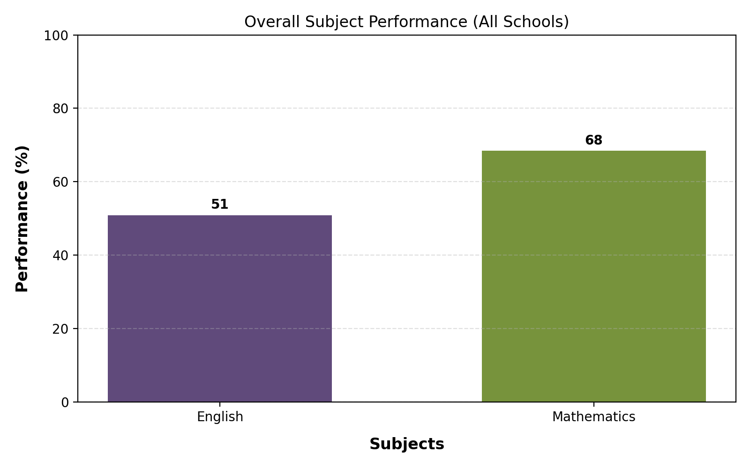
Overall Subject Performance (All Schools)

Slide 32
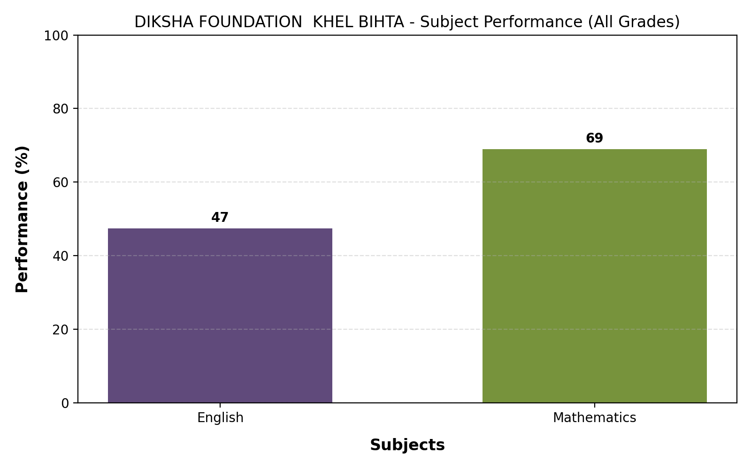
DIKSHA FOUNDATION KHEL BIHTA - Subject Performance (All Grades)

Slide 33
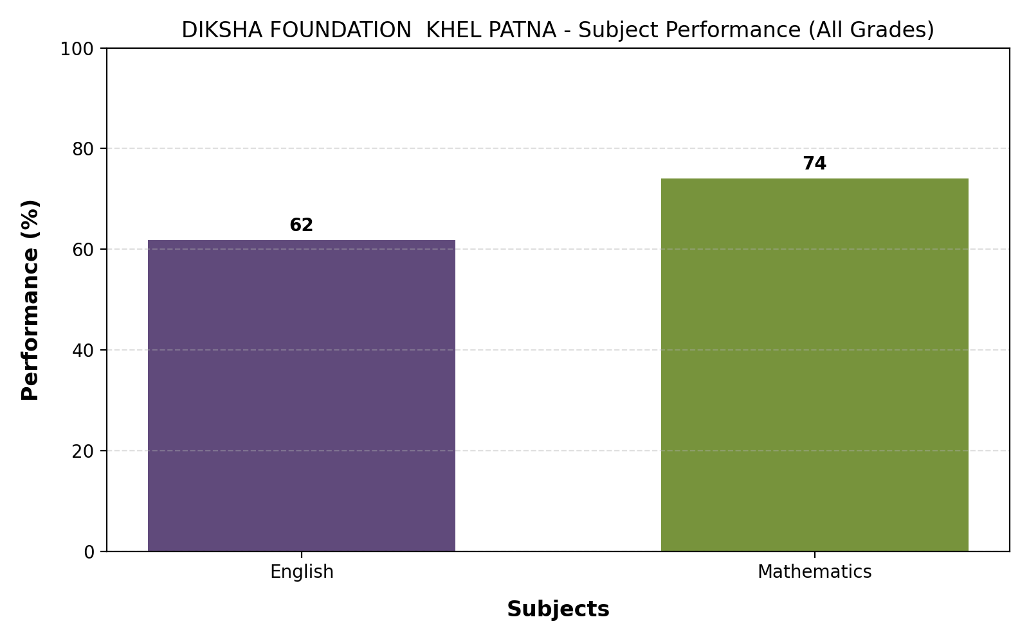
DIKSHA FOUNDATION KHEL PATNA - Subject Performance (All Grades)

Slide 34
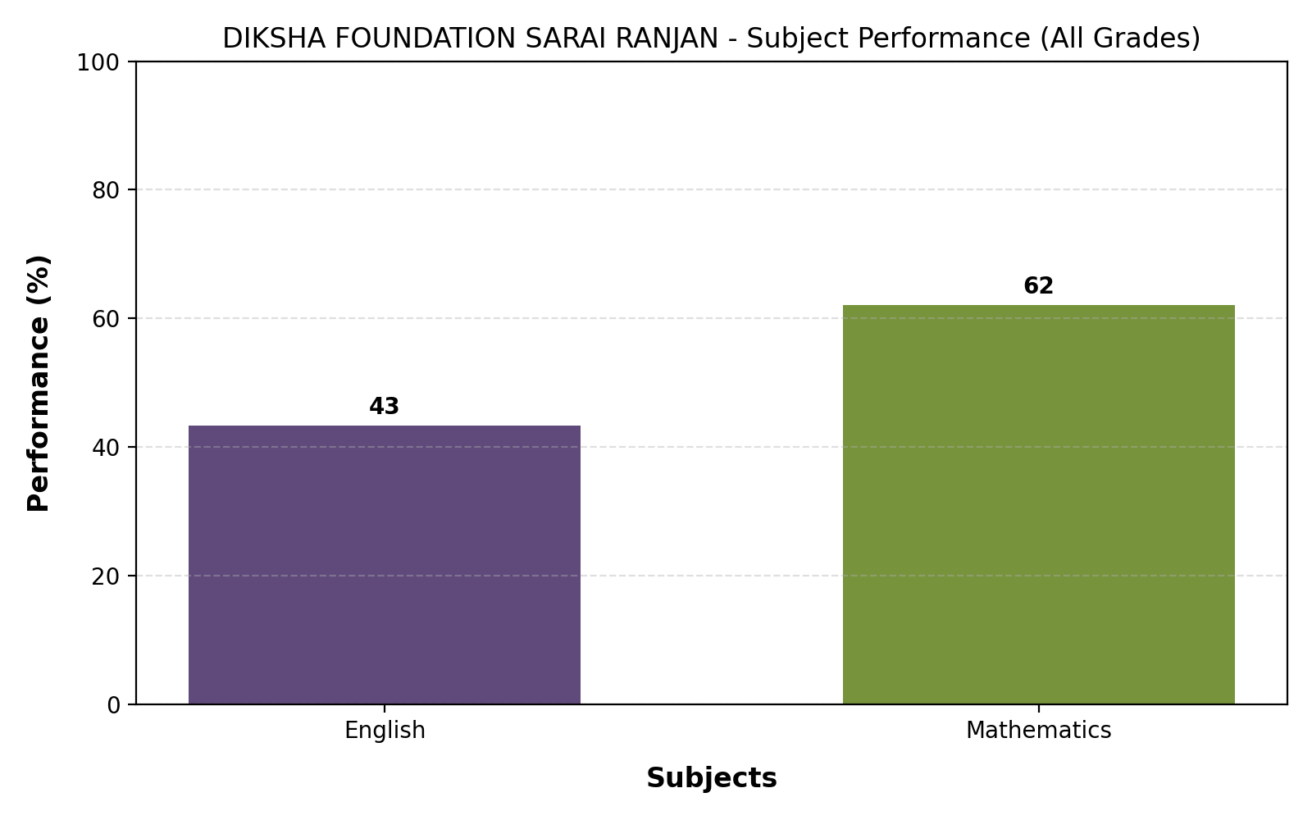
DIKSHA FOUNDATION SARAI RANJAN - Subject Performance (All Grades)

Slide 35
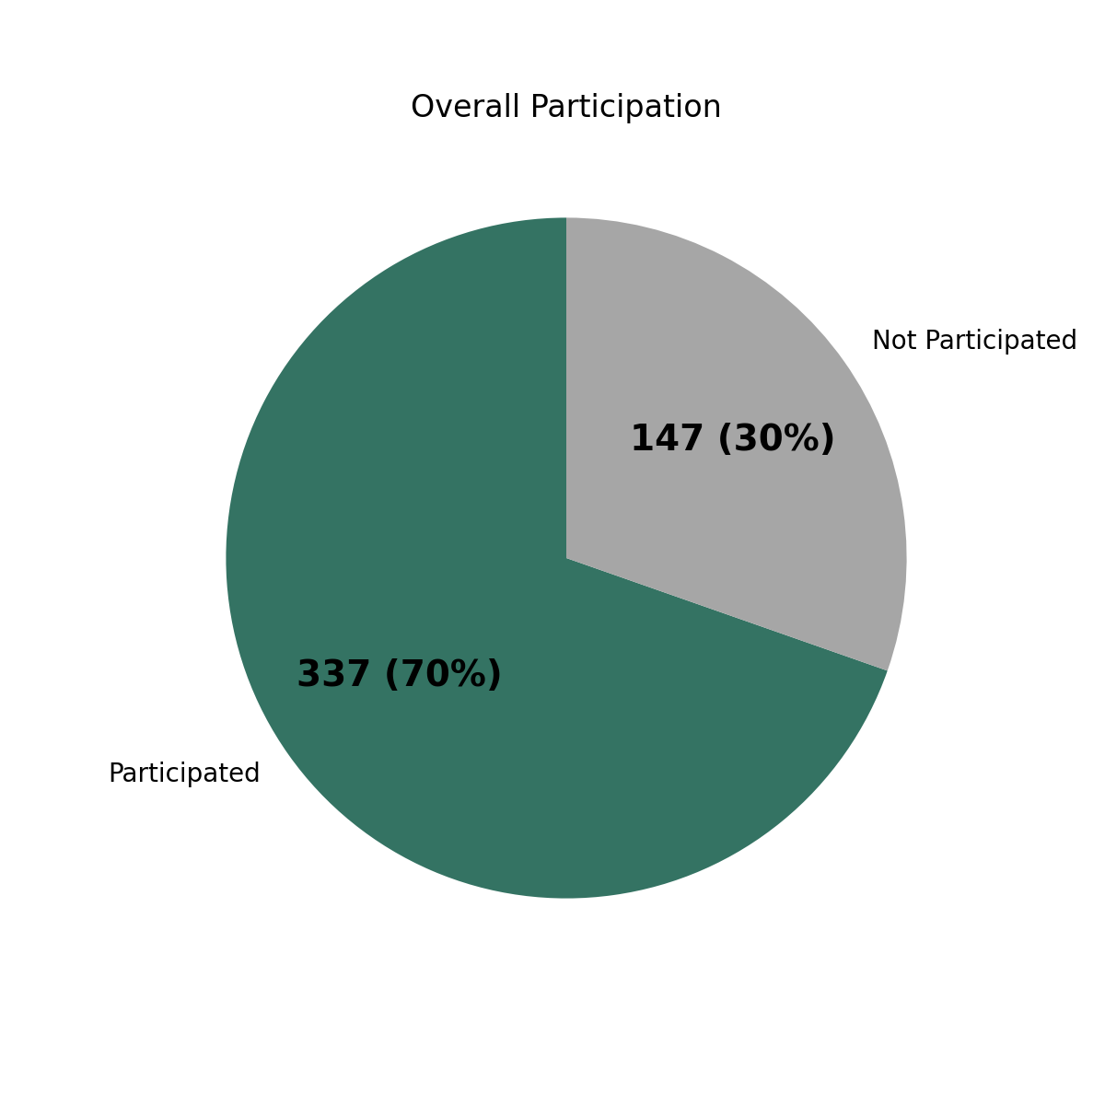
Overall Participation
Total Registrations: 484

Slide 36
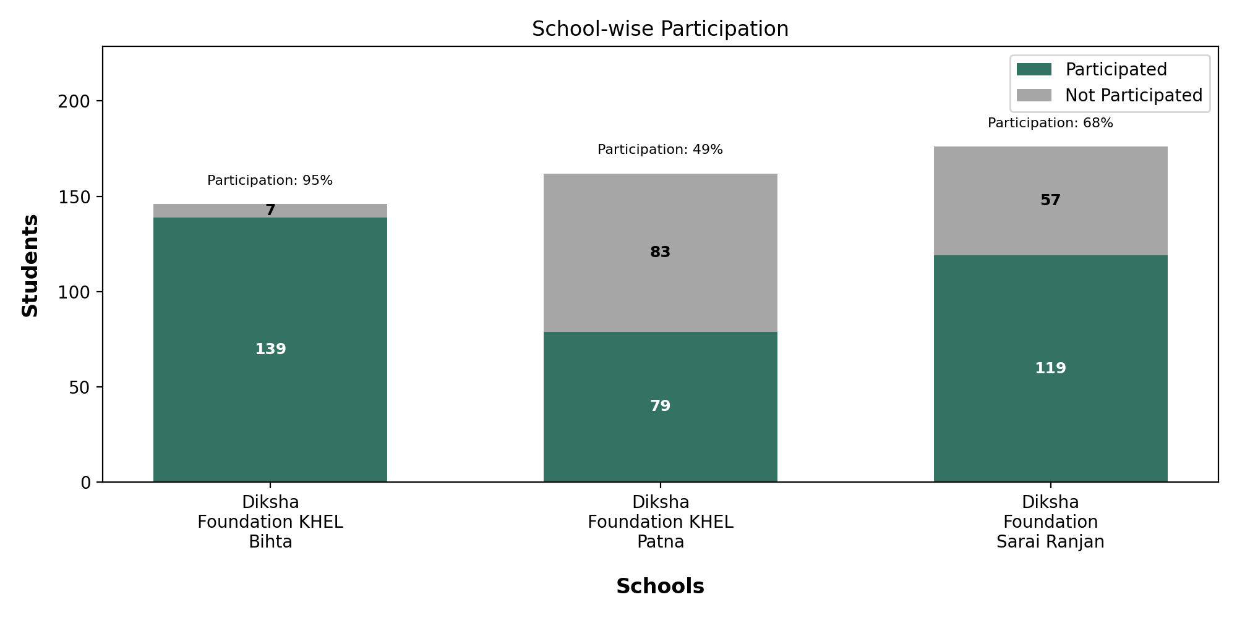
School-wise Participation

Slide 37
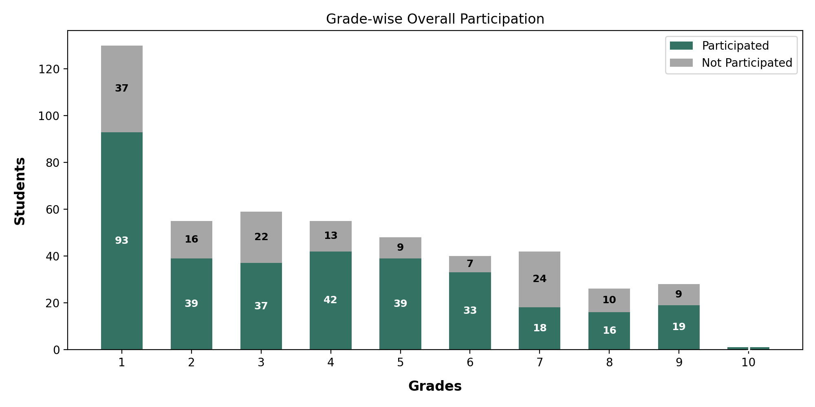
Grade-wise Overall Participation

Slide 38
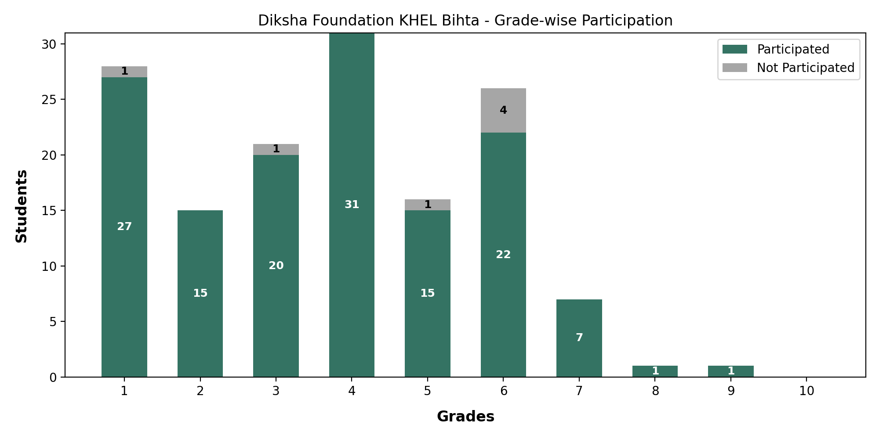
Diksha Foundation KHEL Bihta - Grade-wise Participation

Slide 39
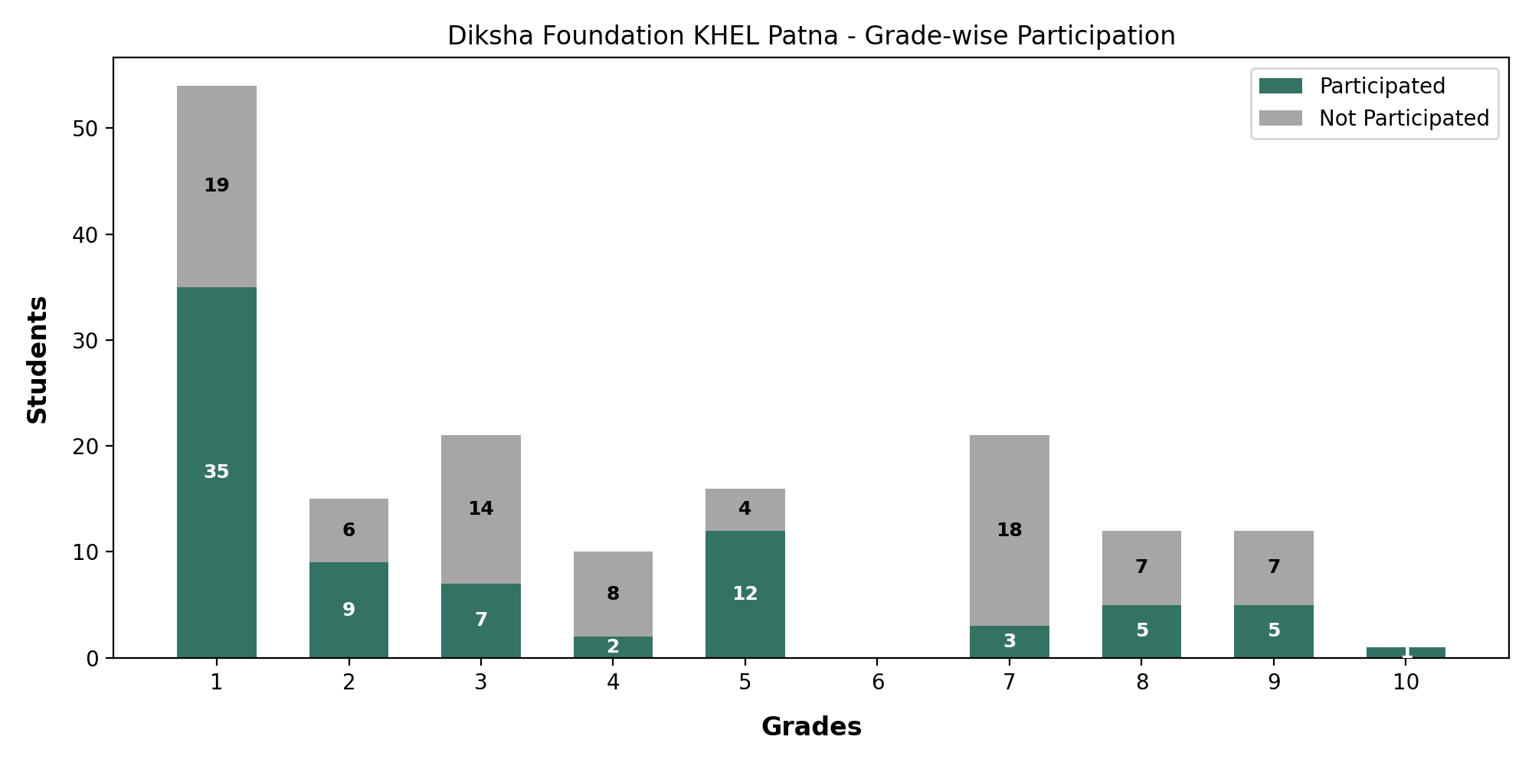
Diksha Foundation KHEL Patna - Grade-wise Participation

Slide 40
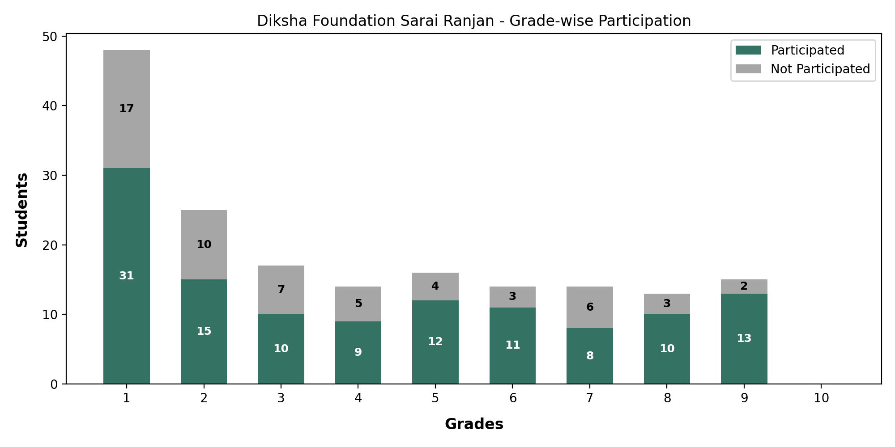
Diksha Foundation Sarai Ranjan - Grade-wise Participation

