Slide 1
Wallmart Sales Forecast Using Deep learning
Since databrick doesn’t support GPU enabled worksheet in community edition, I turned the Google colab into SPARK environment and worked with pyspark
Implementation done by Keras using pyspark

Slide 2
Why deep learning for Forecast?
Deeplearnig
Accurate Long term forecast is possible (in this work, I forecasted 8 months of data)
Does not rely on linear relationship
Easy to deduce complex patterns from multivariate data
Works best even with missing Data’s
Handles noisy data quiet well compared to ARIMA, ARMA

Slide 3
Why LSTM?
Capable to maintain information of the previous input using its internal memory.
loops allow information to be carried across neurons while reading in the input, this helps to deduce correlation of attributes and their relationships

Slide 4
Can the concept of sales forecasting be used for Product demand forecasting?
Yes, Iniatilizing input layer with number of neurons equal to the number of attributes and by choosing appropriate number of hidden layer that will significantly help to reduce the loss function

Slide 5
Walmart Dataset (sales forecast kaggle competition)
Historical Sales Dataset of 45 wall mart stores located in different region
Each store contains number of departments
stores.csv
contains anonymized information about the 45 stores, indicating the type and size of store.
train.csv
Historical training data, which covers to 2010-02-05 to 2012-11-01.
Attributes are
Store - the store number
Dept - the department number
Date - the week
Weekly_Sales - sales for the given department in the given store
IsHoliday - whether the week is a special holiday week

Slide 6
Features.csv
Contains additional data related to the store, department, and regional activity for the given dates.
Attributes are
Store - the store number
Date - the week
Temperature - average temperature in the region
Fuel_Price - cost of fuel in the region
MarkDown1-5 - anonymized data related to promotional markdowns that Walmart is running. MarkDown data is only available after Nov 2011, and is not available for all stores all the time. Any missing value is marked with an NA.
CPI - the consumer price index
Unemployment - the unemployment rate
IsHoliday - whether the week is a special holiday week

Slide 7
Train.csv
Store.csv
Features.csv
Join on Store id
Intermediate dataframe
Join on Store id, date, isholiday
Final dataframe

Slide 8


Steps to convert Colab to SPARK
Install Spark
Set Environmental variables
Work with pyspark

Slide 9
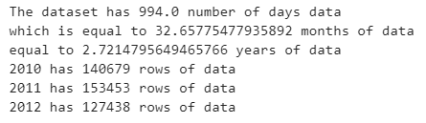
General information about dataset

Slide 10
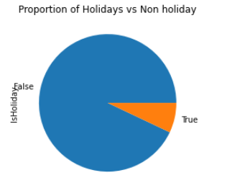
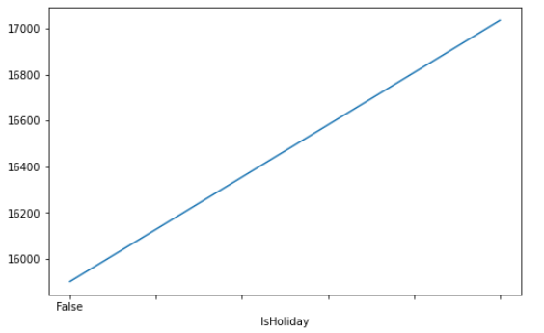
Exploratory Data Analysis
Non holiday data is more compared to the data’s recorded during holiday
Average of weekly Sales during
Holiday is more compared to Non-Holidays

Slide 11
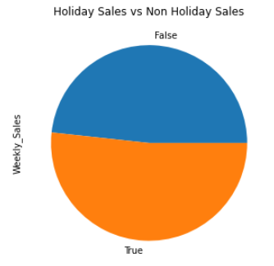
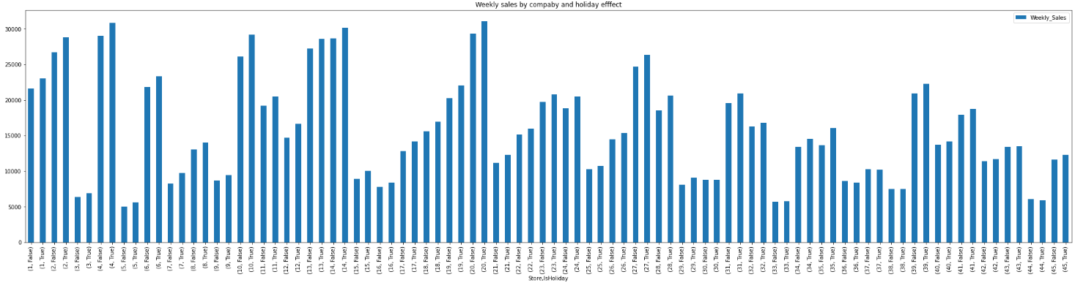
Sales during Holidays is more compared to non holiday sales
Bar chart indicating the sales of each store during holiday and non holidays

Slide 12
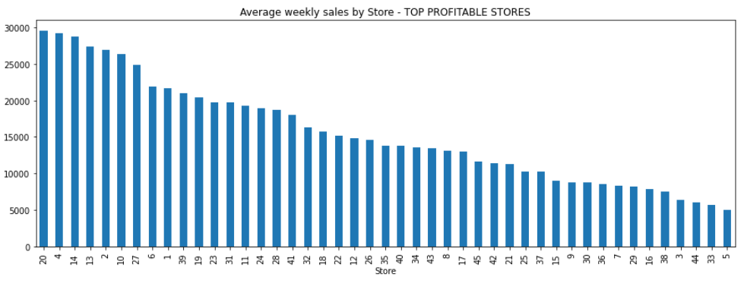
Stores with maximum sales recorded and minimum are clearly seen here

Slide 13
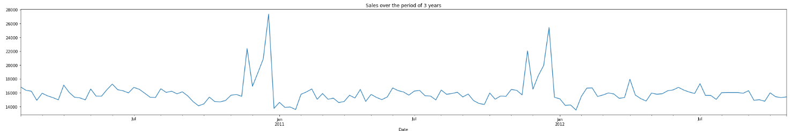
Clearly there is
Seasonality
Trend
Cyclicity
Some visually evident patters are shown by arrows of varying color and size

Slide 14
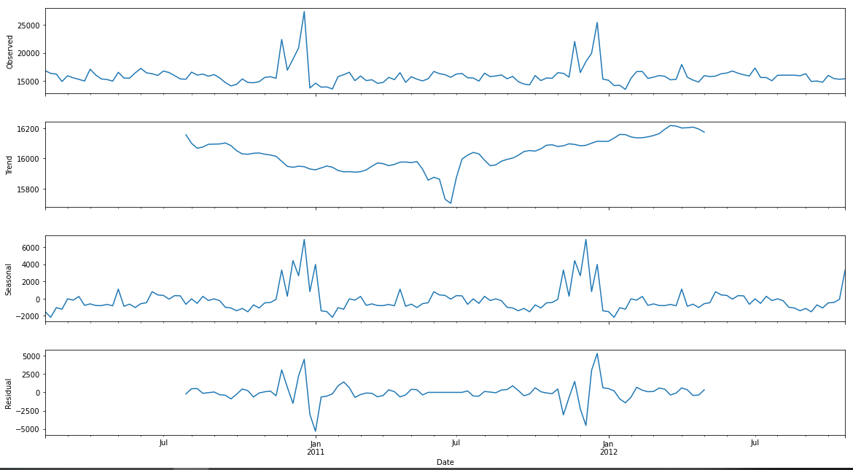
Trend, Seasonality decomposition

Slide 15
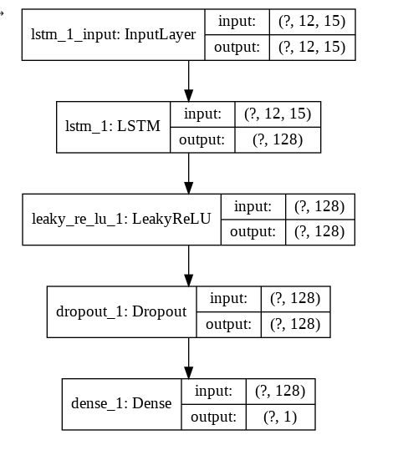
How the model is trained?
Data's has data recorded monthly 4 times accounting to 48 set of data's across various data;
So 12 set of data corresponding to each yearly Quarter are fed to LSTM
Why train using Quarterly data and not monthly data?
- To capture seasonality by four seasons

Slide 16
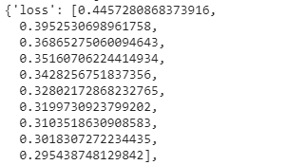
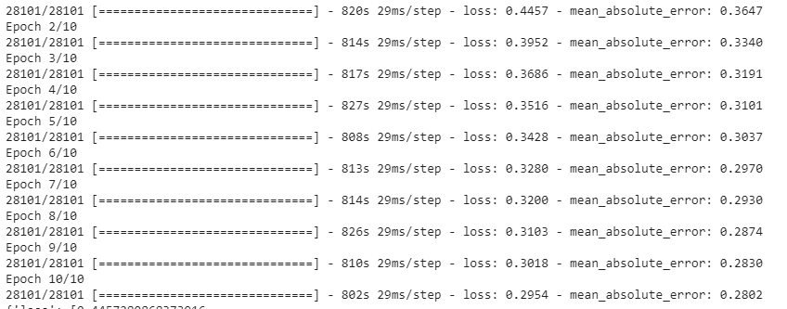
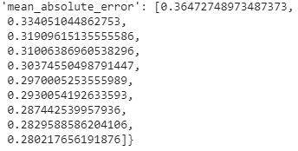
Model is trained using 10 epochs, the mean absolute error are noted
Mean absolute error and loss are found decreasing with repeated training

Slide 17
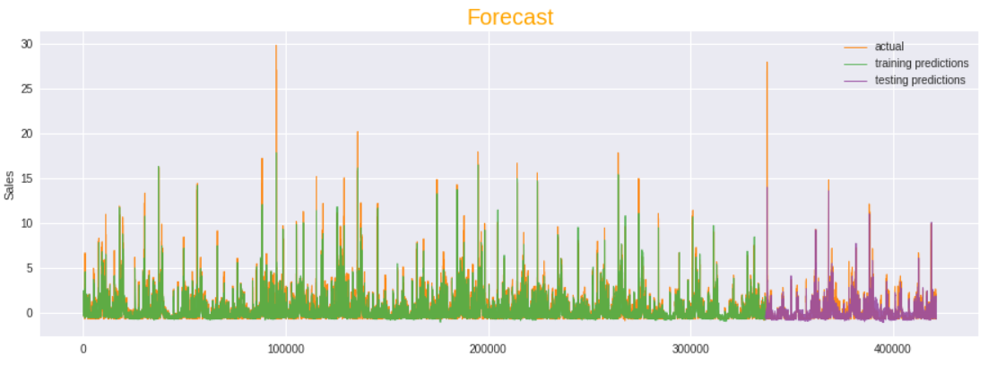
With 2 years of data, the 3rd year’s weekly sales forecast is forecasted by our LSTM model
The actual vs testing prediction are shown, we see the trend and seasonality are maintained and near accurate forecast is made

