Slide 2


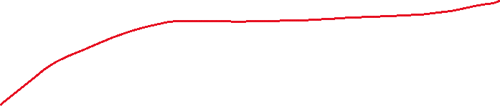










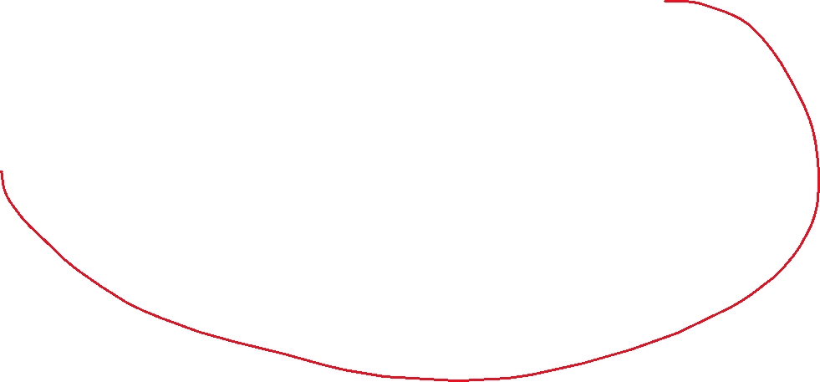








Slide 3
State 0: Noise Identification
No toque applied
Compute maximum of absoluted value of velocity in a defined time window

