Slide 1
Unit: Optimality Conditions and Karush Kuhn Tucker Theorem

Slide 2
Goals
What is the Gradient of a function? What are its properties?
How can it be used to find a linear approximation of a nonlinear function?
Given a continuously differentiable function, which equations are fulfilled for local optima in the following cases?
  Unconstrained
  Equality Constraints
  Inequality Constraints
How can this be used to find Pareto fronts analytically?
How to state conditions for locally efficient in multiobjective optimization?

Slide 3
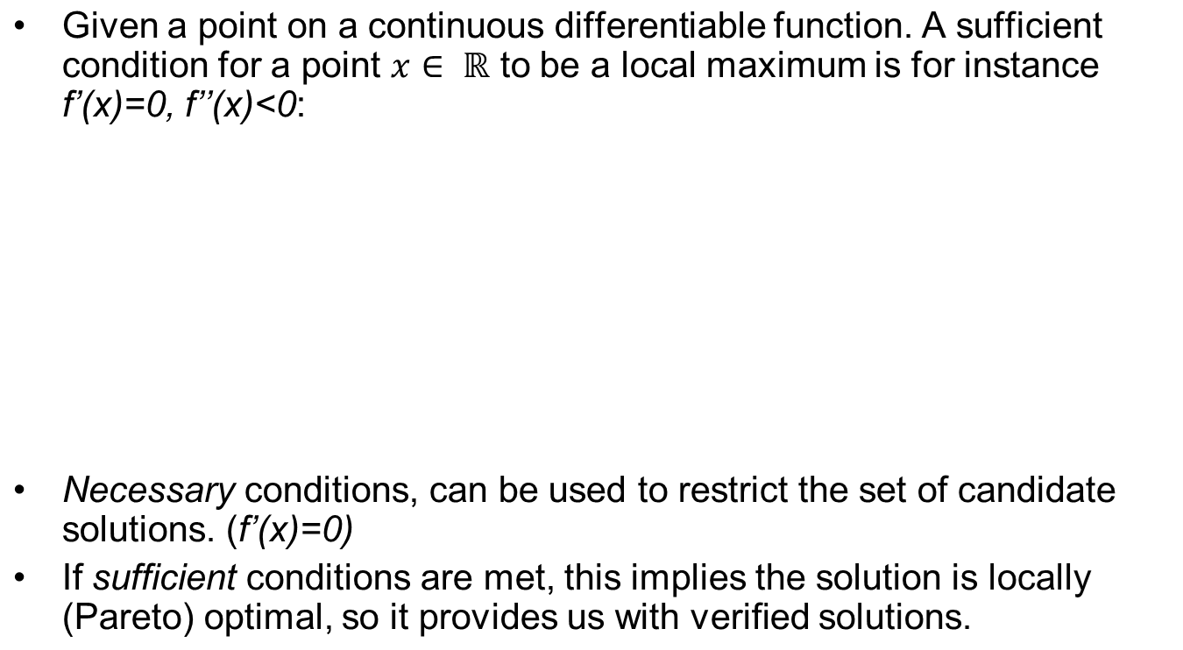



Optimality conditions for differentiable problems

Slide 4
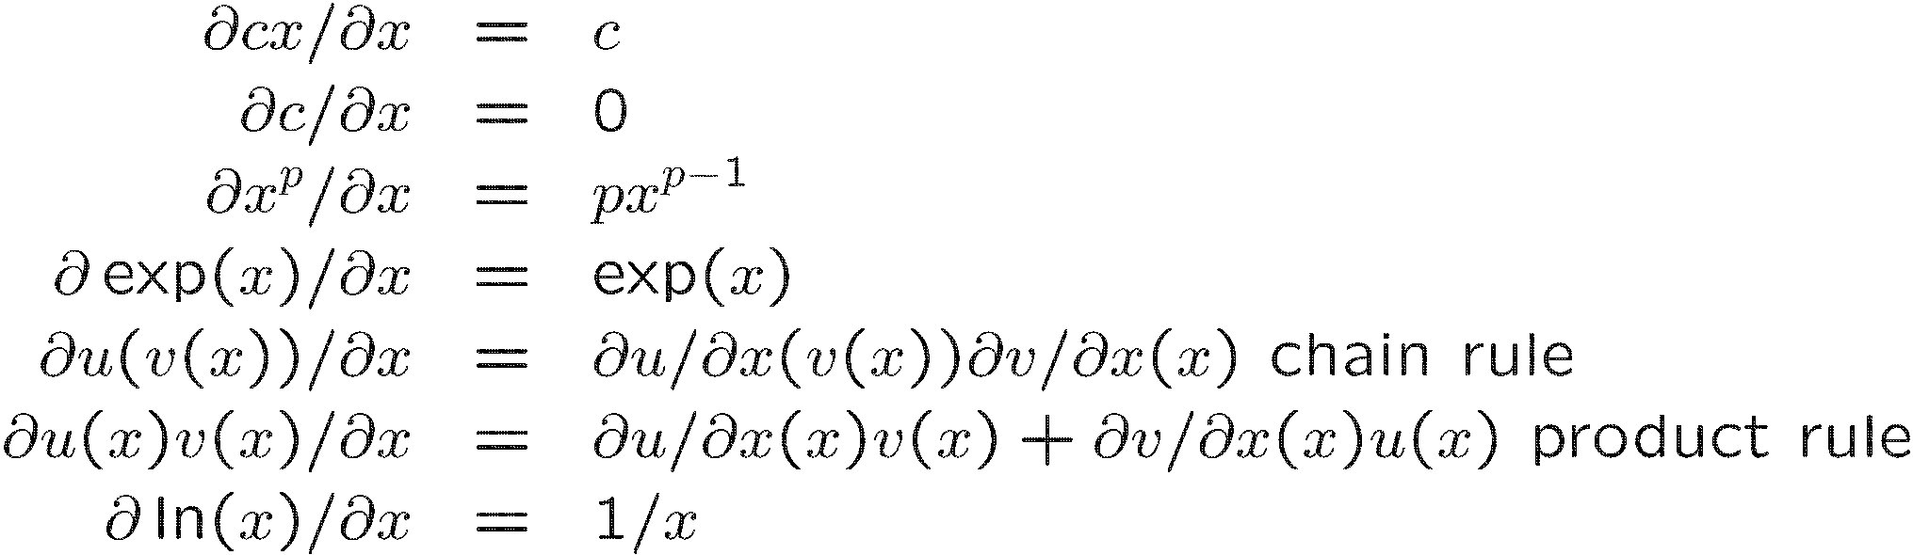
Recall: Derivatives

Slide 5
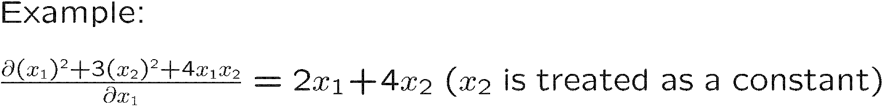
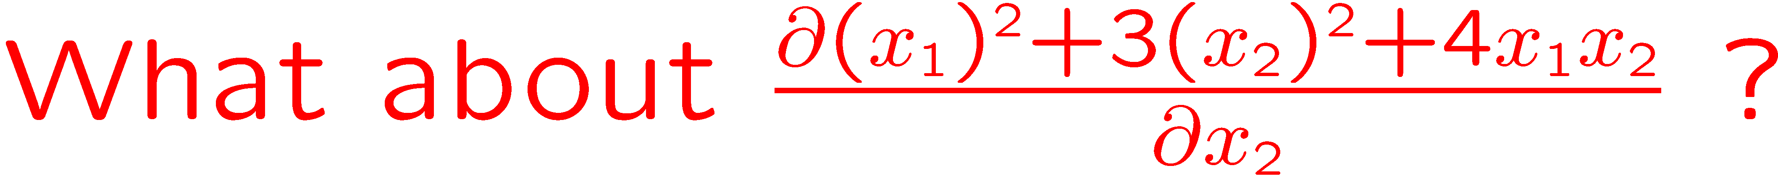
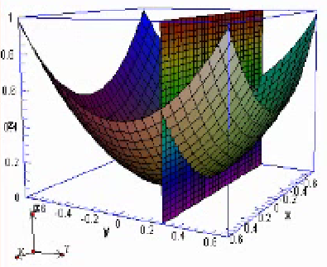
Recall: Partial Derivatives
https://www.khanacademy.org/math/multivariable-calculus/partial_derivatives_topic/partial_derivatives/v/partial-derivatives

Slide 6
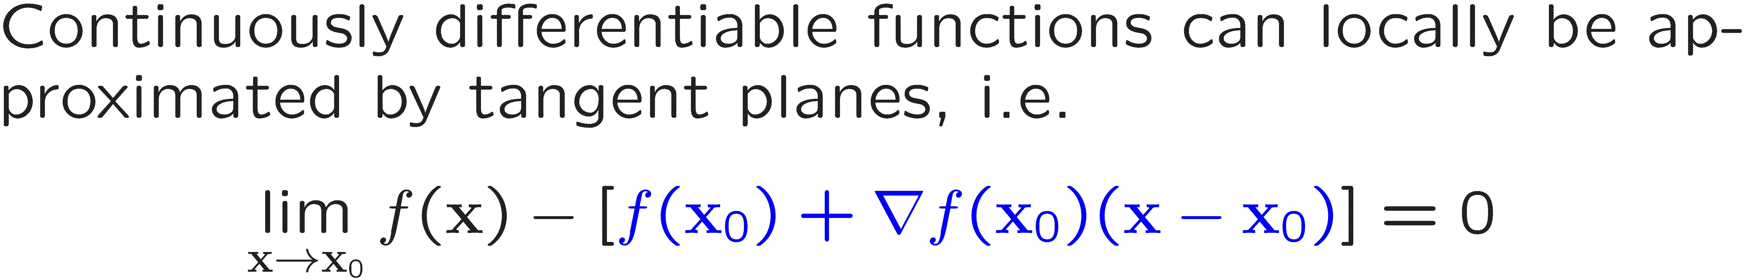
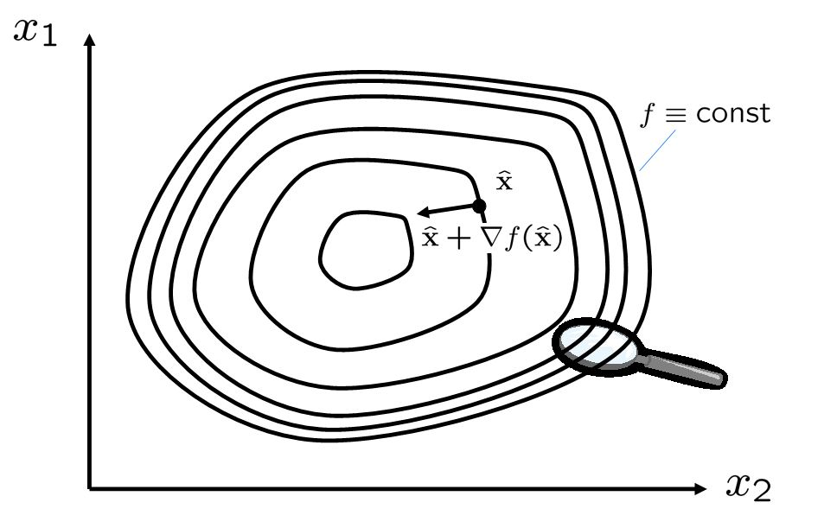
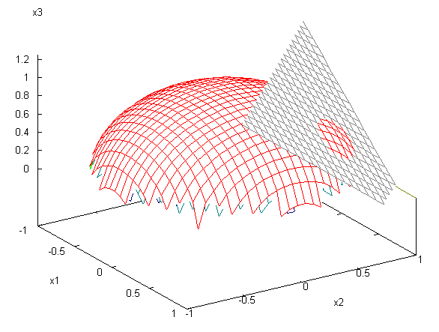
Gradient / Linear Taylor Approximations

Slide 7
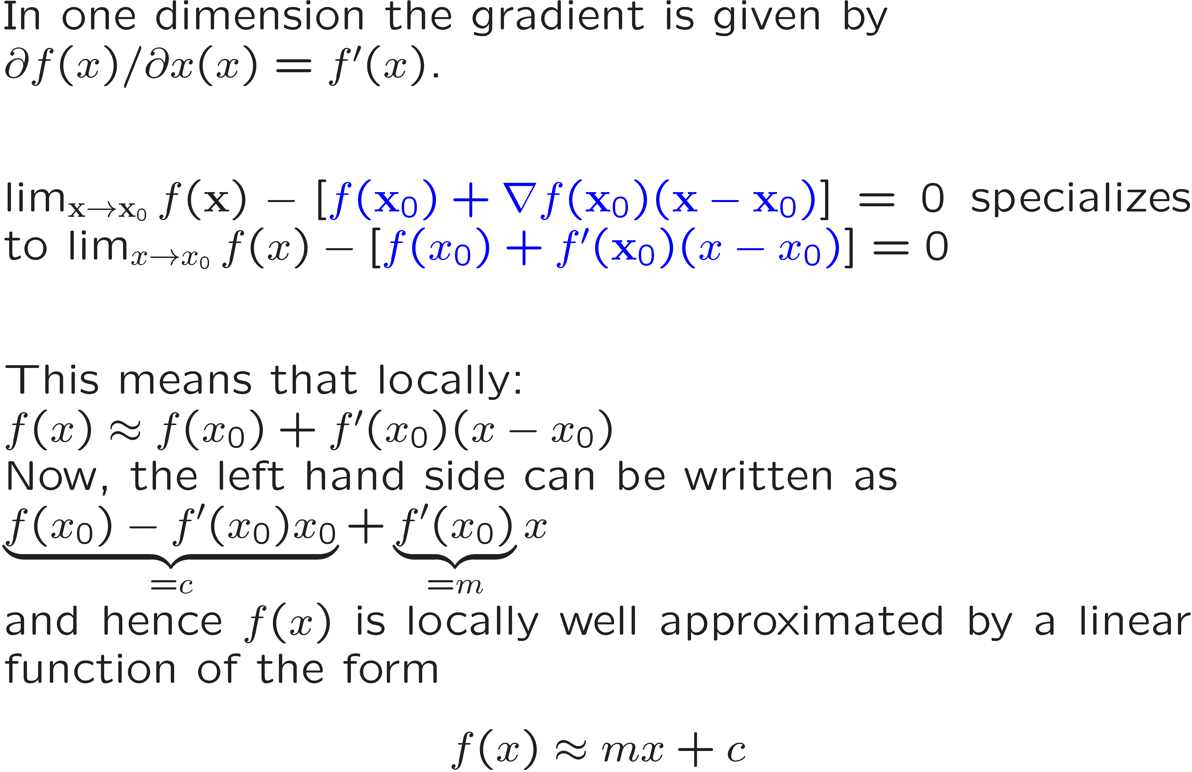
Example 1-Dimension

Slide 8
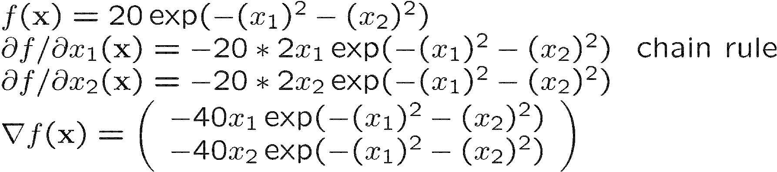
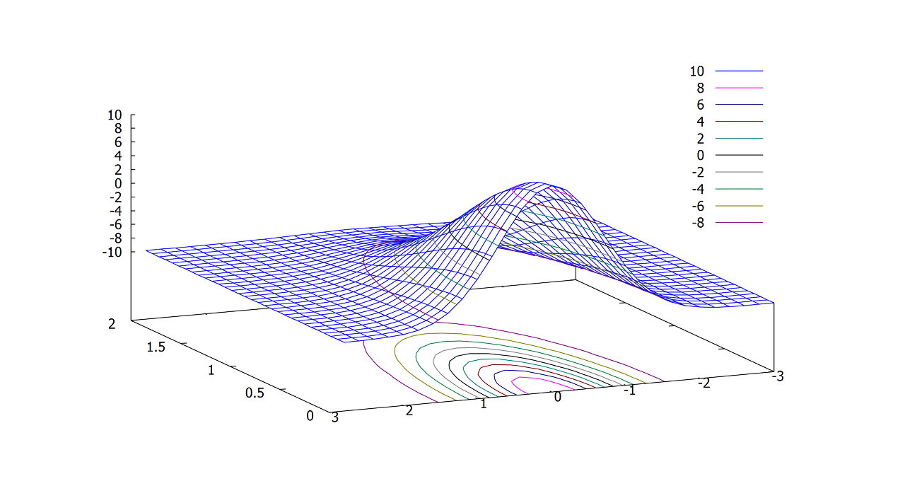
Gradient computation: Example
Program: wxMaxima:
load(draw);
draw3d(explicit(20*exp(-x^2-y^2)-10,x,0,2,y,-3,3), contour_levels = 15, contour = both, surface_hide = true);

Slide 9
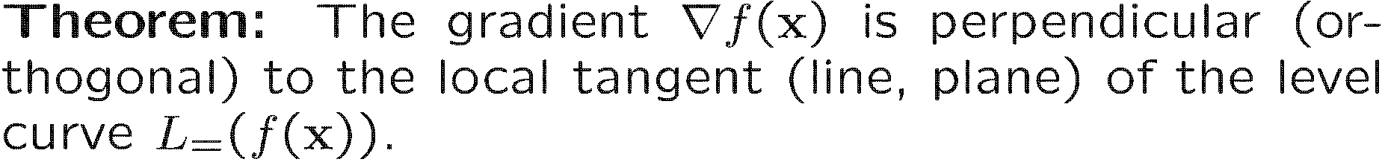
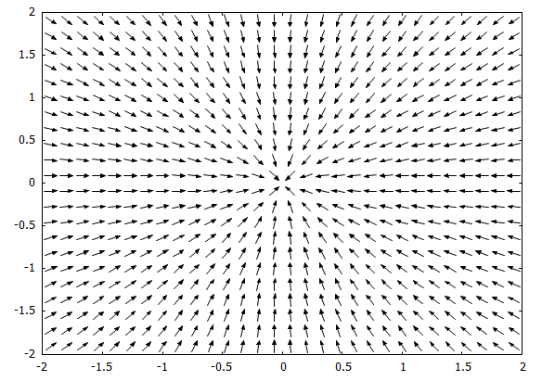
Gradient properties
The plot shows the
Gradient at different points
of the function (Gradient field)
f(x₁,x₂)= 20 exp(-(x₁)² – (x₂)²)
Program: wxMaxima:
f1(x1,x2):=20*exp(-x1^2-x2^2);
gx1f1(x1,x2):=diff(f1(x1,x2),x1,1);
gx2f1(x1,x2):=diff(f1(x1,x2),x2,1);
load(dfdraw);
drawdf([gx1f1(x1,x2),gx2f1(x1,x2)],[x1,-2,2],[x2,-2,2]);

Slide 10
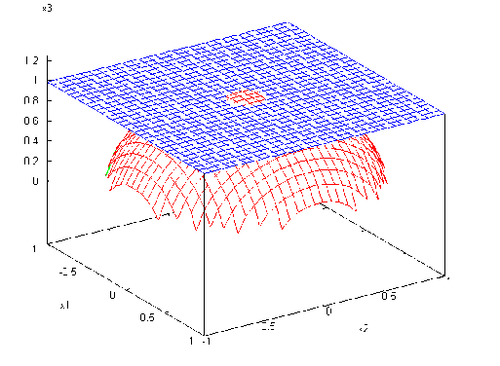


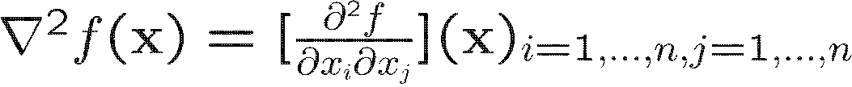
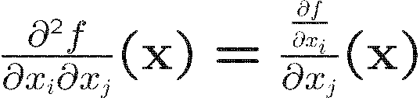
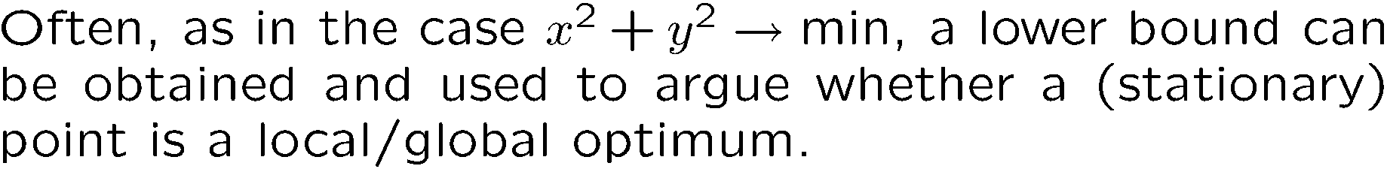
Single objective, unconstrained

Slide 11
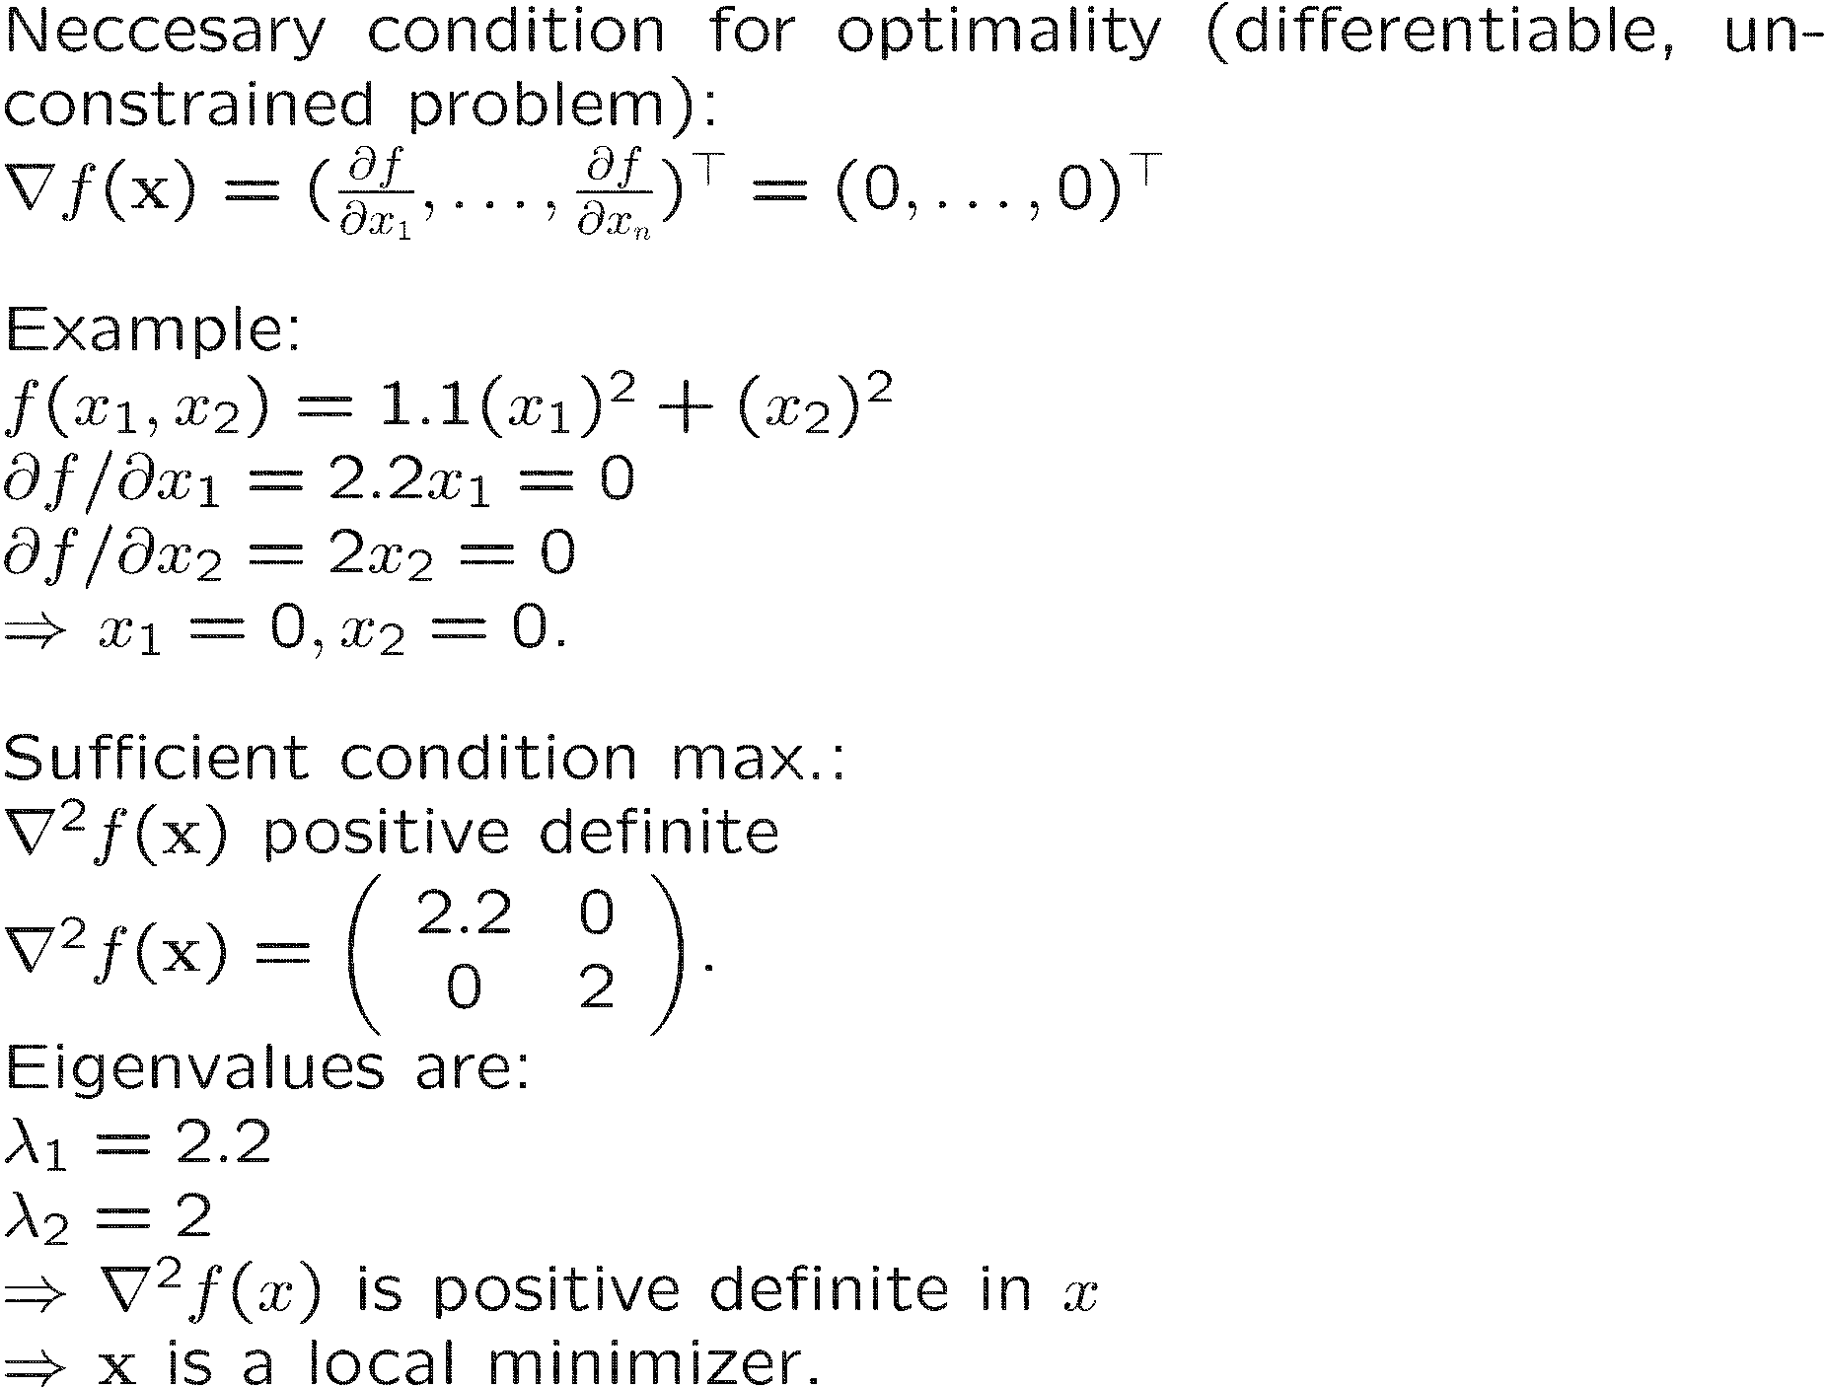
Single objective, unconstrained (example)

Slide 12
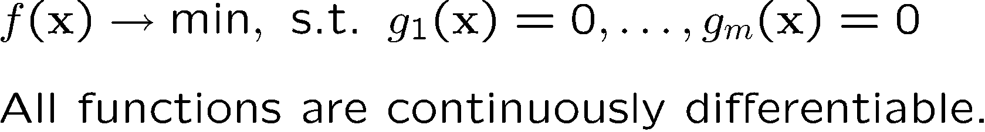
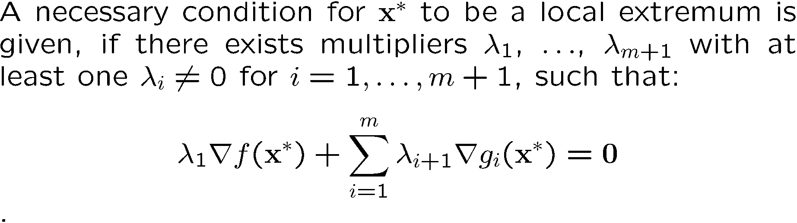
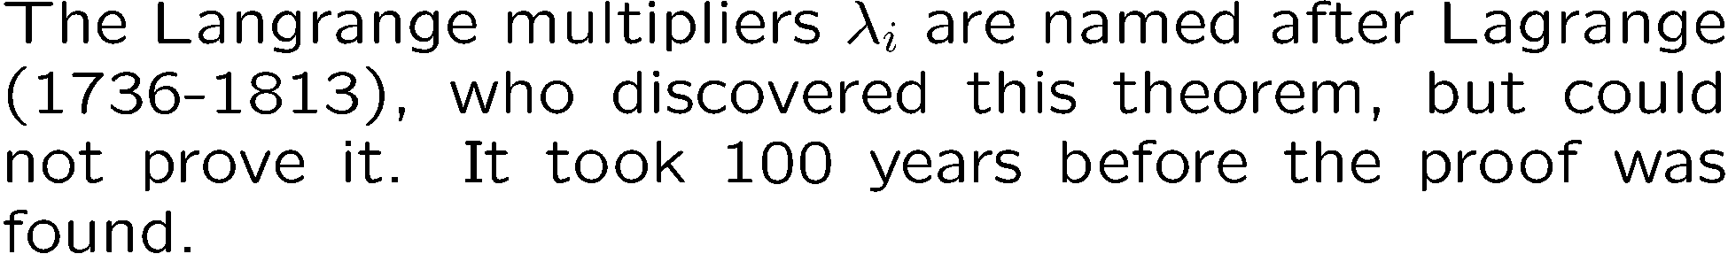
Constraints (equalities)
Show that this yields m+n equations with m+n+1 unknowns.

Slide 13
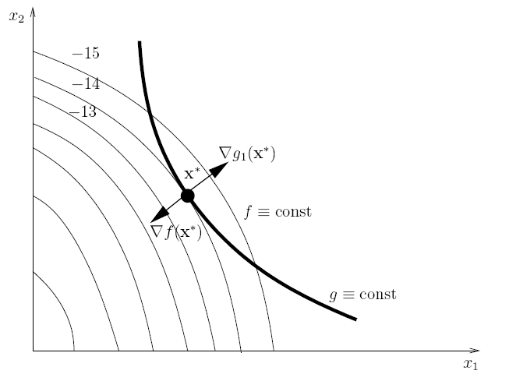
Constraints (equalities) - interpretation
Common tangent line

Slide 14
Example: One equality constraint, three dimensions
Level curve of f: f(x1,x2,x3)=const
All solutions that satisfy
The equality constraints
are located on the
n the gray surface.

Slide 15
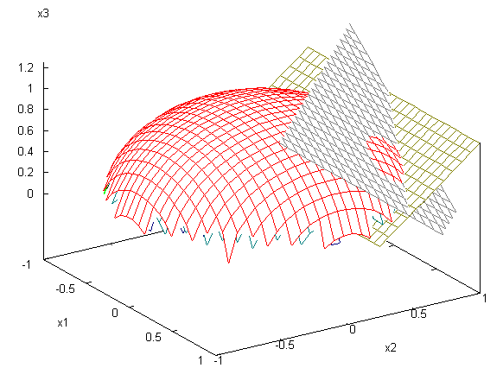
Example: 2 Equality constraints, three dimensions
Points on the intersection of
The two planes satisfy both
constraints.

Slide 16
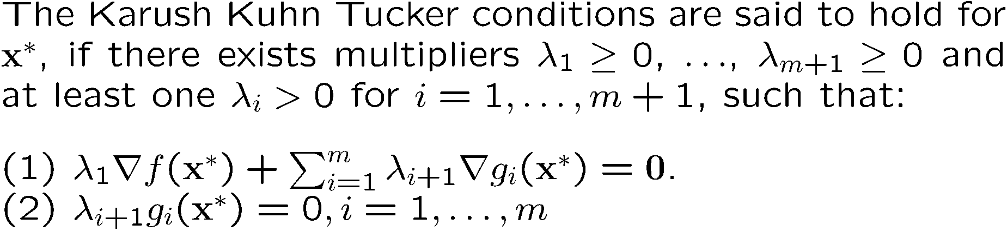
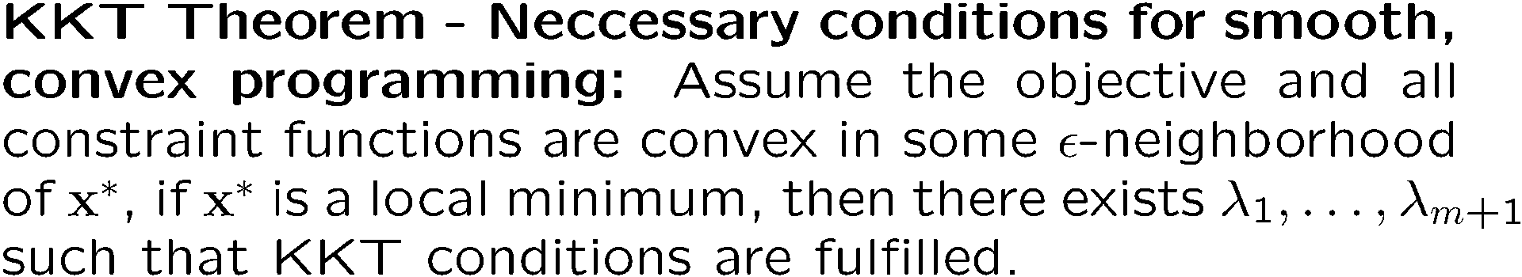
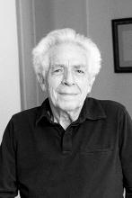
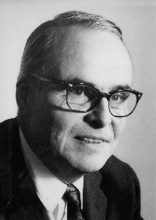
Constraints (inequalities)
Harold W. Kuhn
US-American Mathematician
1924-2014
Albert William Tucker
Canadian Mathematician,
1905-1995

Slide 17
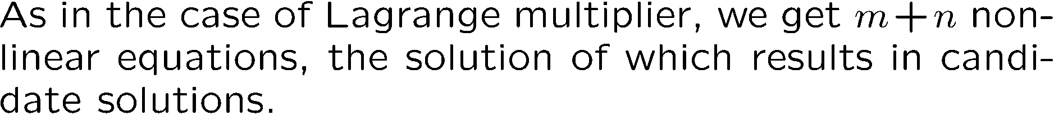
Constraint (inequality)

Slide 18
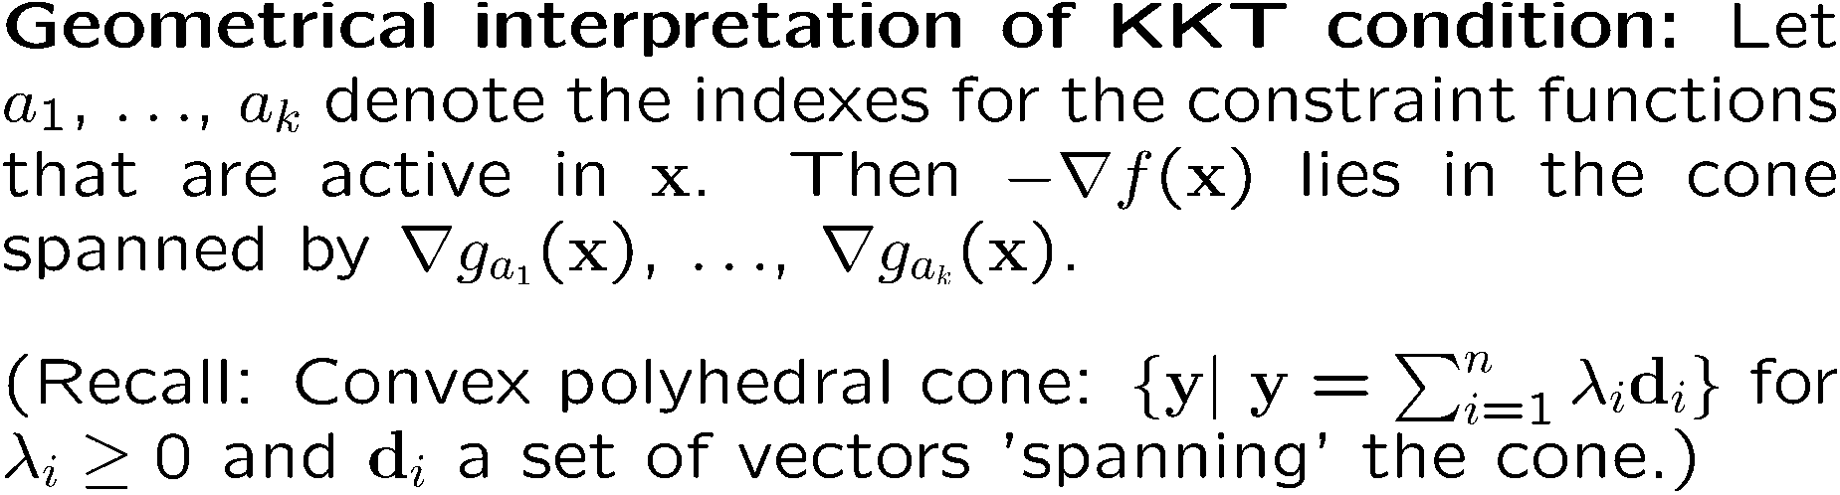
Geometrical interpretation KKT conditions
f
g_{a2}
g_{a1}
x

Slide 19
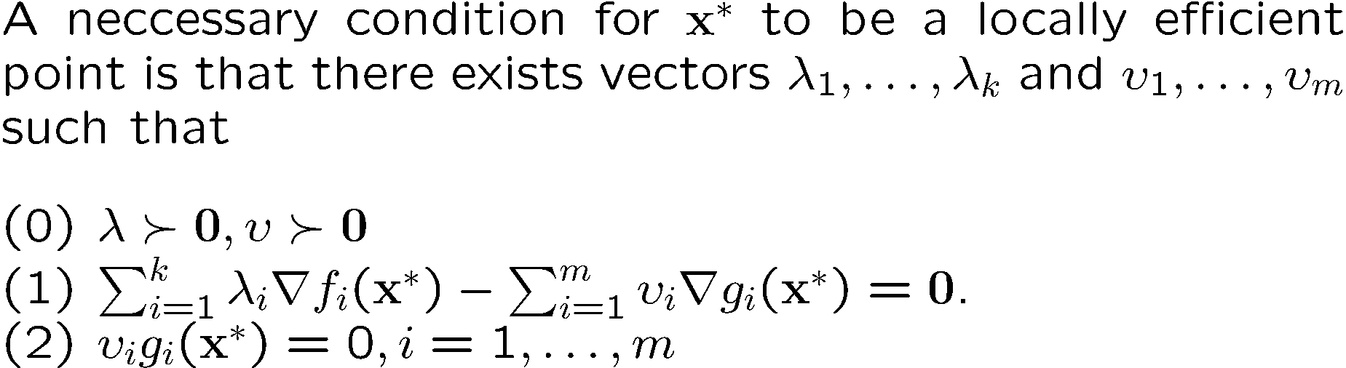
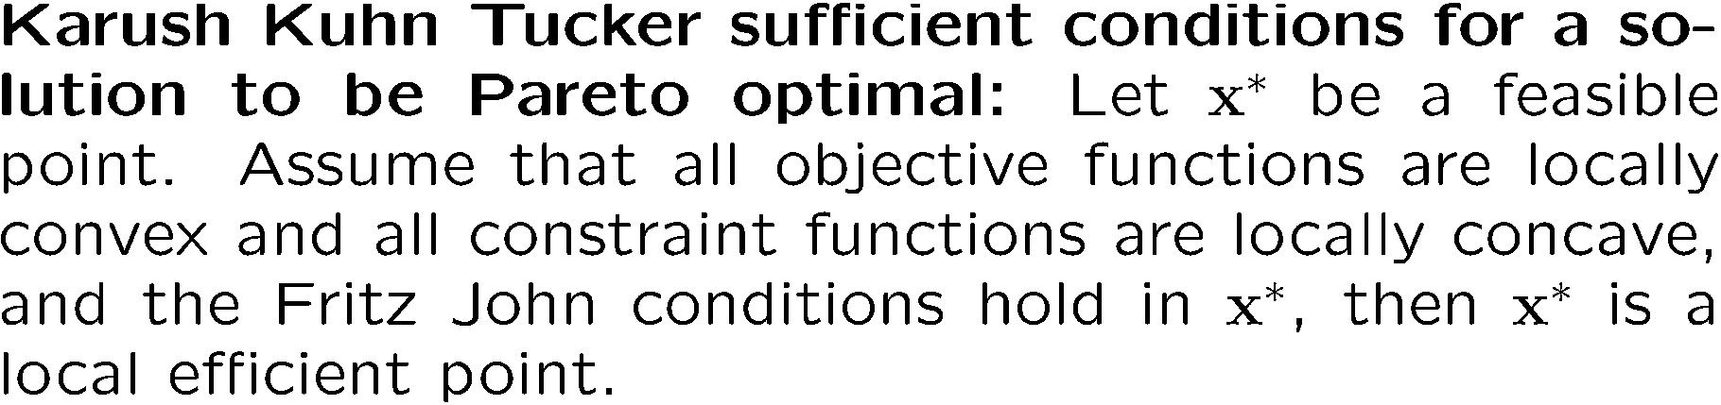
Multiobjective Optimization [cf. Miettinnen ‘99]

Slide 20
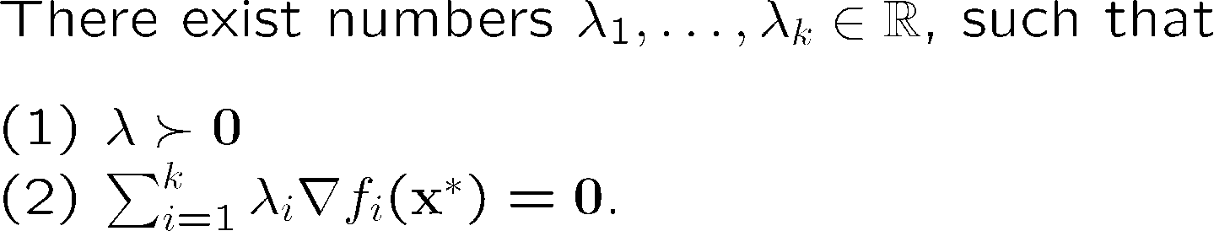




Unconstrained Multiobjective Optimization
In 2-dimensional spaces this criterion reduces to the observation, that either one of the objectives has a zero gradient ( neccesary condition for ideal points) or the gradients are parallel.
X*

Slide 21
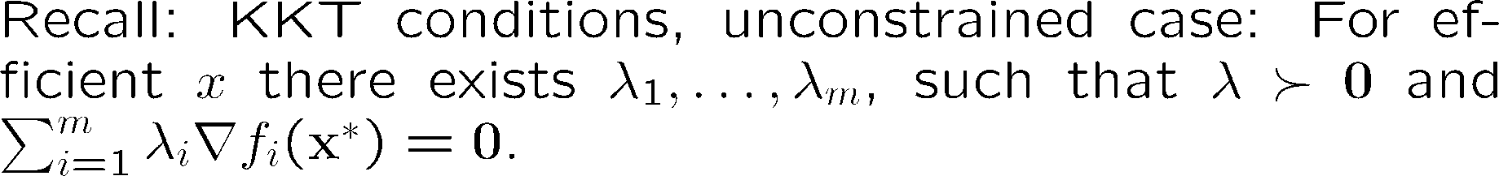
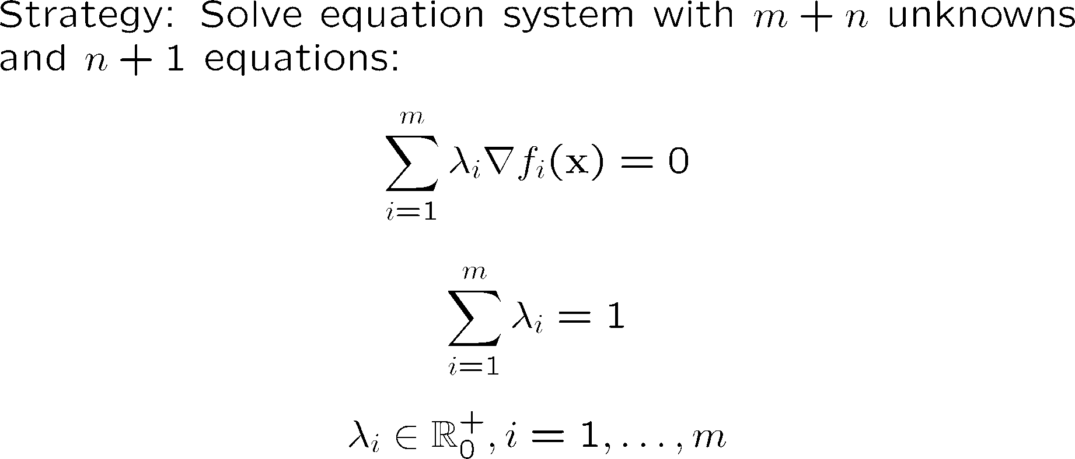
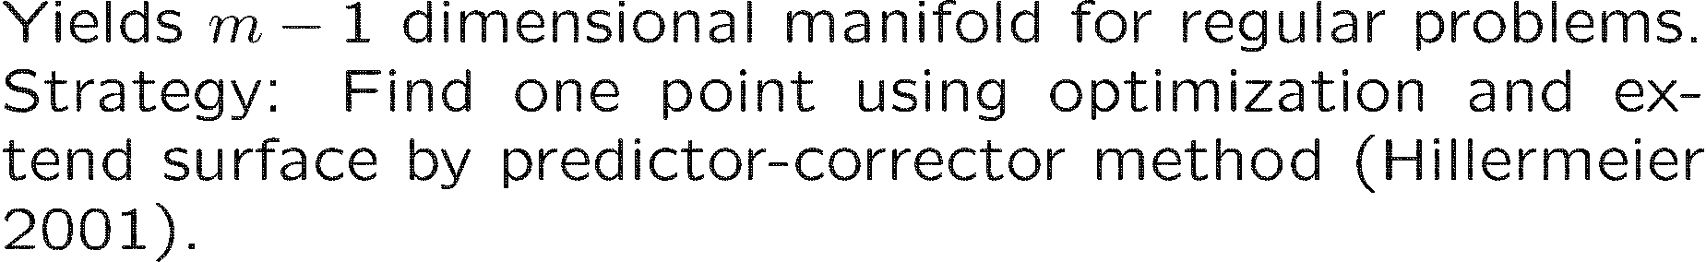
Strategy: Solve multiobjective optimization problems by level set continuation

Slide 22
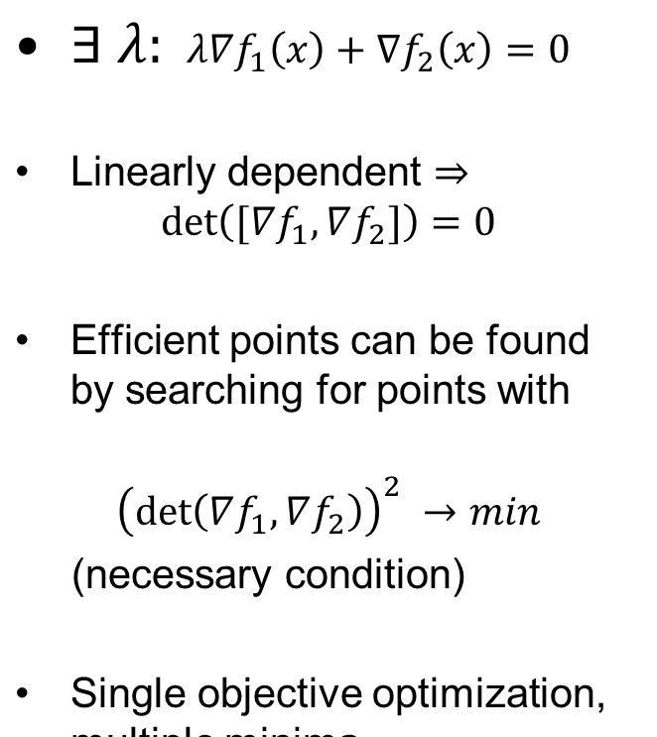
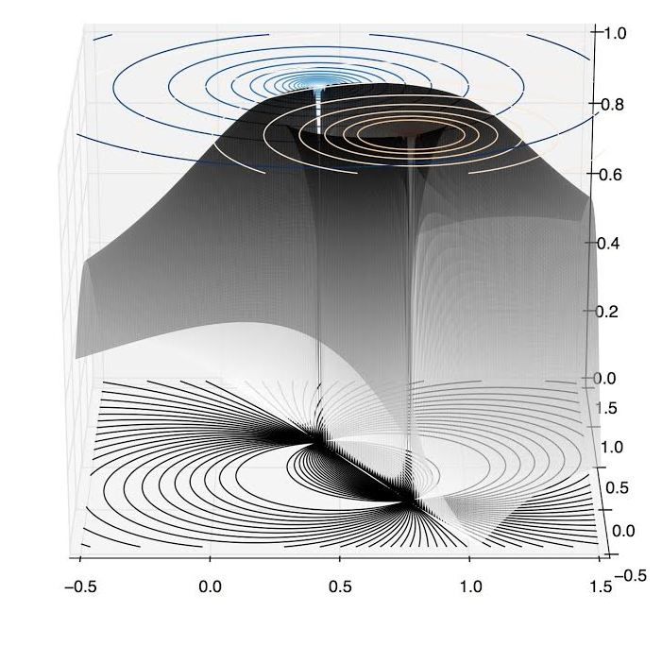
Strategy: Find efficient points using determinant

Slide 23
Take home messages
Gradient is a vector of first order partial derivatives that is perpendicular to level curves; Hessian contains second order partial derivatives.
Local linearization yields optimality condition; in single objective case ‘gradient zero’ and positive/negative definite Hessian.
Lagrange multiplier rule can be used to solve constrained optimization problems with equality constraints.
KKT conditions generalize it to inequality constraints; negative gradient points in cone spanned by active constraints.
KKT conditions for multiobjective optimization require for interior points to be optimal that they have gradients which point in exactly the opposite directions.
KKT conditions define equation system the solution of which is an at most m-1 dimensional manifold

Slide 24
References
Kuhn, Harold W., and Albert W. Tucker. "Nonlinear programming." Proceedings of the second Berkeley symposium on mathematical statistics and probability. Vol. 5. 1951.
Miettinen, Kaisa. Nonlinear multiobjective optimization. Vol. 12. Springer, 1999.
Miettinen, Kaisa. "Some methods for nonlinear multi-objective optimization."Evolutionary Multi-Criterion Optimization. Springer Berlin Heidelberg, 2001.
Hillermeier, C. (2001). Generalized homotopy approach to multiobjective optimization. Journal of Optimization Theory and Applications, 110(3), 557-583.
Schütze, O., Coello Coello, C. A., Mostaghim, S., Talbi, E. G., & Dellnitz, M. (2008). Hybridizing evolutionary strategies with continuation methods for solving multi-objective problems. Engineering Optimization, 40(5), 383-402.

