Slide 1



Single point methods for finding the Pareto front

Slide 2
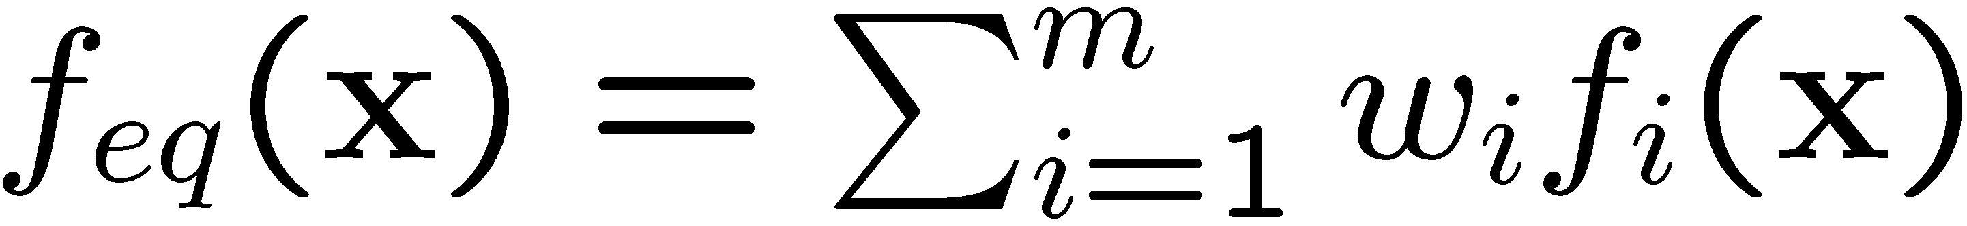
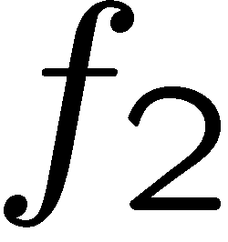
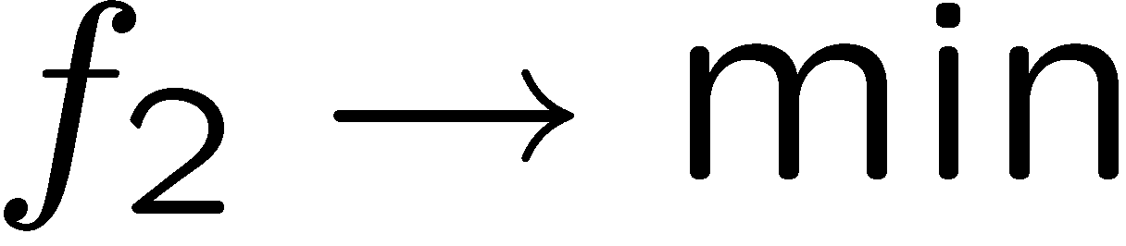
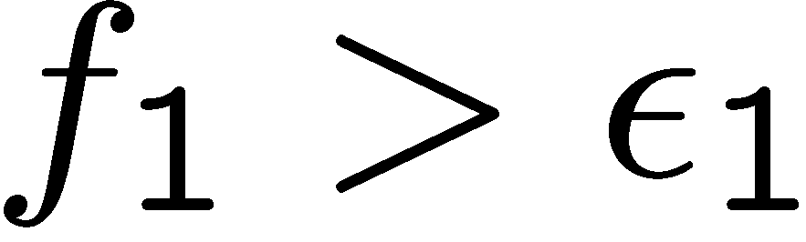
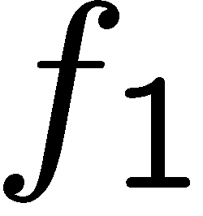
Single point methods

Slide 3
Learning goals
What are different ways to solve multiobjective optimization problems by formulating them as single objective optimization problems (with constraints)?
Can we use linear weighting functions to find all Pareto optimal points?
Which points (on the Pareto front) do we find for different scalarization functions?
How and when can we use single point methods to find all points on a Pareto front?

Slide 4
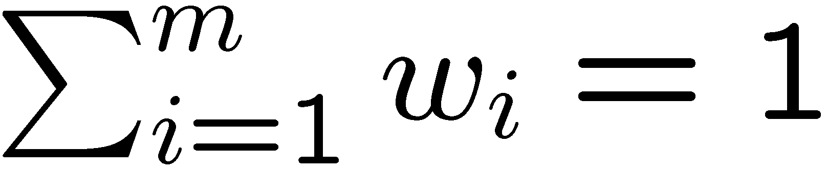
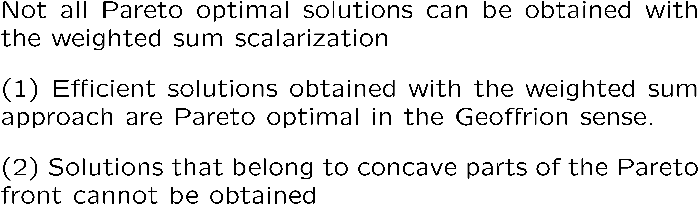
Weighted sum scalarization

Slide 5
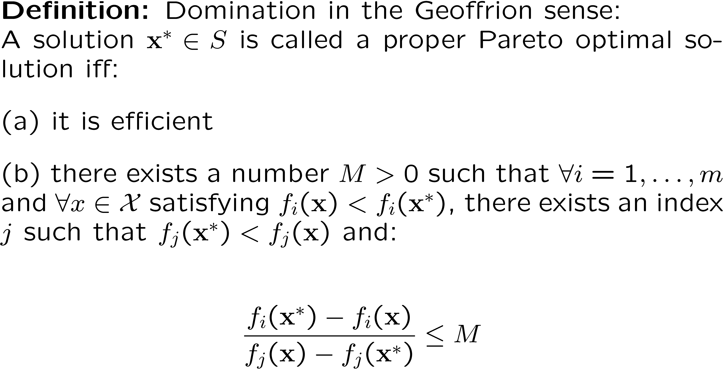
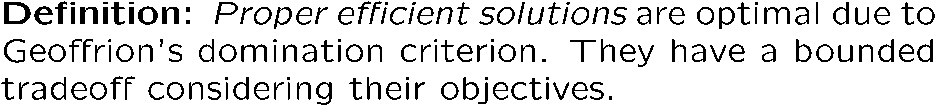
Proper efficiency

Slide 6
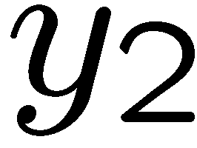
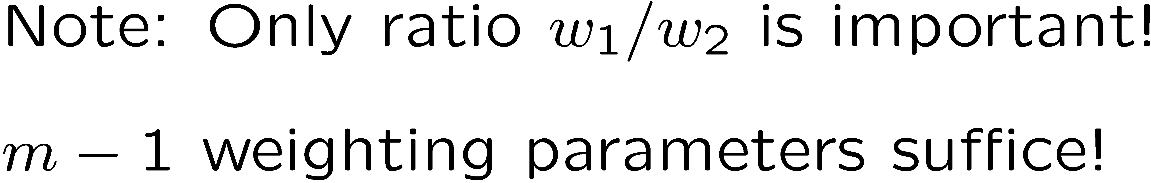
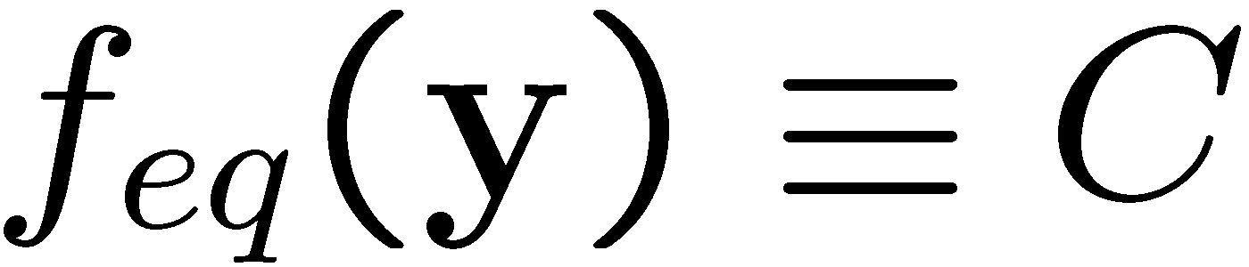
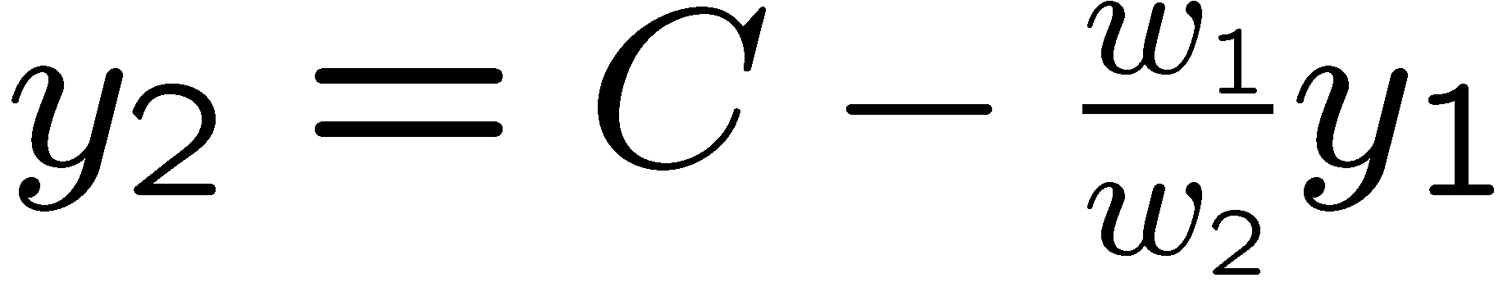
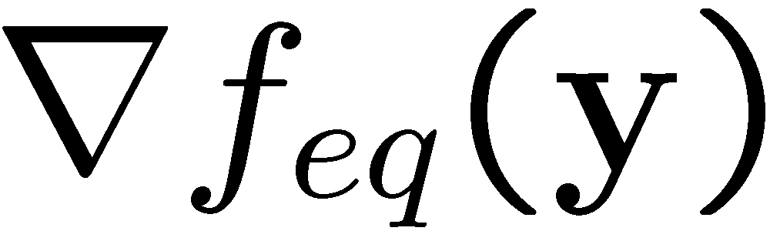

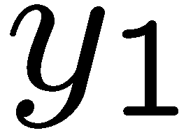
Convex Pareto front
6
5
4
6
4
5
6

Slide 7
Concave Pareto front

Slide 8
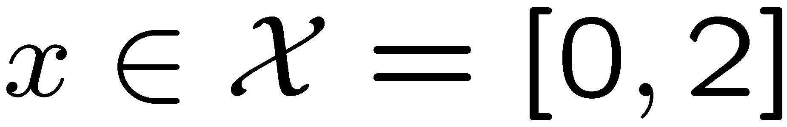
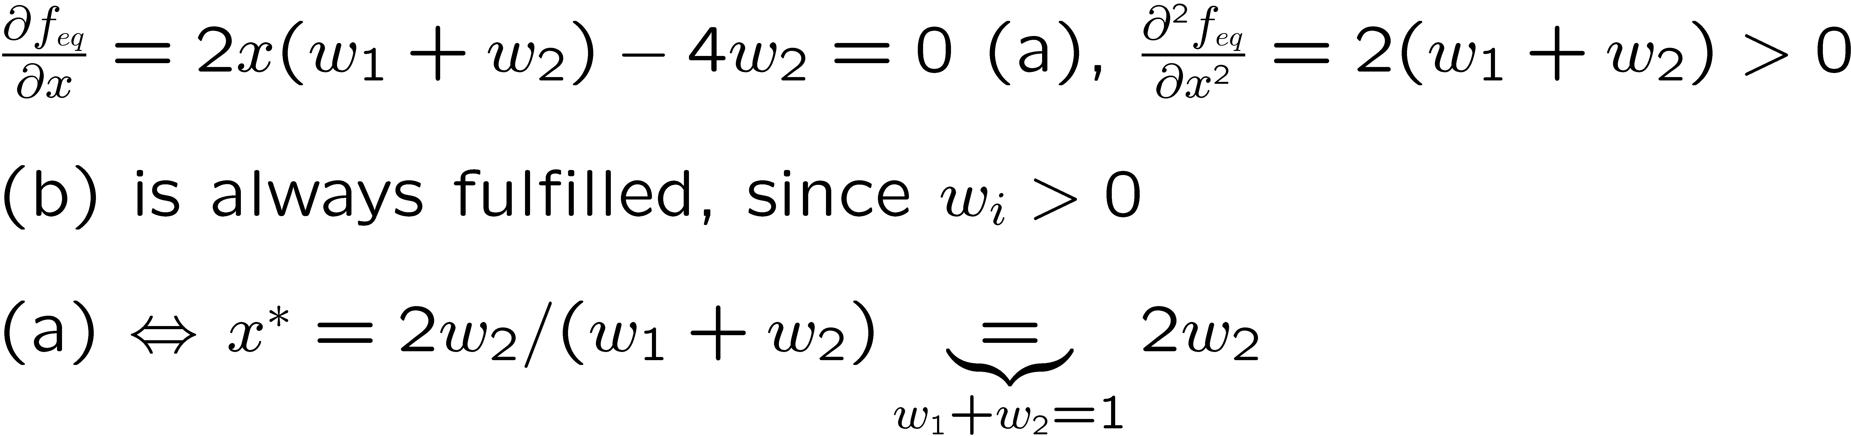
Example: Schaffer problem

Slide 9
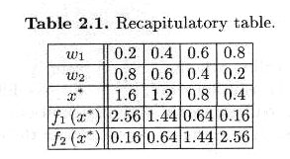
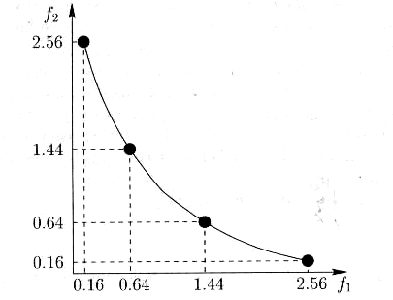
Example: Schaffer problem
Source: Siarry et al. Multiobjective Optimization, Springer, Berlin

Slide 10
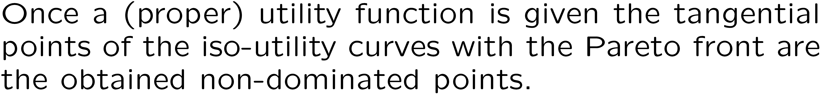

Utility functions
F2 (e.g. -speed)
U = 0
U = 2
U =3
F1 (e.g. cost)

Slide 11



Cobbs Douglas utility functions

Slide 12
Distance to a reference point (DRP) method
These methods aim for minimizing the distance to an ideal point
The ideal point has multiple components and these are the objective function values to be minimized
Examples:
  In a machine learning problem the false positive rate fp and false negative fn rate should be simultaneously minimized. The ideal point is fn=(0,0)^{T}
  In a control problem the pressure should be kept close to p* and the temperature close to T*. The ideal point is (T,p)^{T}=(p*, T*)^{T}.
  In an building optimization problem the fuel consumption EC should be ideally 0 and the annual operation cost AC and investment cost IC, too. The ideal point is (EC,AC,IC)^{T}=(0,0,0)^{T}

Slide 13
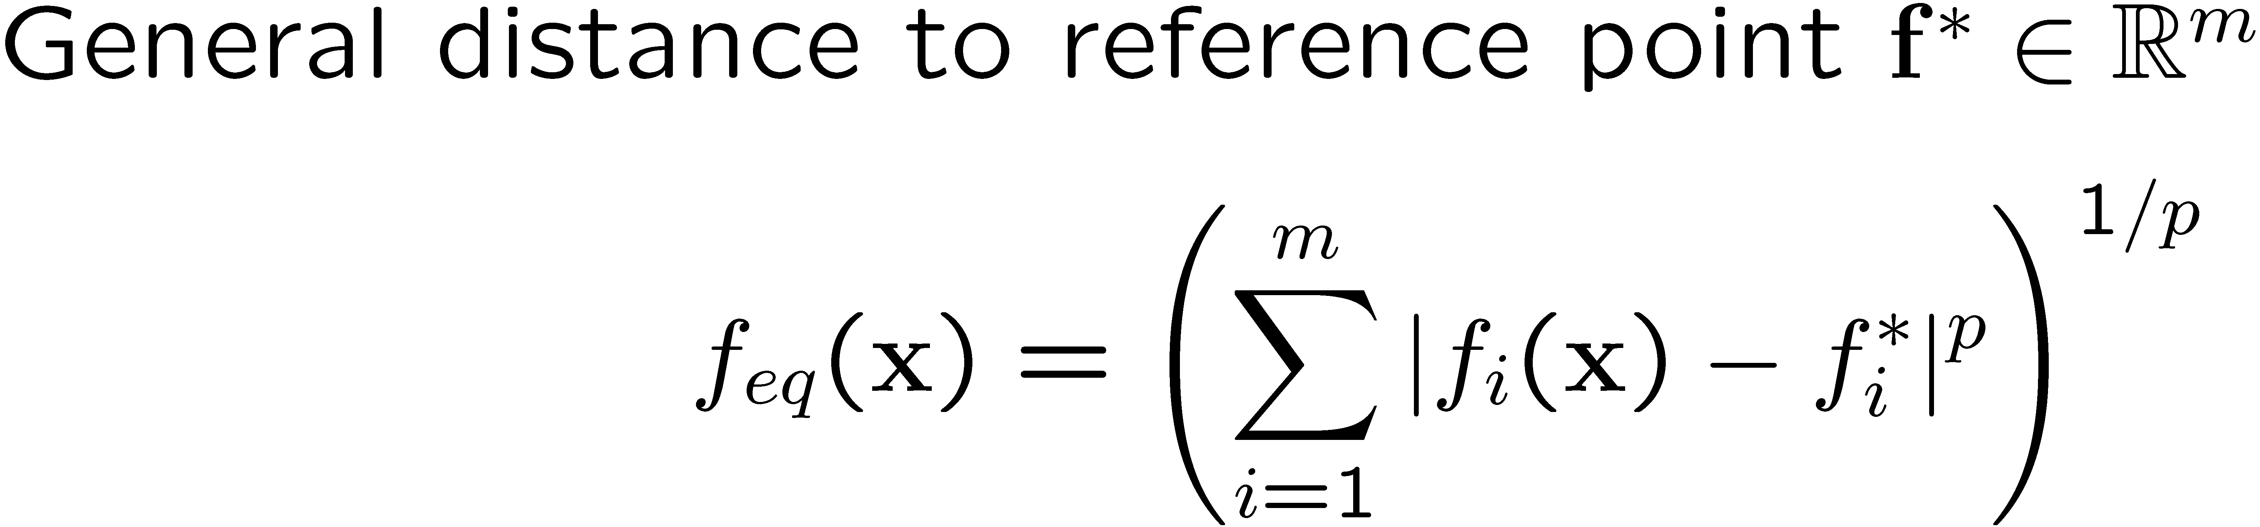
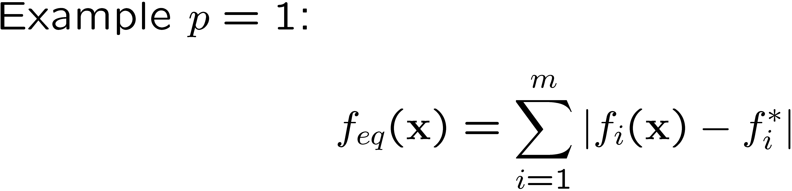
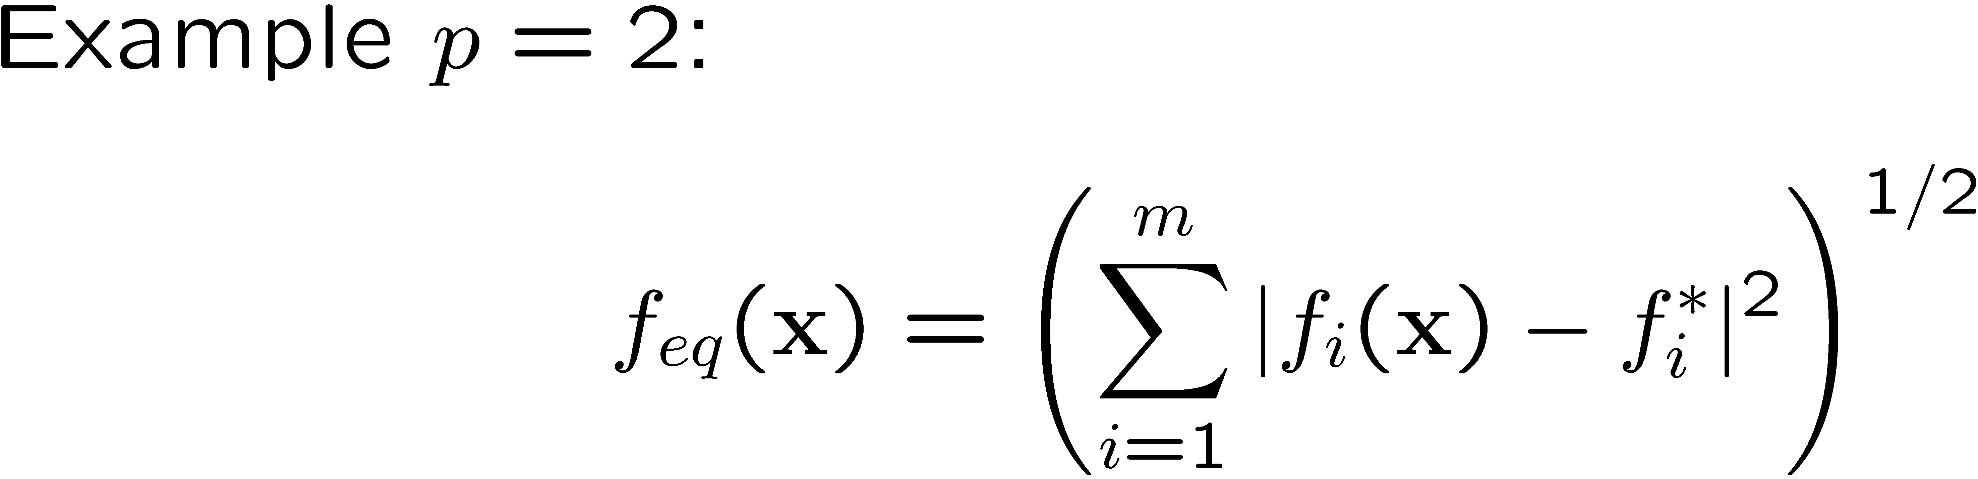
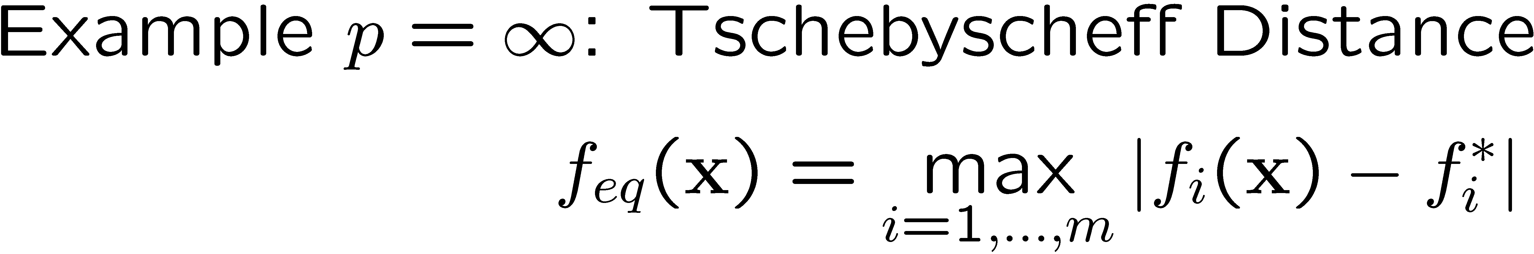
Minkowsky distance functions

Slide 14

View of DRP as a utility function:

Slide 15
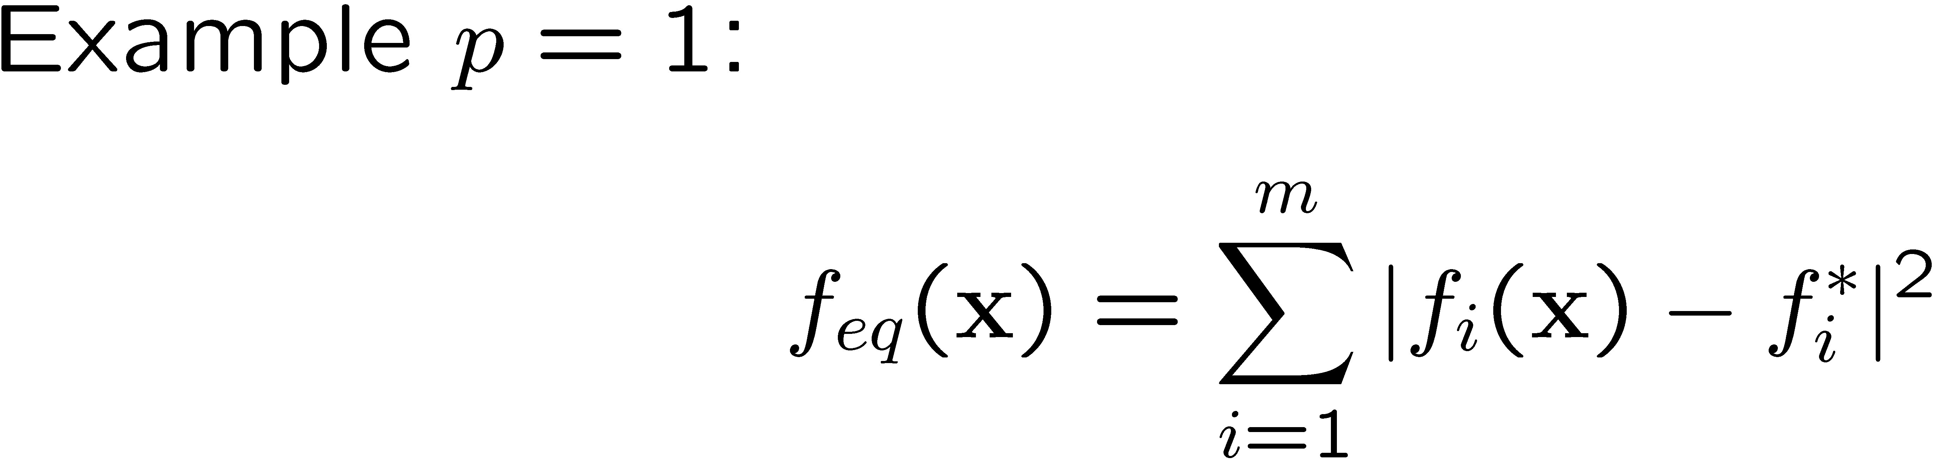
View of DRP as a utility function:

Slide 16
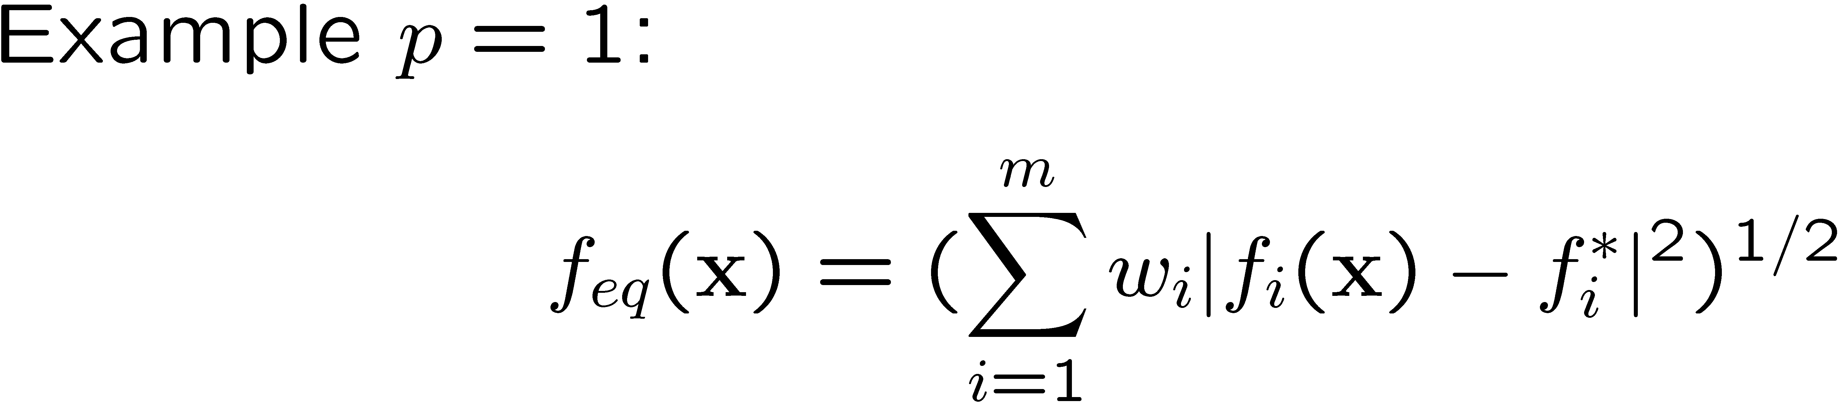
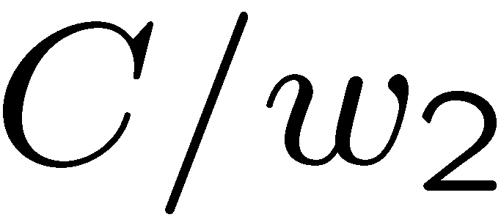
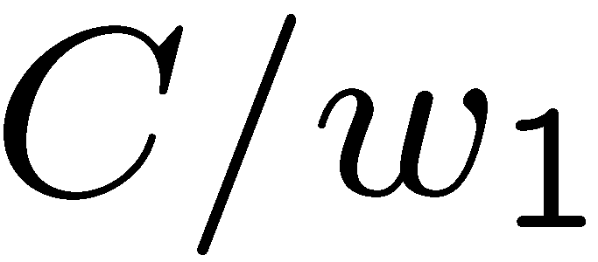
View of DRP as a utility function:
Weighted euclidian distance function

Slide 17
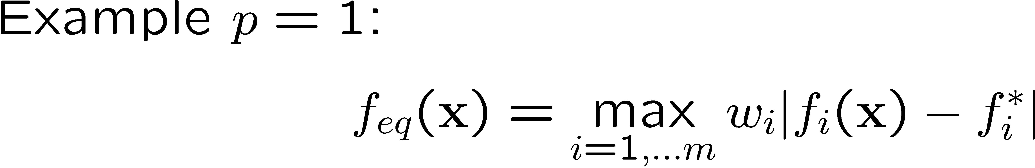
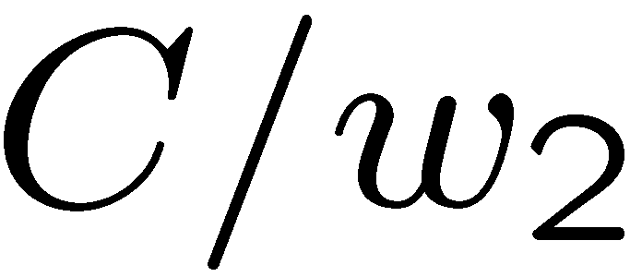
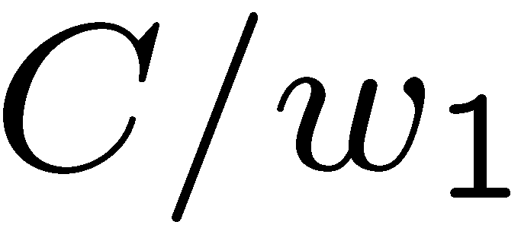
Tschebychev DRP:

Slide 18
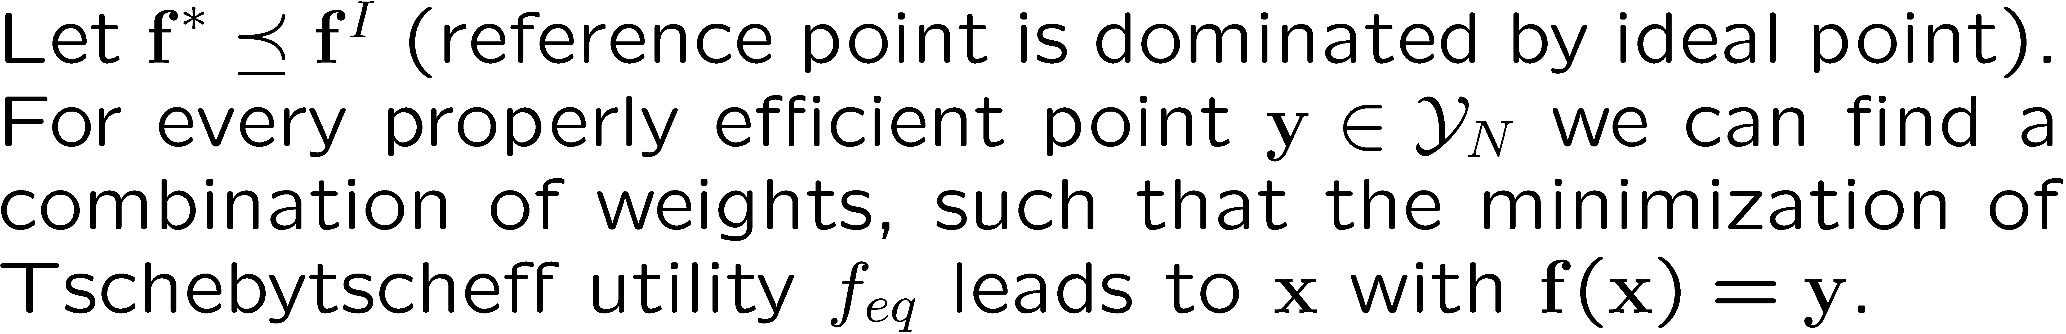
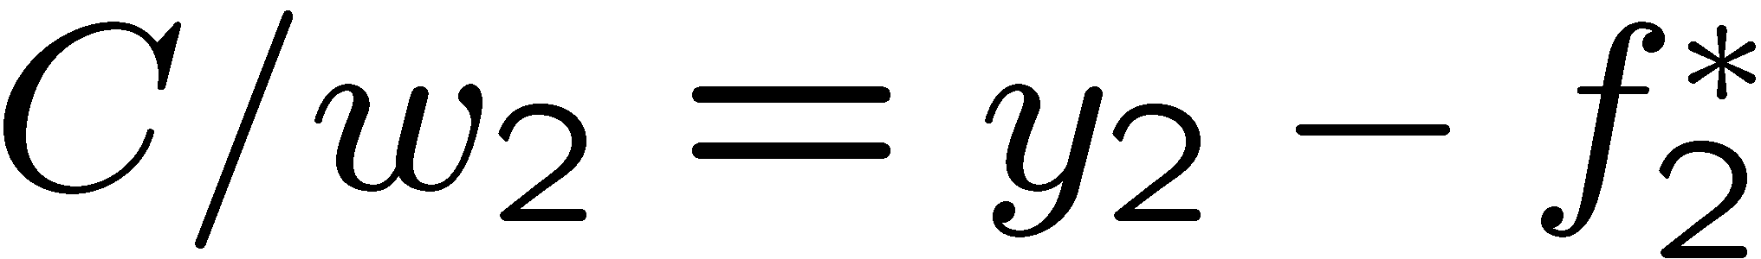
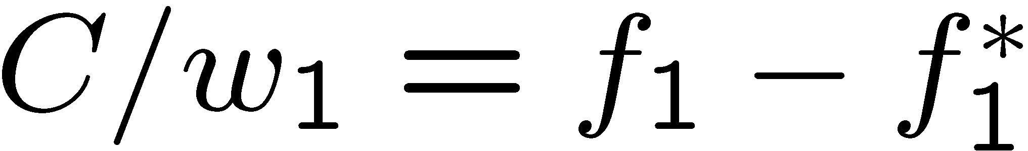
Tschebychev DRP:

Slide 19
Tschebychev DRP:

Slide 20

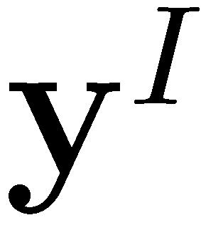

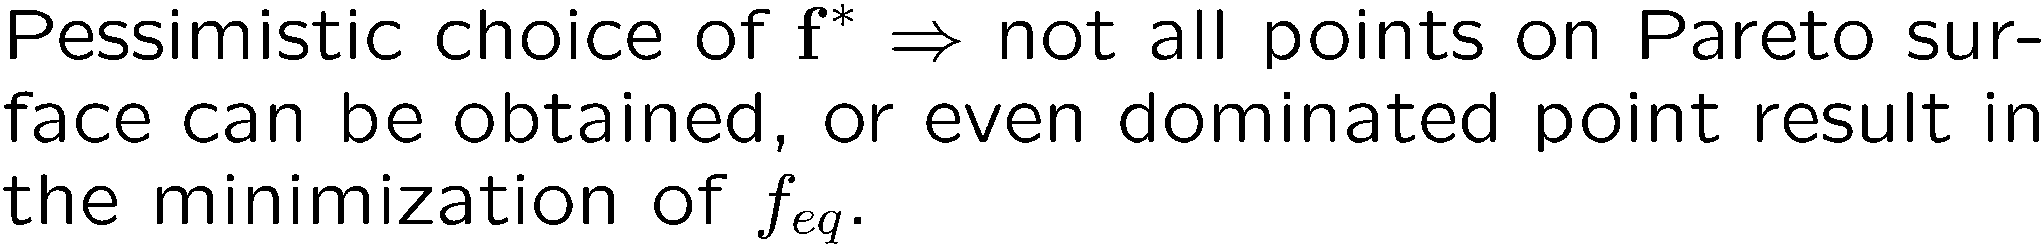
Choice of reference point

Slide 21
ε-Constraint method

Slide 22
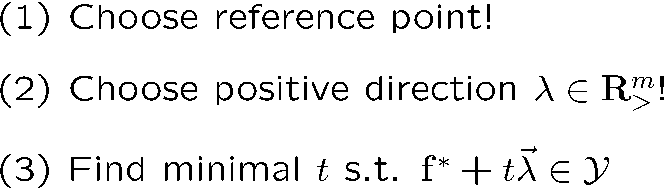
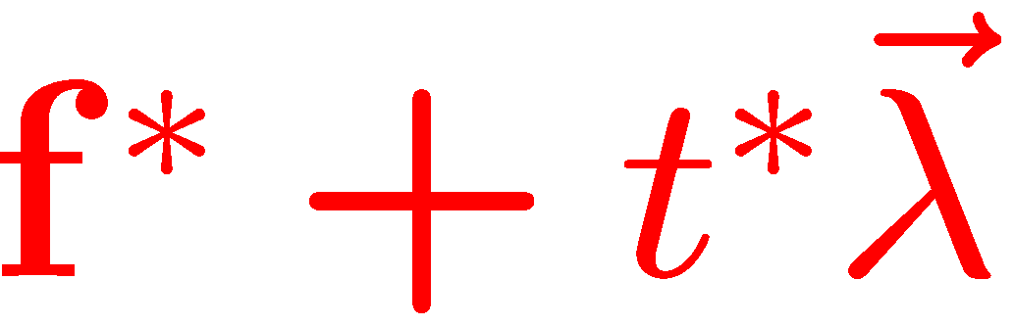
Goal programming

Slide 23
Goal programming

Slide 24
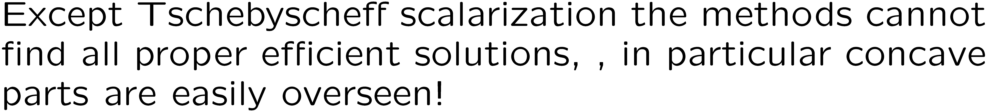

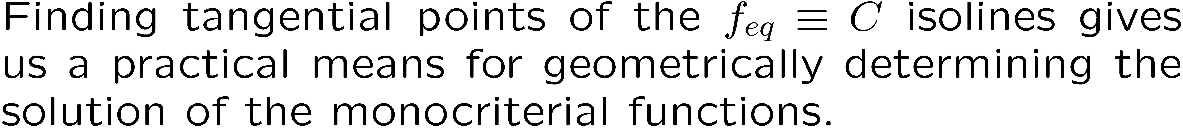
Summary:Scalarization methods

