Slide 1
Hill-climbing Methods (Local Optimization)
Steepest Descent Method
Newton Raphson Methods
Quasi Newton Methods (BFGS, DFP)
Hooke Jeeves Method
Nelder Mead Simplex Methods

Slide 2
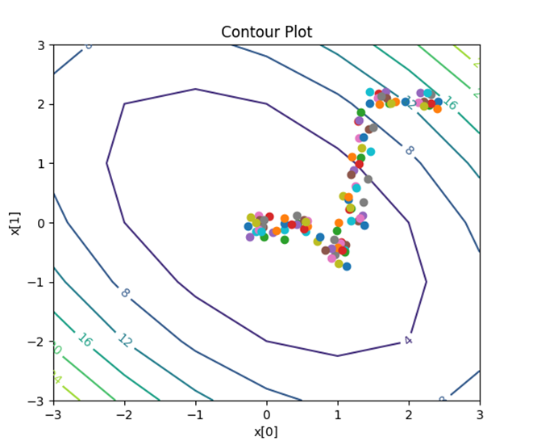
Basic strategy in Black-box optimization
Input Parameters x(t)
Black-box
Optimierungs-
software
Simulator/Evaluator
Zielfunktionswerte,
Restriktionsverletzungen
f(x(t))+penalty(r(x(t))
Stochastic Hillclimbing
Gradient Descent
Newton Method
Simulated Annealing
Evolutionary Algorithm
Bayesian Optimization
Etc.

Slide 3
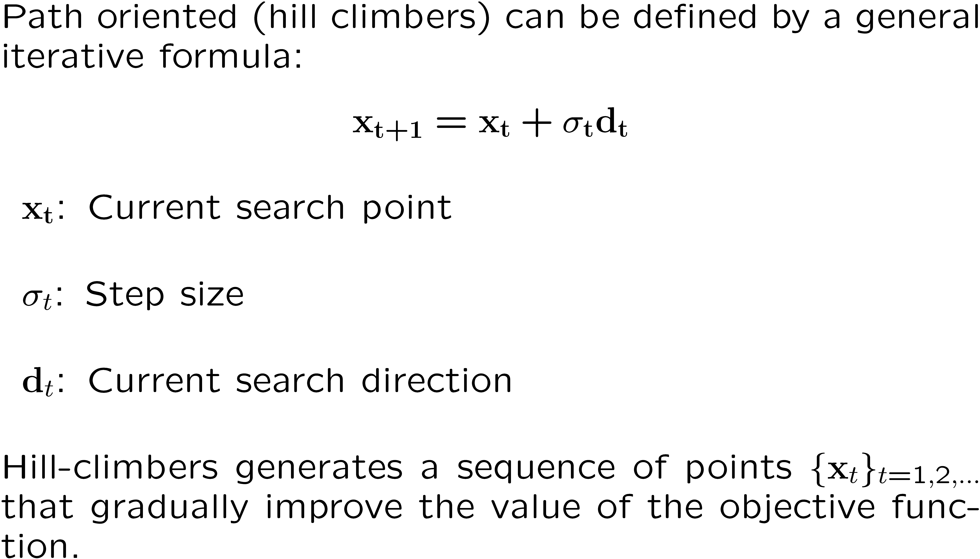
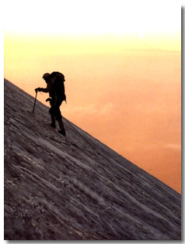
Hill-climbing Methods for Single-Objective Optimization

Slide 4
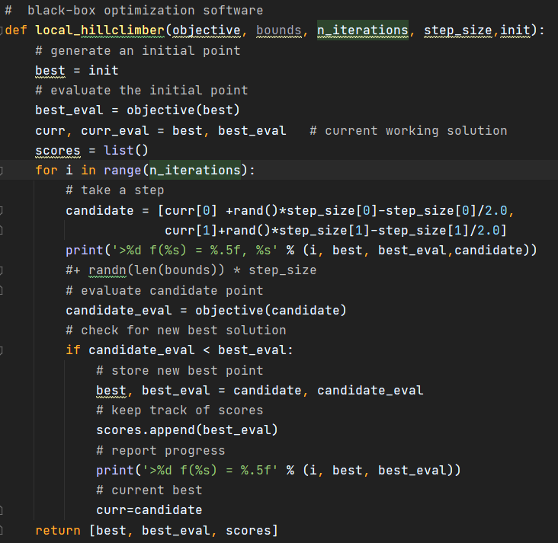
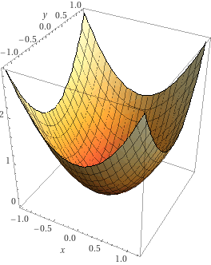

Simple 2-D stochastic hillclimber

Slide 5
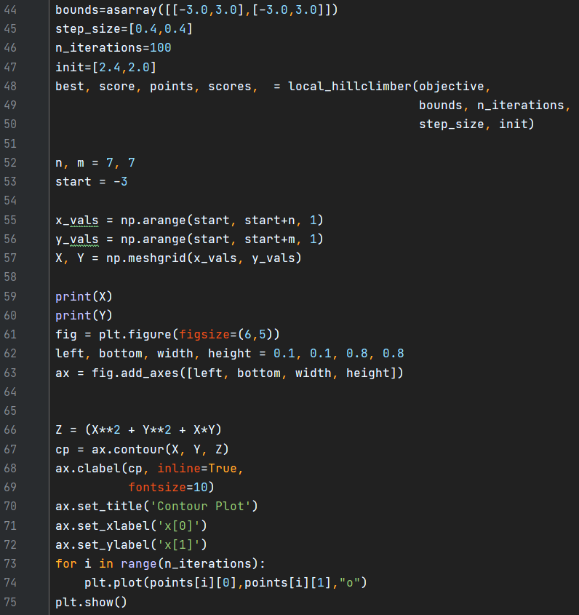
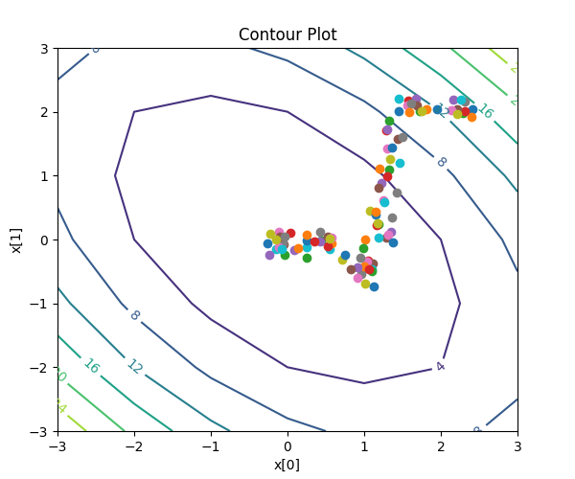
Plotting the history

Slide 6
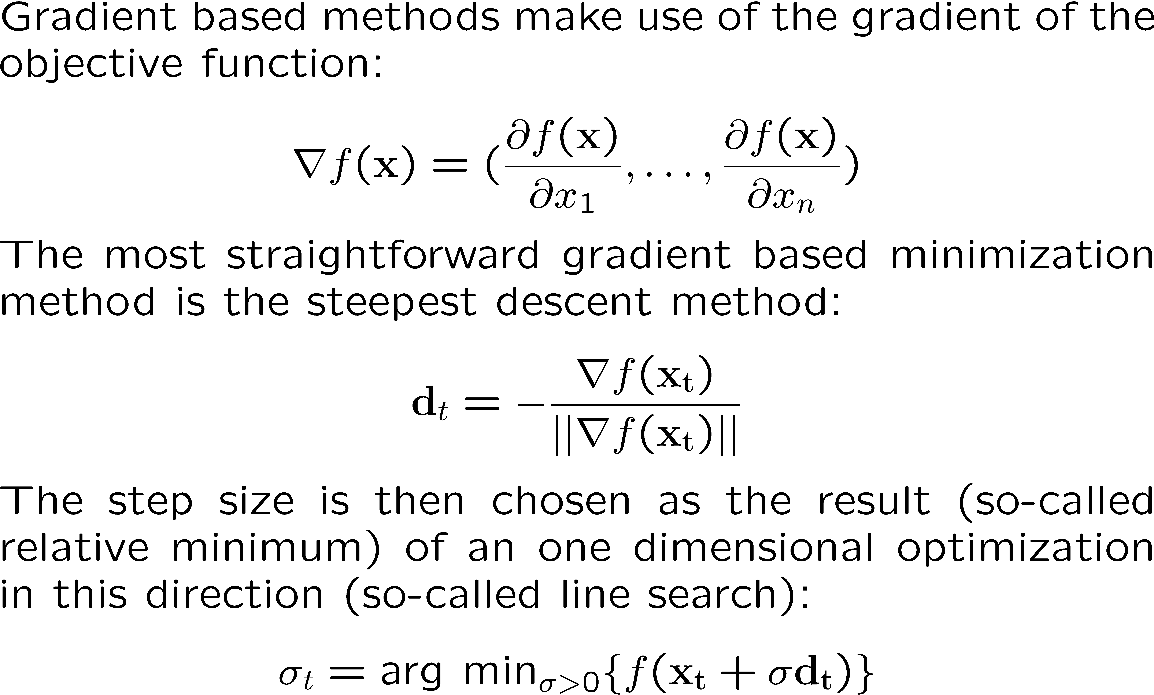
Steepest Descent Method

Slide 7
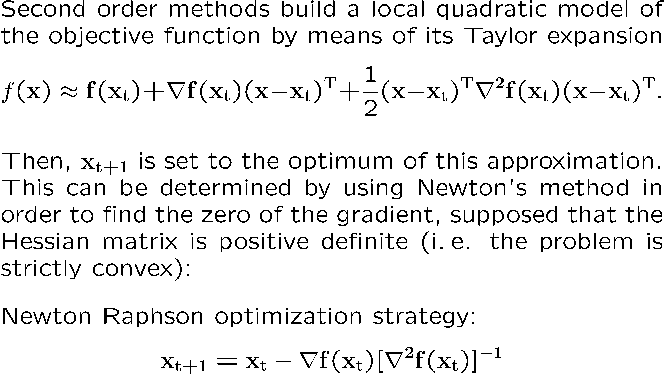
Newton Raphson Optimization Strategy

Slide 8
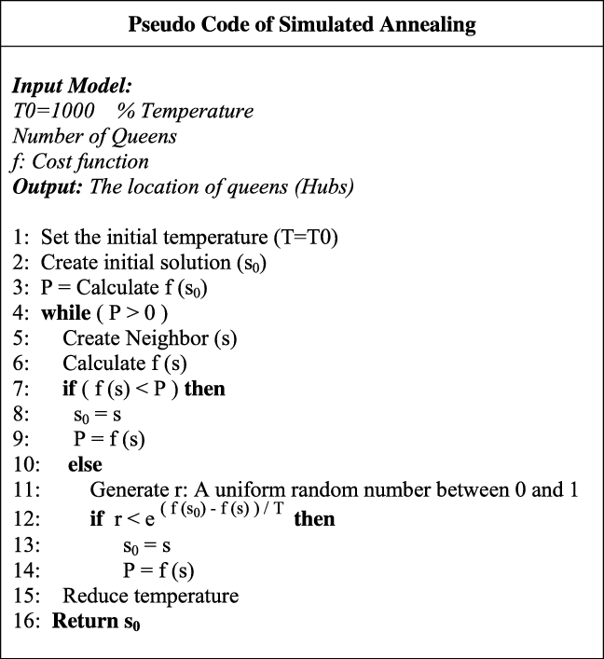
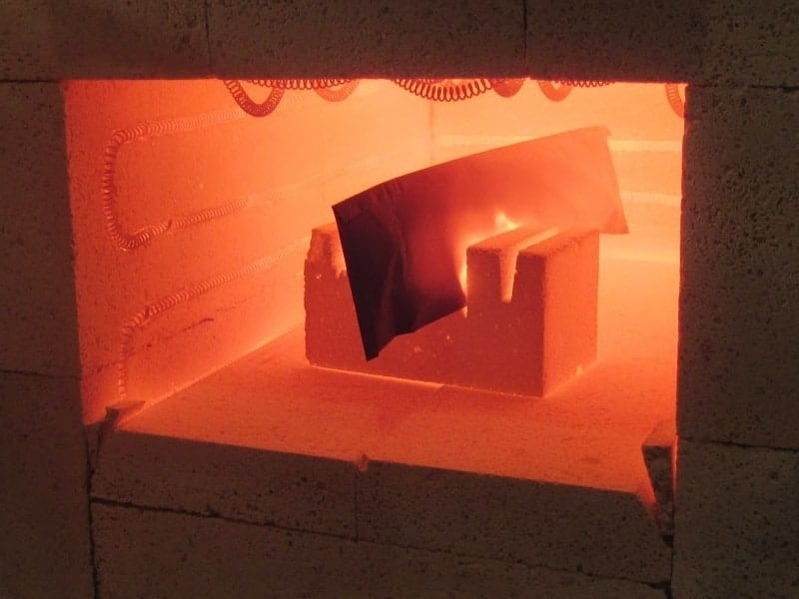
Simulated Annealing
Kirkpatrick, S. Optimization by simulated annealing: Quantitative studies. J Stat Phys 34, 975–986 (1984). https://doi.org/10.1007/BF01009452
Stochastic Hillclimbing inspired by Annealing process in crystals.
Simulated Annealing can always accepts improvements, but also worse solutions with some probability.
In order to get to global optima one might have to accept steps to get worse temporarily
https://makeitfrommetal.com/beginners-guide-on-how-to-anneal-steel/

Slide 9
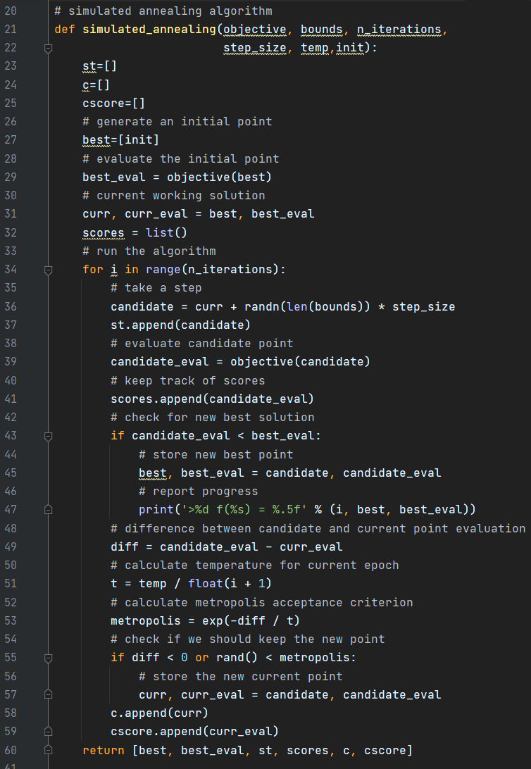

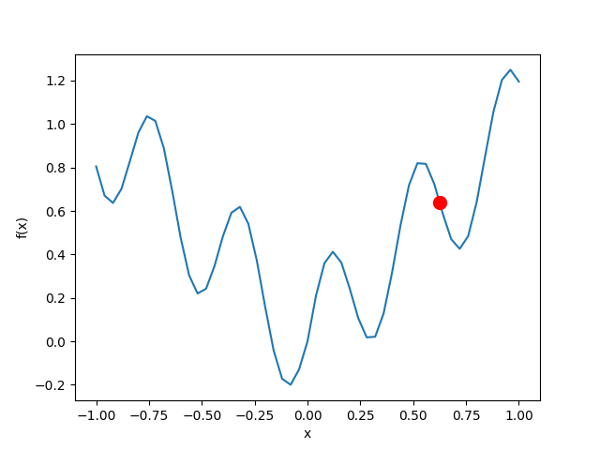
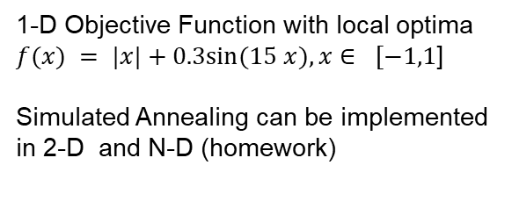
Simulated Annealing

Slide 10
Variable Metric Methods
Basic idea is to approximate inverse Hessian
Two popular variants:
  Davidon Fletcher Powell Method (DFPM)
  Broyden-Fletcher-Goldfarb-Shanno Method (BFGS)

Slide 11

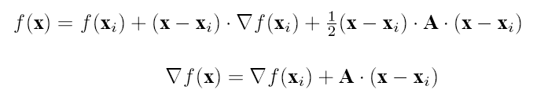

Variable Metric Method
Basic Idea: Construct a sequence of matrices with
Setting gradient to zero and subtracting from two subsequent points:

Slide 12

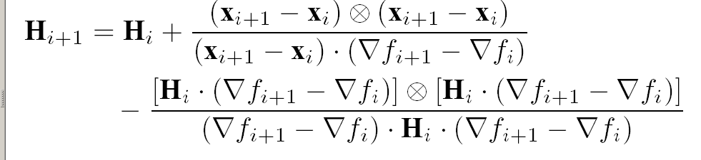
Variable Metric Methods (Quasi Newton)
DFP Method
Numerical Recipes, Corrnell University

Slide 13


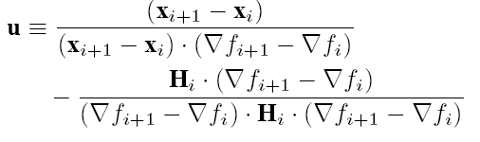
BFGS Method

Slide 14

BFGS Method
Condition for convergence:
(Positive definiteness of the Hessian Matrix)
Proof of Convergence to A⁻¹ in N steps (N=dimension):

Slide 15
Hooke Jeeves Method
We use the phrase `direct search' to describe
sequential examination of trial solutions
involving comparisons of each trial solution with the best obtained up to that time together with a
strategy for determining (as a function of earlier results) what the next trial solution will be.
The phrase implies our preference, based on experience, for straightforward search strategies which employ
no techniques from classical analysis
except when there is a demonstrable advantage of doing so.
Hooke, Jeeves, 1961

Slide 16
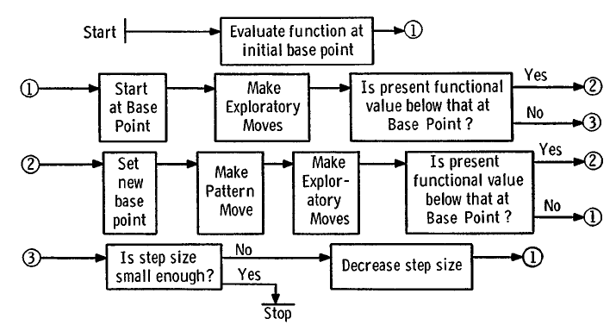
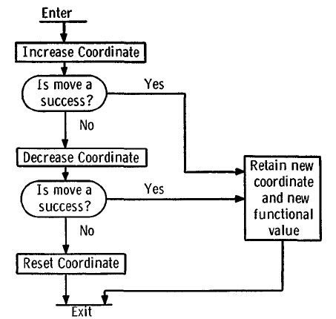
Hooke Jeeves Method
Original description
by Hooke and Jeeves
x2
x1

Slide 17
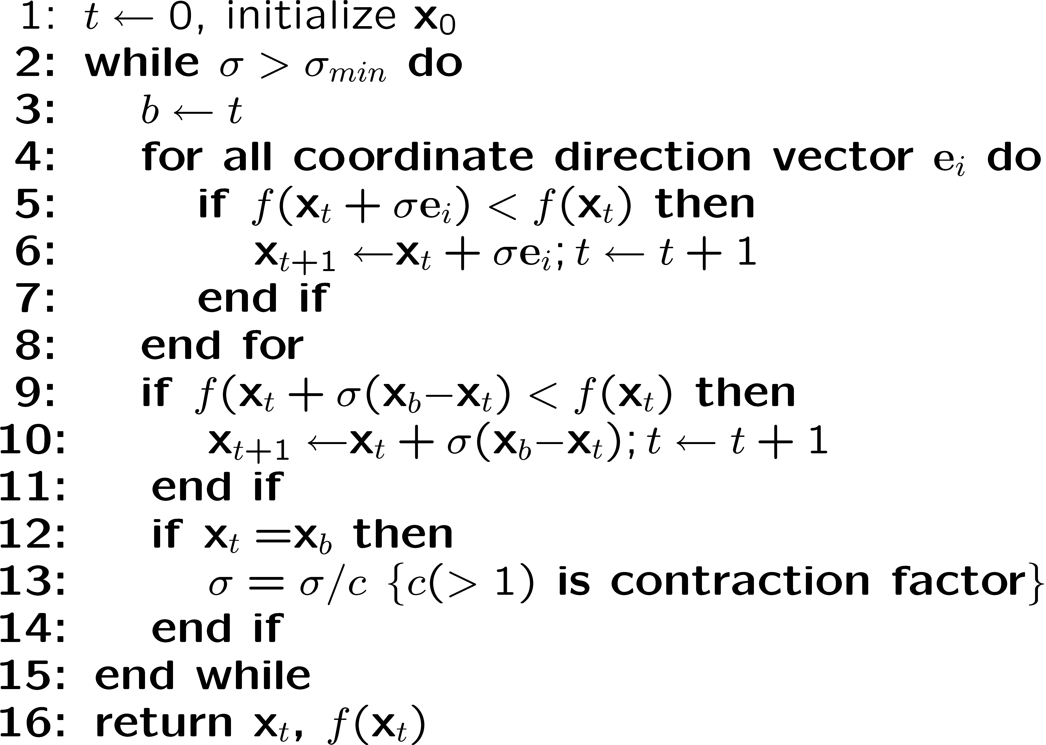
Hooke-Jeeves Method

Slide 18
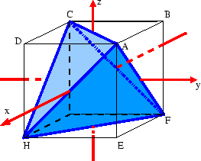
Simplex Method by Nelder and Mead
A simplex is the smallest N-dimenational polyeder in N dimensions
It has N+1 corner points
Objective function is evaluated at the corner points of the simplex
Contraction, Reflection, and Expansion move simplex through search space
Not to be confused with Dantzig’s Simpled Method for Linear Programming

Slide 19
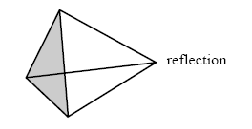
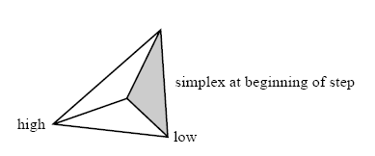
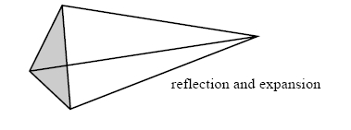
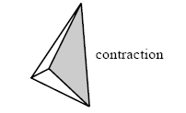
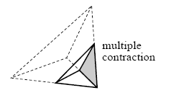
Simplex Method (Nelder Mead)
Exploratory Moves

Slide 20
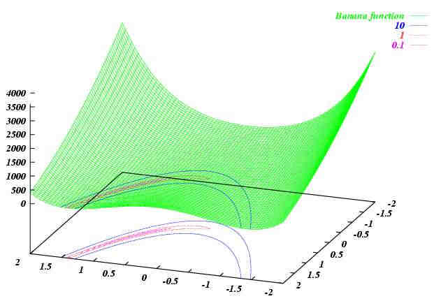
Discussion of steepest descent
Here the steepest descent method will be
trapped because the relative optima
are infinitely close to each other

Slide 21
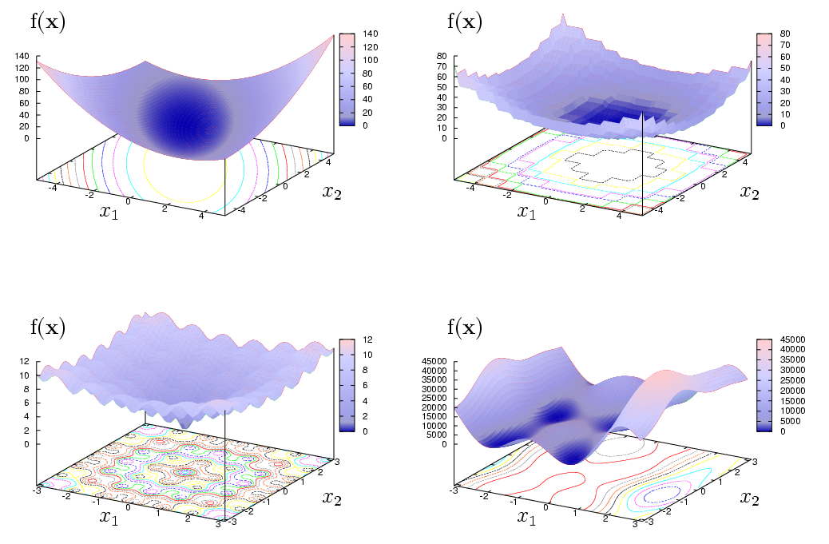
Hill climbing methods: Limitations and Capabilities
Convex-quadratic functions:
Gradient-based work efficiently
Discontinuous functions: fail, gradient of zero/infinity
Multimodal functions: fail, convergence to local optimum if bad starting point
=> Global optimization methods are needed! → next chapter

Slide 22
Hill-climbing in discrete spaces: Local Search
Heuristic 1: Exhaustive neighborhood search
  Look at all neighbors
  Go to best neighbor
Heuristic 2: Greedy neighborhood search
  Look at neigbors one by one
  Change current position to neigbor as soon as improvement was found
Both heuristics converge to local optima
1
11
4
20
8
16
7
9
14
13
6
12
17
5
19
15
2
10
18
3

Slide 23
Hill-climbing in discrete spaces: Local Search
1
11
4
20
8
16
7
9
14
13
6
12
17
5
19
15
2
10
18
3

Slide 24
Hill-climbing in discrete spaces
1
11
4
20
8
16
7
9
14
13
6
12
17
5
19
15
2
10
18
3

Slide 25
Hill-climbing in discrete spaces
1
11
4
20
8
16
7
9
14
13
6
12
17
5
19
15
2
10
18
3

Slide 26
Summary
In quadratic optimization and local optimization on convex differentiable problems Newton or Quasi-Newton methods yield precise solutions in small time (effort increases quadratically with dimension)
For non-quadratic problems with as single optimum robust hillclimbing method like Hooke Jeeves and Simplex Method can be used
Many other local search methods available (see Numerical Recipes etc.)
Local search can be used also in discrete spaces and guarantees the convergence to a local optimum

Slide 27
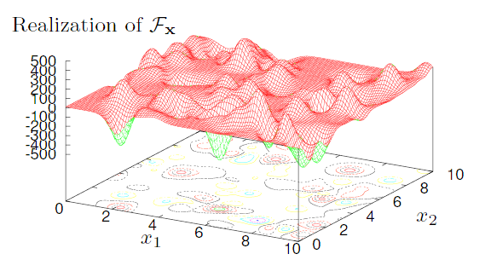
Towards Global Optimization
In global optimization we are looking for global optimum
Global optimization methods can escape local optima
Simulated annealing is an simple example
The problem is assumed to have multiple local optima

Slide 28
Non-adaptive vs. adaptive search
Non-adaptive search
    First determine set of points P in search space
    Evaluate all points in P and select best solution
Adaptive search
    t=0
    Based on the available information determine set of points P(t)
    Evaluate set of points P(t)
    If best found solution not satisfactory: increment t and go to step 2
    Return best found solution(s)

Slide 29
Non-adaptive search examples
Complete enumeration
  Can only be used in small finite spaces S
  Always finds global optimum in time |S|
  Expected time to obtain global optimum on random function is |S|/2
Random sampling (Try and error)
  In finite spaces it finds the global optimum in |S| trials on average
  Probability that it does not find global optimum after at least t iterations is given by 1 - (1 – (1/|S|)^{t})
For finite spaces complete enumeration among the most efficient algorithms known. In fact, any algorithm that avoids repitition is equally efficient (No free lunch theorem)
If extra knowledge is provided about landscape, adaptive search can be more efficient than non-adaptive search

Slide 30
Design of experiments
In continuous spaces various sampling techniques are used to distribute search points uniformly in the search space
  Simple uniformly distributed sampling
  Grid-based methods
  Latin-hypercube methods

Slide 31
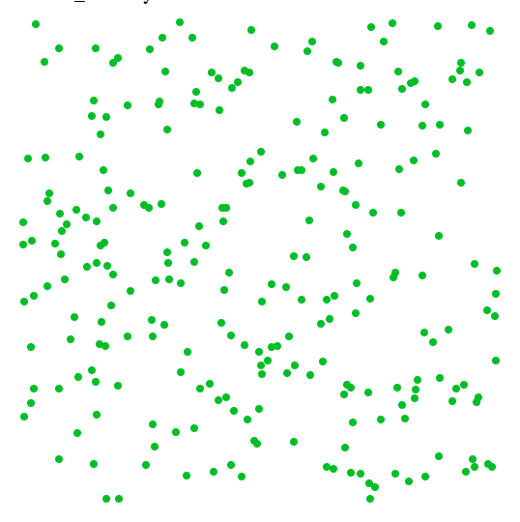
Uniformly distributed sample
Idea: Generate each coordinate independently using uniform distribution
Problem: Cluster formation (Paradox: uniform sampling yields clusters)
Desirable: Space filling distribution without clusters; low discrepancy

Slide 32
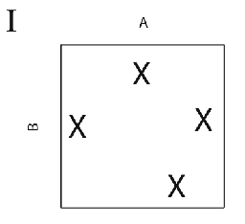
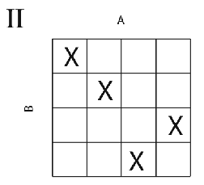
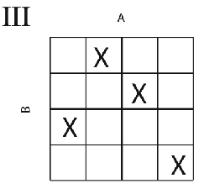
Latin Hypercube Sampling
LHS is used to sample points nicely in N-D Space
avoiding clusters

Slide 33


Curse of dimension!?
Problem in continuous spaces: Curse of dimensions
But! Not only the dimension makes problems difficult but also the lack of smoothness and continuity (predictability of the function values of neighboring solutions)
The approximation precision that can be guaranteed for any function in F given the time t when using algorithm a_{t}
The minimal error that can be guaranteed if we are free can choose any algorithm

Slide 34
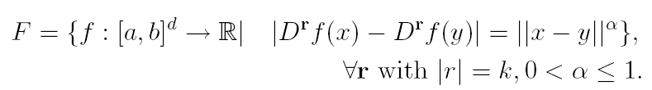

Hölder class of functions

Slide 35


Curse of dimension!?
A result by Novak and Ritter (1996) states for the Hölder class
of functions that:
and, if we want to know how long it takes to achieve a desired precision
Smoothness (k and α) and dimension d determine the exponential factor in
this very general function class!

Slide 36
Some conclusions from Information Based Complexity …
For high-dimensional black-box functions the amount of data needs to grow at least exponentially with the dimension if we want to:
  Approximate, Predict
  Integrate
  Classify
  Optimize
This holds even if the function is Lipschitz continuous, i.e., similar input yields similar output
This holds also for super-modern “deep” and “tuned” methods.
Remedy:
  Hope that the problem is essentially low dimensional (small number of variables or principle components)
  Hope that the problem has only low degree of interaction or even is linear
  Hope that we do not fall into the classes where the worst case scenario holds (flat functions). >> global methods

