Slide 1
Exercise: Hill-climbing Methods (Local Optimization)
Exercise (based on slides and python examples)
Pareto optimization
Adding objective function to Desdeo

Slide 2
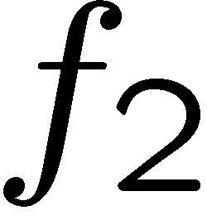
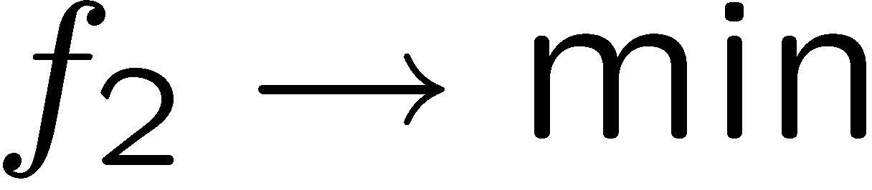
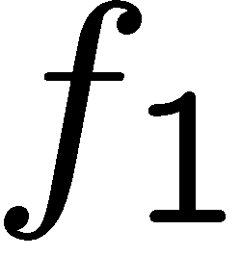
ε-Constraint method
f_2 → min, f_1 <= \epsilon, epsilon \in {e1,e2, ….en}

Slide 3
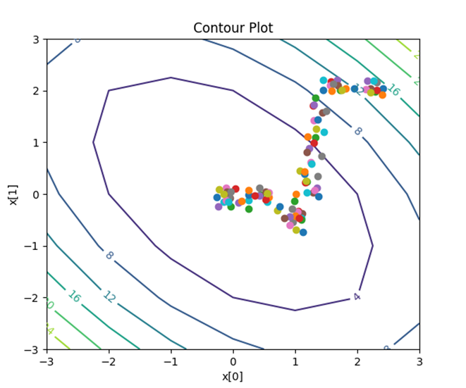
Basic strategy in Black-box optimization
Input Parameters x(t)
Black-box
Optimierungs-
software
Simulator/Evaluator
Zielfunktionswerte,
Restriktionsverletzungen
f(x(t))+penalty(r(x(t))
Stochastic Hillclimbing
Gradient Descent
Newton Method
Simulated Annealing
Evolutionary Algorithm
Bayesian Optimization
Etc.

Slide 4
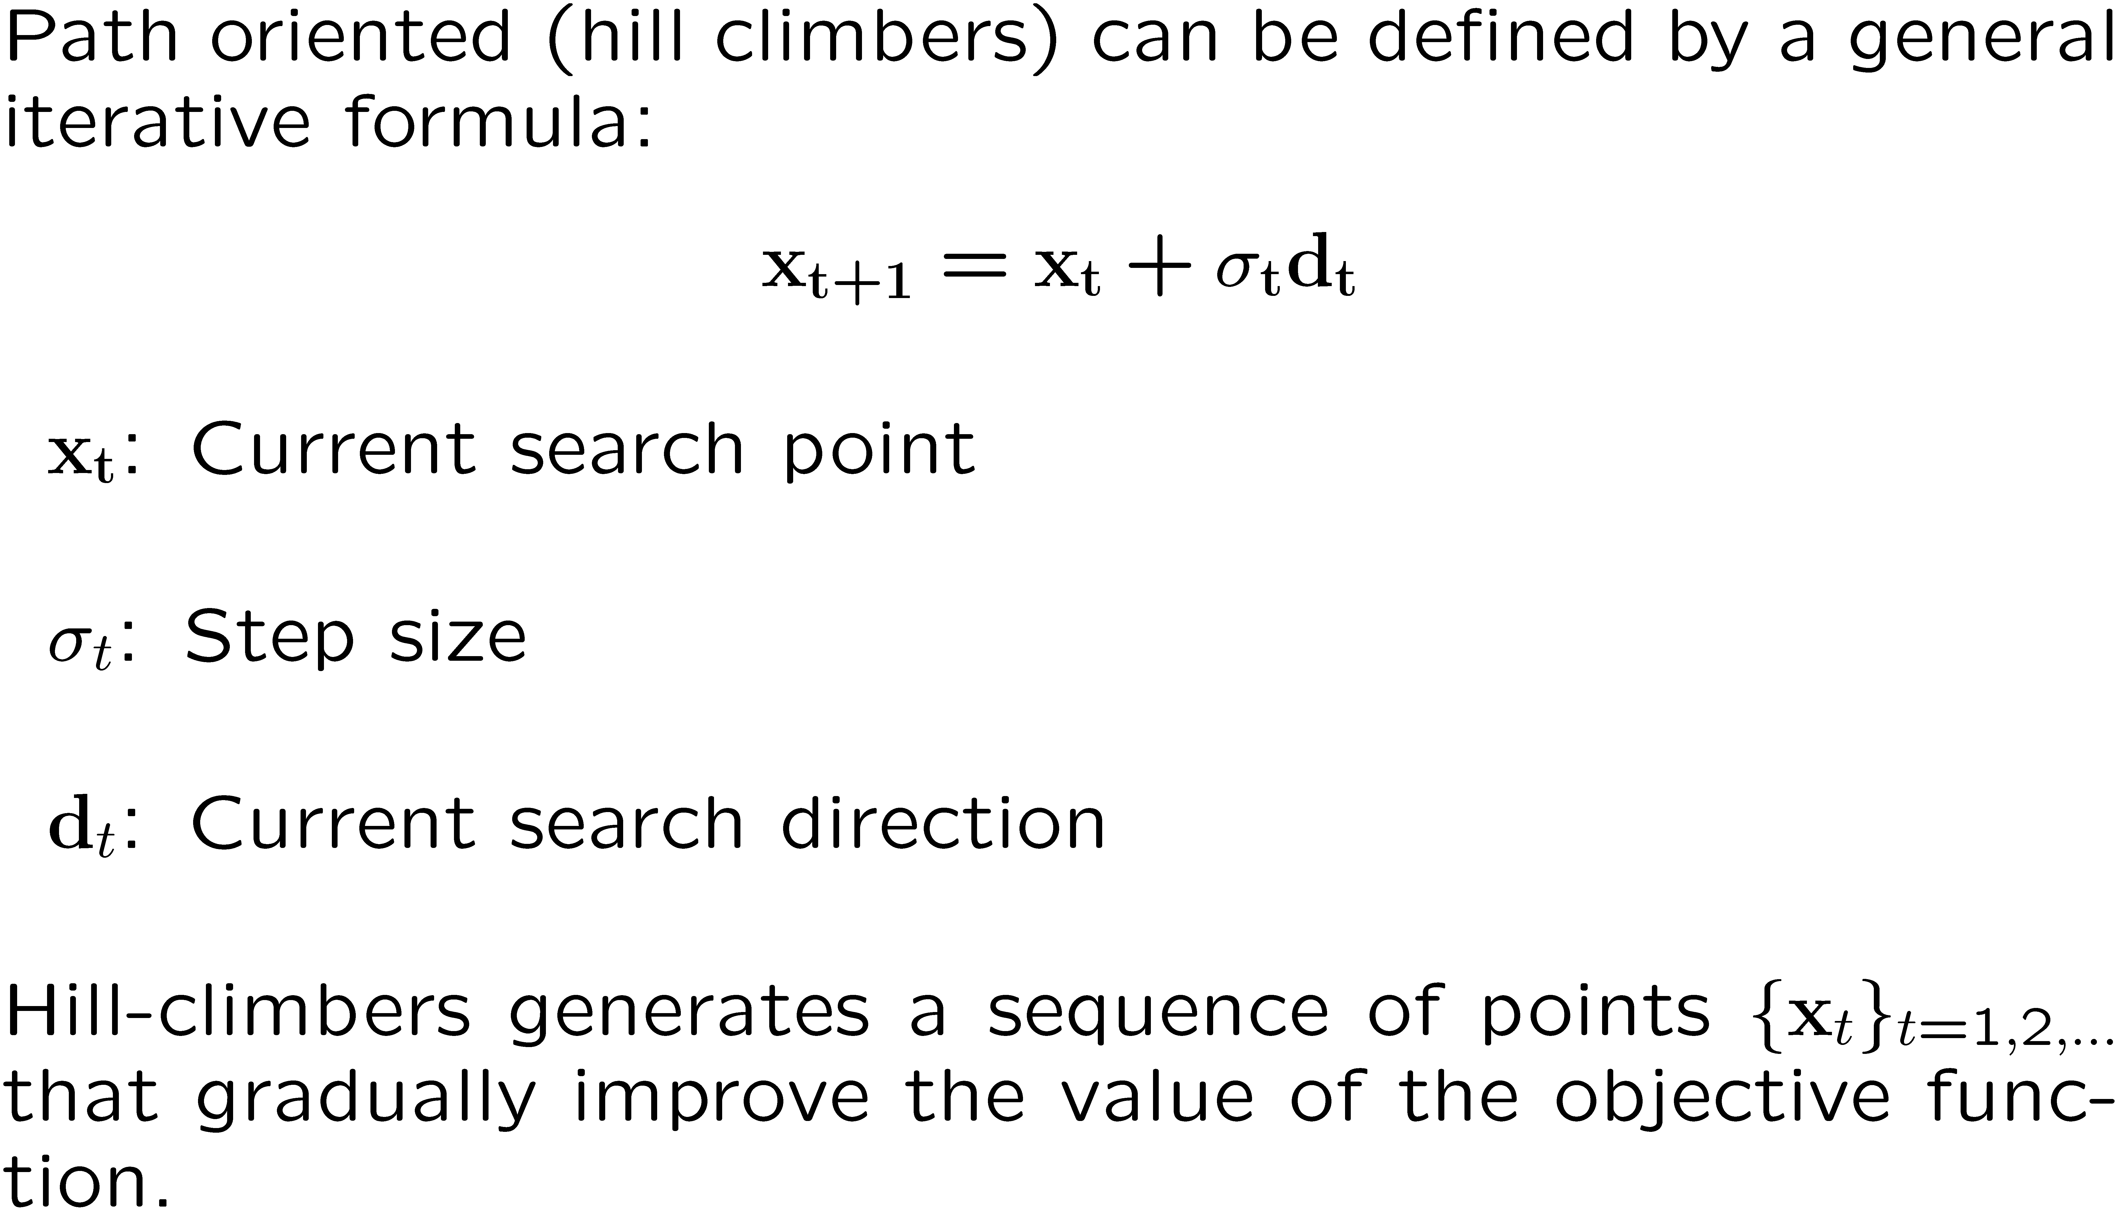
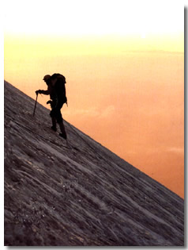
Hill-climbing Methods for Single-Objective Optimization

Slide 5
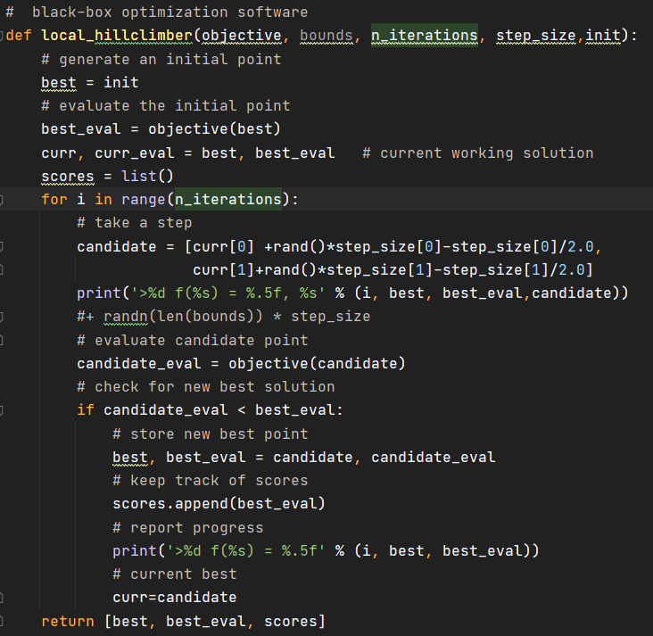
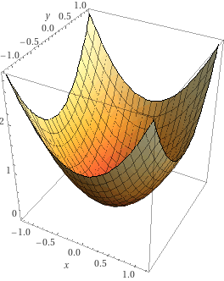

Simple 2-D stochastic hillclimber

Slide 6
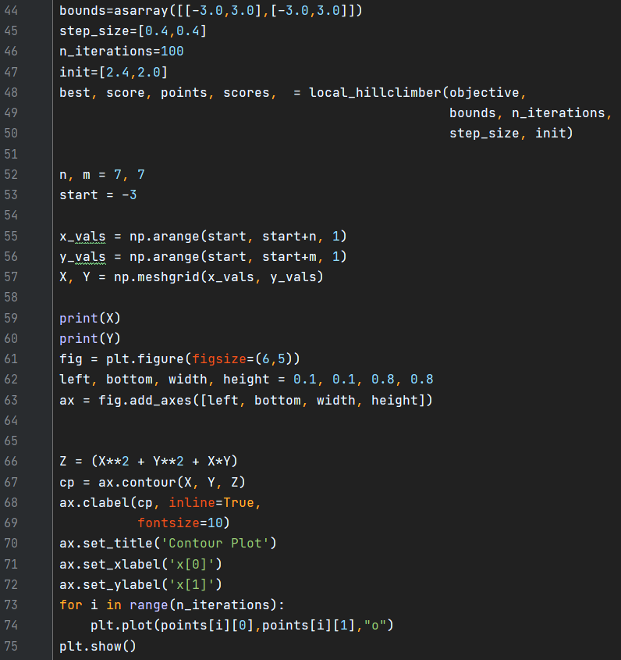
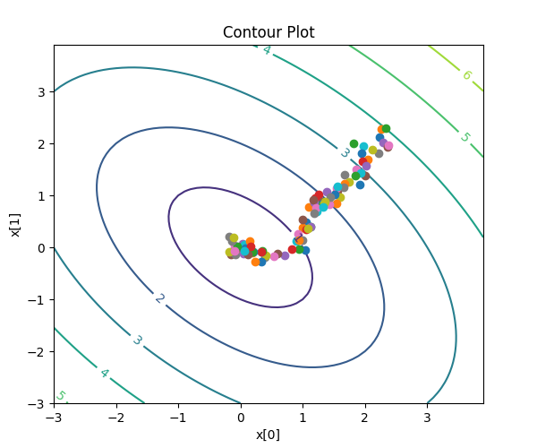
Plotting the history
Notes:
import numpy as np import matplotlib.cm as cm import matplotlib.pyplot as plt import numpy as np from numpy import asarray from numpy.random import randn from numpy.random import rand import matplotlib from matplotlib import pyplot import random def objective(x): return np.sqrt(x[0]**2+x[1]**2+x[0]*x[1]) # black-box optimization software def local_hillclimber(objective, bounds, n_iterations, step_size,init): # generate an initial point best = init # evaluate the initial point best_eval = objective(best) curr, curr_eval = best, best_eval # current working solution scores = list() points=list() for i in range(n_iterations): # take a step candidate = [curr[0] +rand()*step_size[0]-step_size[0]/2.0, curr[1]+rand()*step_size[1]-step_size[1]/2.0] points.append(candidate) print('>%d f(%s) = %.5f, %s' % (i, best, best_eval,candidate)) #evaluate candidate point candidate_eval = objective(candidate) # check for new best solution if candidate_eval < best_eval: # store new best point best, best_eval = candidate, candidate_eval # keep track of scores scores. append(best_eval) # current best curr=candidate return [best, best_eval, points, scores] bounds=asarray([[-3.0,3.0],[-3.0,3.0]]) step_size=[0.4,0.4] n_iterations=100 init=[2.4,2.0] best, score, points, scores, = local_hillclimber(objective, bounds, n_iterations, step_size, init) n, m = 7, 7 start = -3 x_vals = np.arange(start, start+7, 0.1) y_vals = np.arange(start, start+7, 0.1) X, Y = np.meshgrid(x_vals, y_vals) print(X) print(Y) fig = plt.figure(figsize=(6,5)) left, bottom, width, height = 0.1, 0.1, 0.8, 0.8 ax = fig.add_axes([left, bottom, width, height]) Z = np.sqrt(X**2 + Y**2 + X*Y) cp = ax.contour(X, Y, Z) ax.clabel(cp, inline=True, fontsize=10) ax.set_title('Contour Plot') ax.set_xlabel('x[0]') ax.set_ylabel('x[1]') for i in range(n_iterations): plt.plot(points[i][0],points[i][1],"o"); plt.show()

Slide 7
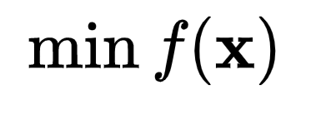
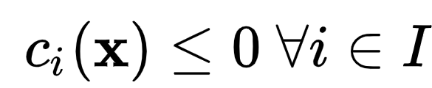
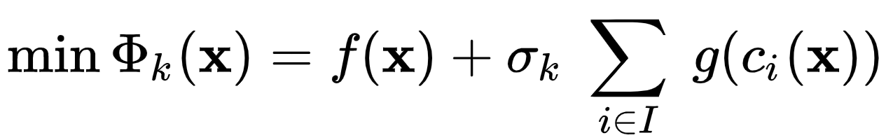
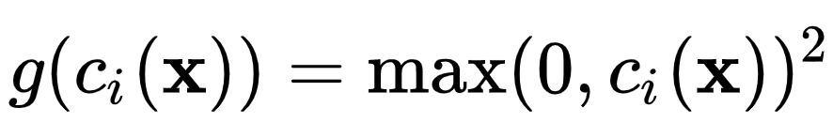
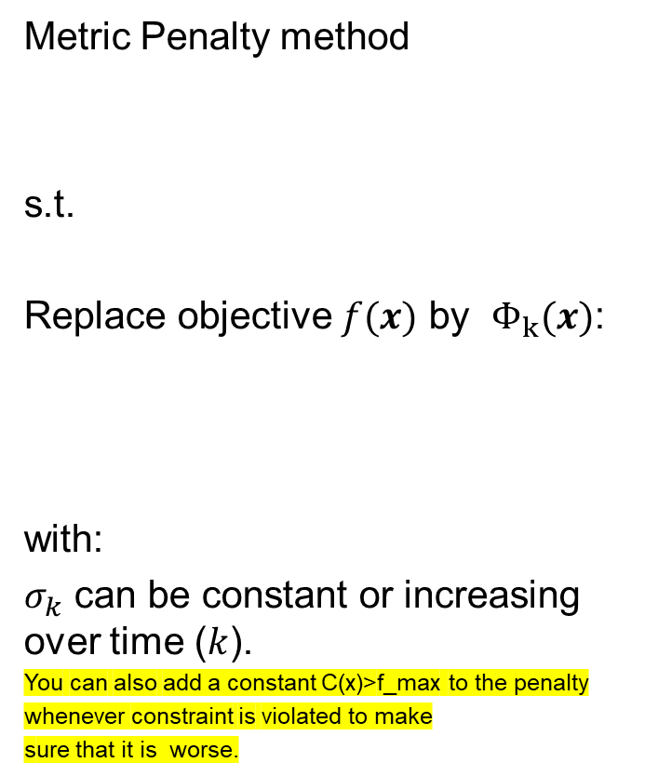
Penalty method for constraints
In single objective black box optimization we can implement constraints in two ways
Box constraints:
When hillclimbing method leaves the search region the point is projected back to the search region
Implicit constraints:
Constraints that require the black-box function to be evaluated can be handled by a (metric) penalty value.
Metric Penalty method
s.t.
Replace objective $f(x)$ by $Φ_{k}(x)$:
with:
$σ_{k}$ can be constant or increasing over time ($k$).
You can also add a constant C(x)>f_max to the penalty
whenever constraint is violated to make
sure that it is worse.

Slide 8
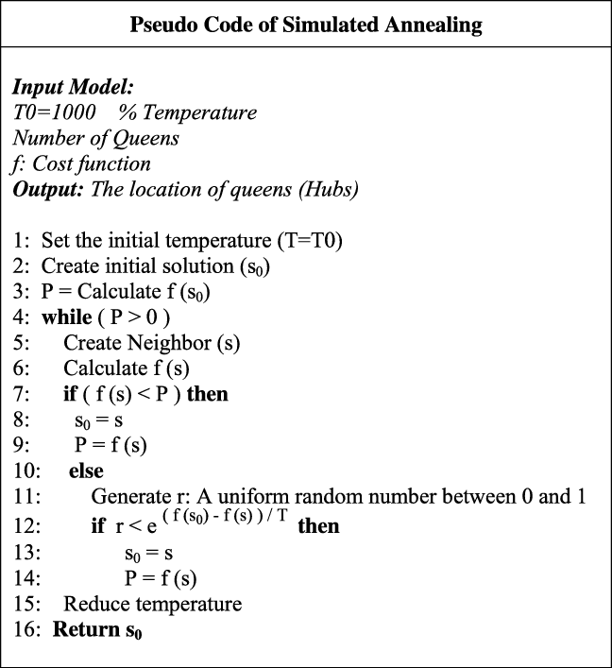

Simulated Annealing
Kirkpatrick, S. Optimization by simulated annealing: Quantitative studies. J Stat Phys 34, 975–986 (1984). https://doi.org/10.1007/BF01009452
Stochastic Hillclimbing inspired by Annealing process in crystals.
Simulated Annealing can always accepts improvements, but also worse solutions with some probability.
In order to get to global optima one might have to accept steps to get worse temporarily
https://makeitfrommetal.com/beginners-guide-on-how-to-anneal-steel/

Slide 9
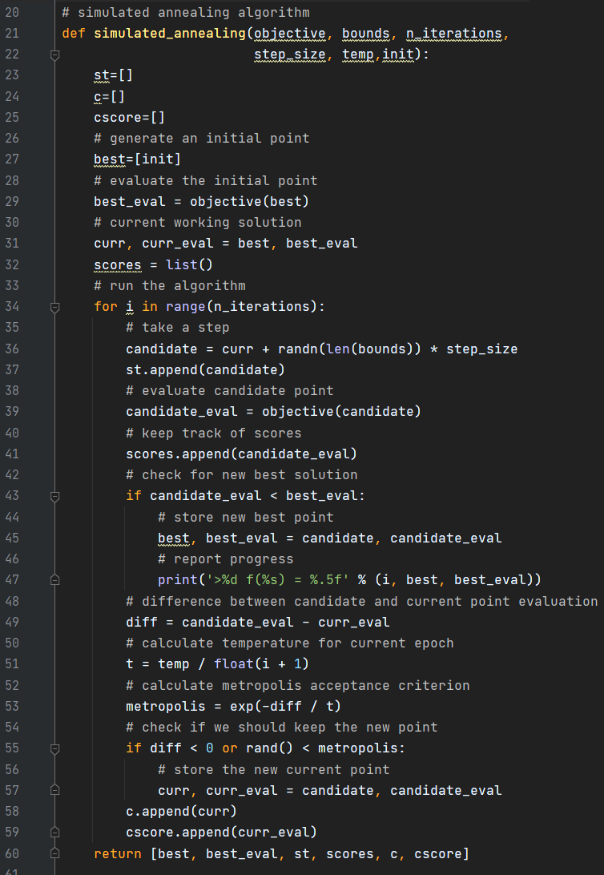

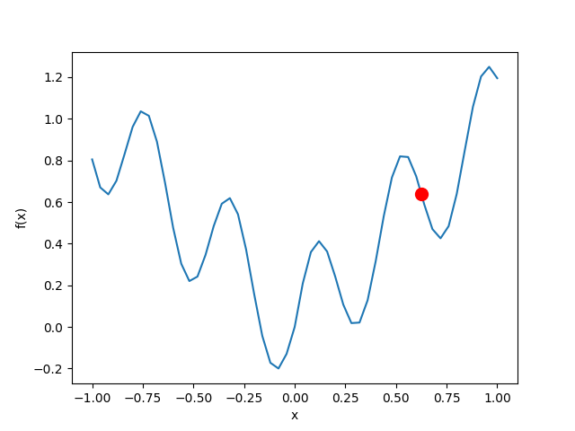
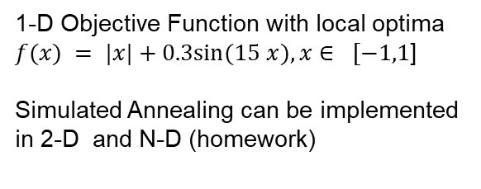
Simulated Annealing
1-D Objective Function with local optima
$f(x) = |x|+0.3sin⁡(15 x), x∈ [−1,1$]
Simulated Annealing can be implemented
in 2-D and N-D (homework)
Notes:
import numpy as np import matplotlib.cm as cm import matplotlib.pyplot as plt import numpy as np from numpy import asarray from numpy import exp from numpy.random import randn from numpy.random import rand import matplotlib from matplotlib import pyplot import random import matplotlib.pyplot as plt import time #simulated annealing algorithm def objective(x): return np.abs(x[0]) + 0.25 * np.sin(x[0] * 15); def simulated_annealing(obiective, bounds, n_iterations, step_size ,temp, init): # Some lists to collect results newpt=[] # list of points newscores = [] c=[] cscore=[] # a generate an initial point best=[init] # evaluate the initial point best_eval = objective(best) # current working solution curr, curr_eval = best, best_eval # run the algorithm for i in range(n_iterations): # take a step candidate = curr + randn(len(bounds)) * step_size newpt.append(candidate) # evaluate candidate point candidate_eval = objective(candidate) # keep track of scores scores newscores.append(candidate_eval) # check for new best solution if (candidate_eval < best_eval): # store new best point best, best_eval = candidate, candidate_eval # report progress print('s%d f(%s) = %.5f' % (i, best, best_eval)) # difference between candidate and current point evaluation diff = candidate_eval - curr_eval # calculate temperature for current epoch t = temp / float(i + 1) # calculate metropolis acceptance criterion metropolis = exp(-diff / t) # check if we should keep the new point if (diff < 0) or (rand() < metropolis): # store the new current point curr, curr_eval = candidate, candidate_eval c.append(curr) cscore.append(curr_eval) return (best, best_eval, newpt, newscores, c, cscore) # Set random seed random.seed(1) # Define the search space lb=-1 ub=1 bounds=asarray([[lb,ub]]) # Random number generator initialization seed(1) n_iterations = 100 #define the maximum step size step_size = 0.15 #initial temperature temp = 1.5 # initial point init=0.65 # perform the simulated annealing search best, score, st, scores, c, cscores = \ simulated_annealing(objective, bounds, n_iterations, step_size, temp, init) def f1d(x): a=[] a.append(x) return objective(a) # Plotting just the function x = np.linspace(start = lb # lower limit ,stop = ub # upper limit, ,num = 51) # generate 51 points between 0 and 3 y = f1d(x) # scalar values in array x will be evaluated plt.plot(x, y) plt.show() # for i in range(n_iterations): plt.xlabel("x") plt.ylabel("f(x)") plt.plot(x, y) plt.plot(c[0:i], cscores[0:i], marker="o", markersize=18, markeredgecolor="red", markerfacecolor="green") plt.plot(st[i], scores[i],'.r',ms=20) plt.show() time.sleep(1)

Slide 10
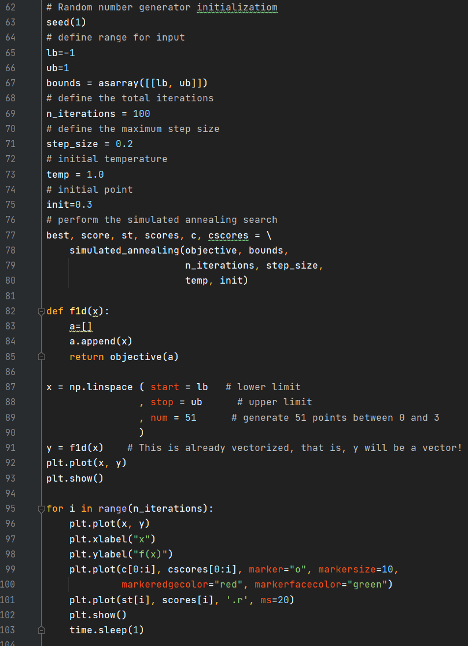
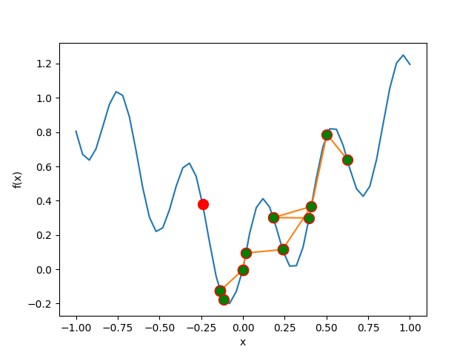

Simulated Annealing
Plot shows the function and linked successful moves
Notice that the
function value gets
worse here
and SA escapes
local optimum
Homework:
Optimize design with N-D Simulated annealing
https://trinket.io/python3/b22300f21e

Slide 11
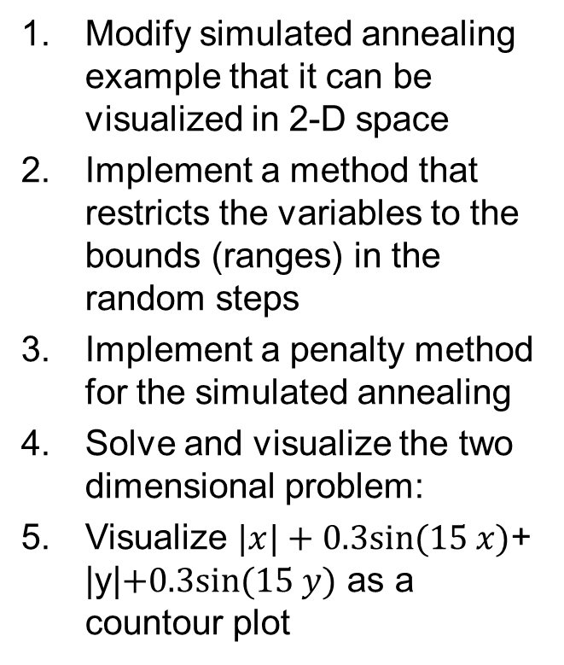
Task Local Optimization with Constraints/Penalties in Python
A
Modify simulated annealing example that it can be visualized in 2-D space
Implement a method that restricts the variables to the bounds (ranges) in the random steps
Implement a penalty method for the simulated annealing
Solve and visualize the two dimensional problem:
Visualize $|x|+0.3sin⁡(15 x)$+ |y|$+0.3sin⁡(15 y)$ as a countour plot
Save the source codes and add it to your homework folder.
You will be later asked to submit them to us.
You can name them after the number exday02A1.py

Slide 12
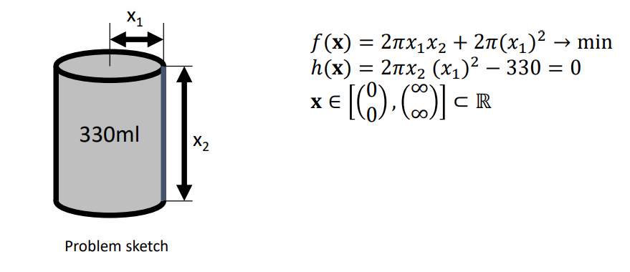
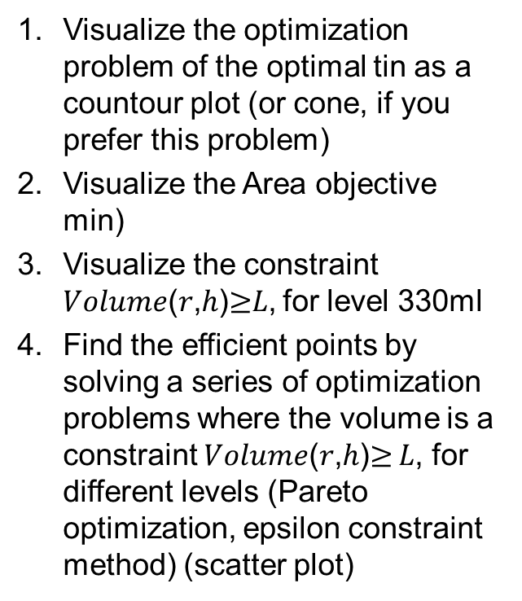
Exercise 2
B
Visualize the optimization problem of the optimal tin as a countour plot (or cone, if you prefer this problem)
Visualize the Area objective min)
Visualize the constraint 𝑉𝑜𝑙𝑢𝑚𝑒(𝑟,ℎ)$≥$𝐿, for level 330ml
Find the efficient points by solving a series of optimization problems where the volume is a constraint 𝑉𝑜𝑙𝑢𝑚𝑒(𝑟,ℎ)$≥$ 𝐿, for different levels (Pareto optimization, epsilon constraint method) (scatter plot)

