Slide 1
Fixture Alternatives
We all secretly know that fixtures are
THE DEVIL

Slide 2
What the hell does users(:quentin) even mean?

Slide 3
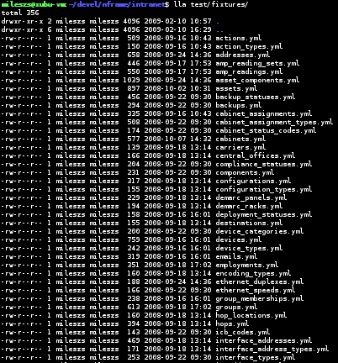
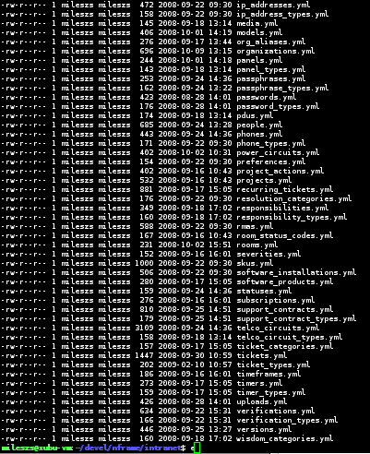
Instruments of THE DEVIL!

Slide 4
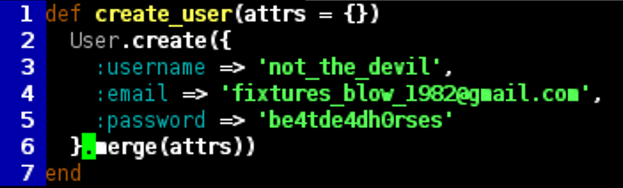
Constructor Helpers

Slide 5

Mocking and Stubbing

Slide 6
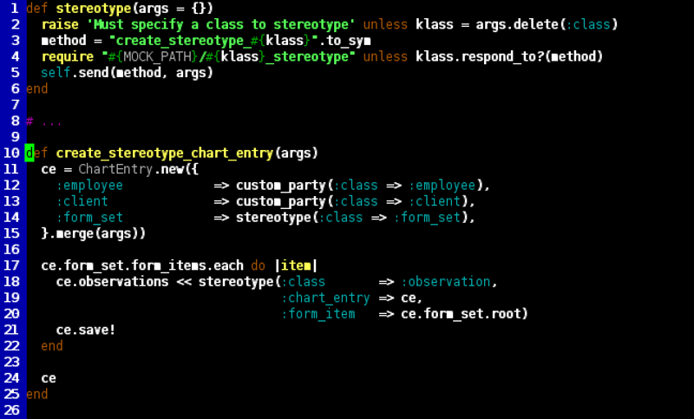
Stereotypes

Slide 7
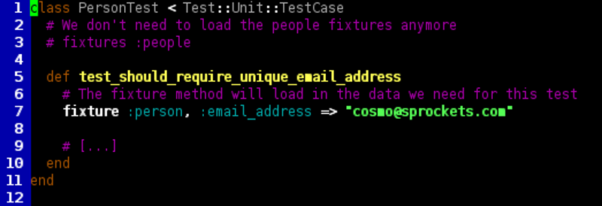
Inline Fixtures
DEVILISH

Slide 8
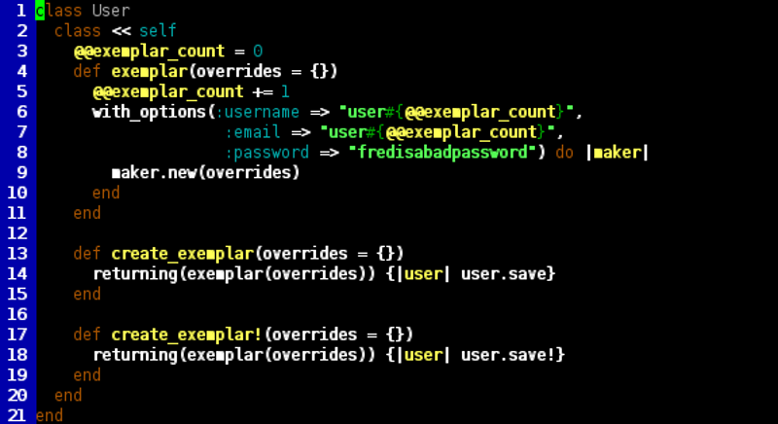
Exemplar

Slide 9
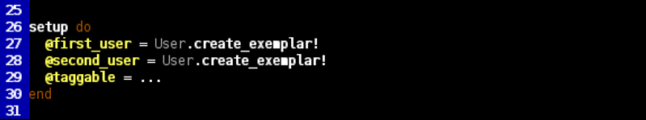
Exemplar (cont'd)
ex · em · plar – noun:
1. a model or pattern to be copied or imitated
Yes, I looked it up. Accurate slides are obviously very important to me.

Slide 10
Factories
Constructor Helpers
Stereotypes
Inline Fixtures
Exemplars
+
=
Factories
(kinda)

Slide 11
Factory Girl
By the makers of Shoulda, Paperclip, and Hoptoad

Slide 12
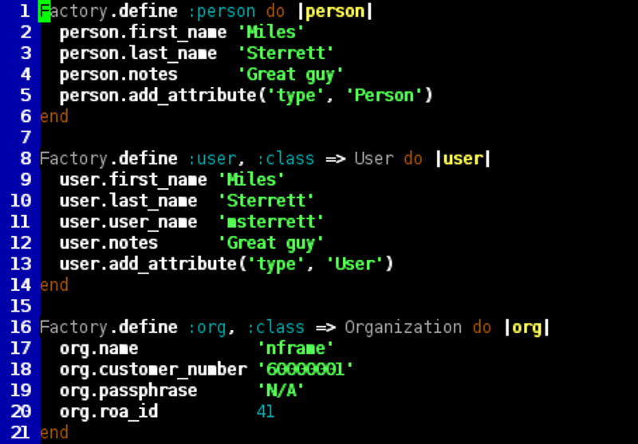

Slide 13
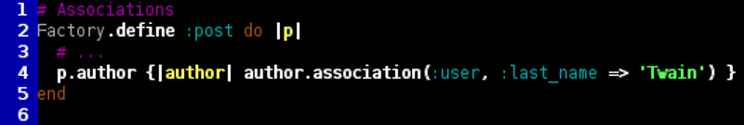

Slide 14
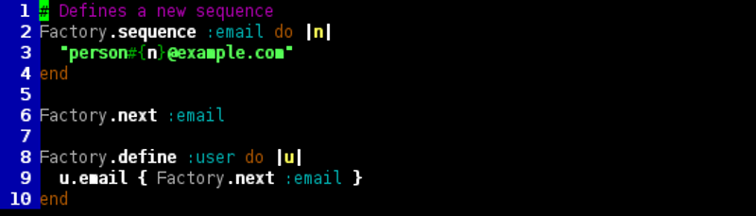

Slide 15
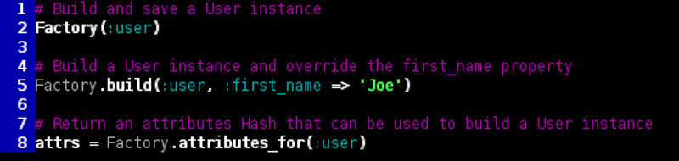

Slide 16
Machinist
A more concise / prettier syntax inspired by FactoryGirl

Slide 17
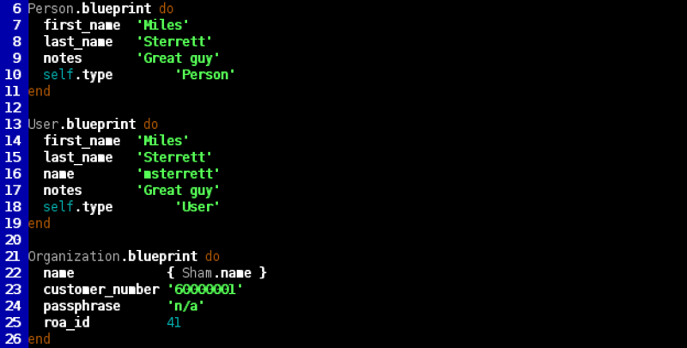

Slide 18
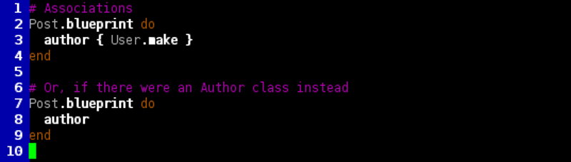

Slide 19
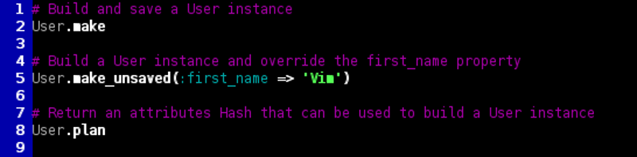

Slide 22
LOTS OF STUFF

Slide 23
EMPTY!

Slide 24
SWEATSHOP!
It does all your work for you!
You can sit back and drink artificially sweetened beverages!
http://github.com/mileszs/sweatshop
You can thank David Baldwin for Machinist support, as well as per-model support.

