Slide 1
Teaching Ruby as a First Language
Robby Slaughter / robslaug@iupui.edu

Slide 2
What To Talk About?
The Biggest Problem
Why Ruby?
Yes, but how Ruby?
War Stories
What’s Next?

Slide 3
The biggest problem
Coming Soon to CBS

Slide 4
The Biggest Problem

Slide 5
The Biggest Problem
We have no idea where are students come from
We have no idea where are students are going.

Slide 6
The Biggest Problem

Slide 7
The Biggest Problem

Slide 8
The Biggest Problem

Slide 9
The Biggest Problem
Weird Result #1
Perspectives on Testing for Programming Aptitude, Wolfe (1971)
“Personnel directors and the computer operators themselves consider this group as a natural source for recruitment for programming. Selection should be made very carefully, however, because the great majority of computer operators do not show superior aptitude for work in programming.”

Slide 10
The Biggest Problem
Weird Result #2
The Mystery of “b := (b = false)”, Reges (2008)
One AP CS test question had a 0.36 correlation with success!

Slide 11
The Biggest Problem
Weird Result #3
Mental Models, Consistency and Programming Aptitude, Bornat (2008)
The best pre-test for programming is consistency, but even this isn’t very good.

Slide 12
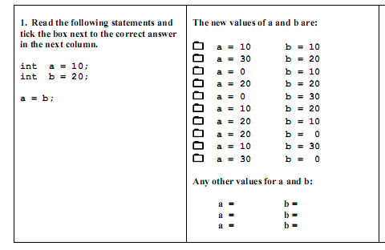

Slide 13
The Biggest Problem
Weird Result #4
“Unskilled and Unaware of It: How Difficulties in Recognizing One's Own Incompetence Lead to Inflated Self-Assessments” (Dunning 2003)
Incompetent individuals tend to:
Overestimate their own level of skill.
Fail to recognize genuine skill in others.
Fail to recognize the extremity of their inadequacy.

Slide 14
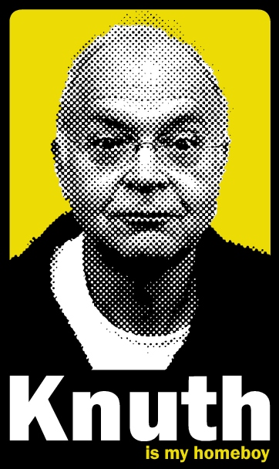
The Biggest Problem
“Educators of computer science have repeatedly observed that only about 2 out of every 100 students enrolling in introductory programming classes really resonate with the subject and seem to be natural-born computer scientists…I conclude that roughly 2% of all people ‘think algorithmically,’ in the sense that they can reason rapidly about algorithmic processes.” (2004)

Slide 15
WHY RUBY?
Why not?

Slide 16
Why Ruby?
Answers:
Nobody knows Ruby!
Students don’t automatically slack off
Ruby syntax is clean
Fully OO, no primitives or simple types
Constructs lend to diagramming & discussion
Challenges:
Variations in student background
Inflated student self-confidence
“Language cruft” stalls learning
Need to introduce OOP
Need to motivate UML and SDLC

Slide 17
Yes, but HOW RUBY?
Very carefully.

Slide 18

Yes, but how Ruby?
Not enough time to teach programming.
Little evidence that one can teach programming.
Many (most?) programmers are mostly self-taught

Slide 19
Yes, but how Ruby?
Instead, assign a one month workshop with daily tasks
Leverage wide variety of online tutorials
Provide direct support in class, but not instruction
Require completion; expect some students to drop out

Slide 20
WAR STORIES
Dispatches from the trenches

Slide 21

War Stories
Help! I’ve tried all of the examples and none of them work right!

Slide 22
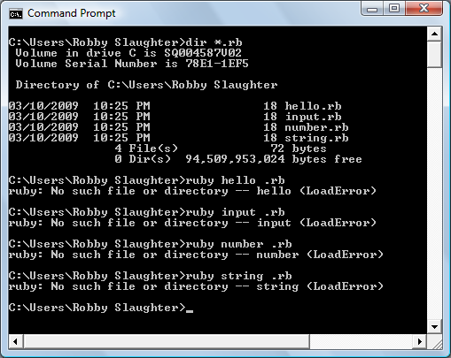

Slide 23
War Stories
3.times puts "hello"
puts "hello"
puts "hello" puts "hello"
✗
✗
3.times do
puts "hello" end
p = proc { puts "hello" }
p.call p.call p.call
✓
✓
puts "hello"*3
3.times {
puts "hello" }
?
✓
3.times { puts "hello" }
✓
3.times { puts
"hello" }
?

Slide 24
War Stories
answer = ""
done = false
while !done
do
puts "Say anything"
answer = gets.chomp
done = (answer,to_s = "goodbye")
end

Slide 25
WHAT’s NEXT?
Who knows what the future holds?

Slide 26
What’s Next?
Almost nobody is teaching Ruby at University level
Al Cripps at MTSU – CS3210
Andy Tinkham at Olin University – CSE4415
Robert Feldt at Chalmers University – DIT275
???

Slide 27
What’s Next?
Basically nobody is teaching Ruby as a first language
My class doesn’t really cover any serious computer science topics

Slide 28
What’s Next?
Ruby might be:
A great language to learn about CS
A great first web development environment
A good basis for higher level OO design
A great environment for teaching TDD
The Next Big Thing?

Slide 29
Teaching Ruby as a First Language
Robby Slaughter / robslaug@iupui.edu

