Slide 1
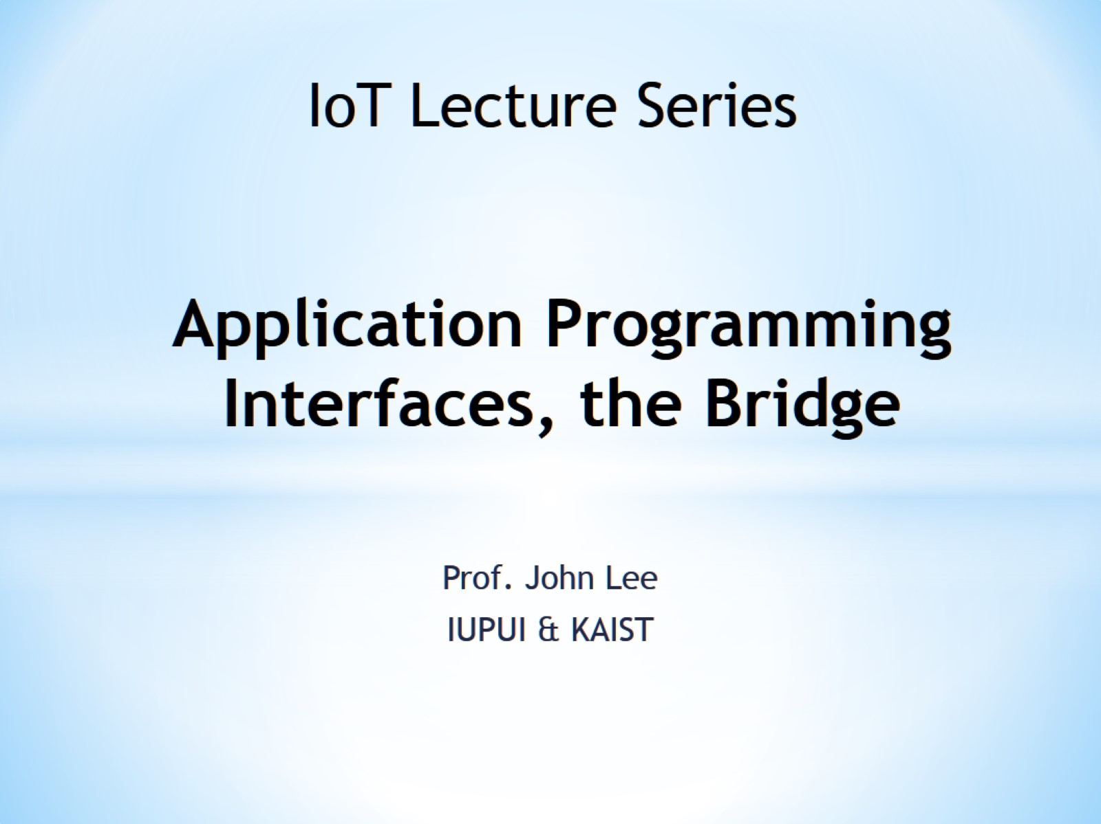
Application Programming Interfaces, the Bridge

Slide 2
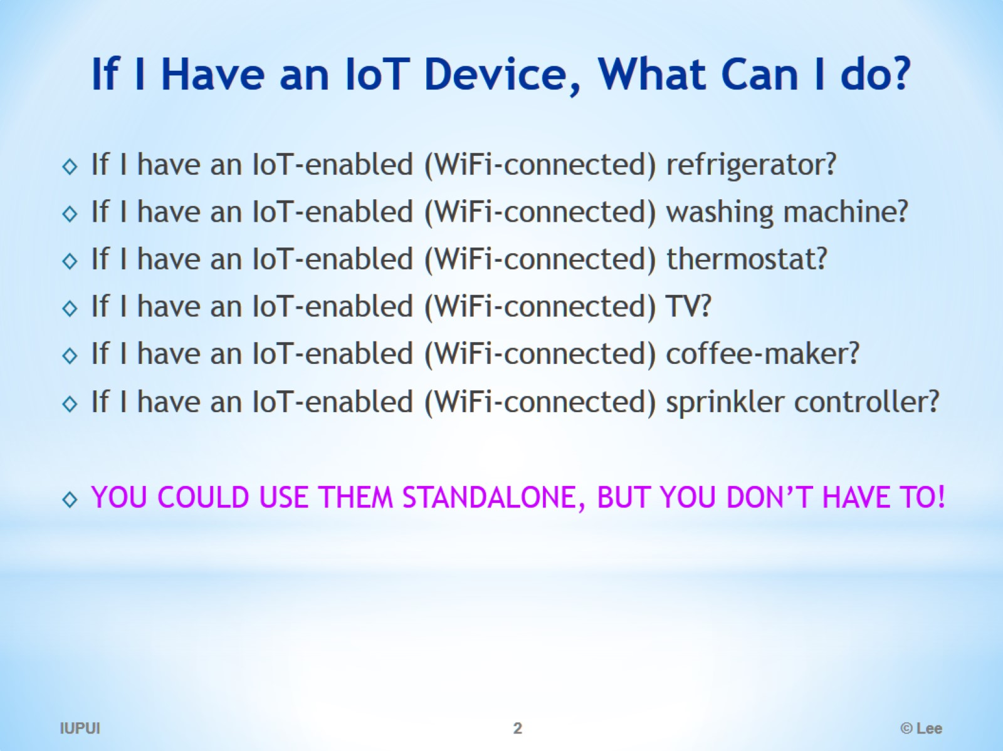
If I Have an IoT Device, What Can I do?

Slide 3
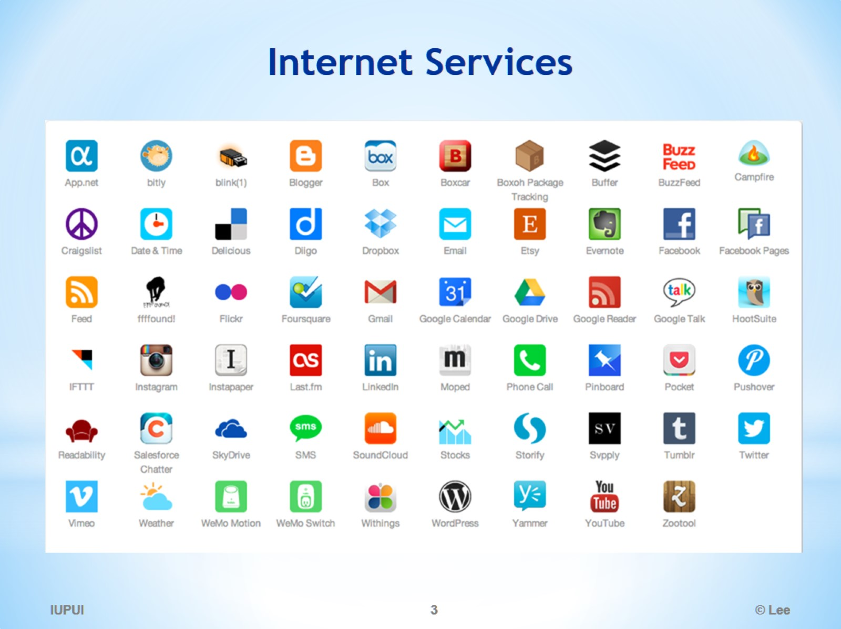
Internet Services

Slide 4
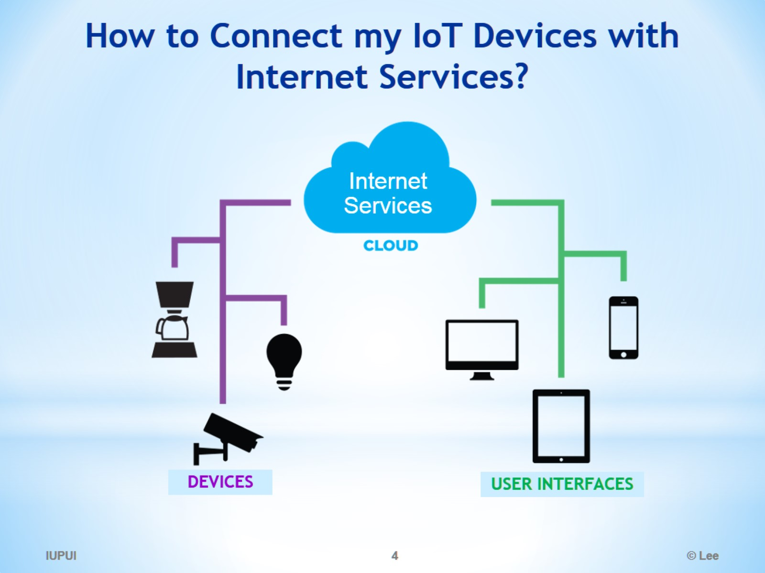
How to Connect my IoT Devices with Internet Services?

Slide 5
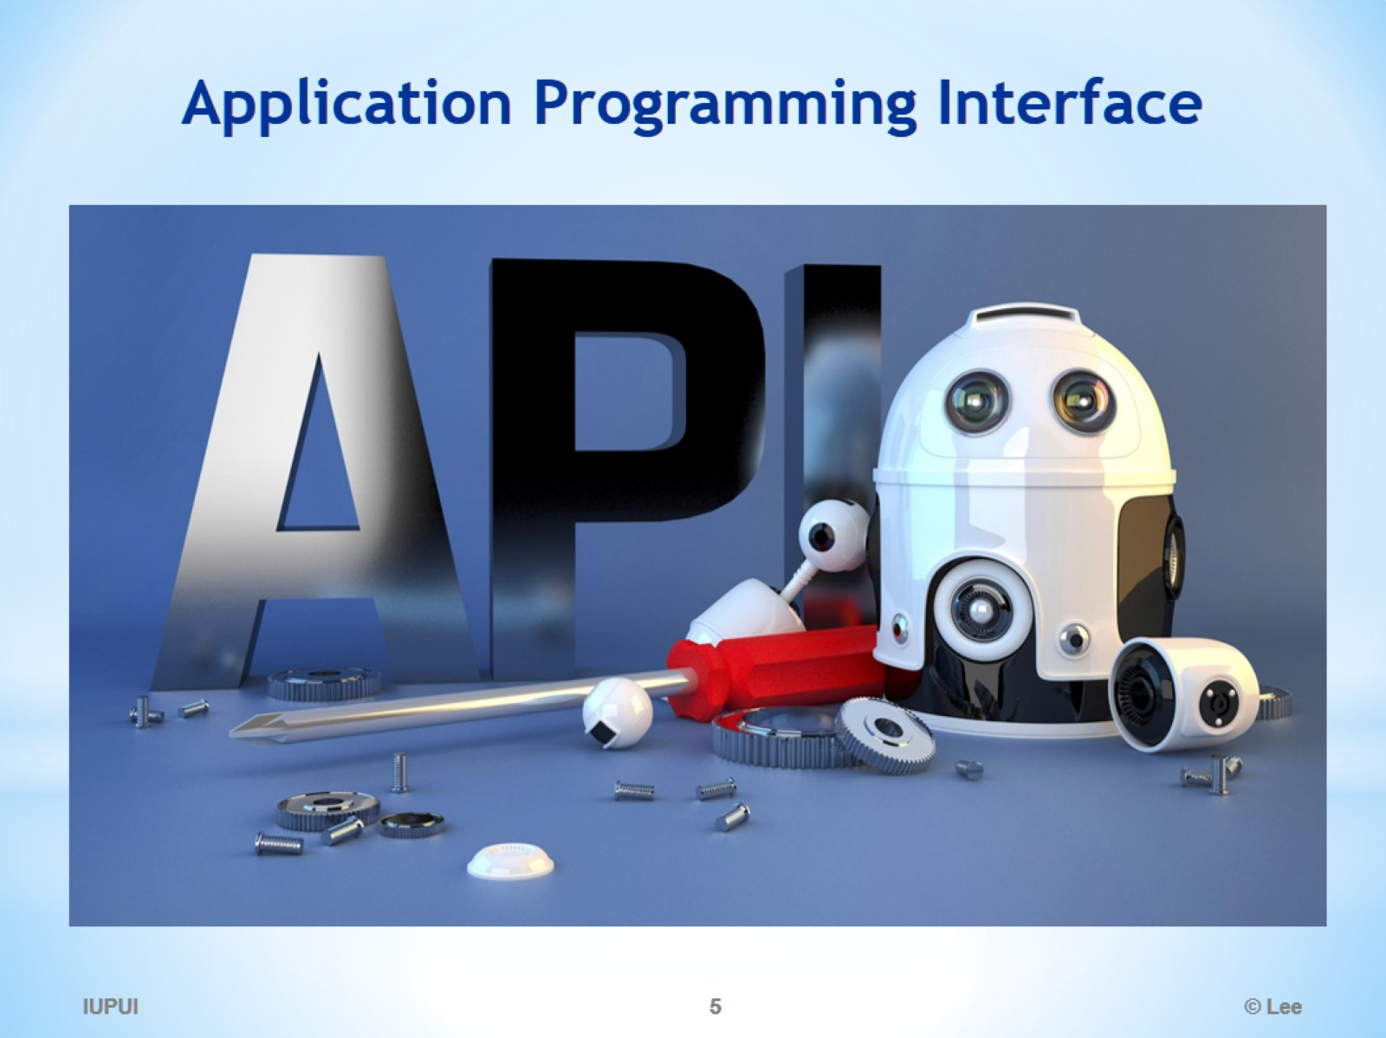
Application Programming Interface

Slide 6
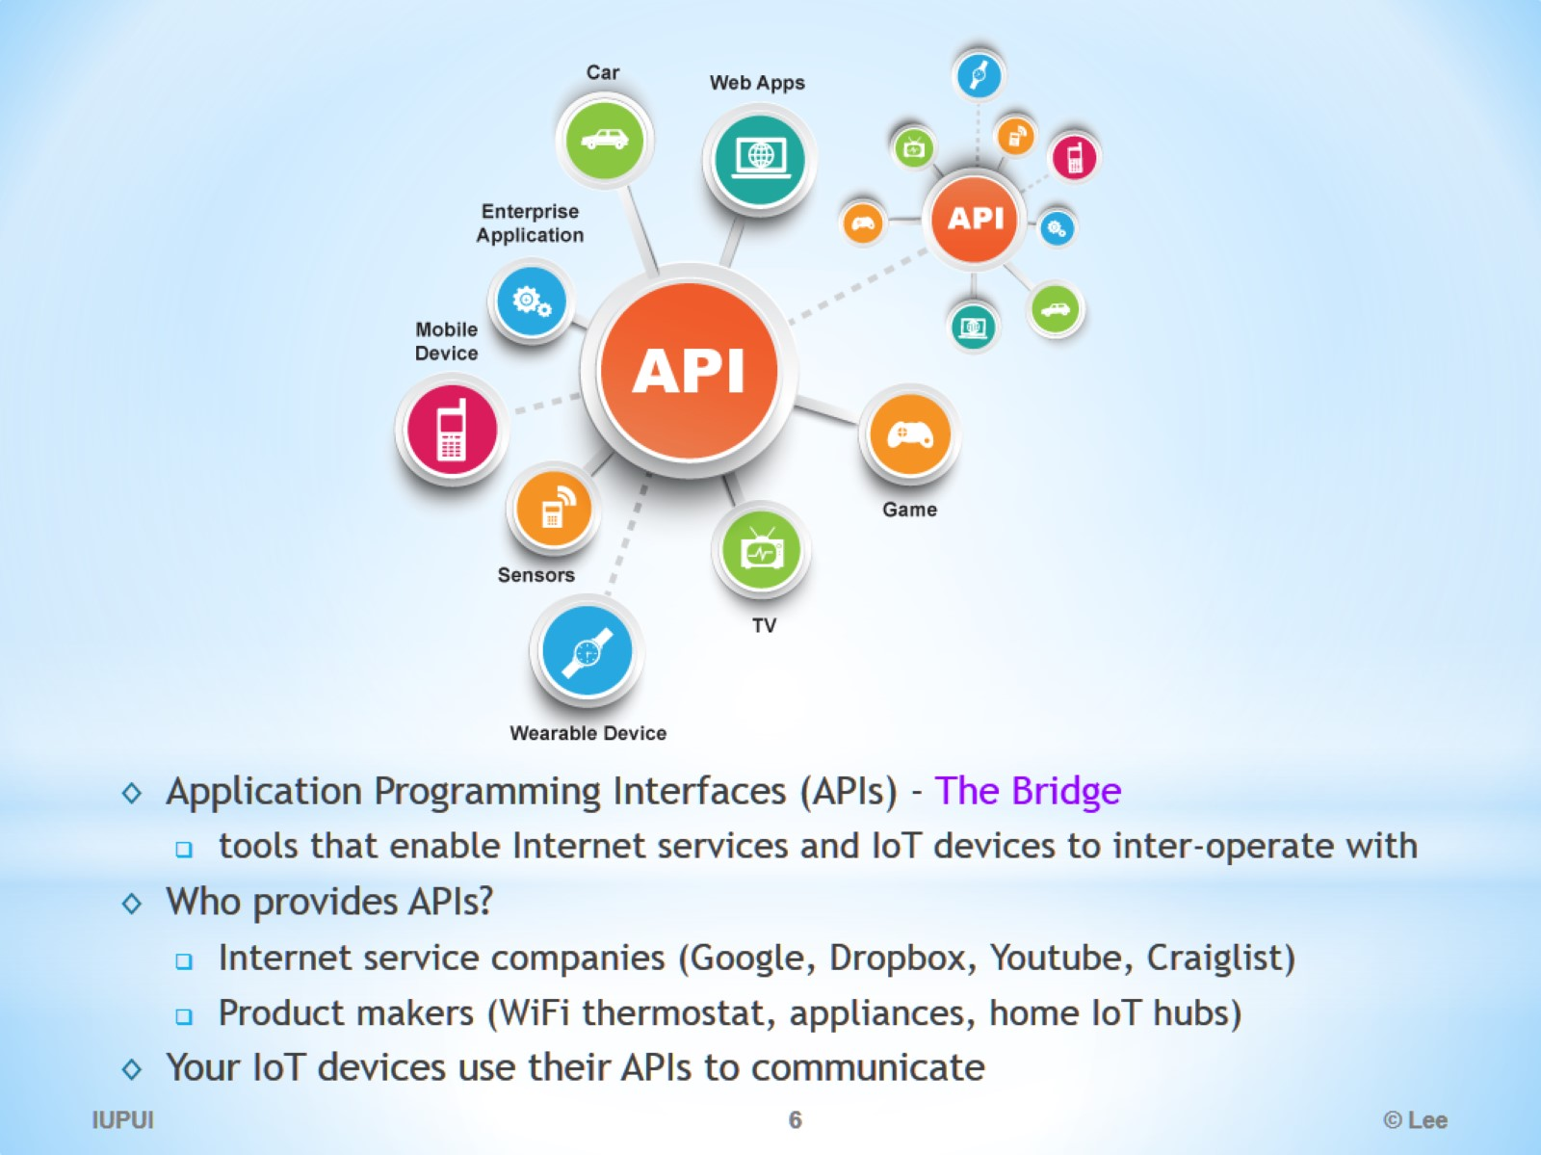

Slide 7
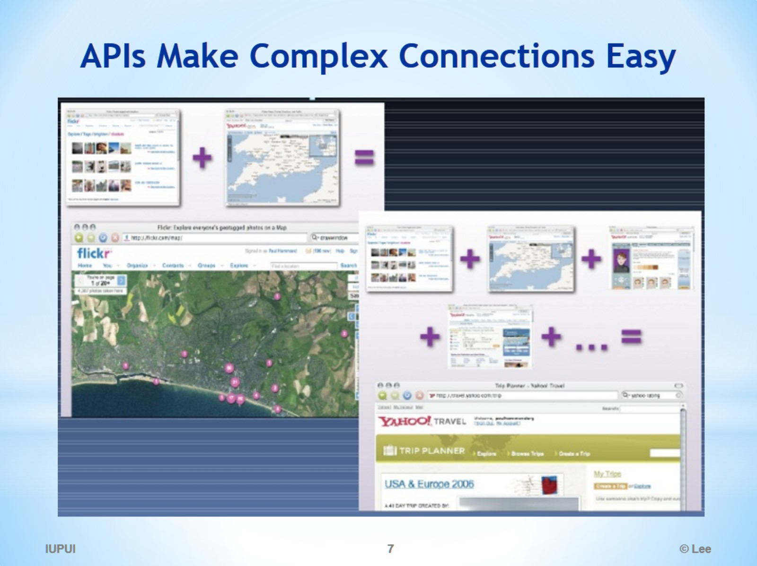
APIs Make Complex Connections Easy

Slide 8
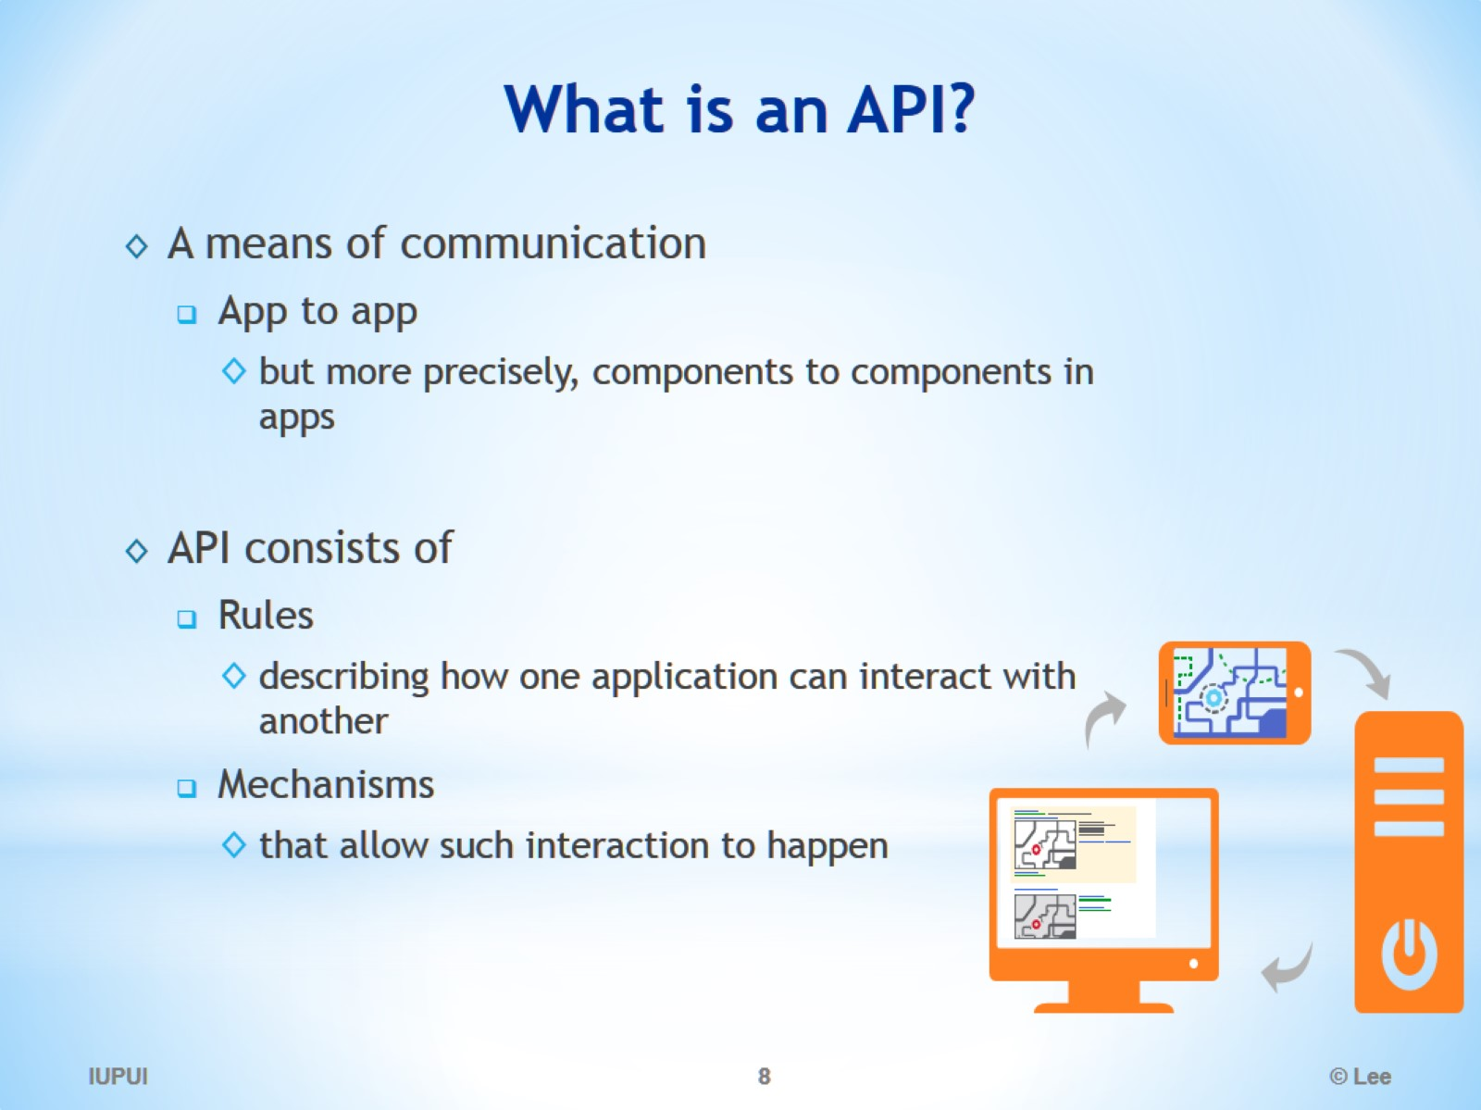
What is an API?

Slide 9
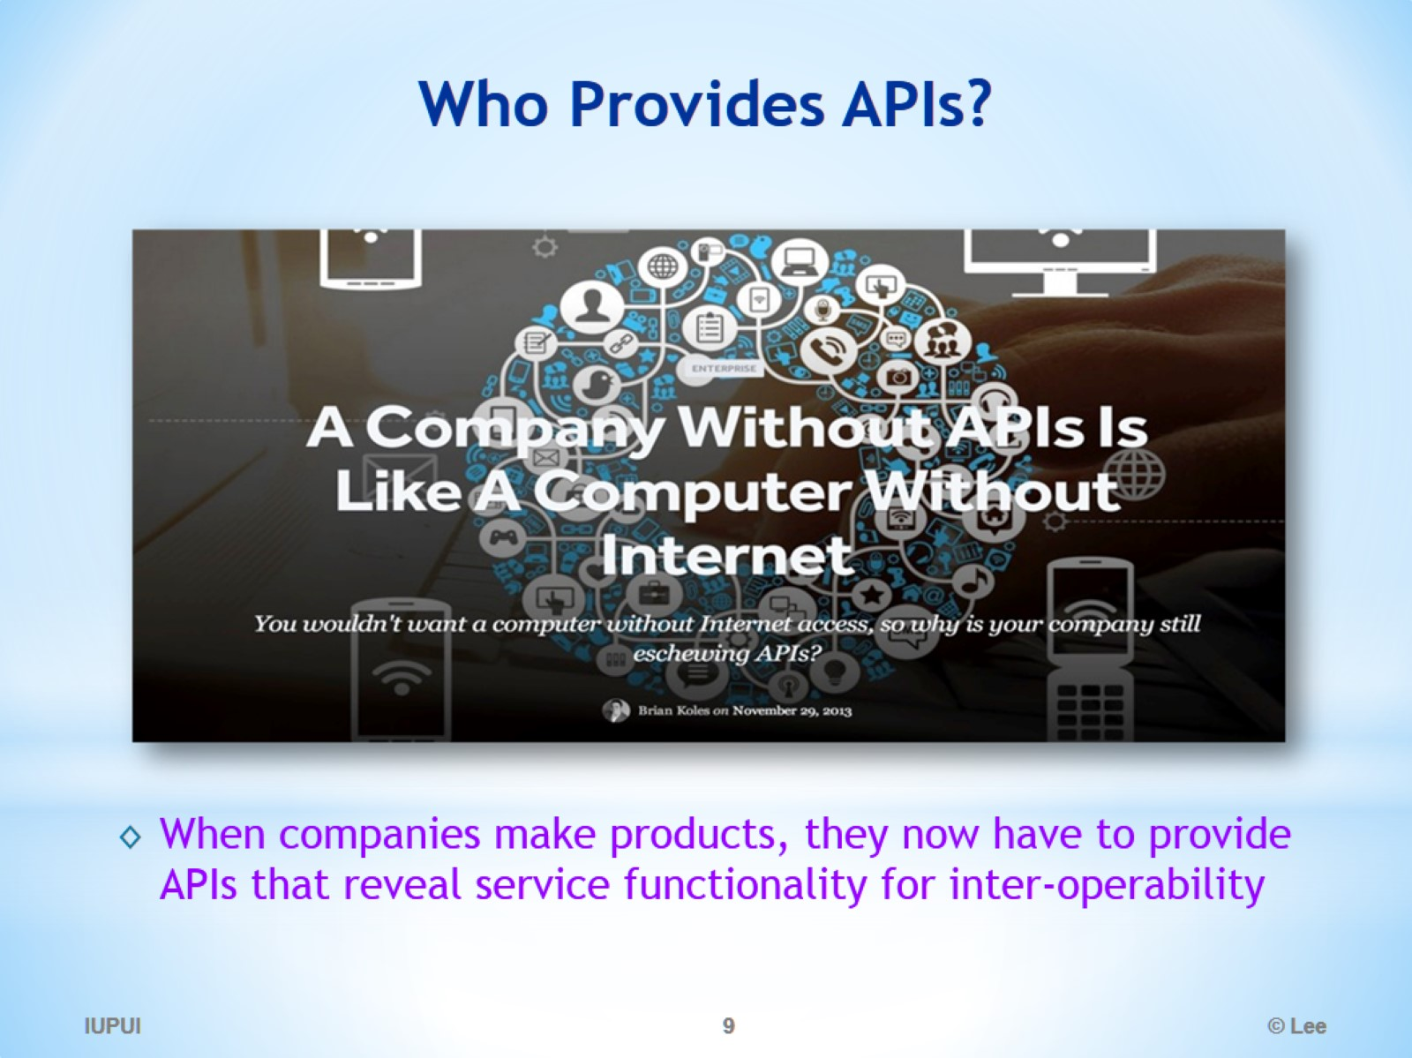
Who Provides APIs?

Slide 10
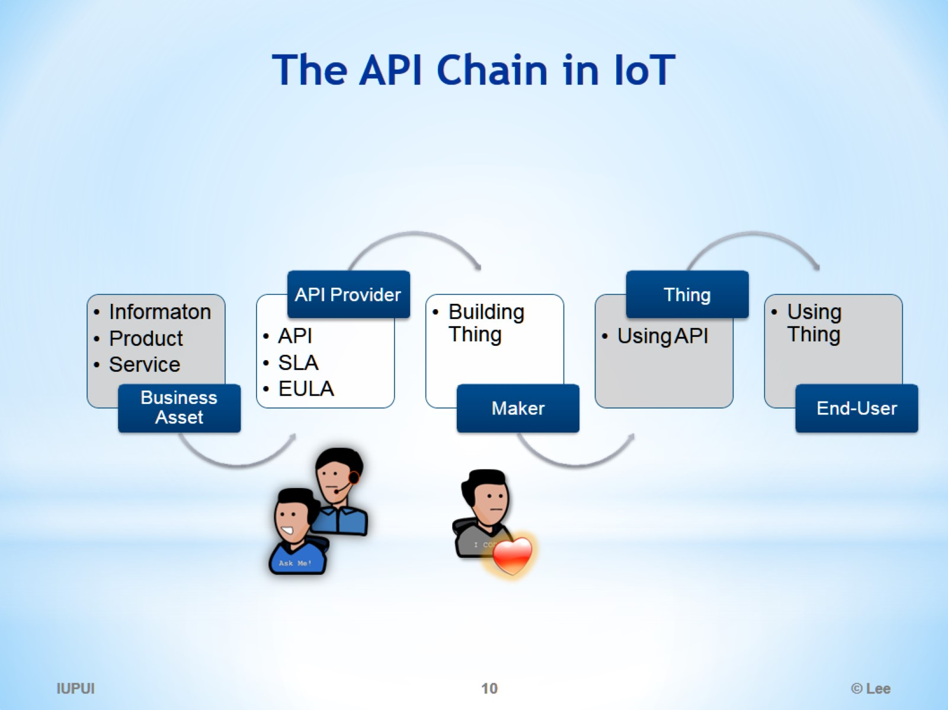
The API Chain in IoT

Slide 11
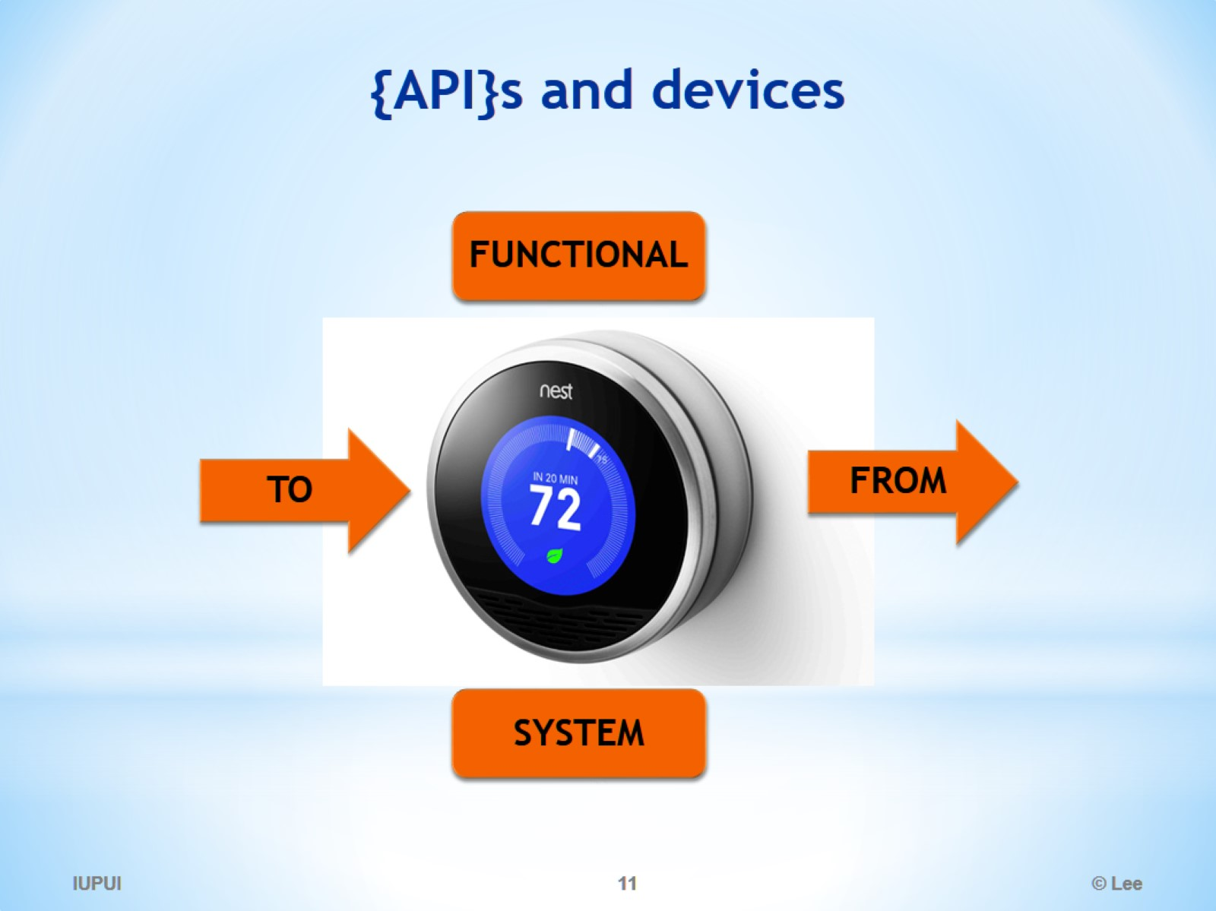
{API}s and devices

Slide 12
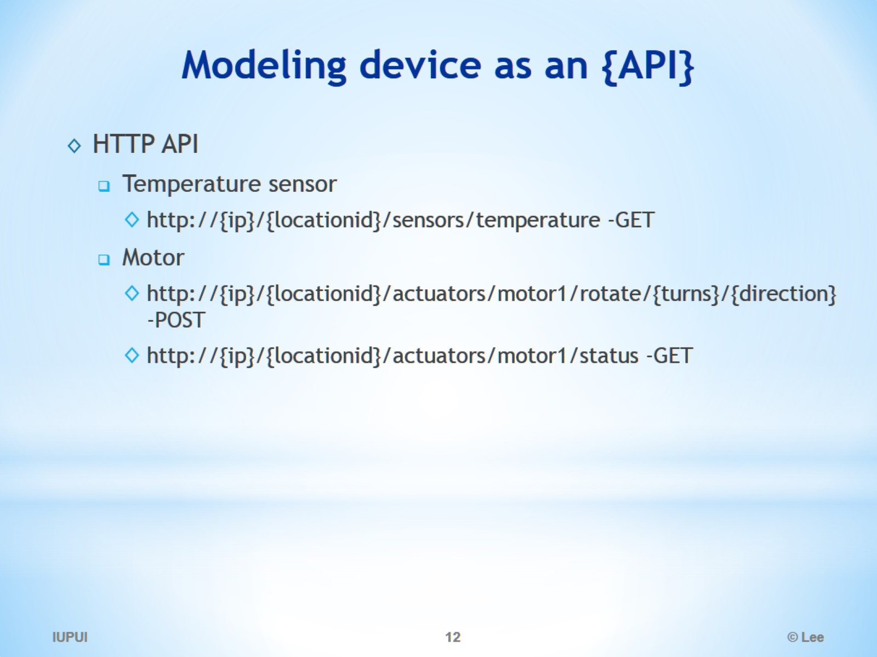
Modeling device as an {API}

Slide 13
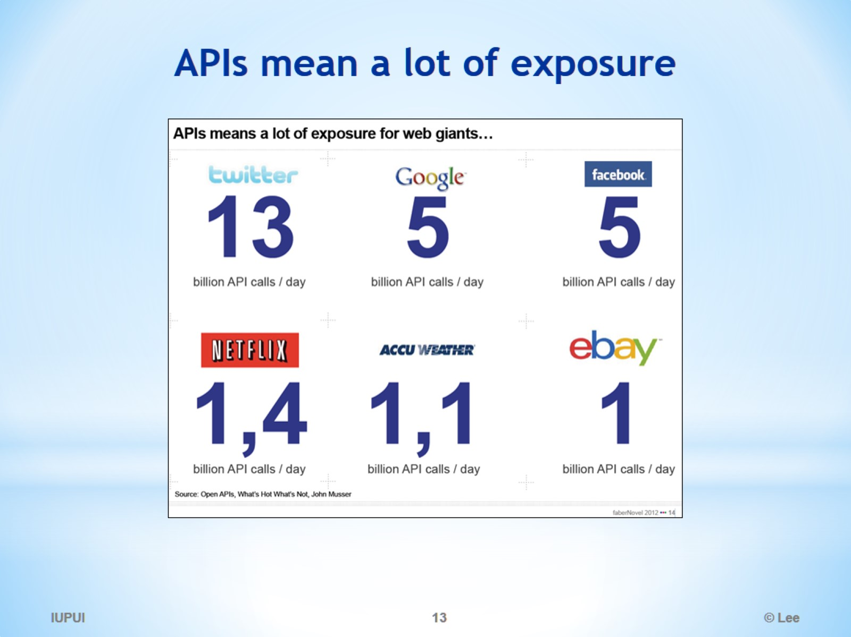
APIs mean a lot of exposure

Slide 14
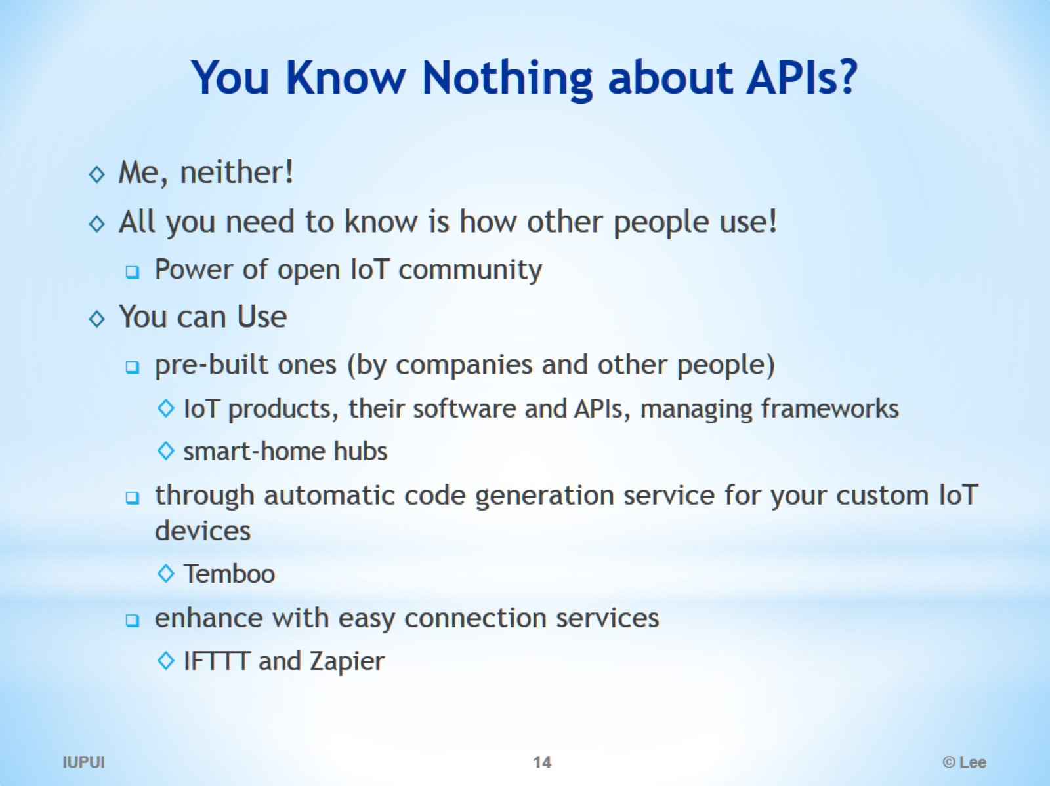
You Know Nothing about APIs?

