Slide 1
Solderingstation
Ine Beddegenoots

Slide 2
Table of contents
Introduction
Materials
Results
Self-reflection

Slide 3
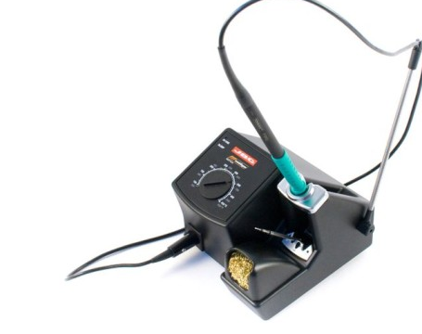
Introduction
What did we make?
Why did we make it?
Notes:
We made a soldering station the inspiration for this project was an article from the elector magazine we also used this as primary source of information
The purpose of this project was to make a functional and educational project as a part of the course project design

Slide 4

Materials
Software tools
SMD components
Notes:
The software tools used for this project are Inventor as a tool for the design of the case and Altium for the design of the schematics and the pcb.
For the PCBs I mainly used SMD components to reduce or minimze the size of both PCBs

Slide 5
Results

Slide 6
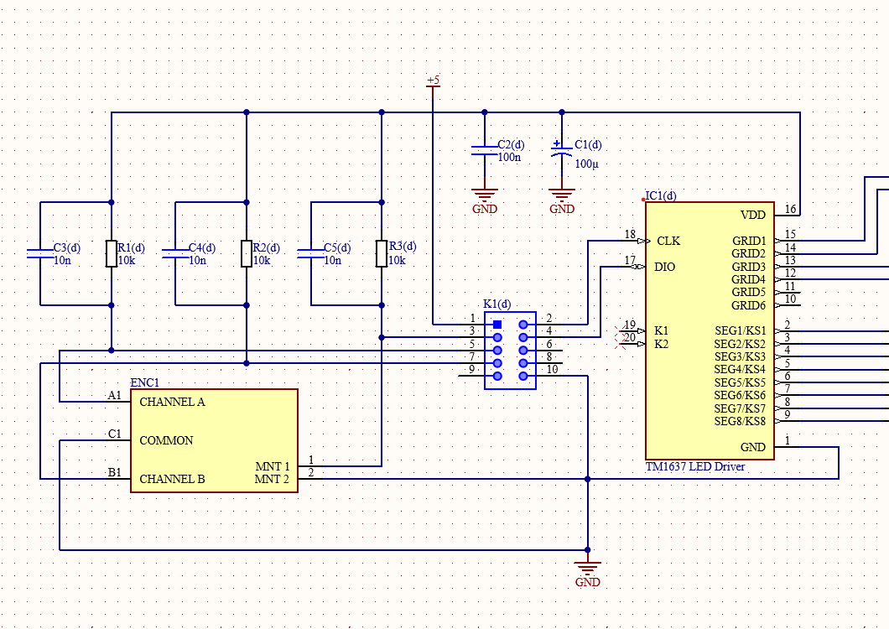
Schematic Design
Divided into 5 smaller schematics
5V to box header

Slide 7
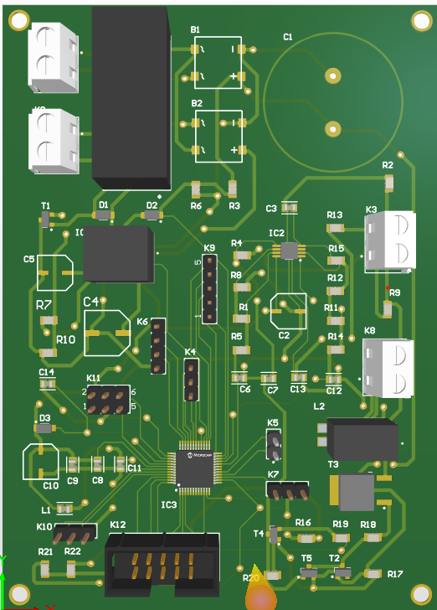
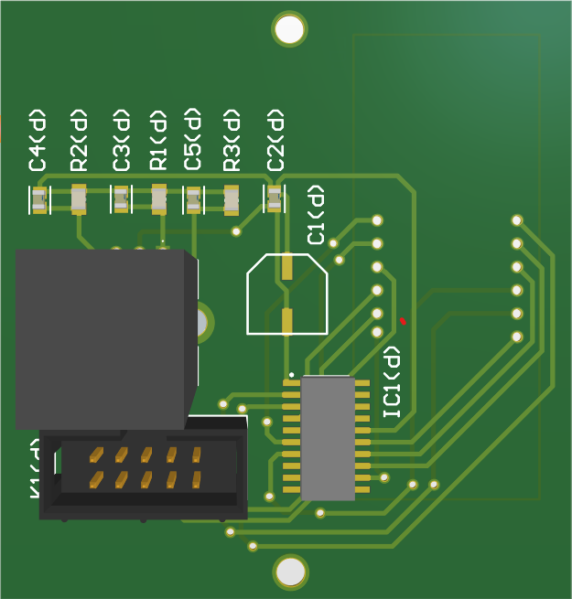
PCB design
2 PCBs
Main circuit PCB
Short circuit and MOSFET
Display PCB
Rotary encoder

Slide 8
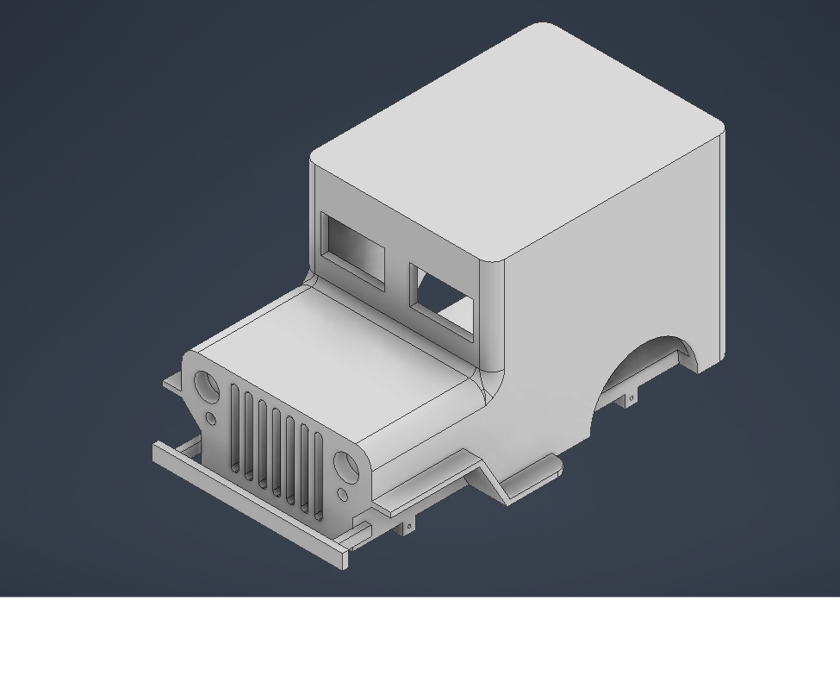
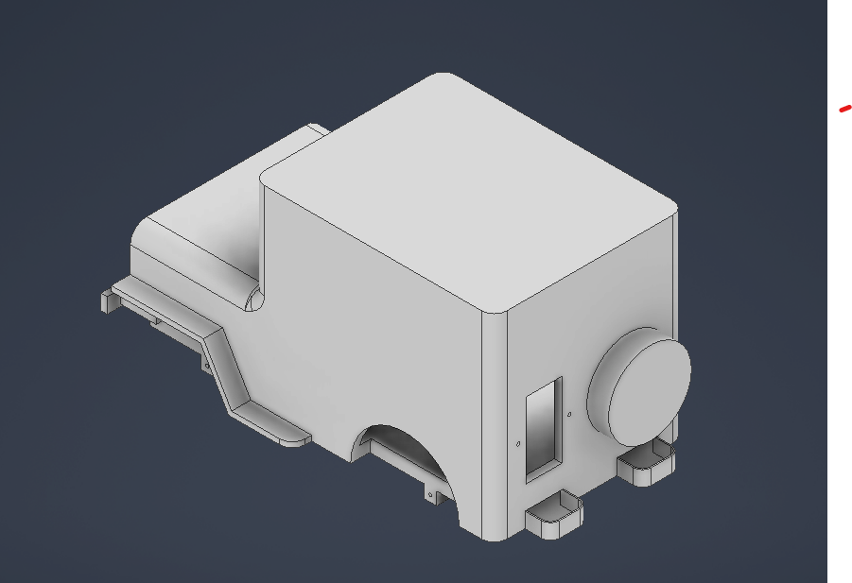
Mechanical design
Jeep-shaped case
Separate soldering iron holder
Not finished
Wheels
Hole for rotary encoder

Slide 9
Assembly
Different case
Functional?

Slide 10
Self-reflection
3D printing
Fuse
Too little knowledge

