Slide 1
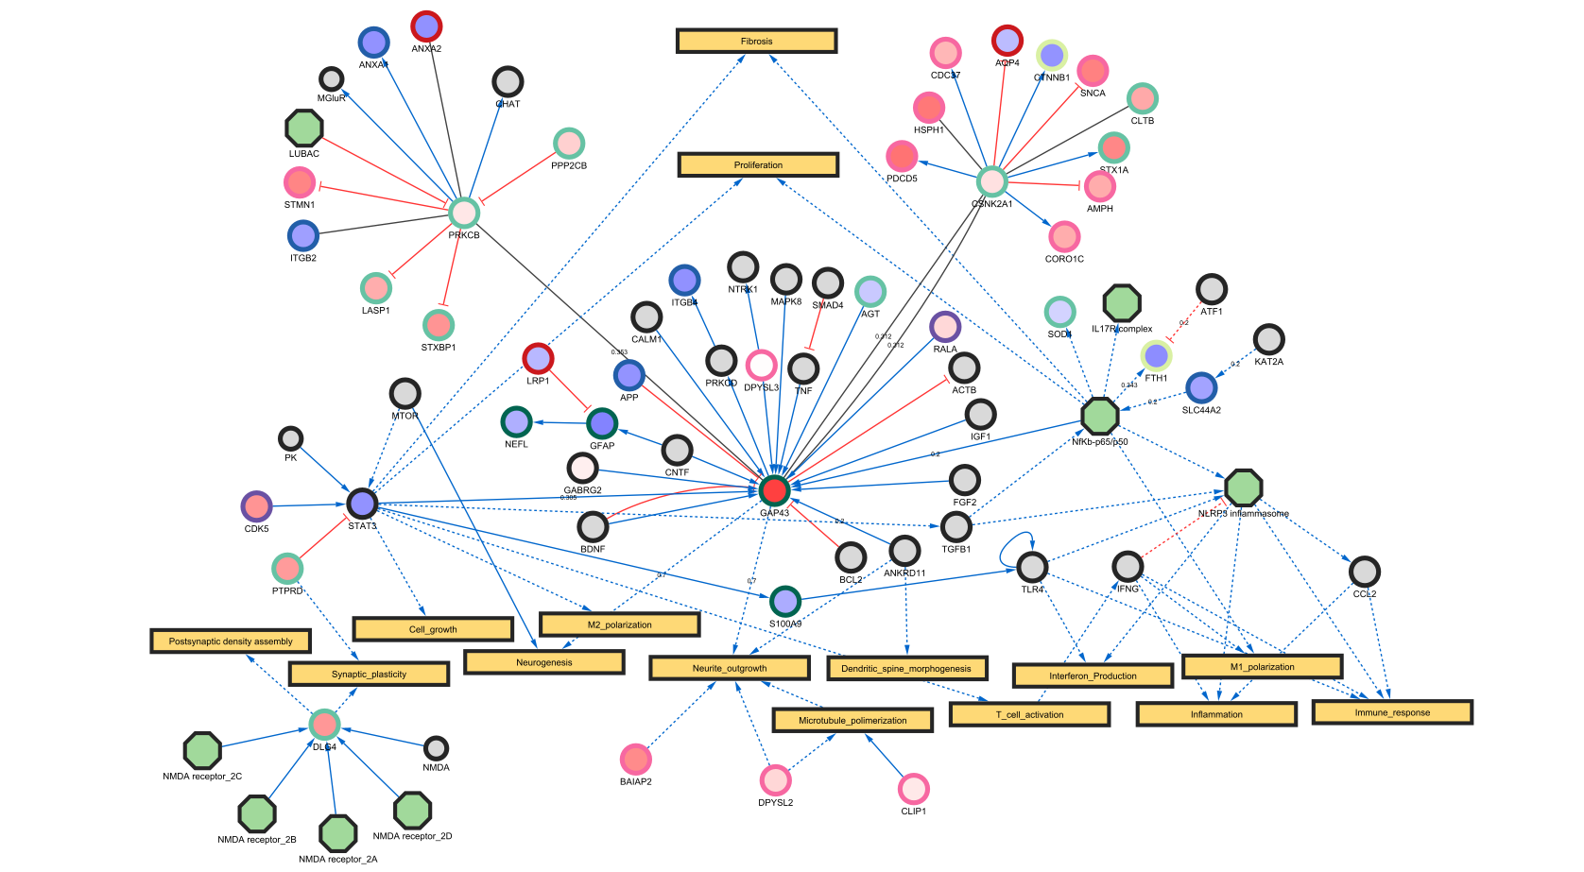
Réduire la taille de du network
Montrer les protéines correlé
Tenter une correlation avec l histologie
Protein | Rvalue | Pvalue
BASP1 | 0,8636 | 0,00000001
PACS1 | 0,823 | 0,00000001
SYN1 | 0,8183 | 0,00000001
RAB14 | 0,7904 | 0,00000001
CPLX2 | 0,782 | 0,00000001
MAPT | 0,7511 | 0,0001
SYT1 | 0,7507 | 0,0001
PPP5C | 0,7489 | 0,0001
MAP6 | 0,7455 | 0,0001
CD47 | 0,7445 | 0,0001
PAK3 | 0,7397 | 0,0001
EPHA4 | 0,7377 | 0,0001
RAB1A | 0,7363 | 0,0001
PDCD5 | 0,7348 | 0,0001
RHOB | 0,727 | 0,0002
LRRC57 | 0,7243 | 0,0002
HSPA4 | 0,7227 | 0,0002
DNAJC5 | 0,7209 | 0,0002
SGIP1 | 0,719 | 0,0002
Protein Complex
Phenotype
Positive Regulation
Negative Regulation
Binding
Top 20 BD-EV positive proteins
correlated with BD-EV GAP43 levels
Indirect interaction
Direct interaction
Phosphorylation
Mitochondria
Synaptic Vesicle
Cell signaling
Extracellular vesicle signaling
Endoplasmic reticulum
No specific module
Significant correlation with GAP43 (r)
GLTP | -0,8011 | 0,00000001
CRYAB | -0,7954 | 0,00000001
TPP1 | -0,7839 | 0,00000001
CPM | -0,7501 | 0,0001
CYB5R2 | -0,7443 | 0,0001
LAMP1 | -0,7406 | 0,0001
APOD | -0,7306 | 0,0002
FLNB | -0,7254 | 0,0002
RPN1 | -0,7193 | 0,0002
PLCD3 | -0,7129 | 0,0003
DDX3X | -0,7102 | 0,0003
PNP | -0,7086 | 0,0003
PTGDS | -0,7059 | 0,0003
VCL | -0,7034 | 0,0004
MOG | -0,6864 | 0,0006
MVP | -0,6856 | 0,0006
NUDT5 | -0,6801 | 0,0007
ITGA2 | -0,6721 | 0,0008
BCAS1 | -0,671 | 0,0009
HSPA2 | -0,6681 | 0,0009
- 1
- 0.5
0
+0.5
1
Top 20 BD-EV negative proteins
correlated with BD-EV GAP43 levels

