Slide 1
Clustering of samples indicates one outlier i.e. ribaq24, potentially a pick’s patient. But we processed with the outlier. Due to the outlier we have the scale for the topology model reaches a high signed R2, hence we have to use 16 as the scale for topology.

Slide 2
M4
M2
M1
M3
Trivalent inorganic cation transport
Endoplasmic reticulum
Mitochondrion
Microtubule
The clustering reveals 4 modules as represented in the figure. We should not consider the grey module as it is denoted for unassigned module genes, so we have to eliminate the grey module from the analysis.

Slide 3
Representation of eigengene values with the pathology. In the mitochondria module the PICK disease shows higher expression whereas for microtubule the expression is decreased in PICK as comapred to PSP.

Slide 4
The correlation of modules with the histological components shows that the Mitochondria module positively correlates with the Coverage% of AT100, that goes with our hypothesis.

Slide 5
Cell type enrichment of modules. Mitochondria module cross the threshold of –logFDR score for Astrocytes and Endothelial cells. Microtubule module correlates with the Neuron and oligodendrocytes. Cation transport barely crosses the threshold and correlates with the Neuron cells.

Slide 6
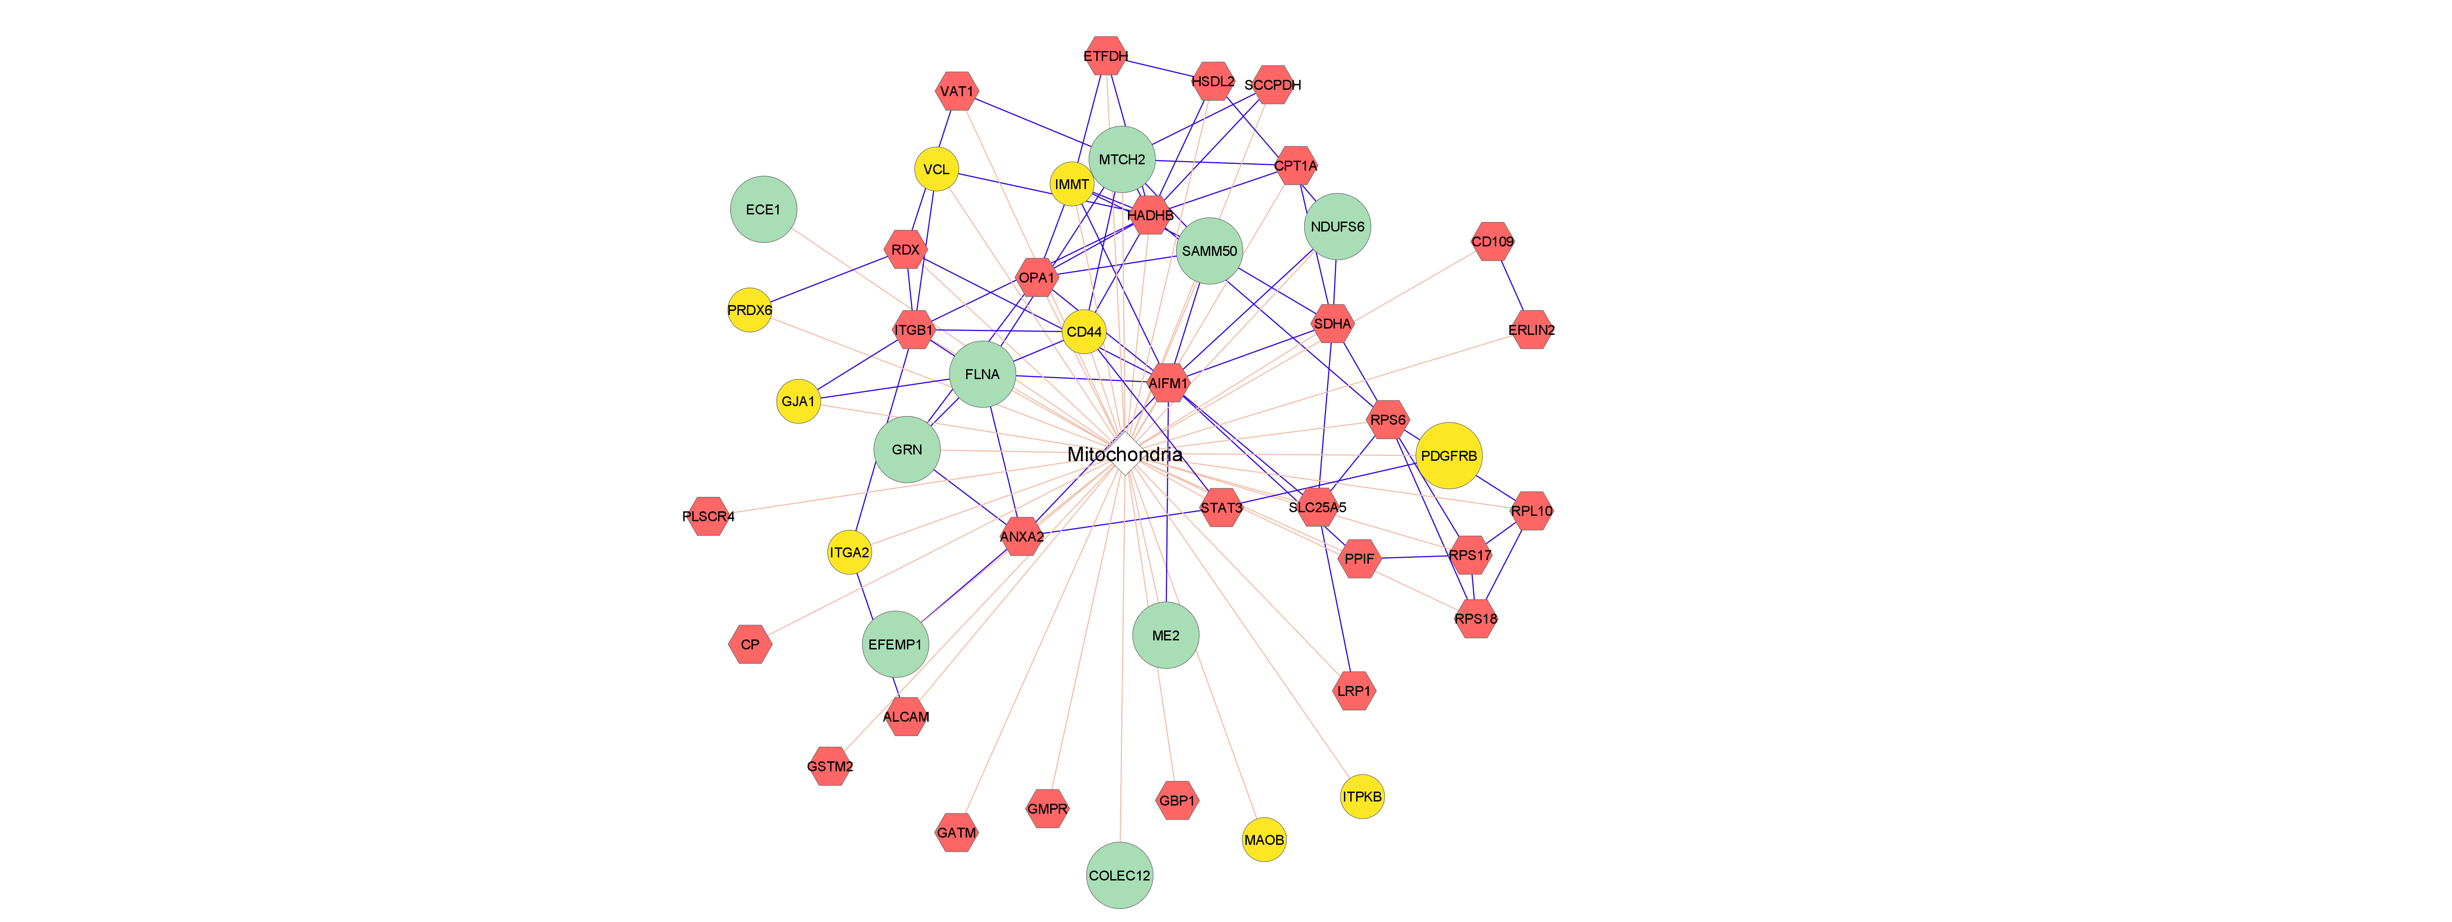
Mitochondrial hub genes. Here the big circle in green indicate the top 10 hub genes. The ones in the yellow indicates the astrocyte derived genes.

Slide 7
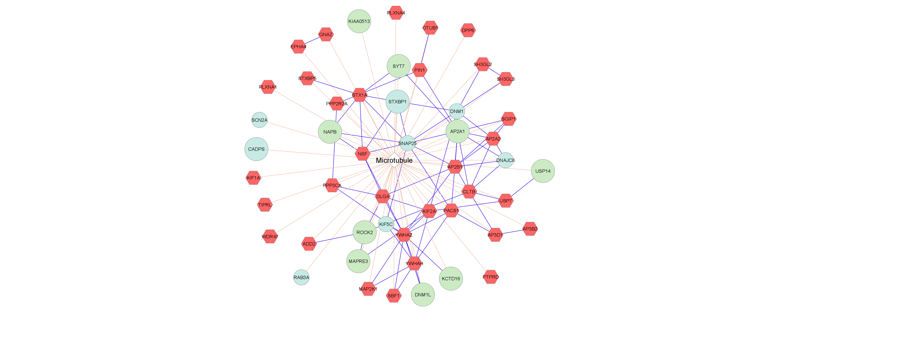
Microtubule hub genes. Here the big circle in green indicate the top 10 hub genes. The ones in the cyan indicates the neuronal derived genes.

Slide 8
Correlation of modules with mitotimer. Mitochondria module negatively correlates with the Ratio2-6h_D3 and the cation transport positively correlates with the Ratio2-6h_D2.

