Slide 1




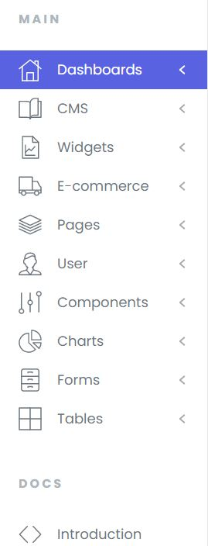


Highlights

Slide 2
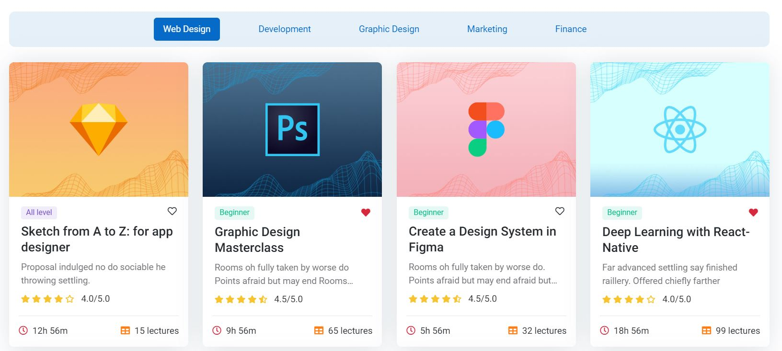
Most Popular Books

Slide 3
