Slide 1



Cholera and Water Safety:
An Analysis of Bordering Countries in West Africa and Southeast Asia
Images sourced from Wikipedia, 2018

Slide 2
RESEARCH QUESTIONS
Using two sets of bordering countries (Myanmar and Thailand in SE Asia, and Niger and Nigeria in West Africa) investigate:
Is there a correlation between Cholera rates between bordering countries?
Is there a correlation between water resources indicators and Cholera rates?

Slide 3
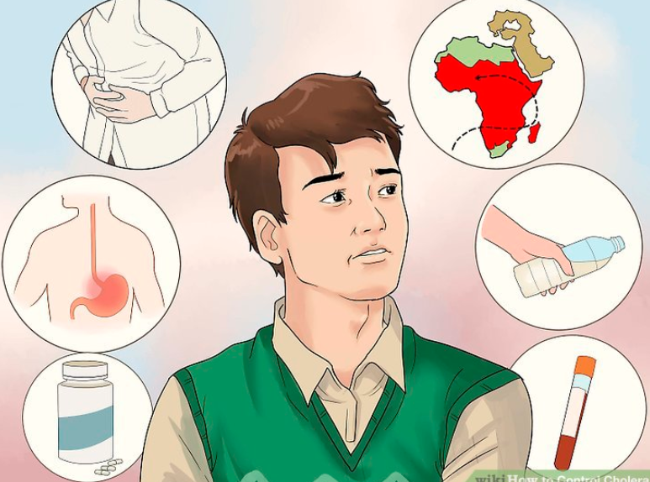
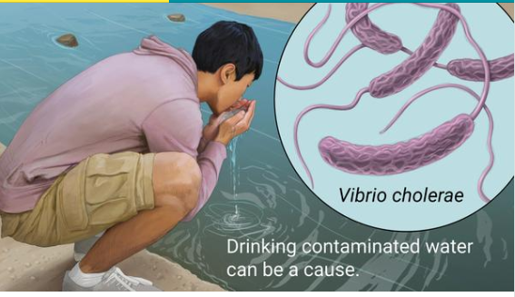
CHOLERA
A bacterial disease causing severe diarrhea and dehydration, usually spread in water.
Source: Google Images

Slide 4
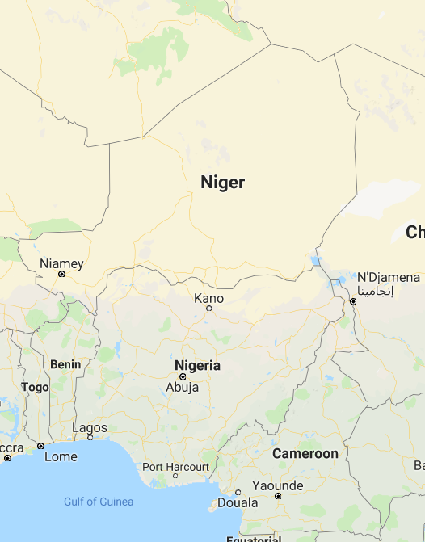
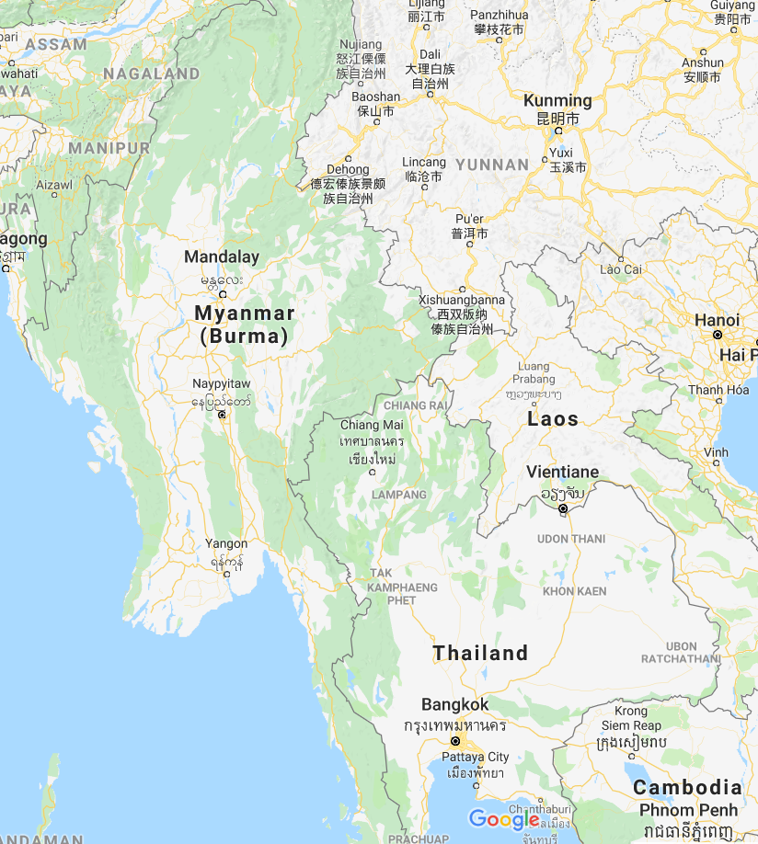
DEMOGRAPHICS
GDP: 405.1 billion USD
Pop: 20.6 million
GDP: 67.4 billion USD
Pop: 53 million
GDP: 7.5 billion USD
Pop: 186 million
GDP: 406.8 billion USD
Pop: 69 million
Demographics represent 2016 data.

Slide 5
METHODOLOGY
DATA RETRIEVAL PROCESS:
Pulled water safety indicators from the Food and Agricultural Organization of the United Nations (FAO)
Pulled Cholera data from the World Health Organization (WHO)
CSVs were used for storing initial raw data
DATA CLEANING:
Utilized pandas to clean, filter and merge data for generating tables
Matplotlib was used for visualizations
Excel initially used to perform regression analysis comparing four target countries to global data

Slide 6
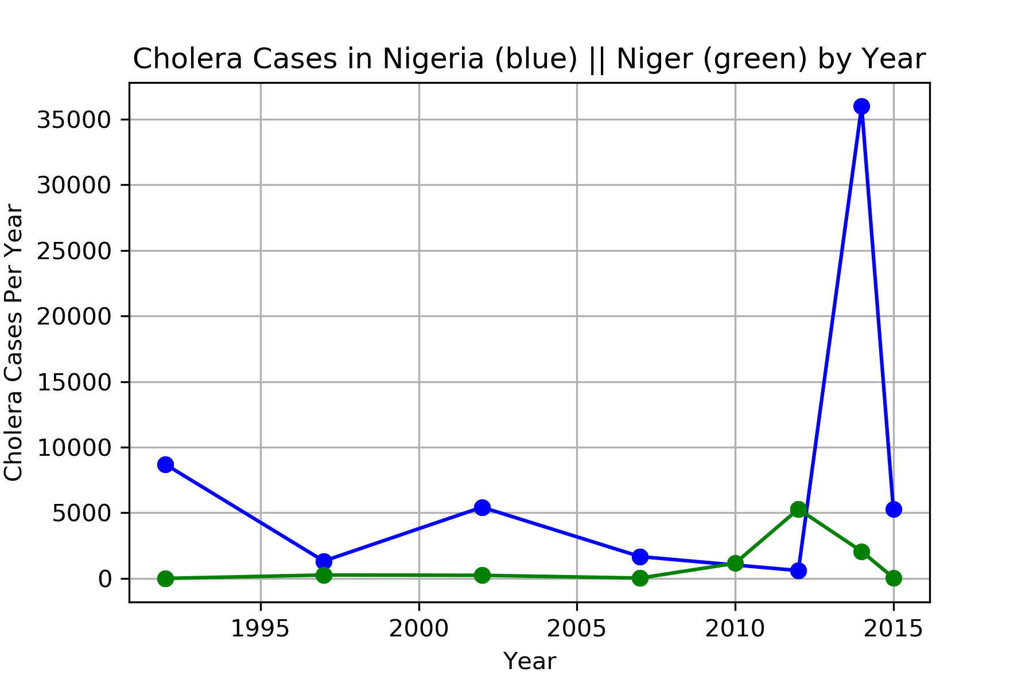
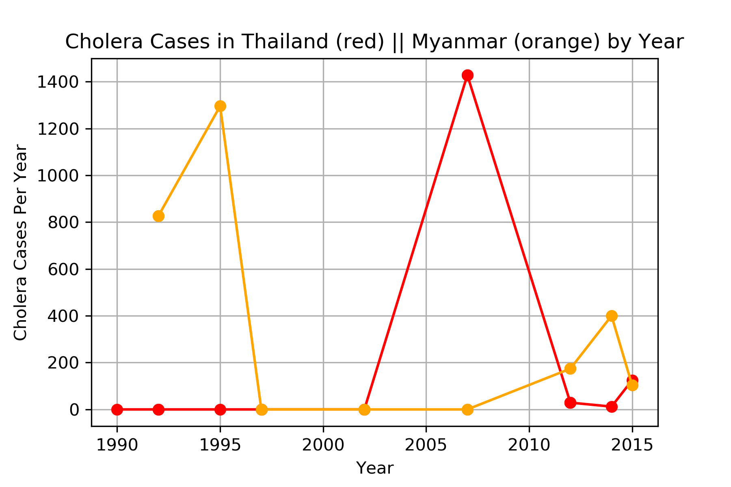
RESULTS – CHOLERA CASES
Note: 0 values are for years with no available data

Slide 7
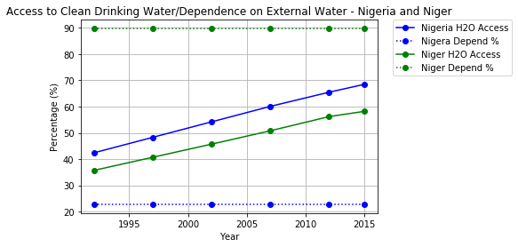
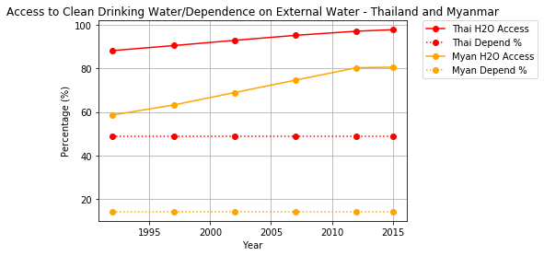
RESULTS – WATER RESOURCES
Access to clean drinking water / dependence on external water
Thailand/Myanmar
Nigeria/Niger

Slide 8
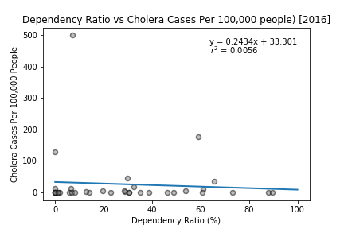
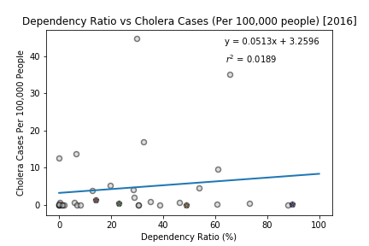
RESULTS – REGRESSION ANALYSIS
Note: Regression for 2016 data and all countries

Slide 9
CONCLUSIONS
Bordering countries show Cholera rates similar to each other and see similar peaks in number of cases, but not necessarily in the same year.
Access to clean water tends to increase for each country over time, while dependence on water remains constant throughout.
Rates of Cholera tend to be independent from water resource indicators (within each country).
In addition, other categories beyond water resource indicators could also be available to help understand potential correlations to Cholera incidence rates.

