Slide 1
Deep Learning for Business Final Group Project
AGOSSOU Ines – FRITSCH Solène – KOUYATE Inès – MAVUA Nandy – PARIS Emma – VINCENOT Amandine

Slide 2
Content
Data preparation
Model building & Training
Model evaluation
Results & Analysis

Slide 3
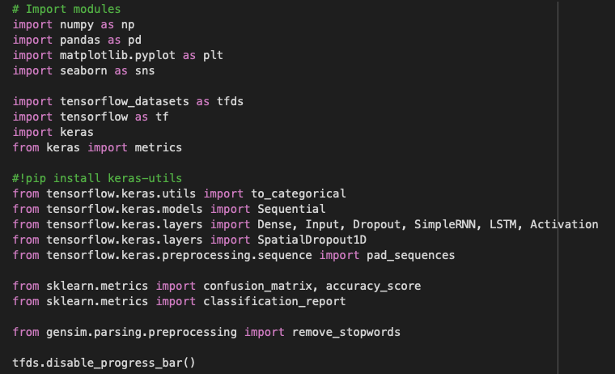
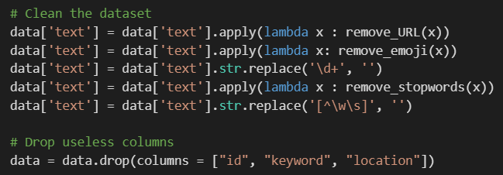
Data preparation
IMPORT
We started by importing the necessary modules as well as the dataset. There are 11370 rows and 5 variables : id, keyword, location, text and target, but we only kept text and target to create our text classification models since they contain the main information.
However, the dataset is very imbalanced, 81% of the tweets are not related to the dataset and only 19% are.
CLEAN
The next step was to clean the data. First, we created functions that helped us remove emojis, URLs, digits, foreign characters, stop words and punctuation. Since we are doing a text classification, these are not useful, nor welcomed. We also removed the useless variables as stated before: id, keyword, and location.

Slide 4
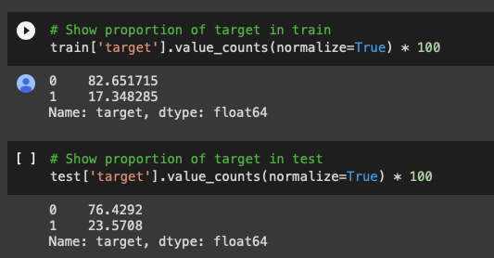
Model building & Training
CREATE THE TEST/TRAIN SETS
After cleaning the data, we created a train and a test sets using the 80/20 rule. We used the copy() function to create them in order not to alter the original dataset when making changes in them. Before starting building the model, we made sure to keep the same proportions of the target variable as in the original dataset i.e., 81% of 0 (not related to the disaster) and 19% of 1 (related to the disaster).
After that, we were able to start defining X and Y and start building the model. The outcome variable (Y) is target, and the explanatory variable (X) is text. We checked the number of tweets in both train and test set (which is respectively 9096 and 2274), and then split the tweets into words using the split() function.

Slide 5
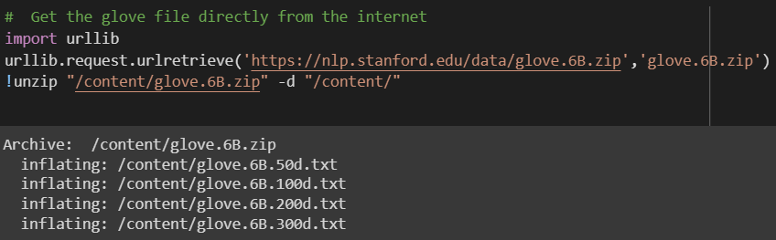
Model building & Training
CHOOSE A METHOD
The Global Vectors for Words Representation technique (GloVe word embeddings) has been used because when it comes to classify tweets, the most important thing is to succeed in capturing the semantic relationship between associated words. In fact, in the previous step, we split the tweets into words, but that is not enough to get the meaning of them.
Thus, we went to look for a file directly on the internet to get all GloVe embeddings, using the request.urlretrieve() function in the urllib package. The pre-trained word vectors we selected to train our model was finally the 50-dimensional GloVe of 400k words.

Slide 6

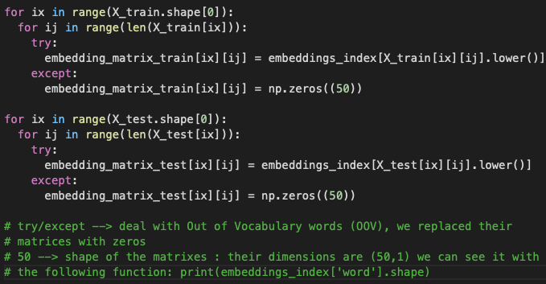
Model building & Training
CREATE AN EMBEDDING MATRIX FOR BOTH SETS
The creation of these embedding matrix required three steps:
Compute an index mapping words: We used the chosen GloVe (glove.6B.50d.txt) to map words that had known embeddings: that is to say, words existing in the GloVe that were also present in our tweets. For words found in the tweets that unfortunately had no corresponding in the GloVe, we tackled them in the 3rd step.
Pick a dimensionality of meaning: The dimension we had to pick was the 2nd one. We first tried with 10, then 30 but it seemed like these were not enough to fill the embedding matrix (3rd step). 35 is fine.
Fill the embedding matrix: For existing words in the GloVe, there were no problem since they have been indexed (step 1). For Out of Vocabulary words (OOV), however, we kept receiving error messages. Our solution to deal with them was replacing their index by zeros.
Check that all words has their corresponding embeddings: At the end, we checked the existing words, as well as the out of vocabulary words and it was working well.

Slide 7
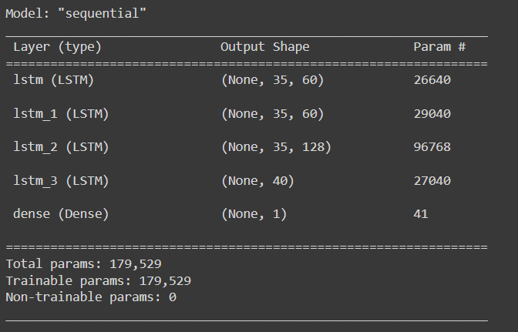
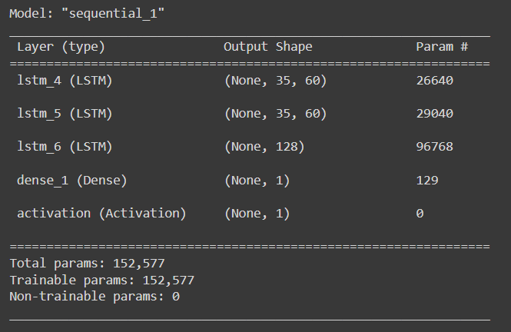
Model building & Training
MODEL 1
The first model is sequential and has 3 LSTM layers. We opted for the sigmoid activation function because the outcome variable (target) is binary. After compiling, we fitted the model against the embedding train matrix. We decided to train this model with 7 epochs at first, then gradually increased it to 20 noticing how the accuracy was skyrocketing until even reaching 97% of accuracy. This result may be due to the use of a recurrent dropout of 0.5 within the first layer.
MODEL 2
The second model is also sequential but has 2 LSTM layers. The main differences are the absence of the additional layer containing 40 neurons as well as the removal of the recurrent dropout. Another difference is that the sigmoid activation function was added outside the Dense. The results of the training were also good : 98% of accuracy and 9% of loss.

Slide 8
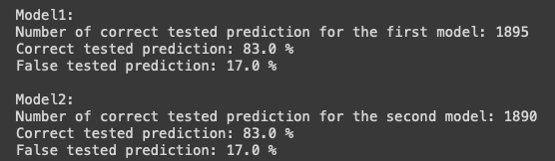
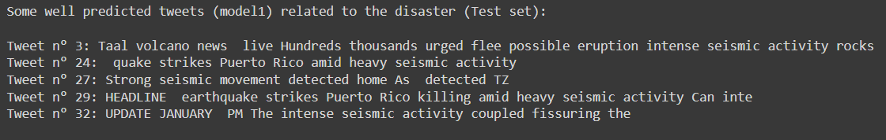
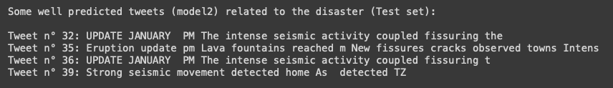
Model evaluation
After the training, we went onto the step of evaluation of the models. To do that, we compared the prediction results and the real tweets in the testing set. Our 1st model has 1895 correct tested prediction and the 2nd one has 1890.
Here are some examples of tweets related to the disaster that were well predicted by both models:

Slide 9
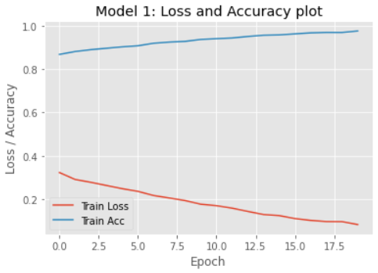
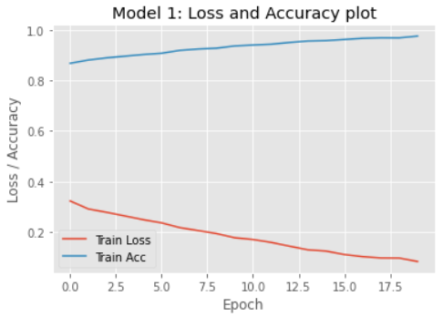
Model evaluation
As already noticed in the previous slide, we barely see the difference between the two models. It seems like they have the same accuracy, still, we will use other metrics (precision, recall, F1-score) to conclude and select the best one of them.
Model 1: Loss and Accuracy plot
Model 2: Loss and Accuracy plot

Slide 10
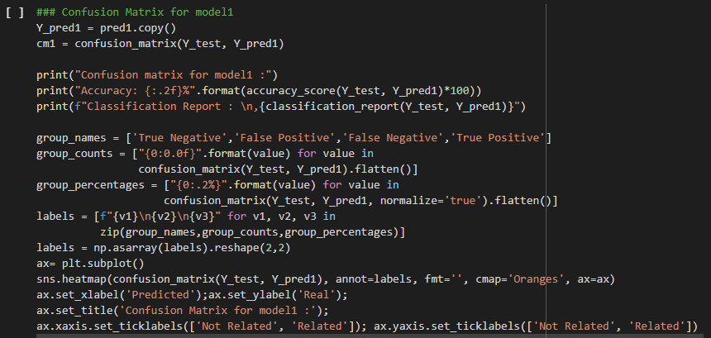
Model evaluation
In classification problems, the aim of the Confusion matrix is to measure the performance of a Machine Learning model by checking how often its predictions are accurate compared to reality. That is why we computed it and plotted it for both models.
We started by defining the Y and X axes, the titles, the data we wanted to have in each square (False Positive, False Negative, True Negative, True Positive) and then plotted the results.

Slide 11
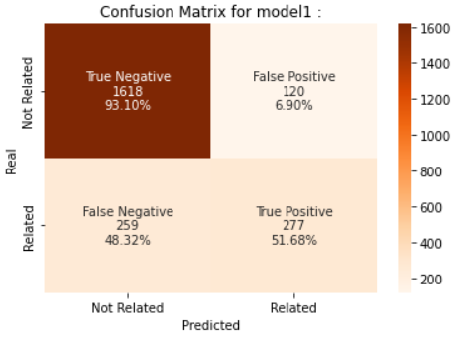
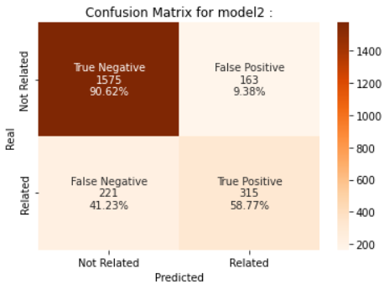
Results and Analysis
MODEL 1
Accuracy: Tweets correctly classified: 83.0%
Recall or sensitivity: Tweets predicted "related" that are truly "related" to the disaster: 52.0%
Specificity: Tweets predicted "not related" that are truly "not related" to the disaster: 93.0%
Precision: Tweets truly "related" to the disaster that were correctly predicted: 70.0%
Negative predicted value: Tweets truly "not related" that were correctly predicted: 86.0%
MODEL 2
Accuracy: Tweets correctly classified: 83.0%
Recall or sensitivity: Tweets predicted "related" that are truly "related" to the disaster: 59.0%
Specificity: Tweets predicted "not related" that are truly "not related" to the disaster: 91.0%
Precision: Tweets truly "related" to the disaster that were correctly predicted: 66.0%
Negative predicted value: Tweets truly "not related" that were correctly predicted: 88.0%

Slide 12
Results and Analysis
We have a good accuracy for both models but we must be careful about overfitting because the accuracy is 97% for train versus 83% for test. As our model was already great before we define hyperparameter, we cannot assure that the hyperparameter had an important impact on it.
Both our models seem strong, they recognize not related tweets (93%, 10%), and even False Positive are lower than 10% (9%, 6%), which is great, especially since we had an imbalanced dataset: 81% of the tweets are not related to the disaster (Cf Slide 1). It would be interesting having a train with a larger and balanced dataset… The objective would be a better train the models to identify disaster-related tweets (i.e. target = 1).
The weaknesses of our models are predicting disaster-related tweets → True Positive (52%, 59%)… This is quite negative since our goal was to recognize tweets related to the disaster… We really struggle to identify related tweets and make many errors → False Negative (48%, 41%), even when trying to improve our model… That means our predictions excluded a lot of tweets that were related to the disaster.
A good model must be both sensitive and specific. Model 2 seems here to be quite better.

