Slide 1

Neuroevolution in Games: State of the Art and Open Challenges
Yeoh Kai Wen
17149195/1 (WID170056)

Slide 2

Introduction
The use of artificial neural networks in neuroevolution (NE) field through evolutionary algorithms.
Simple idea is to train network with an evolutionary algorithm (stochastic, population-based search methods inspired by Darwinian evolution)

Slide 3

Neuroevolution
Basic algorithm where a population of genotypes that encode ANN is evolved to find a network to solve computational problem.
The fitness/performance is tested on specific task for a certain amount of time and it is recorded once fitness value is determined.
New population is generated by changing ANN-encoding (mutation) or combining multiple genotypes (cross-over).
Genotypes with higher fitness has higher chance of being selected.
Process is repeated to find better performing networks.

Slide 4

Role of Neuroevolution
Two roles in order to play or learn to control an NPC in a game :
To evaluate the value of states or actions
To directly select actions to take given state

Slide 5
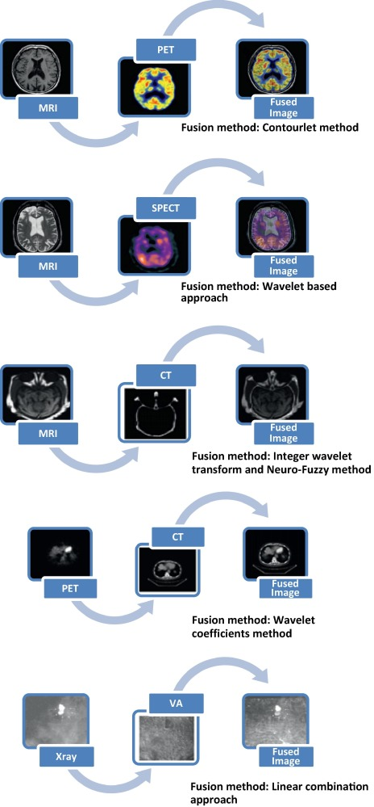
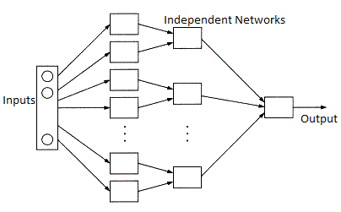
Neural Network Types
Feedforward
Recurrent (Long Short Term Memory –LSTM)
Feedforward Neural Network
Recurrent Neural Network
Modular Neural Network
Modular

Slide 6

Evolving Neural Networks
Earliest NE method only evolved weights of a network with fixed user-defined topology in simplest direct representation also called conventional neuroevolution (CNE).
Highly efficient but the drawback is that user has to choose appropriate topology and number of hidden nodes a priori.
NeuroEvolution of Augmenting Topologies (NEAT) shows the evolving topology together with connection weights outperforms approaches that evolve the weights alone and solve difficult non-Markovian control problems.
Increased its performance in strategic-decision making problems but the drawback is that part of the solution that are similar must be discovered separately by evolution.

Slide 7
Fitness Evaluation and Input Representation
Fitness Evaluation
Input Representation
Fitness function can typically not be “exploited” in the way composite fitness functions sometimes can.
However, if the problem is too complex it can be difficult to evolve the necessary behaviours directly.
It can be helpful to learn them incrementally (staging and/or incremental evolution)
Choosing the “right” representation.
Straight line sensors and pie slice sensors
Angle sensors and relative position sensors
Pathfinding sensors
Third-person input
Learning from raw sensory data

Slide 8
Open Challenges
There are some domains and problems where we have not yet reached satisfactory performance such as:
Reaching Record-Beating Performance
Comparing and Combining Evolution With Other Learning Methods
Learning From High-Dimensional/Raw Data
General Video Game Playing
Combining NE With Life-Long Learning
Competitive and Cooperative Coevolution
Fast and Reliable Methods for Commercial Games

Slide 9
Thank you

