Slide 1
CivicEcho - A03
Inês Alves, 107157
Diogo Rodrigues, 106147
Luca Dallalana, 106378

Slide 2
01
Secure Document Format

Slide 3
Secure Document Format
Hybrid encryption (AES-GCM + RSA)
Confidentiality and integrity by design
Authenticated metadata (AAD)
Anonymity preserved
{
"ciphered": "base64_encrypted_content",
"iv": "base64_initialization_vector",
"aad": {
"timestamp": "report_timestamp",
"location": "report_location",
“operation”: “CREATE/READ”,
“token”: “token + signature”
},
"key": "base64_rsa_encrypted_aes_key"
}

Slide 4
02
Built Infrastructure (Cybersecurity View)

Slide 5
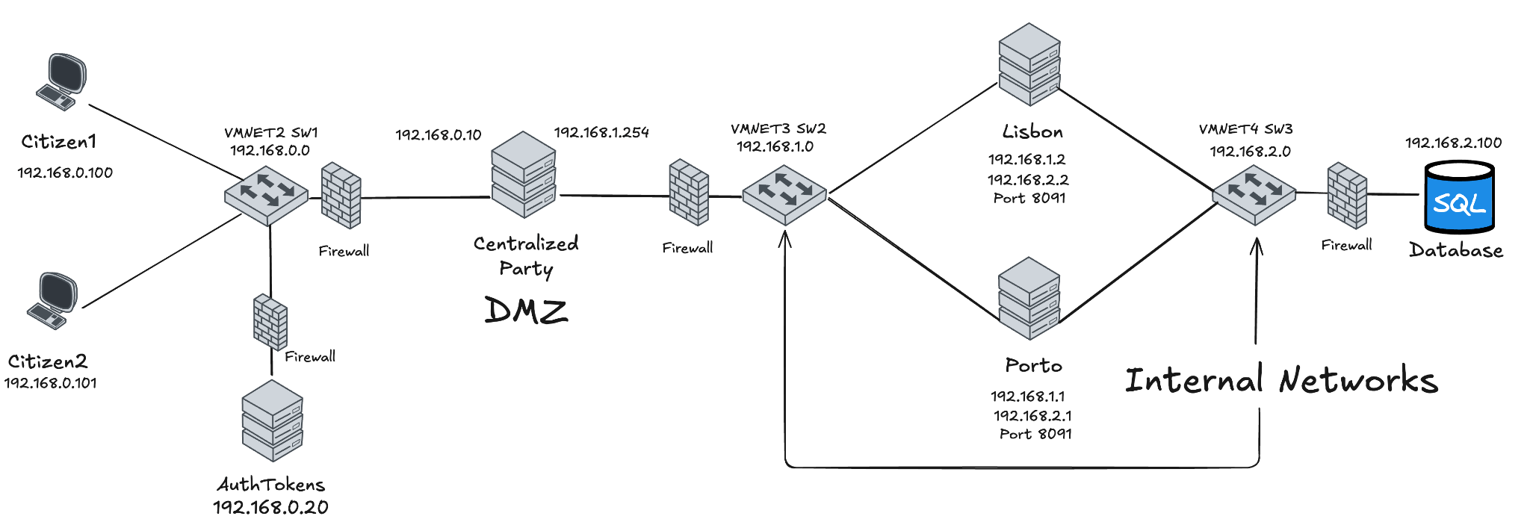
Built Infrastructure
Segmented network (3 subnets)
DMZ + internal isolation
Default-deny firewalls and protection against DoS attacks
Minimal database exposure

Slide 6
03
Secure Channels and
Key Distribution

Slide 7
Secure Channels and Key Distribution
TLS 1.3 everywhere
cipher suite - TLS_AES_128_GCM_SHA256
Certificate Authority rooted at Authentication Server
Mutual authentication, except in login process
Provides: confidentiality, authentication and non-repudiation

Slide 8
04
Security Challenge

Slide 9
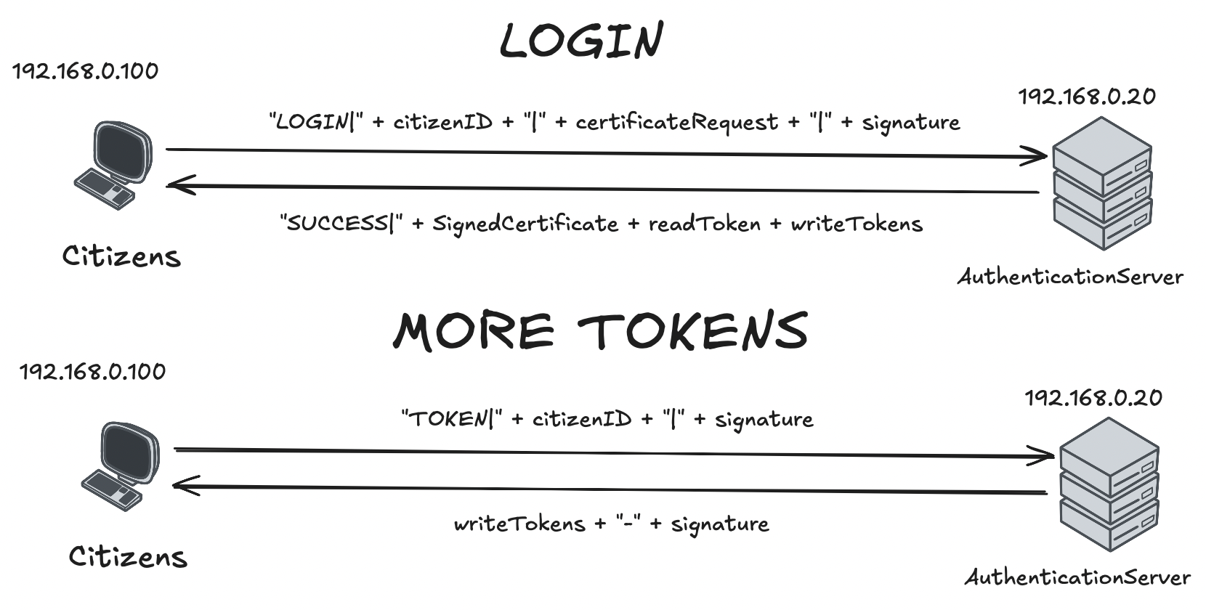
Security Challenge

Slide 10
Security Challenge
Write Token: random 256-bits, expiration time and citizen’s municipality. (Single-use)
Read Token: random 256-bits and citizen’s municipality. (Eternal)
Signed by Authentication Server
Verified by Centralized Party
Replay and spam prevention
Location-bound authorization

Slide 11
05
Main Results and Security Guarantees

Slide 12
Main Results and Security Guarantees
Confidentiality end-to-end
Strong anonymity
Integrity and non-repudiation
Attacker model validated
Future work - misinformation detection

