Slide 1
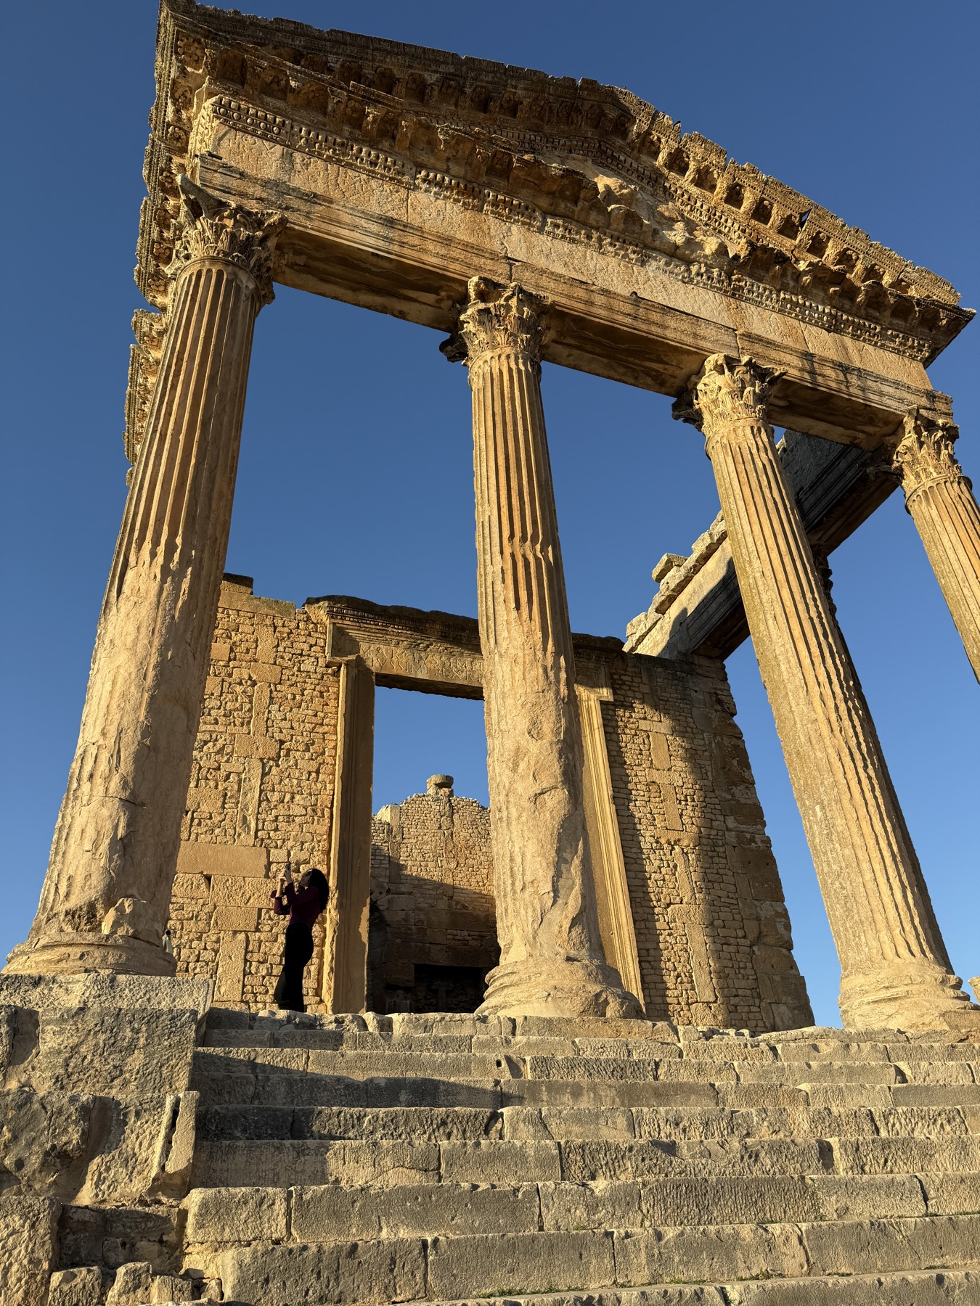
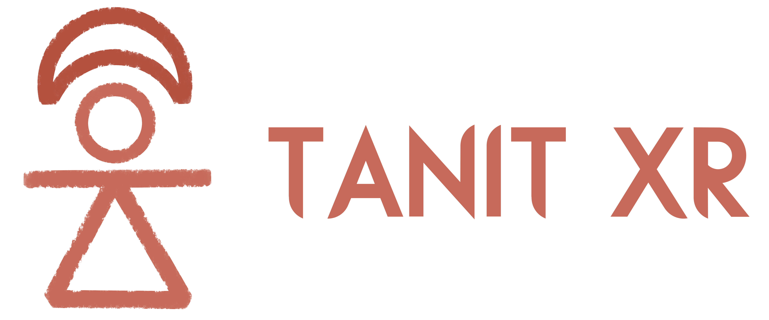
PARTNERSHIP OPPORTUNITIES
Keep a country's memory, with your name on it
Tanit XR is a volunteer community on four continents that 3D-scans Tunisia's endangered heritage with phones and publishes it free, in 3D, AR and VR.
tanitxr.org
Notes:
Open with the four-minute guided visit at tanitxr.org/explore?tour=1 before this deck.

Slide 2
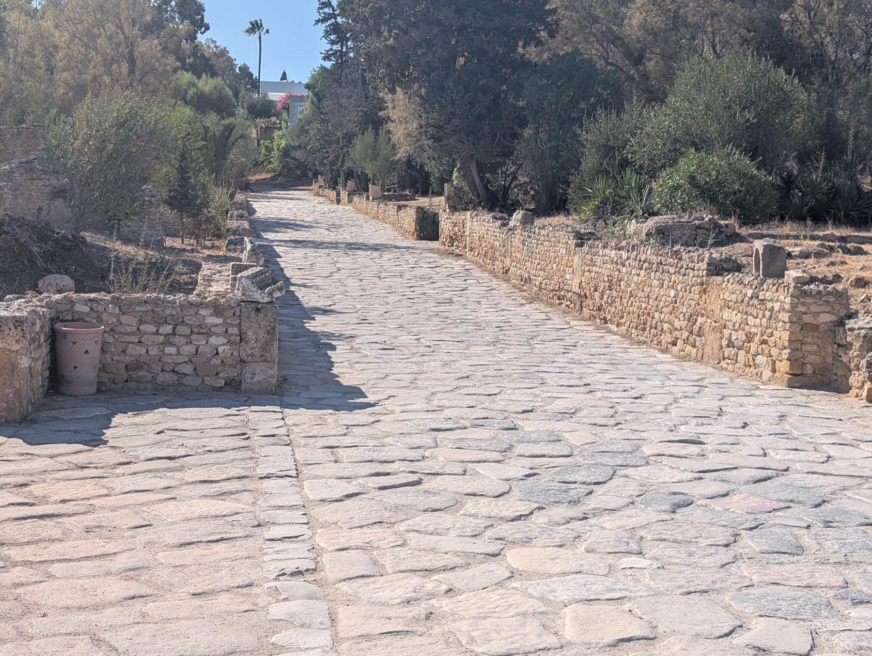
THE PROBLEM
Heritage in the open air, with no record
Storms, erosion, heat and neglect wear down Punic stelae, Roman mosaics and medina doors faster than institutions can document them.
In January 2026 a storm uncovered part of Neapolis for a few days. There was no 3D record to compare against. A volunteer scanned it before the sea came back.
The tools exist, but sit with a few expert teams. The people who live beside these places have had no way to take part, or to see their heritage where young people spend their time.
tanitxr.org

Slide 3





WHAT WE DO
From a phone in Carthage to a headset anywhere
Scan
Clean
Research
Publish
Share
Volunteers in Tunisia walk around an object with a free app. A stone takes minutes.
Volunteers anywhere turn the raw scan into an archival record and a light web-ready twin.
The history behind each object is written up, in three languages, and credited.
Everything goes into the open archive and Explore in 3D, free, on any phone or headset.
Visitors turn objects, meet our guide Nura, save and share them. Every share keeps a piece seen.
Around the software is a community: 85+ volunteers on four continents who meet every Thursday, learn Tunisian history together and build pieces for a virtual museum.
tanitxr.org

Slide 4
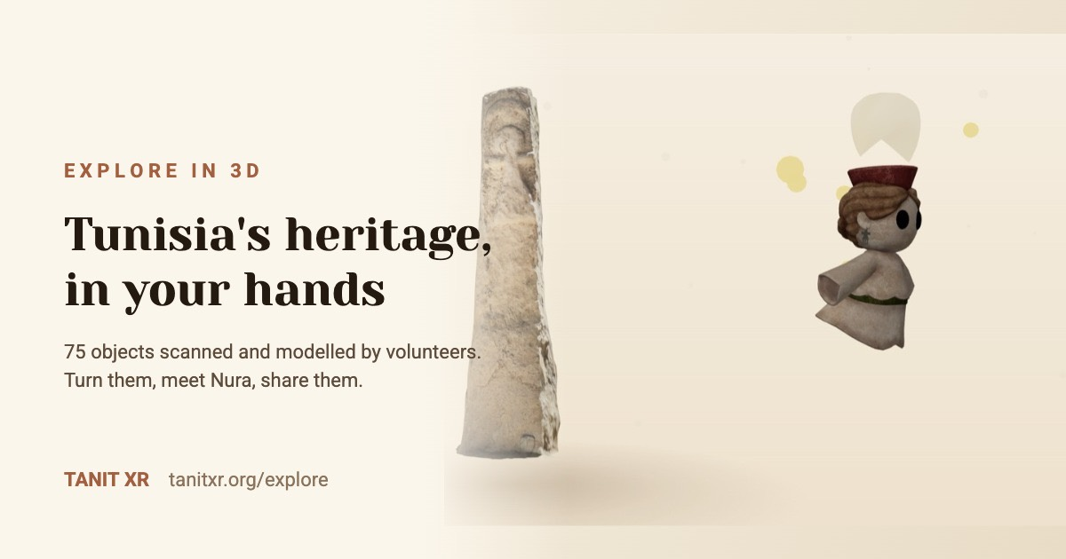
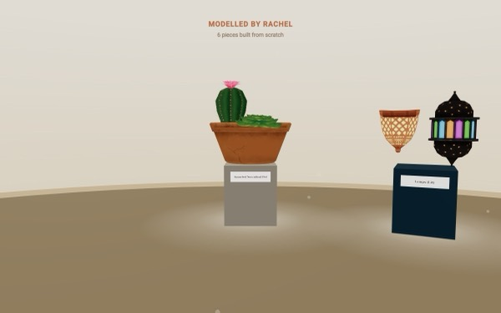
SEE IT NOW
Open this on your phone
tanitxr.org/explore
Turn a two-thousand-year-old stone with your finger. Tap Nura and she tells you its story. Step into a volunteer's gallery. Put on a Quest headset and stand beside it at real size.
Add ?tour=1 for a four-minute guided visit.
tanitxr.org

Slide 5
WHERE WE ARE, SEPTEMBER 2026
Built by volunteers, before the first grant
99
8
85+
75
20+
3
public 3D scans
Tunisian sites
volunteers, 4 continents
objects live in 3D
course graduates
languages, all free
Recognition
Auggie Awards 2026 finalist, Best Societal Impact (AWE USA)
Al Jazeera culture feature; Voices of VR episode 1728; Niantic Spatial video interview
Paper at the El Jem conference in English, French and Tunisian Arabic
Sponsored hackathon tracks at Georgia Tech (ImmerseGT) and CityCamp Gainesville
The model is being replicated in Nigeria by the Unique Mappers Network
tanitxr.org

Slide 6
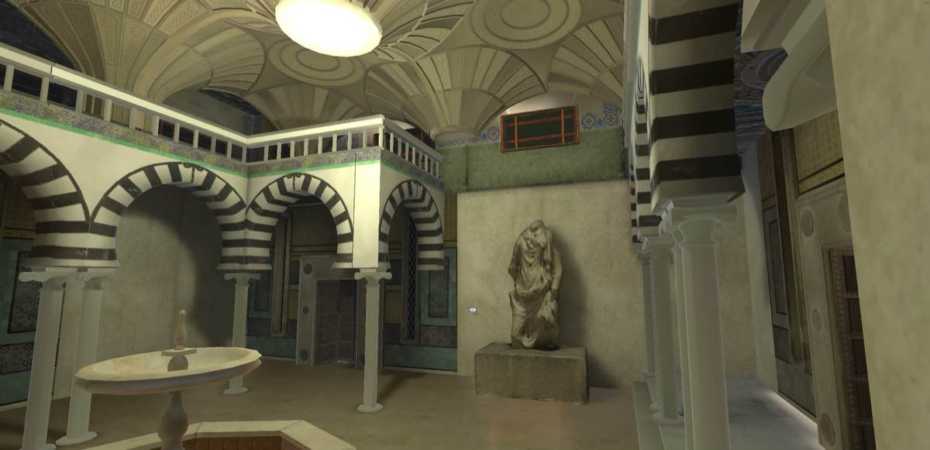
MORE THAN AN ARCHIVE
A cultural exchange that builds a museum
Every Thursday, volunteers in Tunis, Florida, Europe and Lagos review new scans and learn the history behind them. People who have never been to Tunisia model lamps, pottery and courtyards for the virtual museum, and the Tunisian volunteers learn about their countries in return.
Students get portfolio reviews, mock interviews and mentors. Every contribution is credited by name, on the site and on every object.
Tunisia is the pilot. Nigeria is the first proof that the model travels.
The virtual museum, modelled by volunteers, in progress

Slide 7



WHY PARTNER
What this does for your company
Employees who learn something real
A story your communications team can use
Skills-based volunteering: your team learns 3D capture on a phone and publishes actual heritage under their names. People talk about it afterwards.
A storm, a rescue, a volunteer, a stone: pictures and stories we take ourselves, with your part in them told plainly.
Presence in Tunisia and North Africa
Innovation your audience can touch
A visible, respected role in a country's heritage, alongside a Tunisian-led team, at a fraction of a campaign's cost.
Phones, 3D, AR and headsets in the service of memory. A live demo at your event that nobody expects at a tech gathering.
tanitxr.org

Slide 8





WAYS TO PARTNER
Pick one, or shape one with us
Your team learns to scan
Adopt a site or a gallery
Bring a room to your event
A half day or a six-week course, online or on site. Your employees publish a real piece of heritage under their names.
Fund the scanning of one site, or one gallery in the virtual museum, and it carries your name in 3D and in the headset.
The 3D experience and a headset at your conference or office, with a volunteer to guide people through it.
A talk or a workshop
Sponsor a hackathon track
Fund a scanning season
Our founder and team speak on phone photogrammetry, community XR and heritage at risk: AWE, Voices of VR, Georgia Tech, El Jem.
Real scans as the material. You set the challenge, meet the students, see what they build in a weekend.
Bus fares, data, backups and a modest fee for local volunteers, with sites, counts and stories reported monthly.
tanitxr.org

Slide 9
WHAT YOU GET BACK
Impact you can point at
Every object your support made possible is public, in 3D, with your name beside it.
Numbers, monthly: visits, objects viewed, people trained, sites documented, from the same counter we use ourselves.
Stories and pictures for your communications team, told plainly, with your part in them.
Your logo on the site, in the experience and at our events, and a mention in every newsletter edition.
Employees who learned something real and can show their families what they helped keep.
A tax-deductible gift through our fiscal sponsor, Florida Community Innovation, a U.S. 501(c)(3).
One promise, whatever the partnership
The archive stays free and open, and our volunteers are never made to work so that someone else earns. We sell training, events and our time. Never the heritage.
tanitxr.org

Slide 10
PARTNERSHIP LEVELS
A first step, and a way to grow
Scanning day
Adopt a site
Sponsor a track
Founding partner
Title sponsor
$2,500
$10,000
$25,000
$100,000
$300,000
One volunteer's season of site visits: transport, data, backups.
Every object from one site, scanned, researched, published.
A year of one volunteer track, or a full course cohort of 20.
A custom year-round volunteer programme for your team on one track.
All four tracks, the virtual museum, and core team capacity.
Named on the objects scanned that season
Your name on the site's gallery
Featured in materials, quarterly reports
Lead recognition, quarterly reports
Title sponsor of the museum, monthly reports
Every level includes credit on the site and in the 3D experience, monthly numbers, and a tax receipt through our fiscal sponsor.
tanitxr.org
Notes:
Amounts are proposals for the team to confirm before this deck is sent.

Slide 11
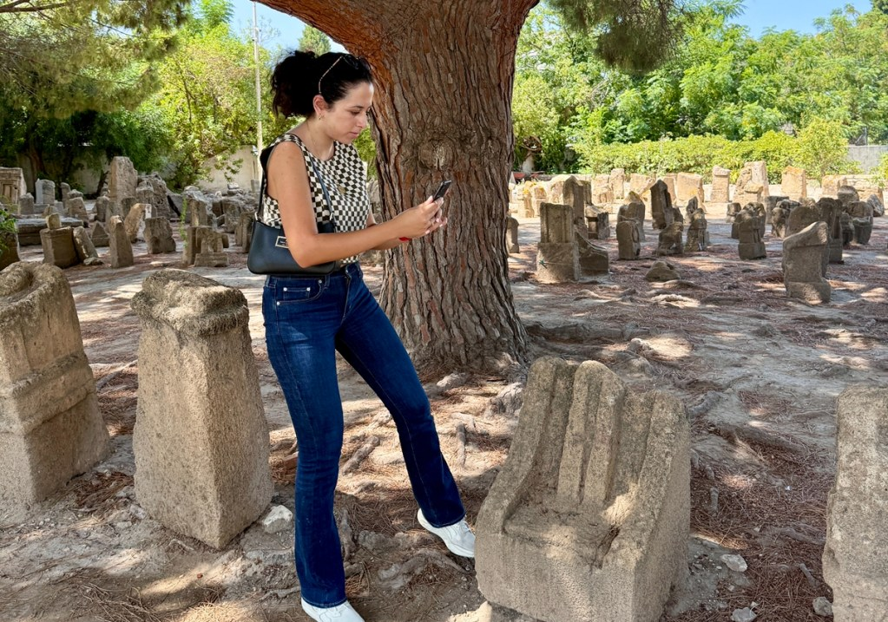
THE PEOPLE
Local roots, global reach
Julia Moreno-Molen
Melek Said
Project Manager
Regional Manager, Tunisia
Dr. Laura Harrison
Dr. Caroline Nickerson
Chief Scientist, archaeology
Partnerships and Community
Margarita Johnson
Fatma Slama
Ines Said, Founder
Research and Writing
Community Liaison, Tunisia
Tunisian XR developer who grew up beside the ruins of Carthage. Smithsonian installations, IEEE best paper, AWE 2026 speaker, Auggie Awards finalist.
And 85+ volunteers: 3D artists, Unity developers, researchers, writers, teachers, in Tunisia, the United States, Europe and Nigeria.
tanitxr.org

Slide 12
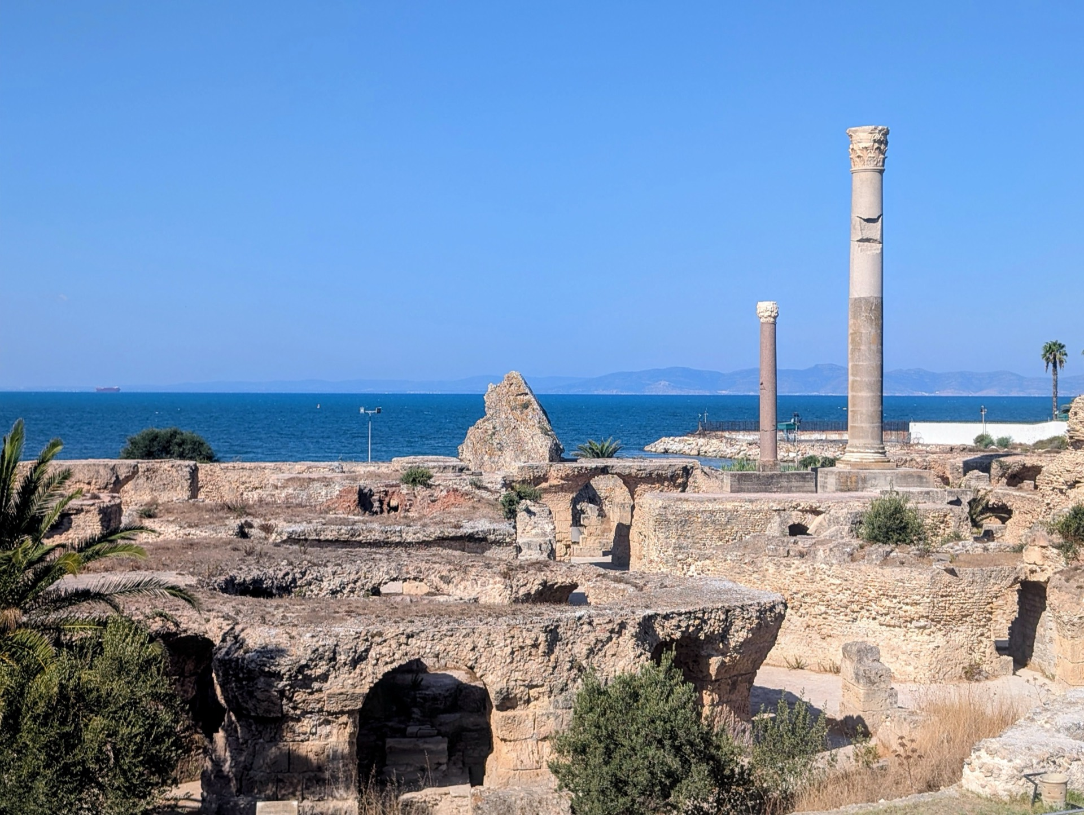
START THE CONVERSATION
Fifteen minutes is enough to see if this fits
Tell us about your team and what matters to you. We come back with two or three ways to work together, with real numbers.
info@tanitxr.org
tanitxr.org/partners · tanitxr.org/explore?tour=1
Tanit XR is fiscally sponsored by Florida Community Innovation, a U.S. 501(c)(3). Gifts are tax-deductible.

