Slide 1

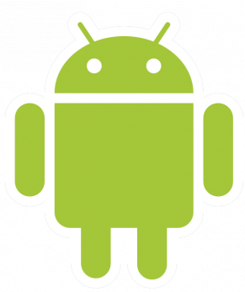
Android Application
Rémi FONTAN
Guillaume FELTRIN
Ines DOBOSZ

Slide 2
Summary
Summary of the project
Description
Goal
User case
  Patient
  Doctor
Requirements
WBS
RACI
Calendar
General architecture
Validation plan
What remains to be done
Expected deliverable

Slide 3

Summary of the project
Whole project regroups 8 parts.
Subject : Medical Desertification Fight
Two Android Application (Kotlin)
Allows patient and doctor to connect to the application
Diagnosis is provided
Optimize the doctor’s journey

Slide 4
Description
The patient fills a form to have a diagnostic
Can be used by disabled person
Both normal case and emergency
Registers user behaviour
Provides a diagnosis
Notes:
Main fonctionality : Form to receive diagnosis

Slide 5
Goal
→ Build a project collaborating with 7 other groups
Analyze patient information to determine the illness / disease
Diagnosis close to the reality
Launch a phone call if it serious
Assign an appointment between client & doctor
→ Follow the user’s health

Slide 6
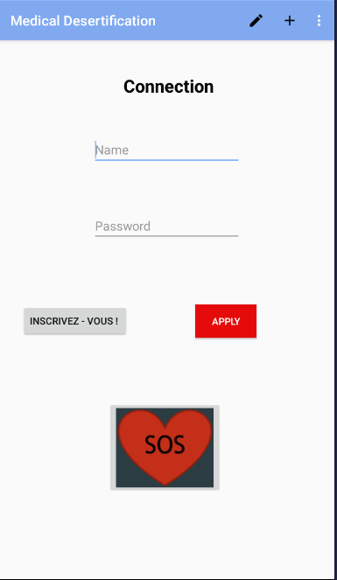

User case (Patient)
Connection
Can see the map
Can fill a form
Access History
SOS
SOS Clicked
Emergency Case
Calls a doctor
Sick person

Slide 7
User case (Patient)
Launch the application
Register or login
Choose to do a diagnosis
Print a pre-diagnosis
Send an appointment with the doctor
In case of emergency : alert the nearest doctor and start phone call

Slide 8
User case (Doctor)
Connection
Access the map
Can care an emergency
Map
Shows the journey / schedule
Displays patients and details
Doctor
SOS
Notes:
No Registration for doctor, we can imagine a customer service which verify the veracity of the informations to Sign Up the doctor

Slide 9
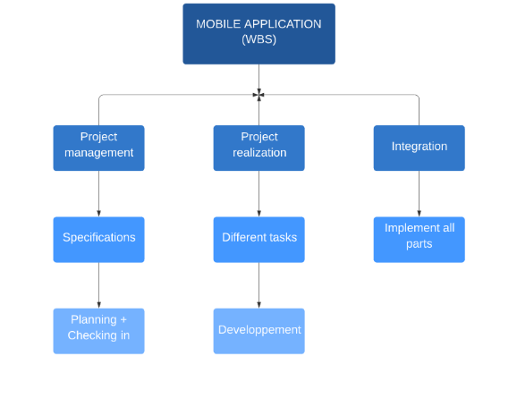
WBS

Slide 10
RACI
 | FELTRIN | FONTAN | DOBOSZ
Authentification | R | I | C
Registration | C | I | R
Form | R | C | I
Map Display | I | R | I
Graphic Part | A | A | R
Schedule | A | R | C

Slide 11
Calendar
First semester
September | October | November | December | January
Documentation | Documentation | Learning Android | Learning Android and development of applications | Integration
Second semester
February | March | April | May
Development | Development | Development | Integration

Slide 12
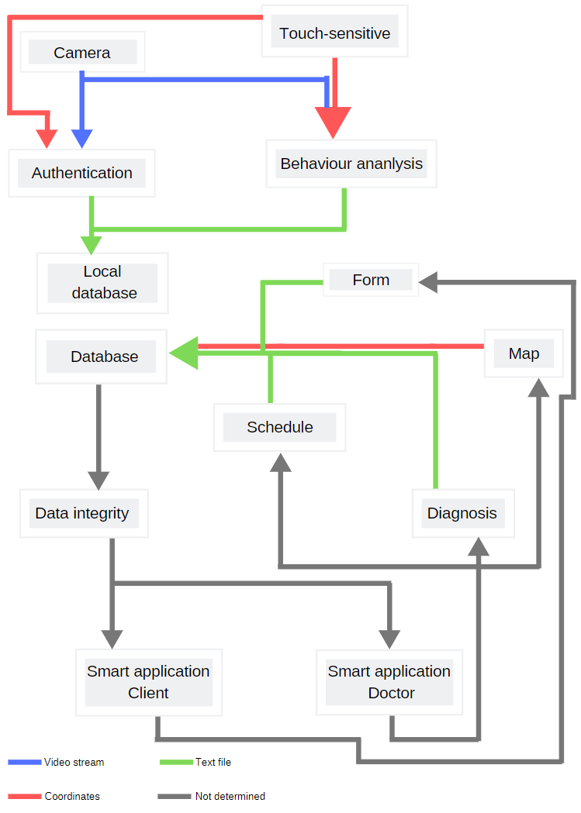
General architecture
12

Slide 13
Requirements
PATIENT
Create new account
Log in : with login, password / with facial recognization
Analyze patient behaviour
Make an appointment
Have a medical advice based on user symptoms
Call a doctor
Close application if authentication failed
COMMON
Edit profile
List existing appointments
User can disconnect
DOCTOR
Log in : with login, password
List and display all doctor’s appointments
Notes:
New account as patient -> all requirements
Medicale advice -> by access form
Analyze with camera & tracking finger position
Edit profile -> edit and add info not requested in registration / complete profile
Call a doctor -> click a button
Make an appointment
List existing appointments -> GPS API

Slide 14
Validation plan
Test interface for each element that we had in our application
  Manual input using User Interface
  API emulation of WebServices
  Register data in local files
  Check the data content
  Equipment : Android Studio 3.6 / ANDROID 10 / emulator BlusStacks /
  screen size : 1280 x 720
All failed test cases will be registered as a defect in a file.
Notes:
Test interface for each element that we had in our application
Manual input using User Interface
API emulation of WebServices → simulate Web Service Behaviour and the result // for exemple → login, local DB
Check data content → in phone files or software output
Create new account
Connection and registration interfaces
The menu
Changing a patient's profile
The symptom form
Card design and information retrieval
Metric data recovery at the touch of a finger to behavior analysis
The design of the schedule
The design of patient sheets

Slide 15
Deliverable
2 Android Application
PATIENT
Create new account → 100%
Log in : with login, password / with facial recognization → 100% / 0%
Analyze patient behavior → 50%
Make an appointment →
Have a medical advice based on user symptoms → 75%
Call a doctor → 75%
Close application if authentication failed → 100%
COMMON
Edit profile → 100%
List existing appointments → 75%
User can disconnect →100%
DOCTOR
Log in
List and display all doctor’s appointments
Notes:
Global Integration with other groups → Local DB to authenticate
Livré, in progress, to be developped, integrated in the app, fully tested
Test à repasser

Slide 16
What remains to be done
Specifications of API Rest
Communication interfaces between the database and the two applications
Map Integration for Doctor application
Global Integration, with other groups
Integration Test and validation
Indeed, 70 percent of the project has been completed
Notes:
Go further : Remind a future appointment
Link to connected object : watch for the pulse ..

Slide 17
Thank you for listening

