Slide 1


Big Data Technical Project
Android Application
Inès Dobosz / Guillaume Feltrin / Rémi Fontan
2019/2020

Slide 2

Summary
I) Summary of the project
II) Description
III) Goal
IV) User cases
Patient
Doctor
V) Requirements
VI) WBS
VII) RACI
VIII)Calendar
IX) General architecture
X) Validation plan
XI) Deliverable
XII) What remains
XIII) Demonstration
XIV) Conclusion

Slide 3

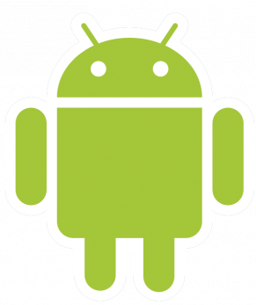
I) Summary of the project
The whole project regroups 8 parts.
Subject : Fighting against Medical Desertification
Two Android application (Kotlin)
Allows patient and doctor to connect to the application
Diagnosis is provided
Optimize the doctor’s journey

Slide 4
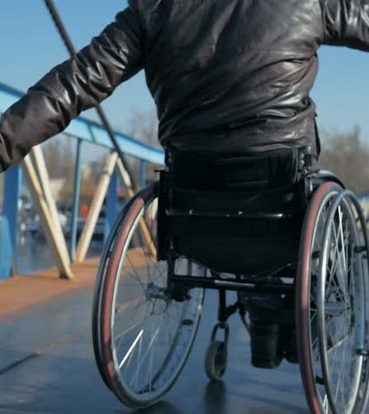
II) Description
The patient fills a form to have a diagnosis
Can be used by disabled person
Both normal case and emergency
Registers user behaviour
Provides a diagnosis

Slide 5
III) Goal
→ Build a project collabortaing with 7 other groups
Analyze patient information to determine the disease
Diagnosis close to the reality
Launch phone call if it is serious
Assign an appointment between client & doctor
→ Follow the user’s health

Slide 6
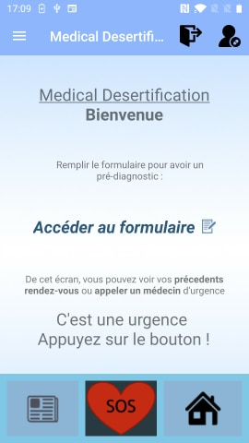
IV) User cases
Patient case
Connection :
Can see the map
Can fill a form
Access history
SOS clicked :
Emergency case
Does phone call

Slide 7
IV) User cases
Patient case
Launch the application
Register or login
Choose to do a diagnosis
Print a pre-diagnosis
Send an appointement with the doctor
In case of emergency : alert the nearest doctor and strat filming a video

Slide 8

IV) User cases
Doctor case
Connection :
Access the map
Can care an emergency
Map :
Shows the journey / schedule
Display patients and details
SOS
Doctor

Slide 9
V) Requirements
PATIENT
Create new account
Log in : with login, password / with facial recognition
Analyze patient behaviour
Make an appointment
Have a medical advice based on user symptoms
Call a doctor
Close application if authentication failed
COMMON
Edit profile
List existing appointments
User can disconnect
DOCTOR
Log in : with login, password
List and display all doctor’s appointments
Map displays the itinerary

Slide 10
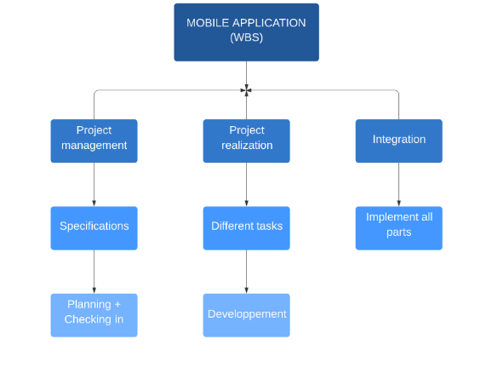
VI) WBS

Slide 11
VII) RACI
 | FELTRIN | FONTAN | DOBOSZ
Authentication | R | I | C
Registration | C | I | R
Form | R | C | I
Map Display | I | R | I
Graphic Part | A | A | R
Schedule | A | R | C

Slide 12
VIII) Calendar
First semester
September | October | November | December | January
Documentation | Documentation | Learning Android | Learning Android and development of applications | First integration
Second semester
February | March | April | May
Development | Development | Development | Development and second integration

Slide 13
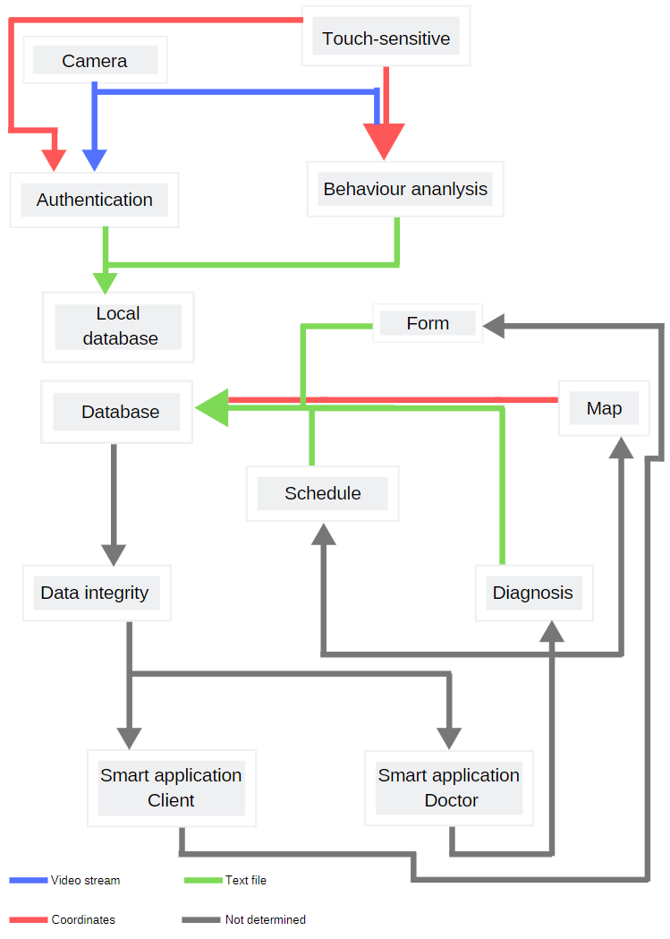
IX) General architecture
server

Slide 14

X) Validation plan
Manual input using User Interface
API emulation of WebServices
Register data in local files
Symptom form
Check the data content
Equipment : Android Studio 3.6 / Android 10 / screen size 1280 x 720
All failed test cases will be registered as a defect in a file.

Slide 15
XI) Deliverable
2 Android Application
PATIENT
Create new account → 100%
Log in : with login, password / with facial recognition → 100% / 0%
Analyze patient behavior → 50%
Make an appointment → 0%
Have a medical advice based on user symptoms → 75%
Call a doctor → 75%
Close application if authentication failed → 100%
COMMON
Edit profile → 100%
List existing appointments → 75%
User can disconnect →100%
DOCTOR
Log in → 50%
List and display all doctor’s appointments → 0%
Map displays the itinerary → 25%

Slide 16
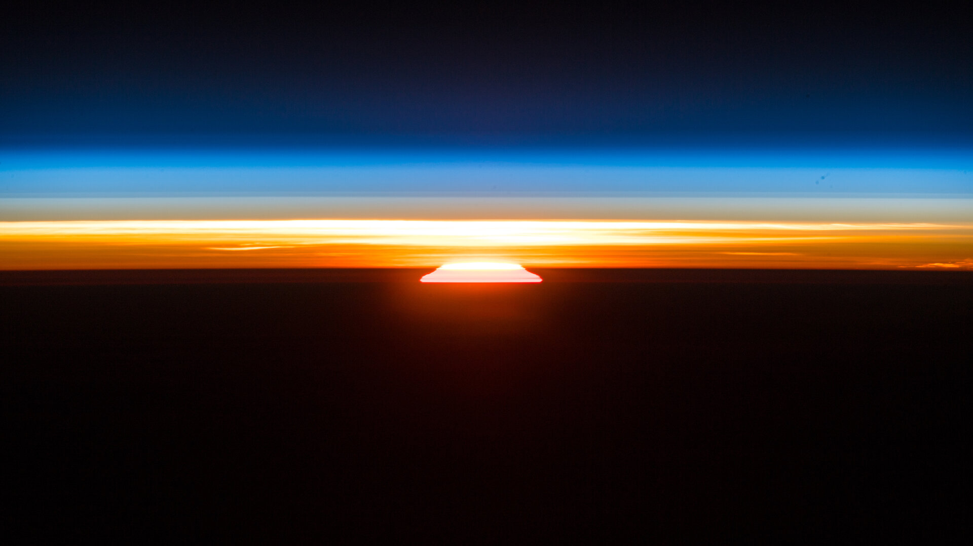
XII) What remains
Specifications of API Rest
Communication interfaces between the database and the two applications
Map Integration for Doctor application
Global Integration, with other groups
Integration Test and validation
Indeed, 70 percent of the project has been completed

Slide 17
XIII) Demonstration

Slide 18
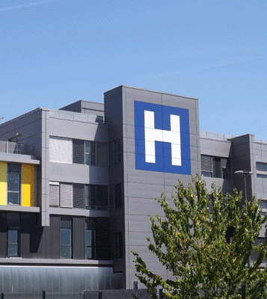
XIV) Conclusion
A huge project that needed a good communication in our team and with others
Need more than one year to develop and integrate all the services
Was a very good experience on the development part

Slide 19

Thank you for your attention

