Slide 1












2 BEANS IN A POT
food image detection for recipe finder with
Presented by Inês Fonseca

Slide 2





Unlock the culinary magic with my ingredient-detecting web app and discover a world of delightful recipes at your fingertips!

Slide 3



Food image Detection
To detect how many objects are in the picture
Pre trained-food model to detect the ingredientes from the picture

Slide 4



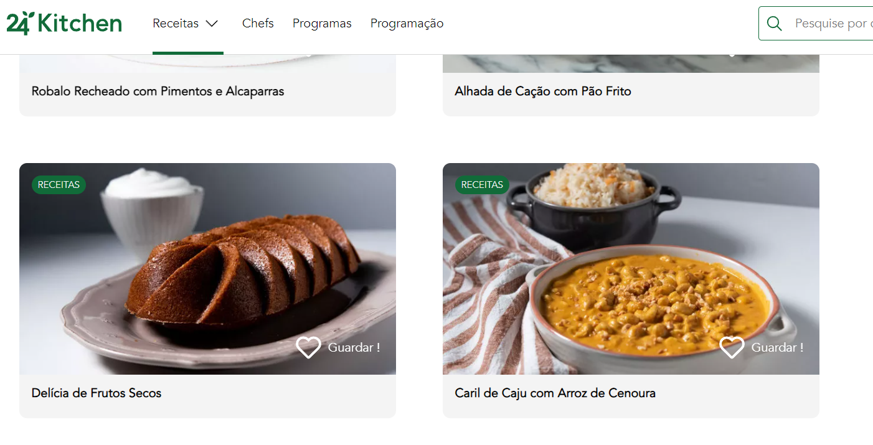

Web Scraping
1082 recipes

Slide 5
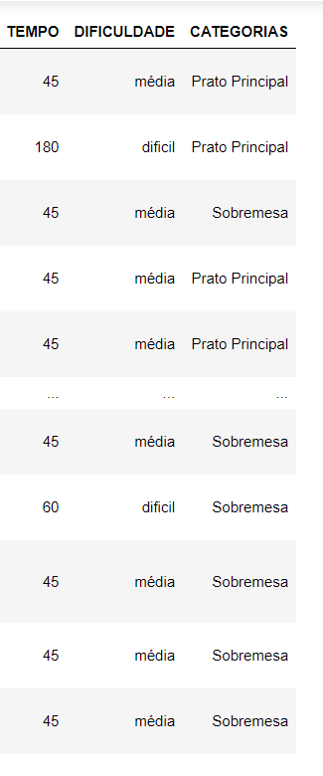
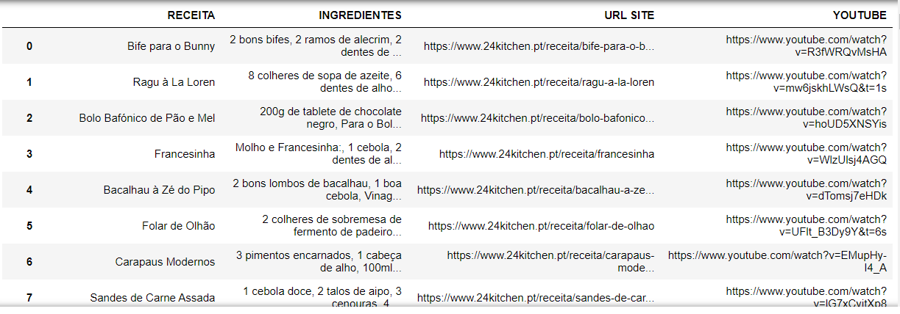
Database

Slide 6
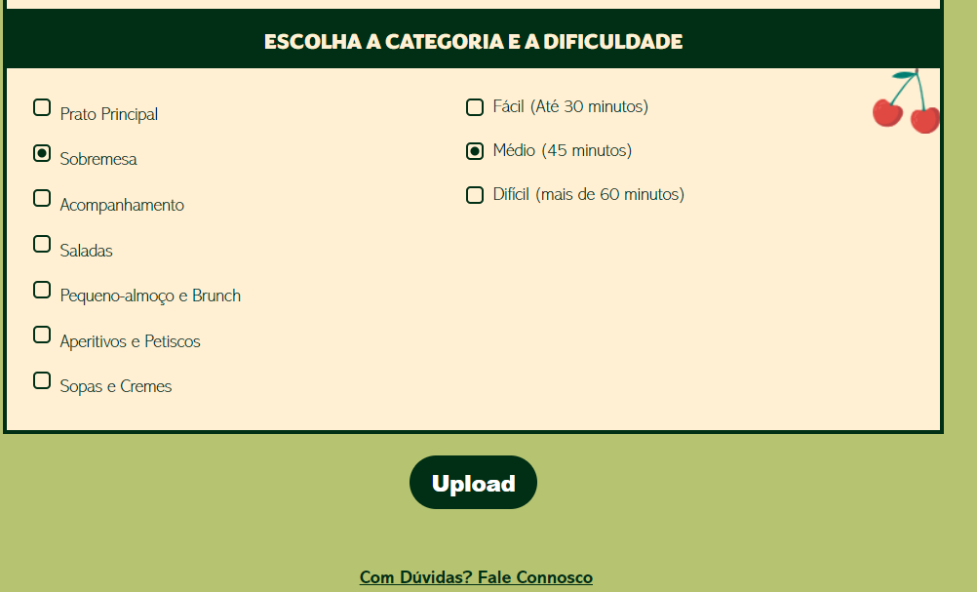
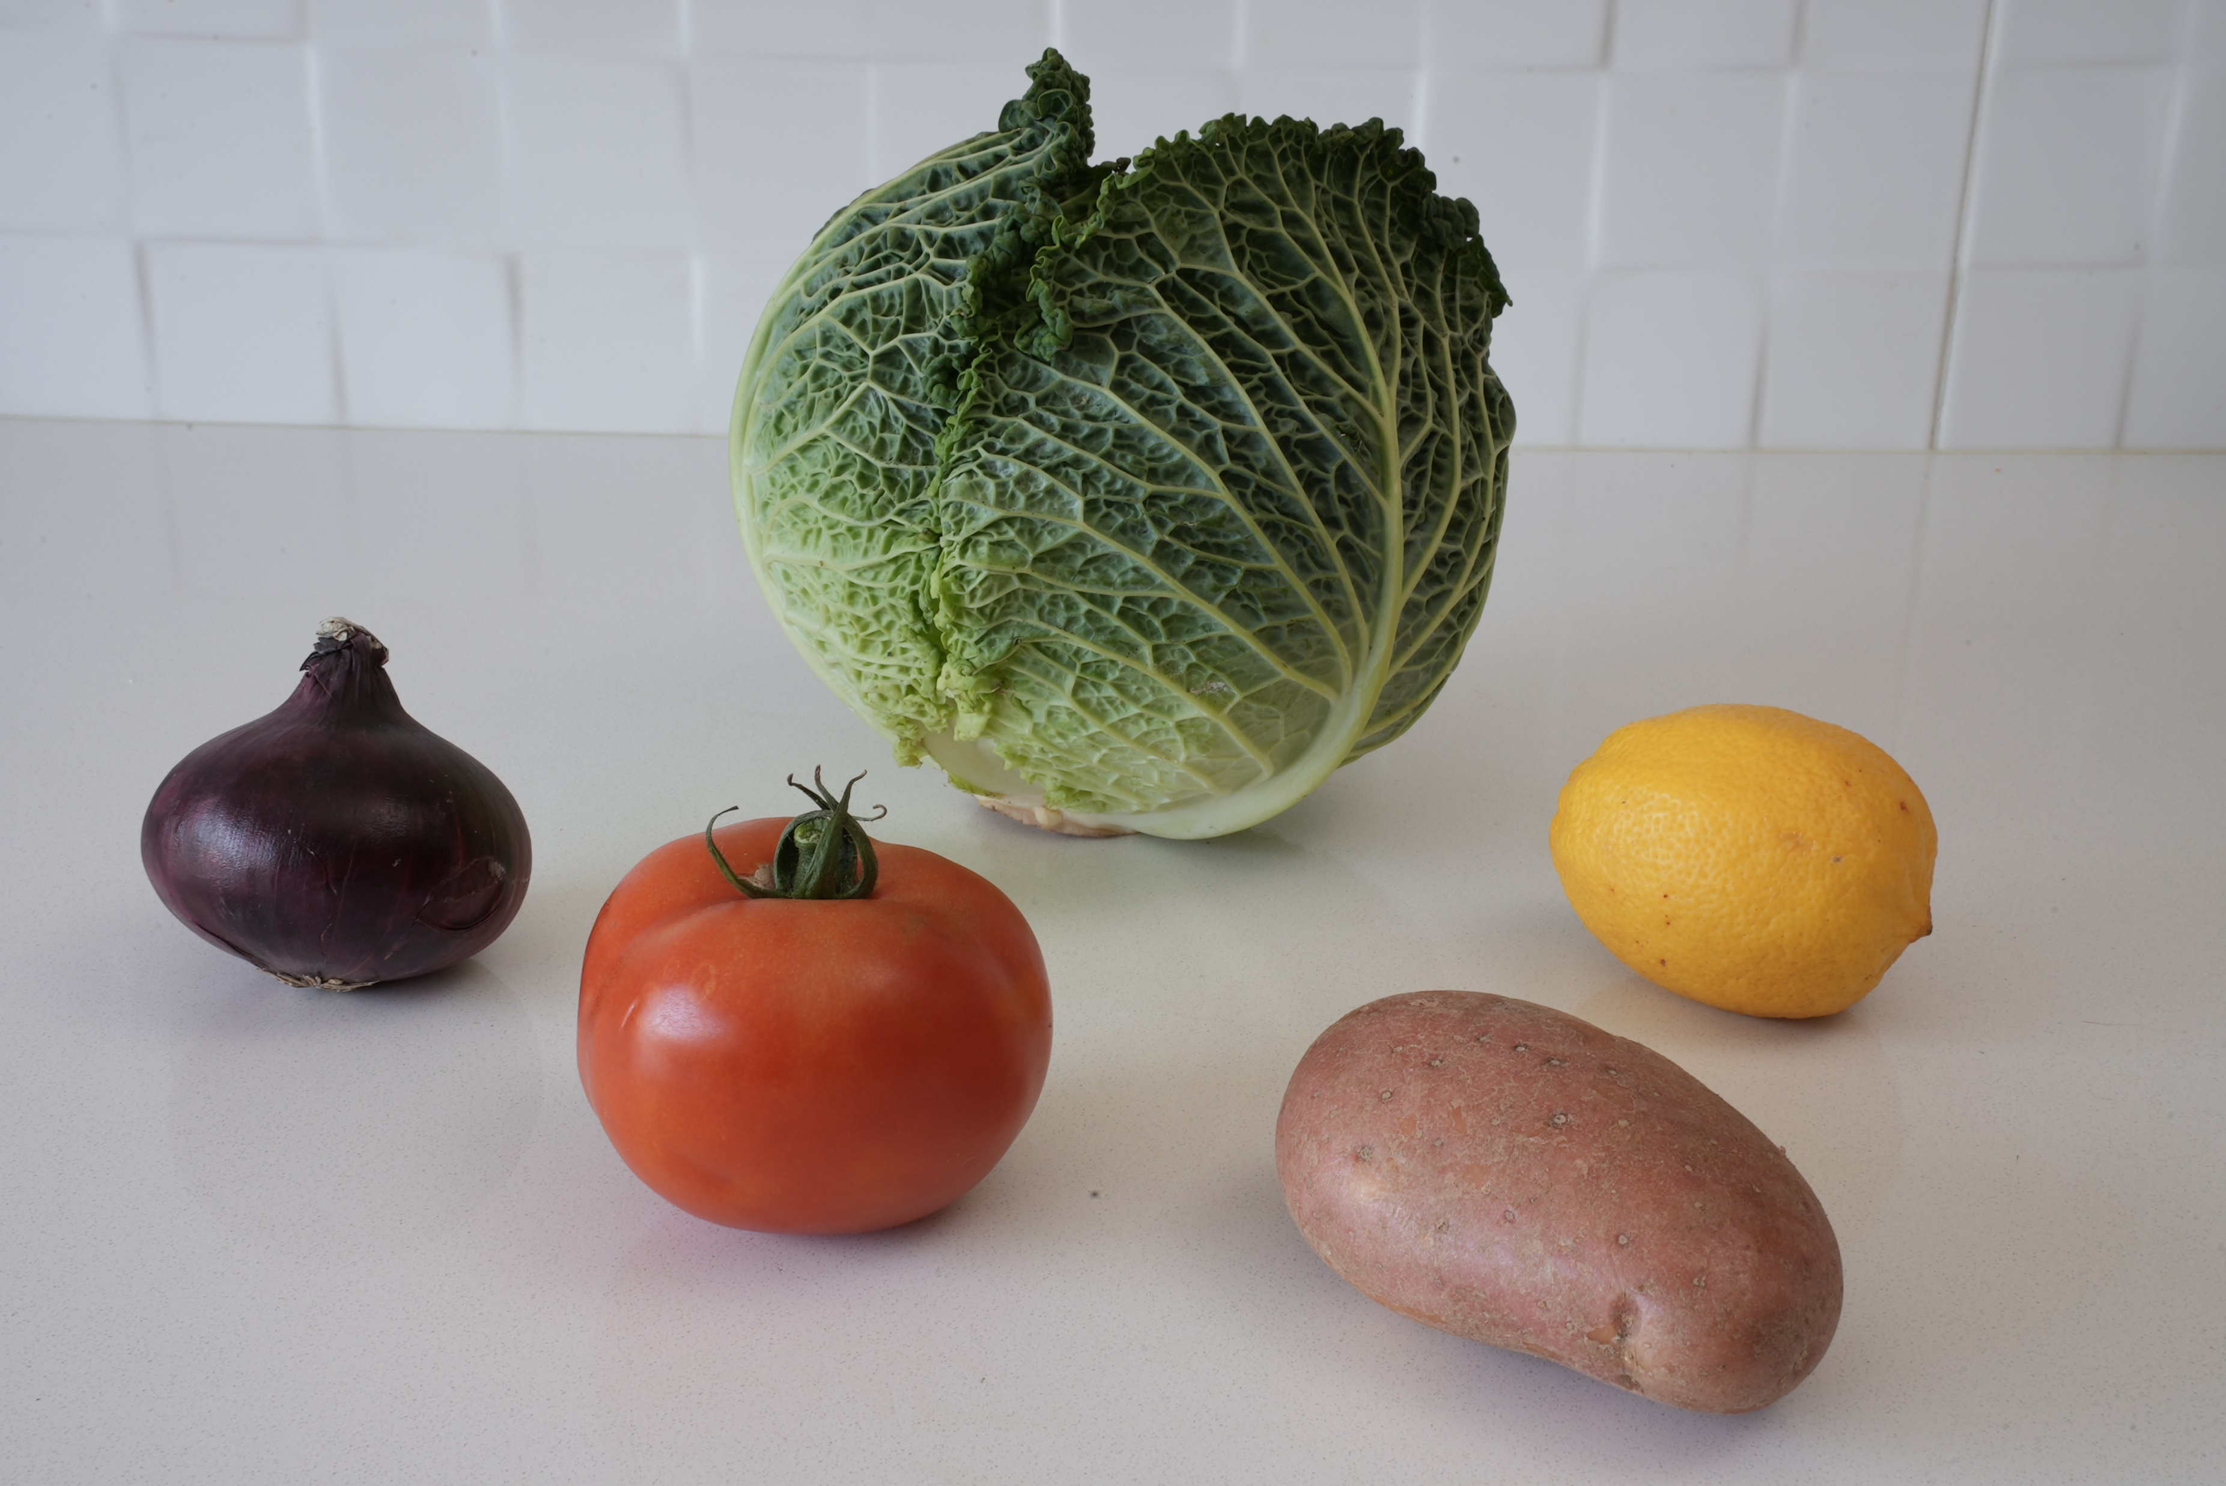
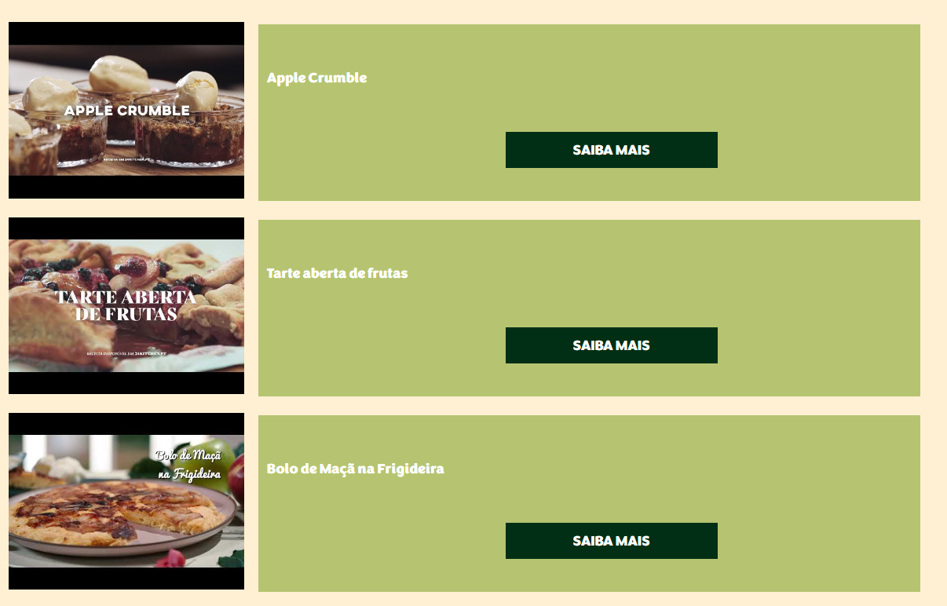
Web Flask App
UPLOADED IMAGE

Slide 7

Conclusions
Having a pre-trained food model made by me to improve the recognition of ingredients
Food item recognition confirmed by the user
Collecting more recipes
User profile with favorite recipes

