Slide 1
Survey
TV &
STREAMING
PLATFORMS
CONSUME
Regression Model
Presented by Inês Fonseca

Slide 2
How will the rise of streaming platforms affect television consumption. Is there still a future and a place for traditional TV viewing?

Slide 3
SURVEY
Per day how much time do you usually spend on a streaming platform?
15
QUESTIONS
82
ANSWERS
82 Answers
Do you watch television?
Which of these activities would be easier for you to stop doing?

Slide 4
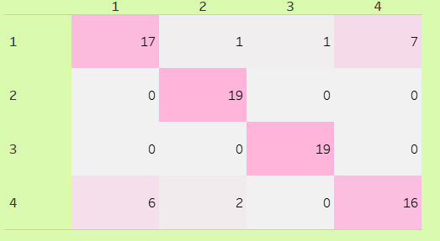
REGRESSION
MODEL
Confusion Matrix heatmap
Classification Score
0.80
SMOTE
Improving my model

Slide 5

Conclusions
Netflix is the most popular streaming platform among respondents.
More than half of respondents (53%) believe that television is the most dispensable media.
50% of respondents spend no more than 30 minutes per day watching TV.
The majority of people use flat panel televisions to watch streaming platforms, followed by smartphones.

Slide 6




THANK
YOU!

