Slide 1
Integrating Type Operators into the FreeST Programming Language

Slide 2
Introduction
$$F_{}^{μ} →F_{}^{μ.} →F_{}^{μ;} →F_{ω}^{μ∗;}$$
Notes:
Locate FreeST in $F_{}^{μ;}$. The next step is higher-order setting.
Work is focused on $F_{ω}^{μ∗;}$ with goal of integrating advanced features (equirecursion, higher-order polymorphism, ctfs) into a cohesive type system incorporated into a programming language.

Slide 3
Context-free Session Types
Table with session type constructors, then add (;) and Skip for context-free.
Example streaming integer trees on channel (maybe another slide)
Notes:
Goal is to move beyond context-free session types by introducing type operators into FreeST.

Slide 4
Duality
Yin-yan figure (maybe) with ?Int and !Int

Slide 5
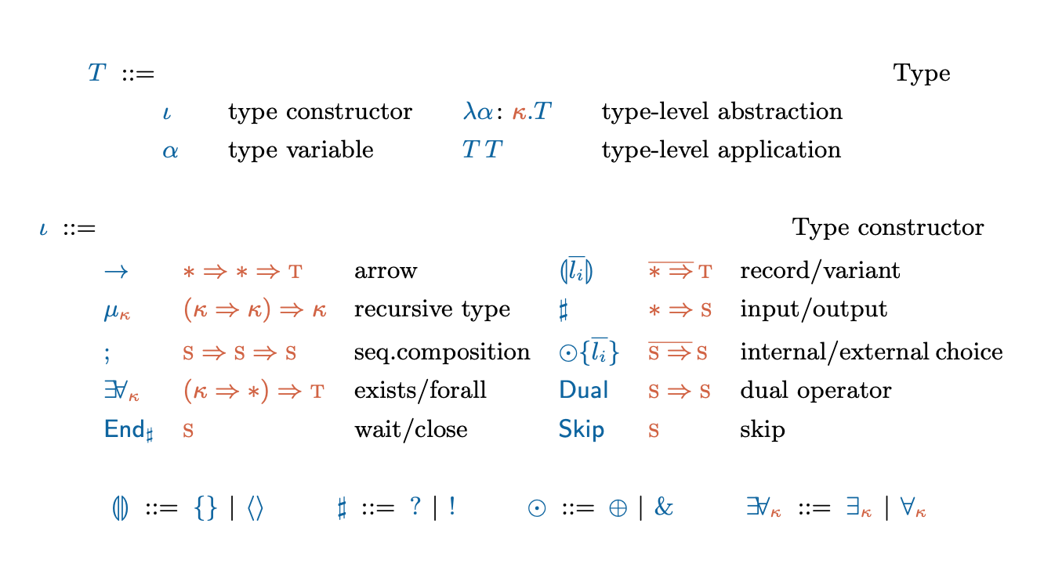
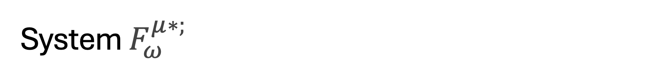
System $F_{ω}^{μ∗;}$
Notes:
Present the system

Slide 6
Weak Head Normal Form

Slide 7
Type Formation
Notes:
Type formation rules
Normalization
Recursive types and challenges

Slide 8
Normalisation

Slide 9
Recursive types

Slide 10



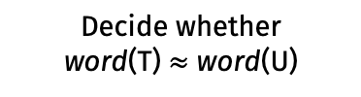
Decidability of type equivalence
Type equivalence is decidable for types in $F_{ω}^{μ∗;}$
Algorithm T ~ U
Compute word(T) and word(U)
Decide whether
word(T) $≈$ word(U)
Notes:
T and U are renamed.

Slide 11
Grammar translation
Show rules and then example.

Slide 12
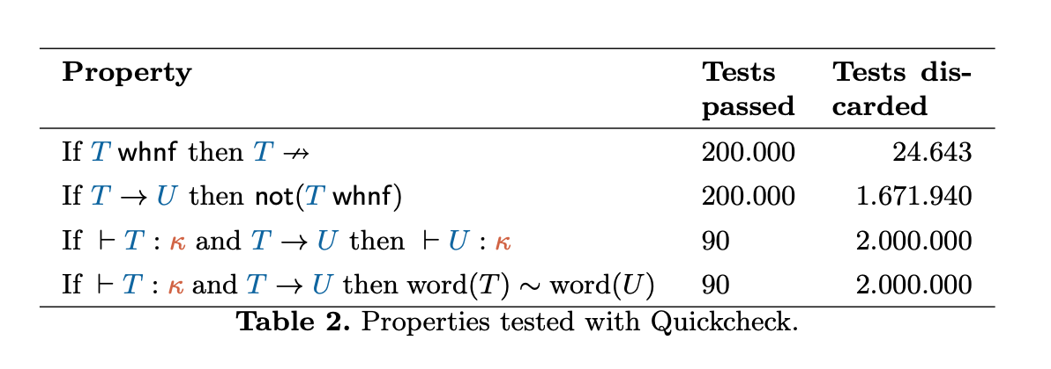
Validation
Notes:
Syntax -> Generate types -> properties -> run (grafico)

Slide 13
Conclusion

