Slide 1
Integrating Type Operators into the FreeST Programming Language

Slide 2
Introduction
Notes:
Motivation; key concepts;

Slide 3
Background
Notes:
Context free session types (with example)

Slide 4
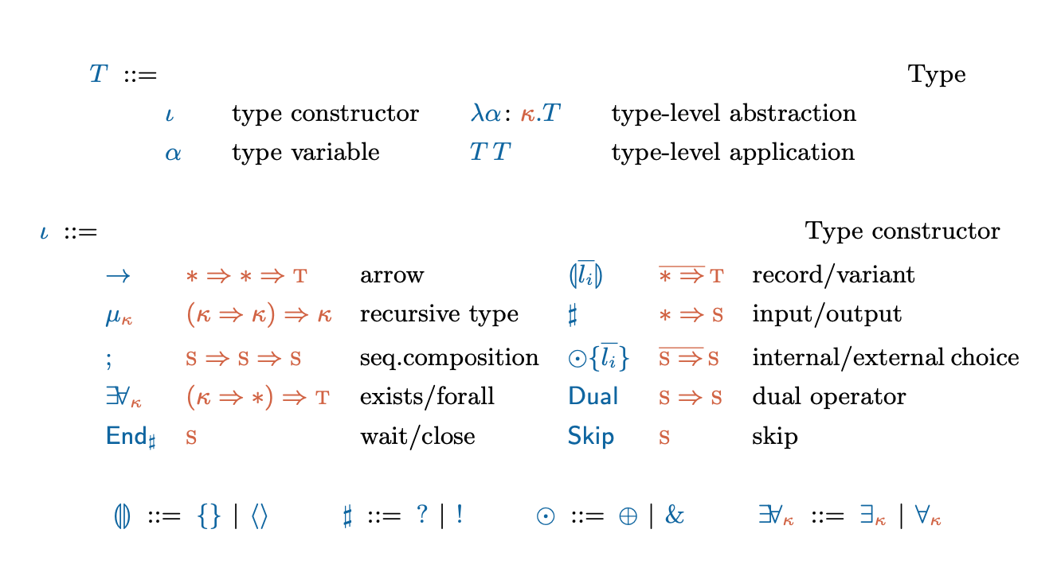
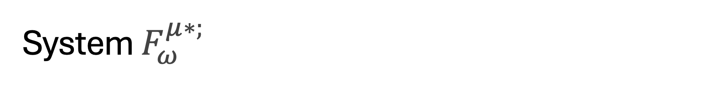
System $F_{ω}^{μ∗;}$
Notes:
Present the system

Slide 5
Weak Head Normal Form

Slide 6
Type Formation
Notes:
Type formation rules
Normalization
Recursive types and challenges

Slide 7
Normalisation

Slide 8
Recursive types

Slide 9



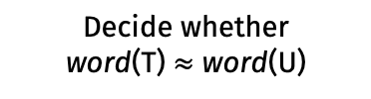
Decidability of type equivalence
Type equivalence is decidable for types in $F_{ω}^{μ∗;}$
Algorithm T ~ U
Compute word(T) and word(U)
Decide whether
word(T) $≈$ word(U)
Notes:
T and U are renamed.

Slide 10
Grammar translation
Show rules and then example.

Slide 11
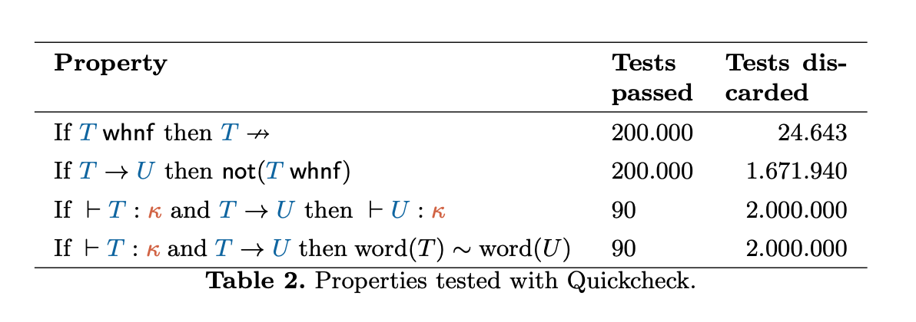
Validation
Notes:
Syntax -> Generate types -> properties -> run (grafico)

Slide 12
Conclusion

