Slide 1
Integrating Type Operators into the FreeST Programming Language

Slide 2
Introduction
$$F_{}^{μ} →F_{}^{μ.} →F_{}^{μ;} →F_{ω}^{μ∗;}$$
Notes:
Locate FreeST in $F_{}^{μ;}$. The next step is higher-order setting.
Work is focused on $F_{ω}^{μ∗;}$ with goal of integrating advanced features (equirecursion, higher-order polymorphism, ctfs) into a cohesive type system incorporated into a programming language.

Slide 3
Context-free Session Types
Table with session type constructors, then add (;) and Skip for context-free.
Example streaming integer trees on channel (maybe another slide)
Notes:
Goal is to move beyond context-free session types by introducing type operators into FreeST.

Slide 4
Duality
Yin-yan figure (maybe) with ?Int and !Int

Slide 5
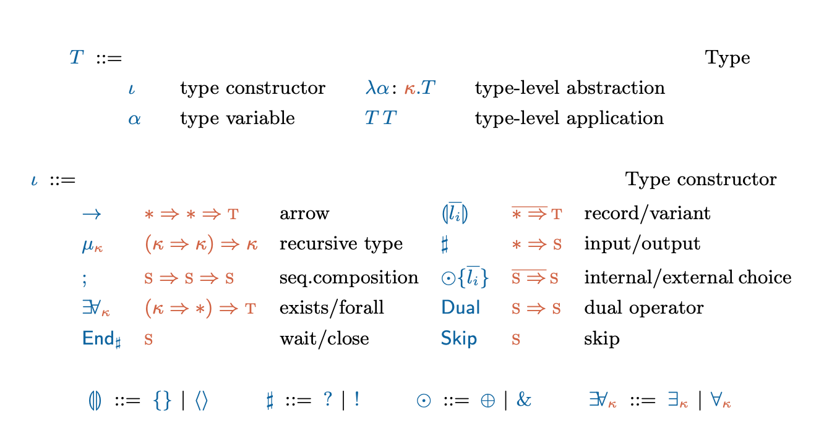
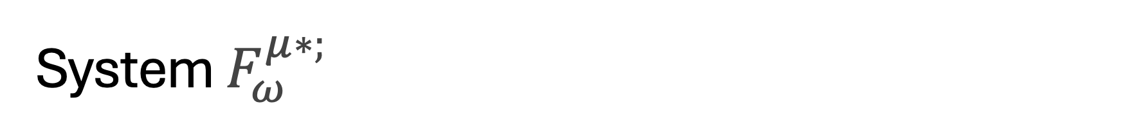
System $F_{ω}^{μ∗;}$
Notes:
Definitions: Kind, proper type, type operator

Slide 6
Not all types are of interest (maybe this slide with example)

Slide 7
Weak Head Normal Form
Show Poças paper rules and add the new proviso for confluence
[Confluence] (maybe a lattice figure)

Slide 8
Concepts
Def: normal form ( T whnf)
Def: norm (T norm)
Example of a type that does not normalise (maybe another slide)

Slide 9
Type Formation
Show rules
(but we just saw that some types do not normalise) -> decidability of type formation
Notes:
Type formation rules
Normalization
Recursive types and challenges

Slide 10
Decidability of Type Formation
Def: pre-kinding (maybe a mirror figure, since the rules mirror each other apart from the T U norm)
Example of unsuccessful pre-kind (maybe another slide)
Notes:
If T is pre-kinded, T norm terminates.

Slide 11
Normalisation
Divide the reduction steps in two groups (2 circles figure, one with mu reductions, one with b;D)

Slide 12
Check if T is well-formed
Step 1: determine if T is pre-kinded.
Step 2: determine if T is kinded, which involves determining if all sub-terms of T normalise.

Slide 13
Case of Recursive Types
Show sequence of possible reductions.
If T reduces by R-mu, show the restriction of mu*

Slide 14
Type Equivalence
Example \alpha and \beta are alpha-congruent.
Introduce minimal renaming from Poças (maybe another slide)
Notes:
Two (renamed) types are equivalent, if their grammars are bisimilar.

Slide 15
Grammar
Def of Greibach Normal Form grammar.

Slide 16



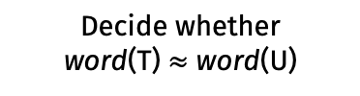
Decidability of type equivalence
Type equivalence is decidable for types in $F_{ω}^{μ∗;}$
Algorithm T ~ U
Compute word(T) and word(U)
Decide whether
word(T) $≈$ word(U)
Notes:
T and U are renamed.

Slide 17
Grammar translation
Show rules and then example (maybe another slide).
Notes:
The application of the word function to T terminates producing a simple grammar (because our well-formed types normalise).

Slide 18
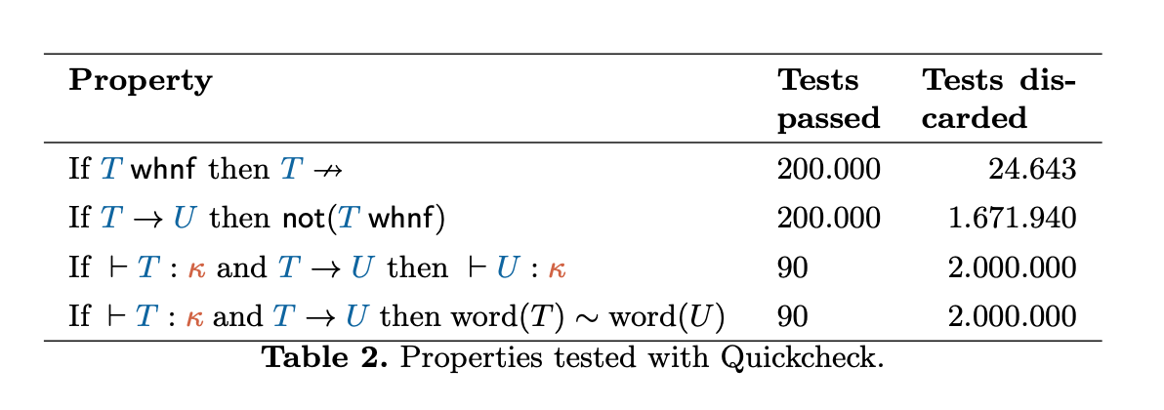
Validation
Syntax -> Generate types -> properties -> run (grafico)
Notes:
Mention that formal proofs are present in Poças work?

Slide 19
Conclusion

